Slide 1
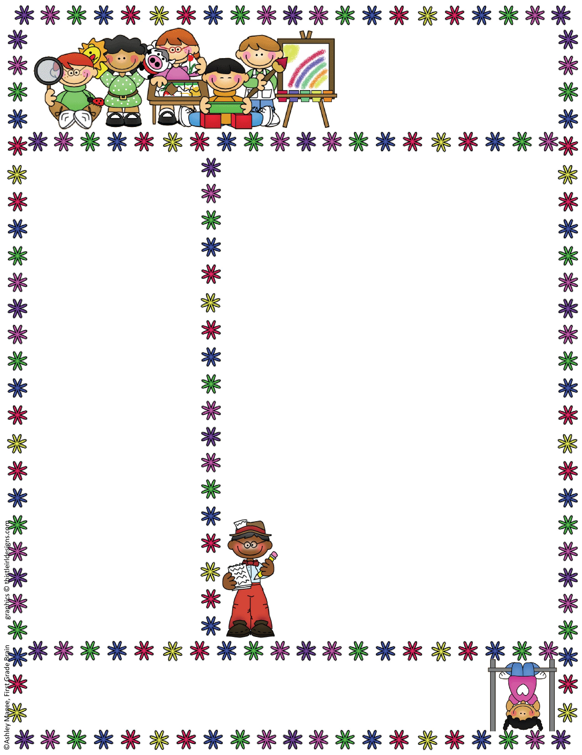
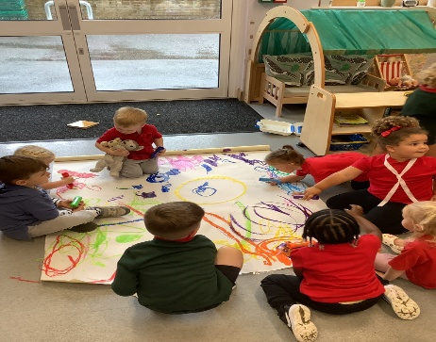
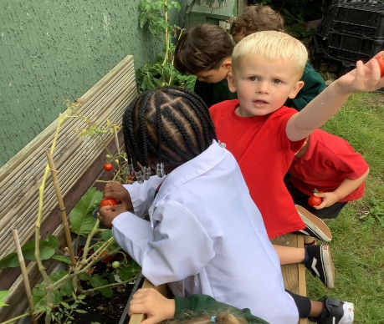

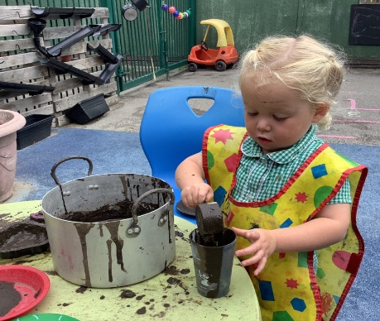
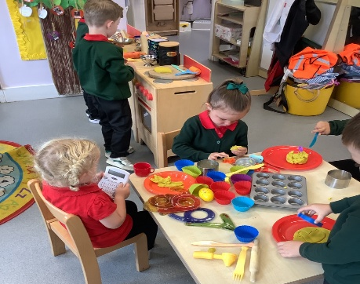

Bapchild and Tonge Nursery
Newsletter
Term 1
Welcome back to school!!
Welcome back everybody! We hope you had a great summer and have enjoyed the great British sunshine.
Over term 6 we really enjoyed getting to know our new children and families! It is wonderful to see our returning children and we have missed you all. The children have settled well and are really enjoying exploring the learning environment and we have an exciting year ahead planned with fabulous learning adventures for all to share!
Our topic for this term is ‘Who am I? – It is all about ourselves, our families and all different kinds of people.
We will explore differences and similarities in
people and think about what makes us unique.
We will also be inviting parents in this term to
make something special with your child for our
classroom display.
Attendance
When contacting School about your Nursery child’s absence
please contact the School Office, 01795 424143
Reminder: if your child is vomiting or has diarrhea, it is 48hrs before they can return to Nursery.

Slide 2
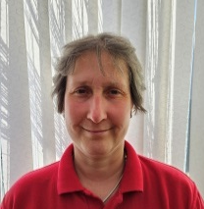
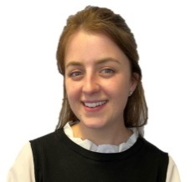
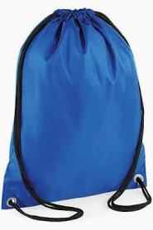
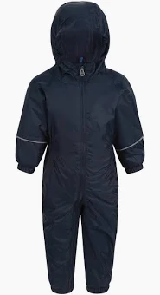
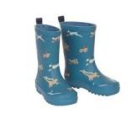
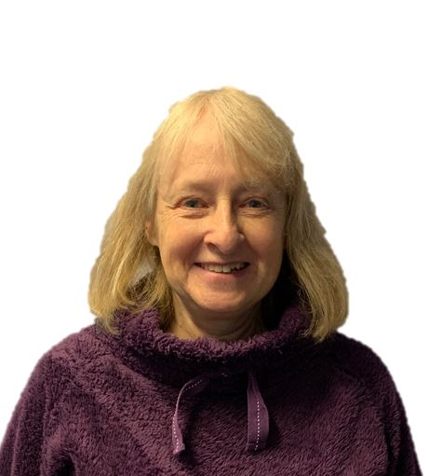

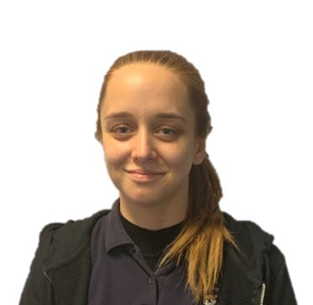
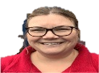
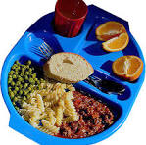
Bapchild and Tonge Nursery
Newsletter
Term 1
Meet the team
Things To Remember
Just a reminder of things we need in school..
Please make sure your child brings a draw string bag with spare clothes to each session. We would recommend in their bag they have a puddle suit in school, as we enjoy a lot of messy play!
Please can you also bring in a named pair of wellington boots for your child that we can keep at Nursery for them to use for outdoor play.
Water bottle; please bring
a named water bottle
everyday.
Lunches; please make sure you provide your child with a balanced/heathy packed lunch, we do not
encourage chocolate bars or sweets. You do
have the option for a hot school dinner, just ask on morning drop off.
Mrs Dadd
(Lorraine)
Mrs Hatcher
(Polly)
Mrs Lee-Harrison
(Janet)
Miss Tewkesbury
(Amber)
Mrs Fox
(Kerry)
Harvest Festival – Wednesday 15th October
Our Harvest Festival is on Wednesday 16th October 2.45pm.
We hope you can all join us at the church to celebrate.
.

Slide 3
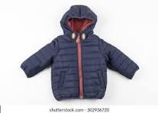

Bapchild and Tonge Nursery
Newsletter
Term 1
COATS
As the weather will soon be turning colder please ensure your child has appropriate Autumn wear, as we will be outside in all weathers.
Tapestry
We are all very excited to share your children’s learning with you and Tapestry is a fantastic way to do this. This week you should have (if you haven't already) received an email asking you to activate your account. Once this is set up you can begin to add observations. These can be anything from a family picnic, to drawing, to playing in the garden. You will also be able to see any observations that we put up for your child and you can add comments or simply press the like button. Through tapestry we add observations and for those wow moments we will add next steps. We will flag areas of learning seen and also celebrate their successes with you.
Once you have set up the log in...
1. On the right hand side near the top click the +observation button.
2. Under select child, you must select your child (no other children are available but you still have to select).
3. Give the observation a title and then add your notes.
4. Add photo or video, click add files then click start upload.
5. When you have finished click Save, then you can log out.
Nursery stories
In the nursery we value reading stories with children. The children will be bringing reading folder home and the children will be given a book to share with you at home. We change books once a week
Shoes
Please could make sure that your children’s shoes are suitable for them to change themselves and for climbing in.
Stay and Play - Tuesday 7th / Thursday 9th October
We will be having a stay and play session on the Tuesday 7th /Thursday 9th October
for you to come and join in some activities with your child.
Details and times to follow.
.

