Slide 1

Home Learning
Year 2 Term 5 Week 1

Slide 2


Message from the class teacher
Hi Year 2. I have been thinking about you all a lot and missing your lovely faces. I hope you had a lovely Easter with your families. Not too many chocolate eggs I hope!! I have been spending time with my boys in the garden, enjoying the lovely weather. My youngest boy Arthur turned 8 last week so we had our first lockdown birthday with garden games, video calls and lots of cake. We have planned some nice activities for you to get Term 5 started. I hope you enjoy them, Love Mrs Clark.
Hello Year 2! I hope you are all ok and missing us just as much as we are missing you! It has been lovely having some sunshine over the Easter weekend. My two children Ronnie and Teddy enjoyed getting in the paddling pool even though the water was freezing! We have spent a lot of time in the garden and going on long walks. We have kept in contact with our family through many face time calls. We are also doing lots of arts and crafts that we enjoy putting up at our window for our neighbours to see to keep everybody smiling. Mrs Bradley sends a big hug to you all. Take care and stay safe! Love Mrs Unsworth.

Slide 3

Reading
Hopefully you have access to books at home, but we have sent home extra books with your child.
Accelerated Reading
Home quizzing is not always recommended but in this case we have adjusted the settings to allow quizzing to happen at home.
If your child wants to read a book from home, please check that there is a quiz available for the book and that the book level (BL) is within or near to your child’s reading range. Also take note of the quiz number for future reference.
To check books please visit: https://www.arbookfind.co.uk/
Go to the next page for how to quiz.

Slide 4



AR quizzing at home.
To log into AR to take a quiz please visit: https://ukhosted27.renlearn.co.uk/2240835/
Your child should know what to do from here and should know their login details. If they are not aware, most details are written in their reading record.
Click on Accelerated reader.
Type in the name the book or the quiz number.
We advise students complete quizzes unaided. If parents/carers wish to support their child, they can do so in the following ways:
Discuss the book with your child as the book is being read
Ask your child to read the question out loud
Re-word questions for your child, if necessary
Ask your child which answers are not correct

Slide 5

Visit http://readon.myon.co.uk

Slide 6

Choose an area that interests you or use the search option.

Slide 7


Using My Maths
Children should know their way round My Maths but here are some reminders on how access the lessons. Visit: www.mymaths.co.uk
bapchild
divide162

Slide 8

Using My Maths
Access any lesson based on what your child is learning in class or search the topic in the search bar.
Use the login portal to access specific homework and lessons that your teacher has set.

Slide 9

Maths – White Rose Home Learning
In school we follow the White Rose scheme of learning. Their website has put together free lessons and resources that link to the learning taking place in school. Please visit: https://whiterosemaths.com/homelearning/

Slide 10



TT Rockstars
To access TT Rockstars please visit: https://play.ttrockstars.com/auth/school
Start typing in the school name or the post code (ME99NL)
Pupils type in their username and password, usually written in their reading record.
Pupils can practice all tables but Year 2 should be practicing 2, 5, and 10’s
Year 3: 2,5,10,3,4,8’s
Year 4,5,6: all tables

Slide 11

Accessing Twinkl
Many educational content providers are offering free access to their resources. Twinkl is a website that we use from time to time to resource our lessons to aid in teacher input and pupil activities.
We will be able to direct you towards activities and learning via this website based on lessons that may be missed due to absence. To access Twinkl please visit: www.twinkl.co.uk/offer
You will have to sign up and put in the offer code: UKTWINKLHELPS

Slide 12
English Learning
To kick off Term 5 we would like you to think about the Easter story. Please find below a link to a powerpoint telling the Easter story or use any book or resource you may have at home.
https://www.twinkl.co.uk/resource/t-t-5074-the-easter-story-powerpoint
Then you can re-tell the Easter story in any way you like. You could write it as a story, draw or collage it or maybe try a storyboard. Please find below a link to some blank story boards that you could fill in or you could create one of your own.
https://www.twinkl.co.uk/resource/t-l-2162-storyboard-templates
Alternatively you could write an Easter diary of the things you got up to over the Easter weekend.
Have fun and look out for more activities next week.

Slide 13
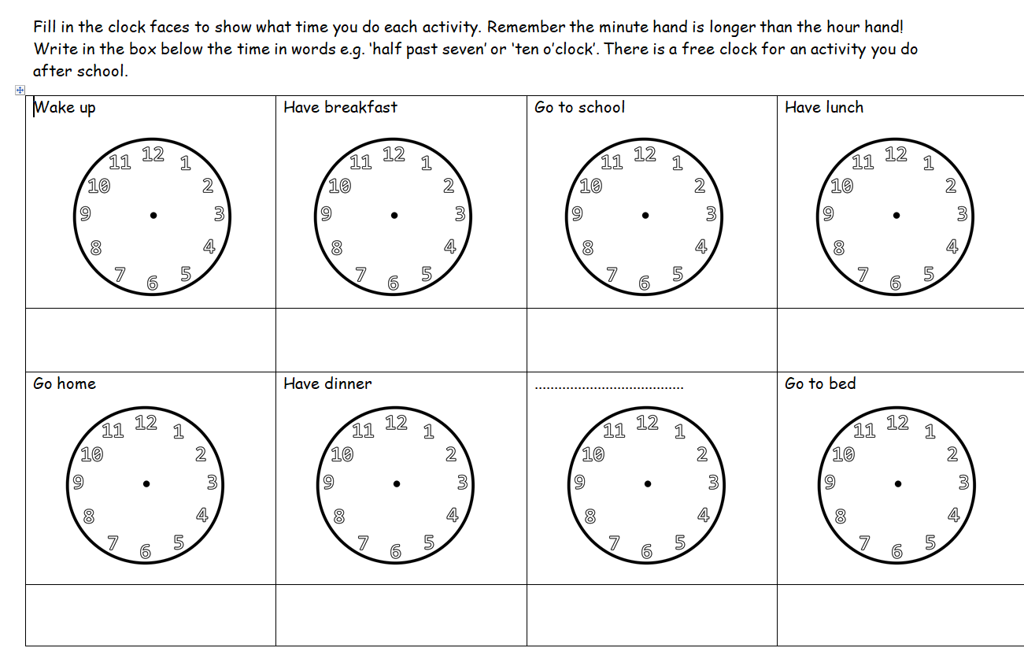
Maths Learning
This week we are going to start looking at the concept of telling the time. In year 2 by the end of the unit children are supposed to be able to tell the time to 5 minutes. For this weeks activity we would like to think about telling the time using the key vocabulary, o clock, half past, quarter to and quarter past.
Can the children record their daily schedule, thinking closely about what time they carry out each activity.
You can follow this example if you would like or you could make up your own including more detail.
As an extension can you convert the time shown on your analogue clock to the correct digital time?

Slide 14
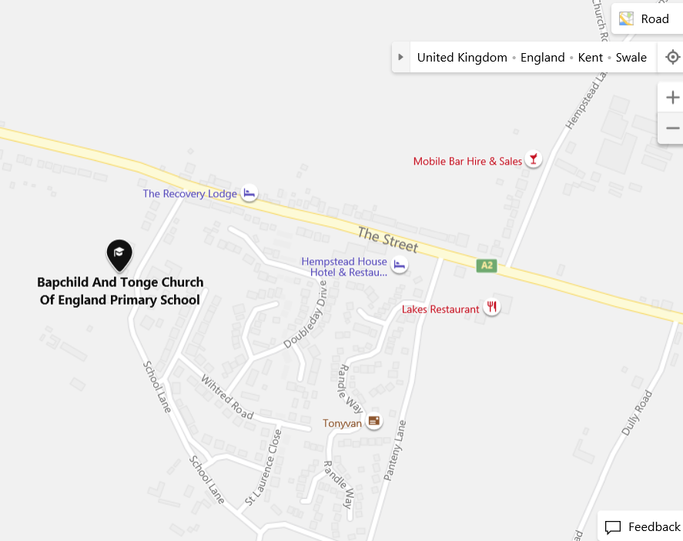
Topic – Map skills
We would have started our topic by having a walk around Bapchild Village. We would have noticed many places have changed over the past few years and many more changes are taking place, for example, new houses are being built. The old mars bar shop and post office have now gone and there has been a housing estate been built in the past 15 years.
Can you find Bapchild on google maps? Can you write down some key places that are in Bapchild? Eg. St Lawrence's church.
Could you then research your local area
if that is not Bapchild. What key
features do you have in your local area?
Could you go on a walk to see these
places you have found on google maps?

Slide 15

P.E.
It is important to keep your children active. If it is safe to do so, ensure they have some time outside throughout the day. Please visit Joe Wicks YouTube channel (https://www.youtube.com/channel/UCAxW1XT0iEJo0TYlRfn6rYQ), which has lots of exercise videos for children. He will also be hosting a live P.E. lessons Monday to Friday at 9:00am.

Slide 16

Classroom Secrets
The site classroom secrets https://classroomsecrets.co.uk/free-home-learning-packs/ has free class packs which provide some great additional ideas and resources you can use.

