Slide 1

Home Learning
Year 4 Term 6 Week 7

Slide 2
Message from the class teacher
Good Morning Year 4,
Where do I begin, what a year it has been! Although very shortly you will no longer be Year 4’s, you are all more than welcome to always pop your head into the Year 4 classroom to say ‘hello.’ Mrs Staker and myself will miss you so incredibly much but look forward to getting to see your lovely little faces again around school. You all have been a lovely class, although sometimes very chatty. You always continued to put a massive smile on my face. I would like to wish you all the best of luck next year and hope you stay safe during the summer.
Best Wishes
Miss Solomon

Slide 3

Reading
Hopefully you have access to books at home, but we have sent home extra books with your child.
Accelerated Reading
Home quizzing is not always recommended but in this case we have adjusted the settings to allow quizzing to happen at home.
If your child wants to read a book from home, please check that there is a quiz available for the book and that the book level (BL) is within or near to your child’s reading range. Also take note of the quiz number for future reference.
To check books please visit: https://www.arbookfind.co.uk/
Go to the next page for how to quiz.

Slide 4



AR quizzing at home.
To log into AR to take a quiz please visit: https://ukhosted27.renlearn.co.uk/2240835/
Your child should know what to do from here and should know their login details. If they are not aware, most details are written in their reading record.
Click on Accelerated reader.
Type in the name the book or the quiz number.
We advise students complete quizzes unaided. If parents/carers wish to support their child, they can do so in the following ways:
Discuss the book with your child as the book is being read
Ask your child to read the question out loud
Re-word questions for your child, if necessary
Ask your child which answers are not correct

Slide 5

Visit http://readon.myon.co.uk

Slide 6

Choose an area that interests you or use the search option.

Slide 7


Using My Maths
Children should know their way round My Maths but here are some reminders on how access the lessons. Visit: www.mymaths.co.uk
bapchild
divide162

Slide 8

Using My Maths
Access any lesson based on what your child is learning in class or search the topic in the search bar.
Use the login portal to access specific homework and lessons that your teacher has set.

Slide 9
Maths – White Rose Home Learning
Fantastic well done for all your hard work over the last number of months. For this weeks maths home learning we are going to complete some worksheets as revision regarding all of our work this year.
Good Luck and Have fun!

Slide 10
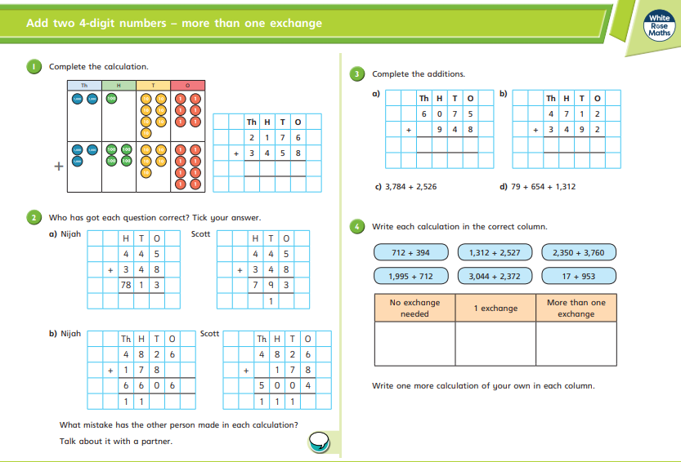

Slide 11
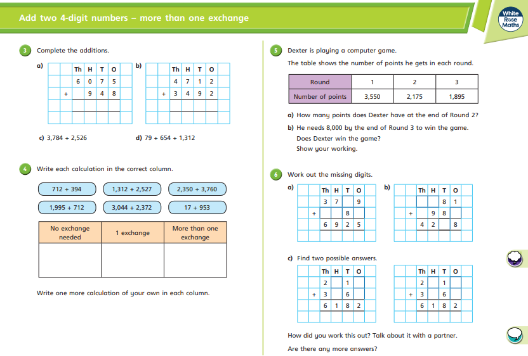

Slide 12
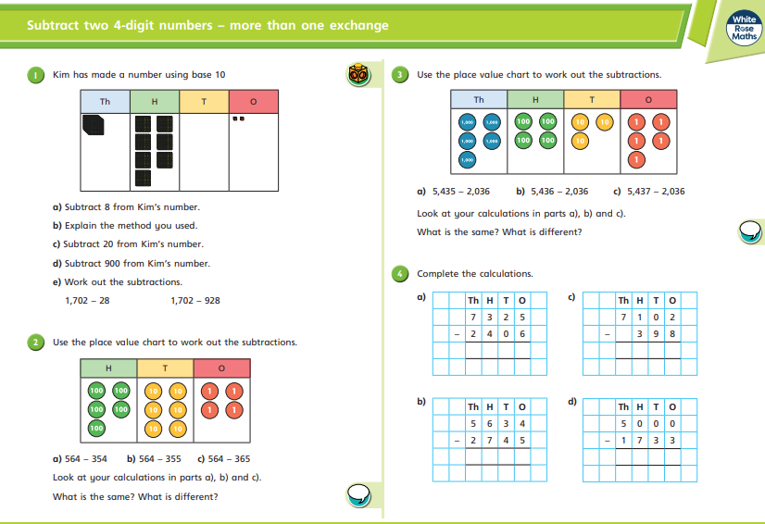

Slide 13
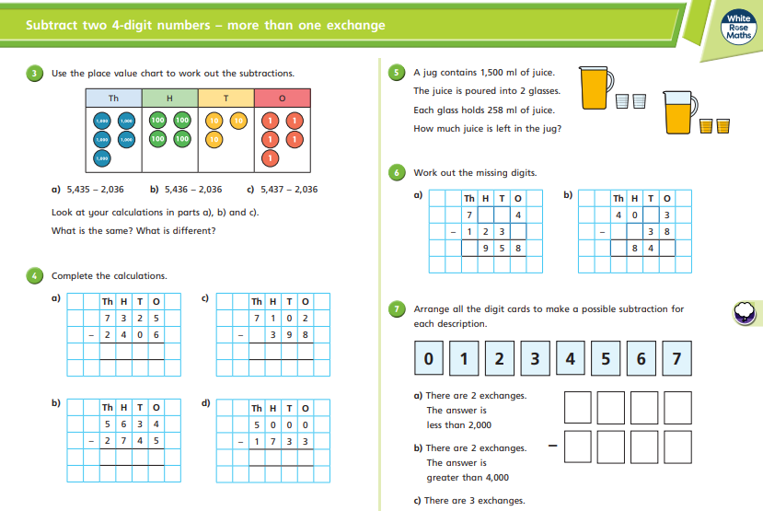

Slide 14
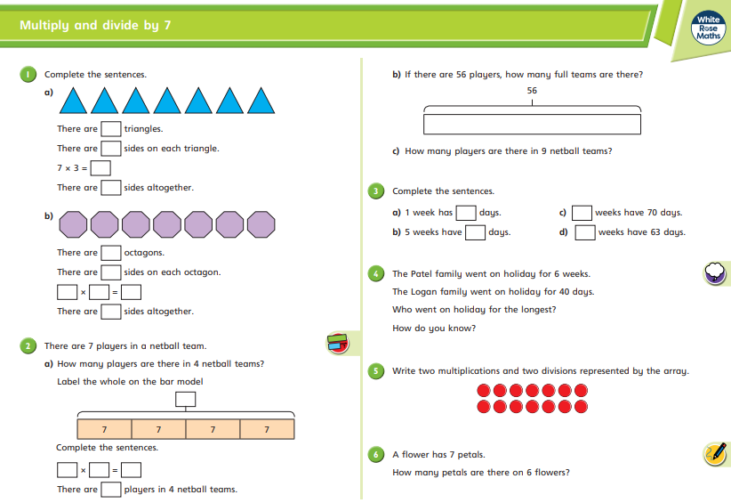

Slide 15
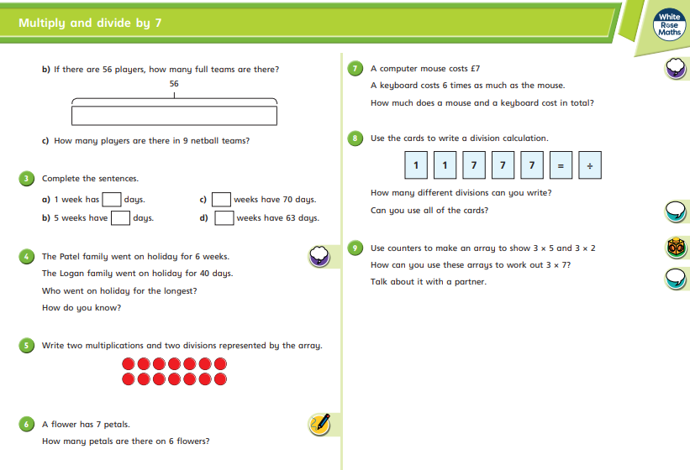

Slide 16
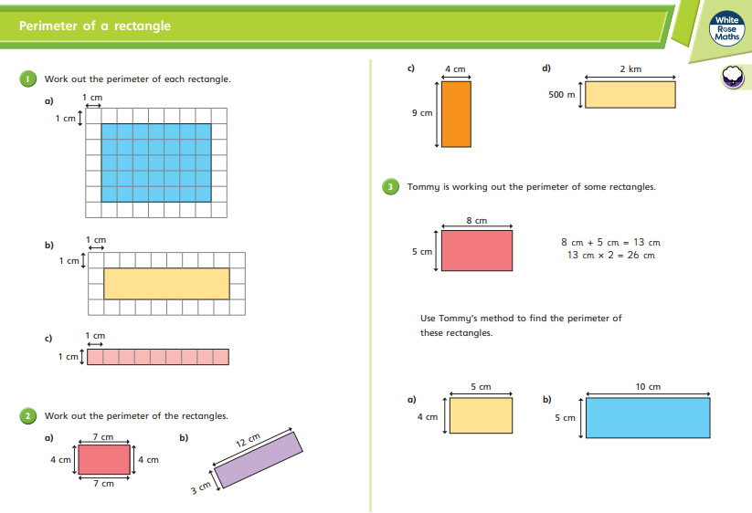

Slide 17
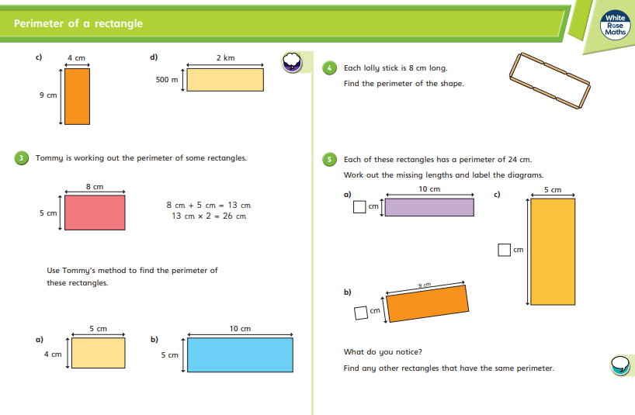

Slide 18



TT Rockstars
To access TT Rockstars please visit: https://play.ttrockstars.com/auth/school
Start typing in the school name or the post code (ME99NL)
Pupils type in their username and password, usually written in their reading record.
Pupils can practice all tables
I have specifically allocated different times tables for you to practise each week.

Slide 19

Accessing Twinkl
Many educational content providers are offering free access to their resources. Twinkl is a website that we use from time to time to resource our lessons to aid in teacher input and pupil activities.
We will be able to direct you towards activities and learning via this website based on lessons that may be missed due to absence. To access Twinkl please visit: www.twinkl.co.uk/offer
You will have to sign up and put in the offer code: UKTWINKLHELPS

Slide 20
English
Task:
Create a spider diagram
Follow this new link below for the English Task.
Similarly on the website it has a selection of 3 activities from which you can complete.
https://www.bbc.co.uk/bitesize/articles/zcytjsg
For this activity we will focus on ‘Writing headlines using alliteration’

Slide 21
English Task
For the second activity follow this different link below for the second English Task.
Once on the website it has a selection of 3 activities from which you can complete.
https://www.bbc.co.uk/bitesize/articles/zhxdg7h
This activity focuses on ‘Writing a Newspaper Article.’

Slide 22
Final English Task
For the final English task follow this different link.
Once on the website again you will notice it has a selection of 3 activities from which you can complete.
https://www.bbc.co.uk/bitesize/articles/zvrbp4j
This activity focuses on ‘Revising adverbs and fronted adverbials.’

Slide 23
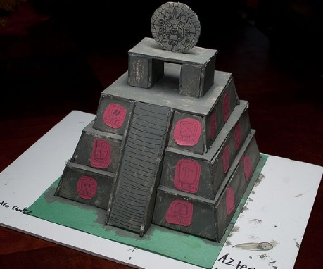
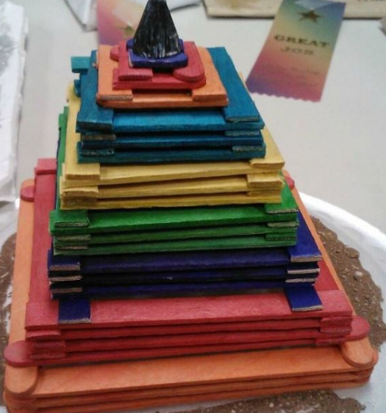
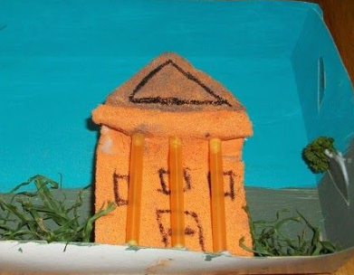
Topic: Mayan’s
For topic this week we are going to think back to our learning regarding the Mayan’s.
We are going to recreate our own version of the Mayan’s Civilisation, using recycled boxes, sticks, pieces of paper or any junk around your house to develop your own model.
Here are some examples of what you could recreate;

Slide 24

P.E.
It is important to keep your children active. If it is safe to do so, ensure they have some time outside throughout the day. Please visit Joe Wicks YouTube channel (https://www.youtube.com/channel/UCAxW1XT0iEJo0TYlRfn6rYQ), which has lots of exercise videos for children. He will also be hosting a live P.E. lessons Monday to Friday at 9:00am.

Slide 25



Music
Collins are also providing home learning activities https://collins.co.uk/pages/support-learning-at-home.
You can access free Music Express songs and activities by clicking on the free children's song bank. Some of these the children will recognise from class music lessons with Mrs Julier .
Go to Collins Connect and click on the Teacher portal and enter:
Username: parents@harpercollins.co.uk
Password: Parents20!
Click Login.
Once you’ve logged into Collins Connect, select Music Express from the menu page. To access the Song Bank click the link on the welcome page.​
'Out of the Ark' music have created 'Out of the Ark at Home' via this website https://www.outoftheark.co.uk/ootam-at-home/​
There are 4 weeks on the website so far and when you click on e.g week 1, there is a lively fun song video for every single day. Definitely something you might enjoy and could work well as a brain break, when needed.

Slide 26

Classroom Secrets
The site classroom secrets https://classroomsecrets.co.uk/free-home-learning-packs/ has free class packs which provide some great additional ideas and resources you can use.

