Slide 1

Home Learning
Year 4 Term 6 Week 6

Slide 2
Message from the class teacher
Good Morning Year 4,
I have loved catching up with so many of your little faces over the last week and by continuing to get a chance to talk to you all on the phone. I am sure it feels very strange that we don’t have very long left at school anymore and next time many of you return, you may be in Year 5. That is okay though because I will always be in the room next door. We still have a couple more weeks left so don’t give up quite yet, myself and Mrs Staker are both super proud with how well you have all dealt with this. Keep going you’ve got this and remember you are all capable of amazing things, never forget that!
Best Wishes
Miss Solomon

Slide 3

Reading
Hopefully you have access to books at home, but we have sent home extra books with your child.
Accelerated Reading
Home quizzing is not always recommended but in this case we have adjusted the settings to allow quizzing to happen at home.
If your child wants to read a book from home, please check that there is a quiz available for the book and that the book level (BL) is within or near to your child’s reading range. Also take note of the quiz number for future reference.
To check books please visit: https://www.arbookfind.co.uk/
Go to the next page for how to quiz.

Slide 4



AR quizzing at home.
To log into AR to take a quiz please visit: https://ukhosted27.renlearn.co.uk/2240835/
Your child should know what to do from here and should know their login details. If they are not aware, most details are written in their reading record.
Click on Accelerated reader.
Type in the name the book or the quiz number.
We advise students complete quizzes unaided. If parents/carers wish to support their child, they can do so in the following ways:
Discuss the book with your child as the book is being read
Ask your child to read the question out loud
Re-word questions for your child, if necessary
Ask your child which answers are not correct

Slide 5

Visit http://readon.myon.co.uk

Slide 6

Choose an area that interests you or use the search option.

Slide 7


Using My Maths
Children should know their way round My Maths but here are some reminders on how access the lessons. Visit: www.mymaths.co.uk
bapchild
divide162

Slide 8

Using My Maths
Access any lesson based on what your child is learning in class or search the topic in the search bar.
Use the login portal to access specific homework and lessons that your teacher has set.

Slide 9
Maths – White Rose Home Learning
As well as the work that can be accessed through My Maths and TT Rockstars, you can see below the future topics we would be covering.
To find further support for the rest of our year curriculum, visit the White Rose website for the schemes of learning. (https://whiterosemaths.com/resources/schemes-of-learning/primary-sols/)
CONGRATULATIONS on all your hard work over the last couple of weeks/ months. Myself and Mrs Staker are so incredibly proud of you all and how much work you have put in.
I know this year has felt very strange but we are almost there so keep up the hard work.
For the next couple weeks we are going to recap over the last couple of topics we studied in Maths with some questions/papers.

Slide 10
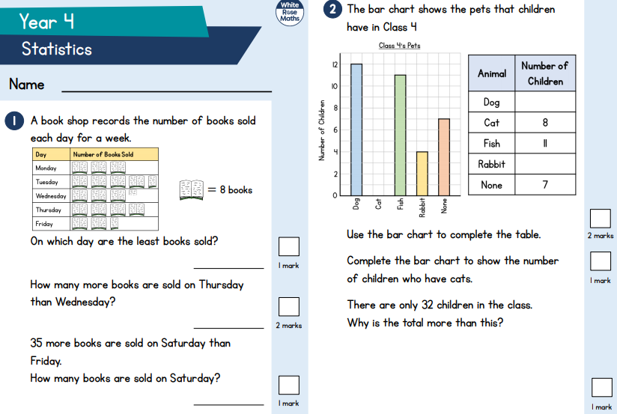

Slide 11
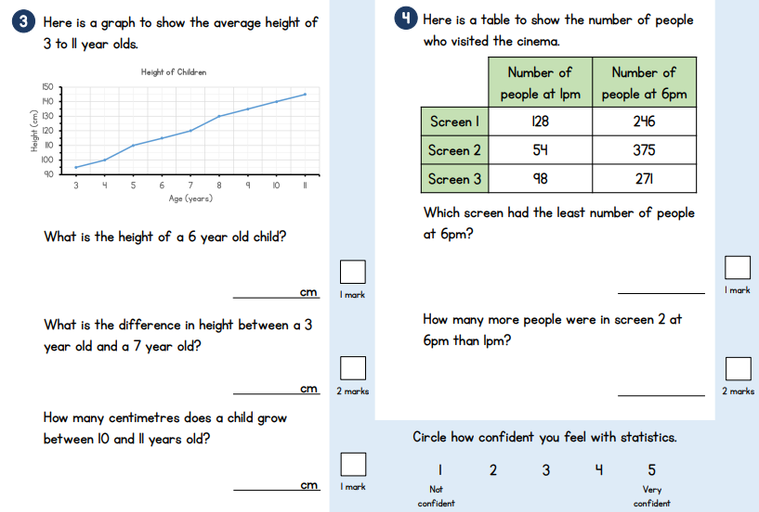

Slide 12
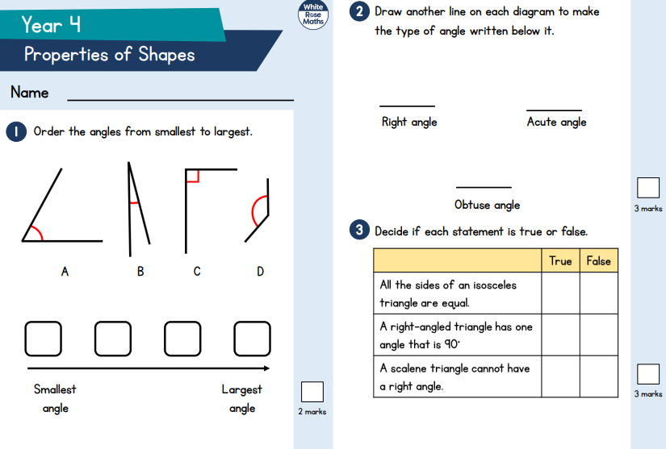

Slide 13
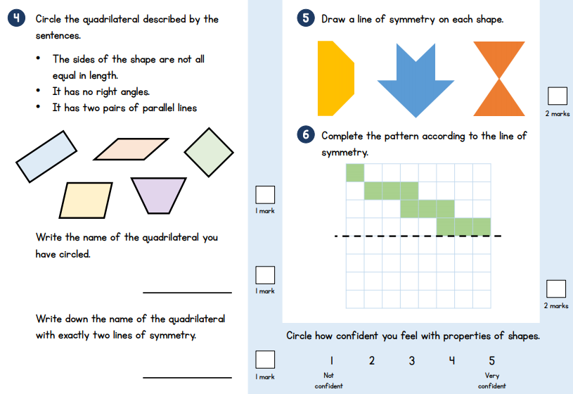

Slide 14
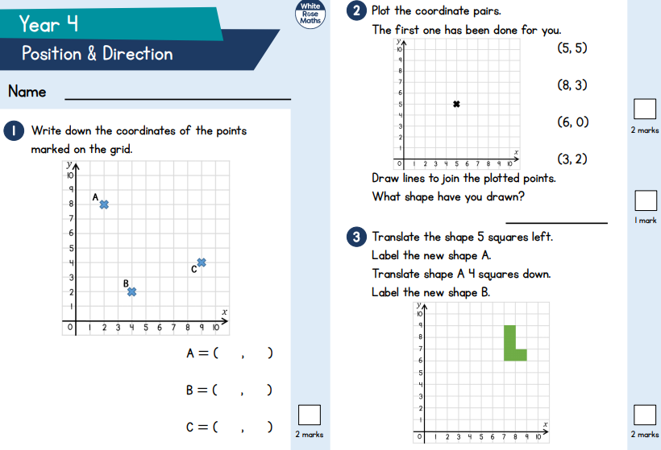

Slide 15
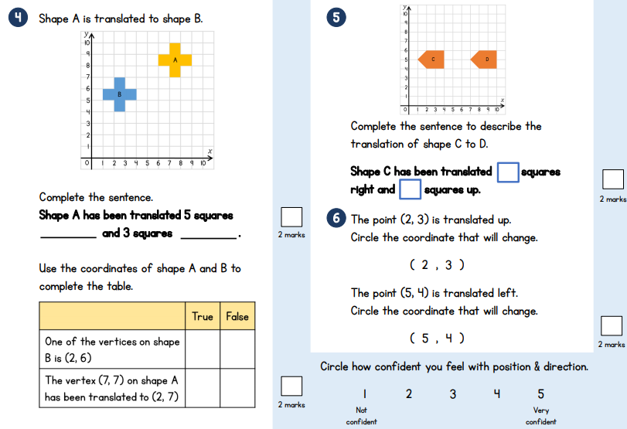

Slide 16



TT Rockstars
To access TT Rockstars please visit: https://play.ttrockstars.com/auth/school
Start typing in the school name or the post code (ME99NL)
Pupils type in their username and password, usually written in their reading record.
Pupils can practice all tables
I have specifically allocated different times tables for you to practise each week.

Slide 17

Accessing Twinkl
Many educational content providers are offering free access to their resources. Twinkl is a website that we use from time to time to resource our lessons to aid in teacher input and pupil activities.
We will be able to direct you towards activities and learning via this website based on lessons that may be missed due to absence. To access Twinkl please visit: www.twinkl.co.uk/offer
You will have to sign up and put in the offer code: UKTWINKLHELPS

Slide 18
English
Task:
Create a spider diagram
Follow this new link below for the English Task.
Similarly on the website it has a selection of 3 activities from which you can complete.
https://www.bbc.co.uk/bitesize/articles/z2gq4xs
For this activity we will focus on ‘Write a Letter’

Slide 19
English Task
For the second activity follow this different link below for the second English Task.
Once on the website it has a selection of 3 activities from which you can complete.
https://www.bbc.co.uk/bitesize/articles/zcvdg7h
This activity focuses on ‘Using Bullets.’

Slide 20
Final English Task
For the final English task follow this different link.
Once on the website again you will notice it has a selection of 3 activities from which you can complete.
https://www.bbc.co.uk/bitesize/articles/zrn796f
This activity focuses on ‘Revising Conjunctions.’

Slide 21
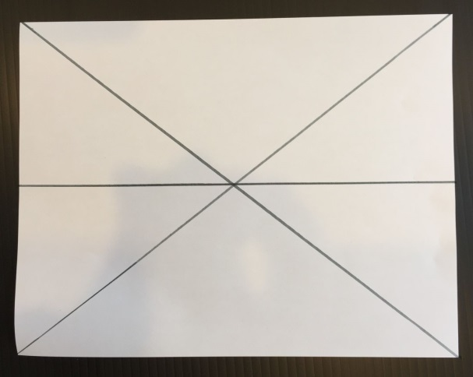
Art- One Point Perspection
First discuss Bulb Fields by Vincent Van Gogh as described above.
Lightly with pencil, draw an “x” from corner to corner of the paper.
Draw a dot in the middle of the “x” (the vanishing point).
Draw a horizontal line through the middle of the paper, passing through the dot.

Slide 22
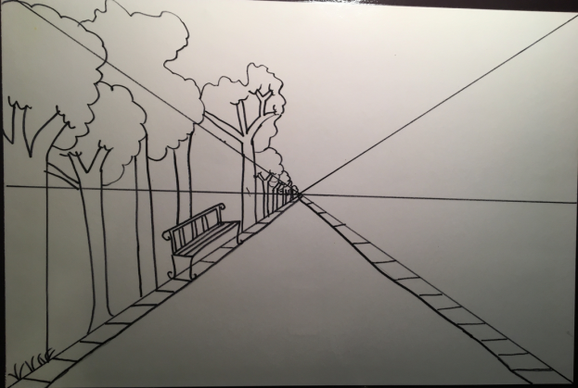
Next, draw the scene. One side will be a landscape with trees. The other side will be city buildings.
Draw the sidewalk first from the vanishing point. Draw the sidewalk on both sides of the paper.
On the left side, draw trees starting in the front of the paper. Draw the trees large in the front, then middle size, then smaller going toward the vanishing point.
Next, draw the buildings on the right side of the paper.
Draw a roof with a straight, horizontal line. This will be the side roof.
Draw the vanishing point (top front edge) of the roof. Draw a small diagonal line. The line is parallel to the top half of the “x”.
Draw a straight vertical line to ground to make the side of the building.
Draw a straight vertical line again from the corner roof line.

Slide 23
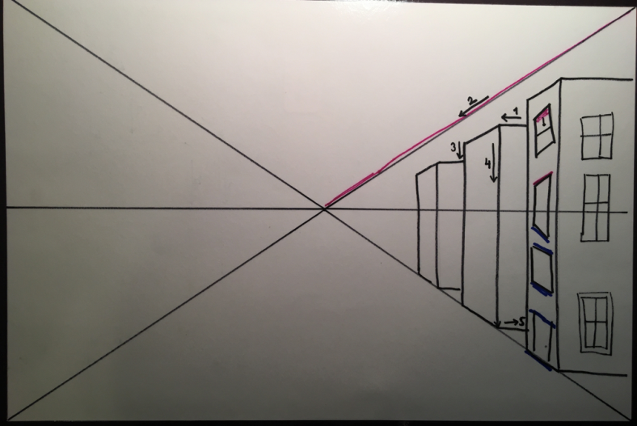
Draw a horizontal line at the bottom to create the bottom of the building.
Draw a small diagonal line. Draw this line along the bottom “x” guidelines. Draw this parallel to the bottom half of the “x” guideline.
Add another building. Make the height of each building smaller as you near the vanishing point.
Finish the details by adding windows and front doors to the buildings. Take care the windows on the building fronts are angled parallel to the vanishing point.

Slide 24
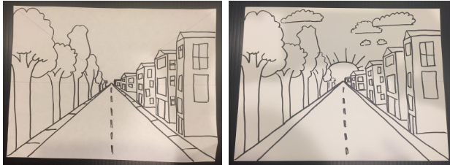
Trace over the pencil lines with a black marker. Then Add the line down the center of the road, details of the sky, etc.

Slide 25
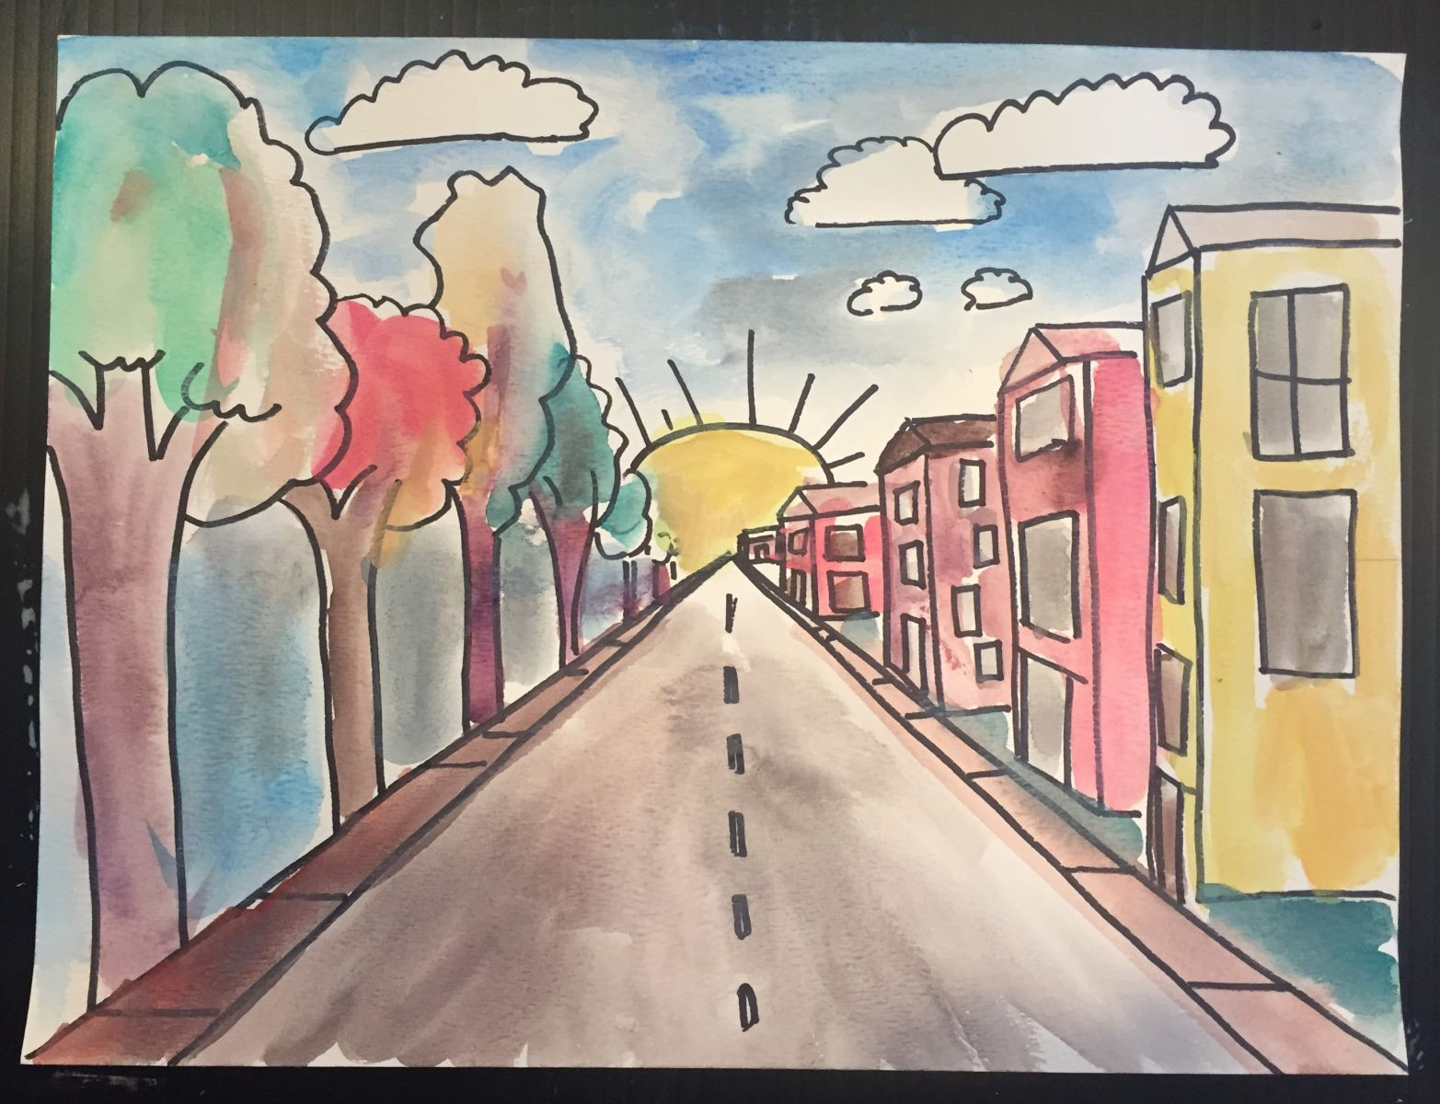
Paint/ Colour your artwork in.

Slide 26

P.E.
It is important to keep your children active. If it is safe to do so, ensure they have some time outside throughout the day. Please visit Joe Wicks YouTube channel (https://www.youtube.com/channel/UCAxW1XT0iEJo0TYlRfn6rYQ), which has lots of exercise videos for children. He will also be hosting a live P.E. lessons Monday to Friday at 9:00am.

Slide 27



Music
Collins are also providing home learning activities https://collins.co.uk/pages/support-learning-at-home.
You can access free Music Express songs and activities by clicking on the free children's song bank. Some of these the children will recognise from class music lessons with Mrs Julier .
Go to Collins Connect and click on the Teacher portal and enter:
Username: parents@harpercollins.co.uk
Password: Parents20!
Click Login.
Once you’ve logged into Collins Connect, select Music Express from the menu page. To access the Song Bank click the link on the welcome page.​
'Out of the Ark' music have created 'Out of the Ark at Home' via this website https://www.outoftheark.co.uk/ootam-at-home/​
There are 4 weeks on the website so far and when you click on e.g week 1, there is a lively fun song video for every single day. Definitely something you might enjoy and could work well as a brain break, when needed.

Slide 28

Classroom Secrets
The site classroom secrets https://classroomsecrets.co.uk/free-home-learning-packs/ has free class packs which provide some great additional ideas and resources you can use.

