Slide 1

Home Learning
Year 4 Term 6 Week 4

Slide 2
Message from the class teacher
Welcome Back for another week Year 4. It has been so lovely catching up with so many of you on the phone. I have loved hearing your little voices again. It has been so strange not seeing your little faces around school. I cannot wait to see you all again soon!
Best Wishes
Miss Solomon

Slide 3

Reading
Hopefully you have access to books at home, but we have sent home extra books with your child.
Accelerated Reading
Home quizzing is not always recommended but in this case we have adjusted the settings to allow quizzing to happen at home.
If your child wants to read a book from home, please check that there is a quiz available for the book and that the book level (BL) is within or near to your child’s reading range. Also take note of the quiz number for future reference.
To check books please visit: https://www.arbookfind.co.uk/
Go to the next page for how to quiz.

Slide 4



AR quizzing at home.
To log into AR to take a quiz please visit: https://ukhosted27.renlearn.co.uk/2240835/
Your child should know what to do from here and should know their login details. If they are not aware, most details are written in their reading record.
Click on Accelerated reader.
Type in the name the book or the quiz number.
We advise students complete quizzes unaided. If parents/carers wish to support their child, they can do so in the following ways:
Discuss the book with your child as the book is being read
Ask your child to read the question out loud
Re-word questions for your child, if necessary
Ask your child which answers are not correct

Slide 5

Visit http://readon.myon.co.uk

Slide 6

Choose an area that interests you or use the search option.

Slide 7


Using My Maths
Children should know their way round My Maths but here are some reminders on how access the lessons. Visit: www.mymaths.co.uk
bapchild
divide162

Slide 8

Using My Maths
Access any lesson based on what your child is learning in class or search the topic in the search bar.
Use the login portal to access specific homework and lessons that your teacher has set.

Slide 9
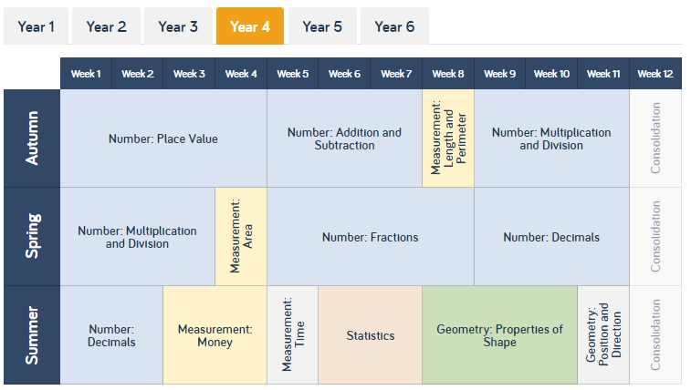
Maths – White Rose Home Learning
As well as the work that can be accessed through My Maths and TT Rockstars, you can see below the future topics we would be covering.
To find further support for the rest of our year curriculum, visit the White Rose website for the schemes of learning. (https://whiterosemaths.com/resources/schemes-of-learning/primary-sols/)
Here, you can find everything we should be covering across year 4 and the small steps within this. For example…

Slide 10
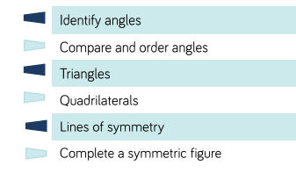
Maths – White Rose Home Learning
CONGRATULATIONS, well done for completing the topic on Statistics. Our new topic this term in maths is going to be Geometry. If you follow that link from the previous slide, it’ll open up a PDF that shows me all the information for that topic.
I’ve put a star next to the areas we are going to focus on this week. Remember to focus on the small steps and to try not too rush. Take your time!

Slide 11
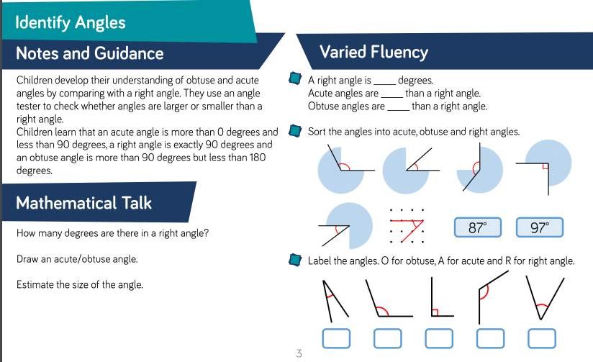
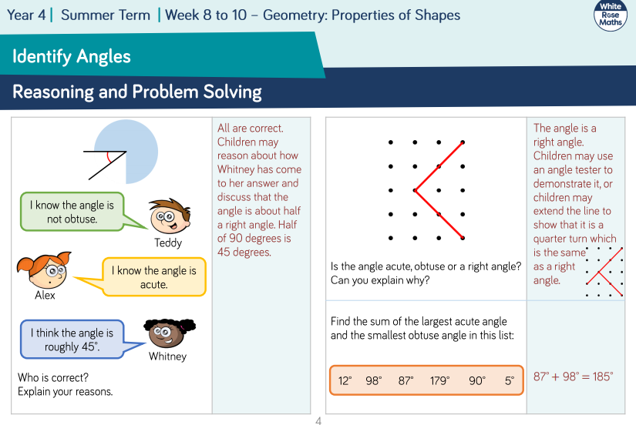
Maths – White Rose Home Learning
Each small step has notes and guidance for the topic and fluency suggestions. The second page provides reasoning and problem solving questions that the children can try to consolidate their learning.

Slide 12
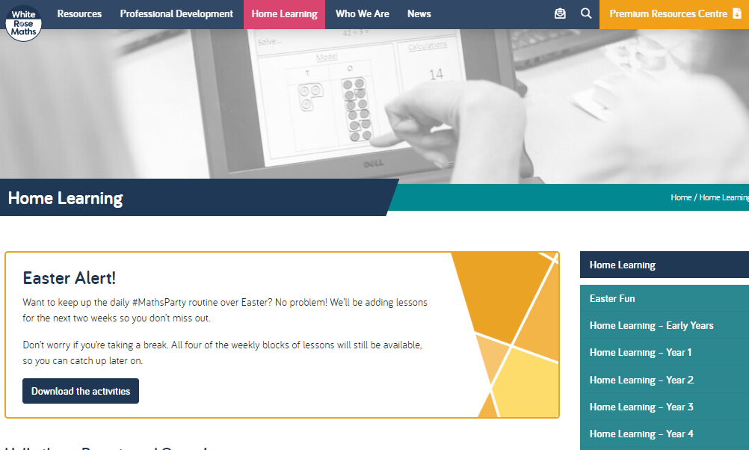
Maths – White Rose Home Learning
In school as we follow the White Rose scheme of learning. Their website has put together free lessons and resources that link to the learning taking place in school. Please visit: https://whiterosemaths.com/homelearning/

Slide 13
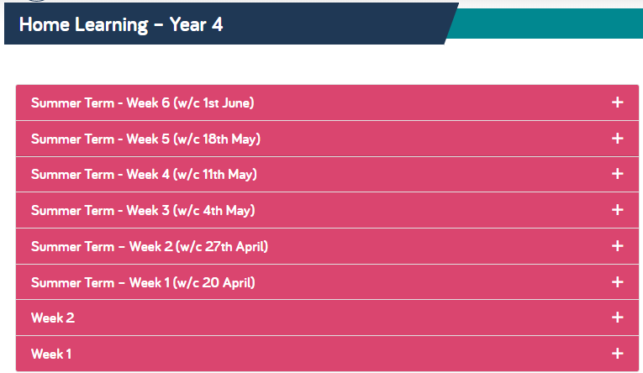
Maths – White Rose Home Learning
Complete Summer Term-Week 5, Lesson 3-4 and then move onto Summer Term-Week 6, Lessons 1-2 throughout the week. Each Lesson has linked a PowerPoint video to explain how to do that specific maths activity. HOWEVER please note: the website have stopped showing the worksheets on the website, but I have attached a worksheet to complete on the next couple of slides. This worksheet should work alongside the videos from the website.

Slide 14
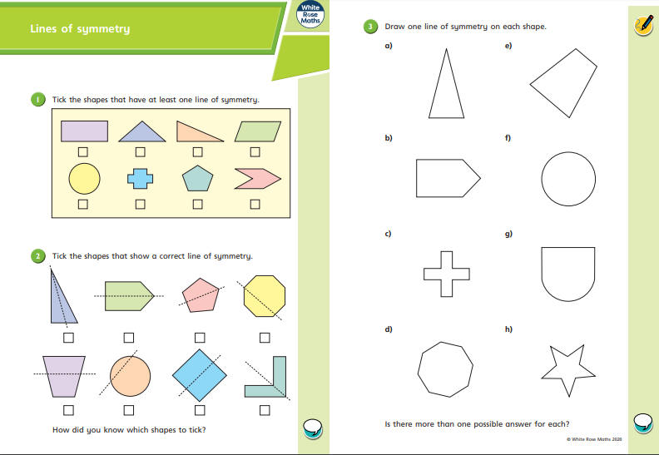

Slide 15
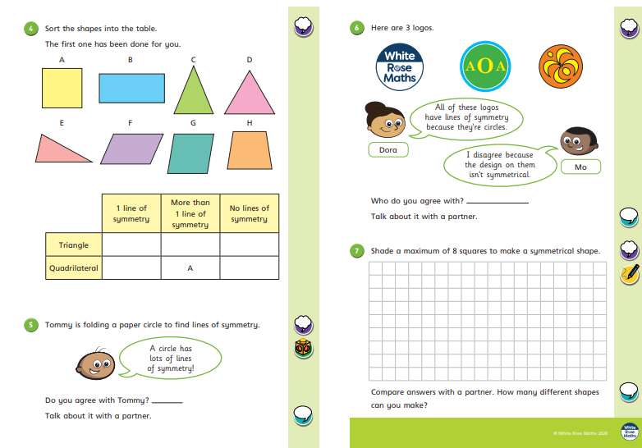

Slide 16
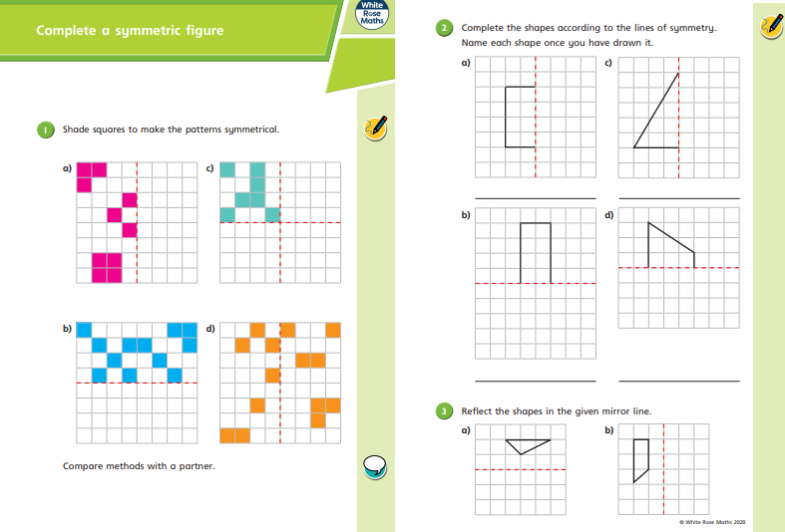

Slide 17
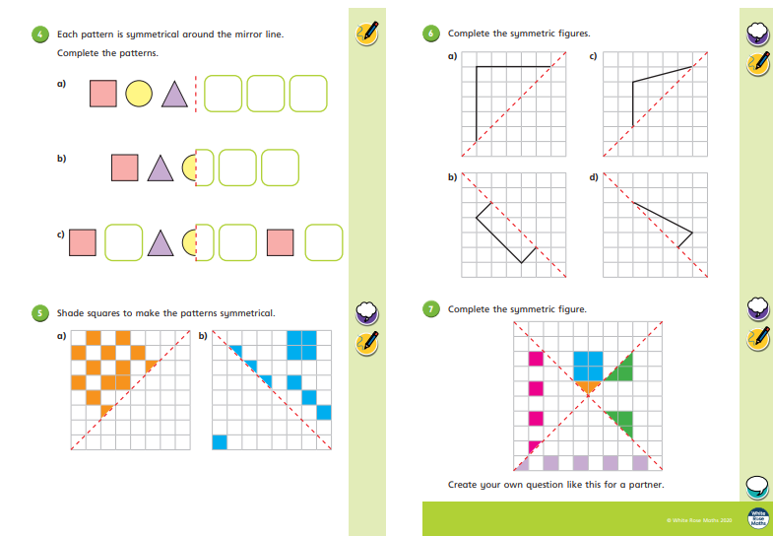

Slide 18
Maths Continued….
For more maths activities follow the link over to MyMaths and complete the activities.

Slide 19
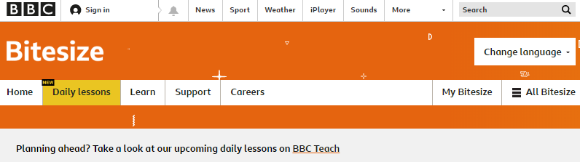
BBC Bitesize
Follow the link below to find some helpful resources for maths. (You will also find some helpful resources for subjects such as English also)
https://www.bbc.co.uk/bitesize/tags/z63tt39/year-4-and-p5-lessons

Slide 20



TT Rockstars
To access TT Rockstars please visit: https://play.ttrockstars.com/auth/school
Start typing in the school name or the post code (ME99NL)
Pupils type in their username and password, usually written in their reading record.
Pupils can practice all tables
I have specifically allocated different times tables for you to practise each week.

Slide 21

Accessing Twinkl
Many educational content providers are offering free access to their resources. Twinkl is a website that we use from time to time to resource our lessons to aid in teacher input and pupil activities.
We will be able to direct you towards activities and learning via this website based on lessons that may be missed due to absence. To access Twinkl please visit: www.twinkl.co.uk/offer
You will have to sign up and put in the offer code: UKTWINKLHELPS

Slide 22
English
Task:
Create a spider diagram
Follow the link below for the English Task.
Once on the website it has a selection of 3 activities from which you can complete.
https://www.bbc.co.uk/bitesize/articles/zk23c7h
For this activity we will focus on ‘Exploring synonyms and antonyms’

Slide 23
English Task
For the second activity follow this different link below for the second English Task.
Once on the website it has a selection of 3 activities from which you can complete.
https://www.bbc.co.uk/bitesize/articles/zf7qmfr
This activity focuses on ‘Using inferencing to be a reading detective.’

Slide 24
Final English Task
For the final English task follow this different link.
Once on the website again you will notice it has a selection of 3 activities from which you can complete.
https://www.bbc.co.uk/bitesize/articles/zr8kwty
This activity focuses on ‘Suffixes: -ous and –sion’

Slide 25
PHSE
As a slightly different activity this week, I thought we could take a minute to reflect upon what things make us all unique.
I have provided an example on the next slide. Once you have made a list of all the things which make you special. You can complete the worksheet on the next slide.

Slide 26
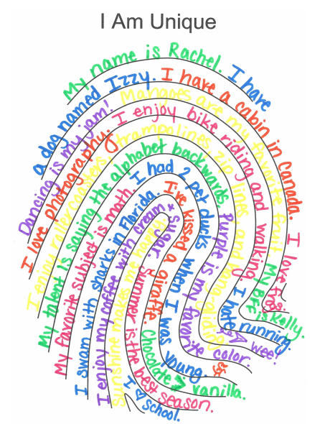

Slide 27


Slide 28

P.E.
It is important to keep your children active. If it is safe to do so, ensure they have some time outside throughout the day. Please visit Joe Wicks YouTube channel (https://www.youtube.com/channel/UCAxW1XT0iEJo0TYlRfn6rYQ), which has lots of exercise videos for children. He will also be hosting a live P.E. lessons Monday to Friday at 9:00am.

Slide 29



Music
Collins are also providing home learning activities https://collins.co.uk/pages/support-learning-at-home.
You can access free Music Express songs and activities by clicking on the free children's song bank. Some of these the children will recognise from class music lessons with Mrs Julier .
Go to Collins Connect and click on the Teacher portal and enter:
Username: parents@harpercollins.co.uk
Password: Parents20!
Click Login.
Once you’ve logged into Collins Connect, select Music Express from the menu page. To access the Song Bank click the link on the welcome page.​
'Out of the Ark' music have created 'Out of the Ark at Home' via this website https://www.outoftheark.co.uk/ootam-at-home/​
There are 4 weeks on the website so far and when you click on e.g week 1, there is a lively fun song video for every single day. Definitely something you might enjoy and could work well as a brain break, when needed.

Slide 30

Classroom Secrets
The site classroom secrets https://classroomsecrets.co.uk/free-home-learning-packs/ has free class packs which provide some great additional ideas and resources you can use.

