Slide 1

Home Learning
Year 4 Term 6 Week 2

Slide 2
Message from the class teacher
Good Morning Year 4,
Welcome back for another week. How have you been? It’s a pity the weather hasn’t been too good over the weekend. For this week I decided to change the English activity to writing a recount about an experience which you have had, alongside this I have left some of the usual math activities. Also I have left another topic activity. Have fun and Stay safe!
Best Wishes,
Miss Solomon

Slide 3

Reading
Hopefully you have access to books at home, but we have sent home extra books with your child.
Accelerated Reading
Home quizzing is not always recommended but in this case we have adjusted the settings to allow quizzing to happen at home.
If your child wants to read a book from home, please check that there is a quiz available for the book and that the book level (BL) is within or near to your child’s reading range. Also take note of the quiz number for future reference.
To check books please visit: https://www.arbookfind.co.uk/
Go to the next page for how to quiz.

Slide 4



AR quizzing at home.
To log into AR to take a quiz please visit: https://ukhosted27.renlearn.co.uk/2240835/
Your child should know what to do from here and should know their login details. If they are not aware, most details are written in their reading record.
Click on Accelerated reader.
Type in the name the book or the quiz number.
We advise students complete quizzes unaided. If parents/carers wish to support their child, they can do so in the following ways:
Discuss the book with your child as the book is being read
Ask your child to read the question out loud
Re-word questions for your child, if necessary
Ask your child which answers are not correct

Slide 5

Visit http://readon.myon.co.uk

Slide 6

Choose an area that interests you or use the search option.

Slide 7


Using My Maths
Children should know their way round My Maths but here are some reminders on how access the lessons. Visit: www.mymaths.co.uk
bapchild
divide162

Slide 8

Using My Maths
Access any lesson based on what your child is learning in class or search the topic in the search bar.
Use the login portal to access specific homework and lessons that your teacher has set.

Slide 9
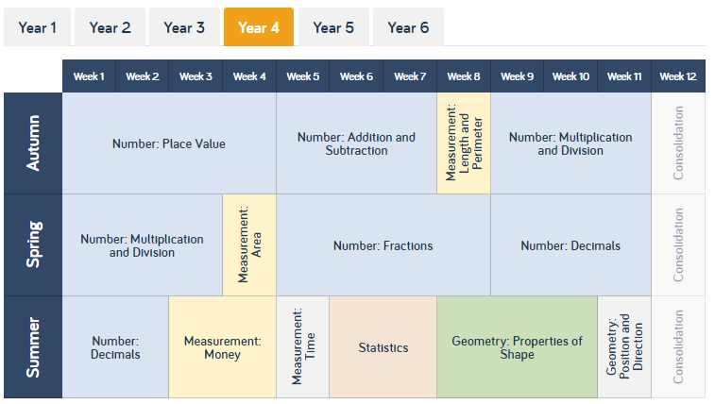
Maths – White Rose Home Learning
As well as the work that can be accessed through My Maths and TT Rockstars, you can see below the future topics we would be covering.
To find further support for the rest of our year curriculum, visit the White Rose website for the schemes of learning. (https://whiterosemaths.com/resources/schemes-of-learning/primary-sols/)
Here, you can find everything we should be covering across year 4 and the small steps within this. For example…

Slide 10
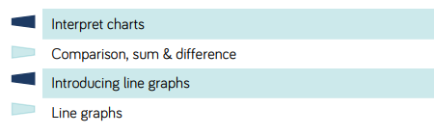
Maths – White Rose Home Learning
CONGRATULATIONS, well done for completing the topic on Time. Our new topic this term in maths is going to be Statistics. If you follow that link from the previous slide, it’ll open up a PDF that shows me all the information for that topic.
I’ve put a star next to the areas we are going to focus on this week. Remember to focus on the small steps and to try not too rush. Take your time!

Slide 11
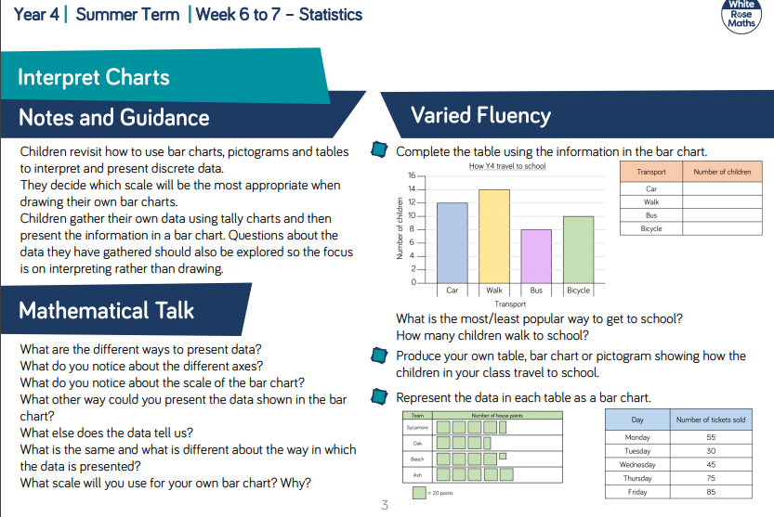
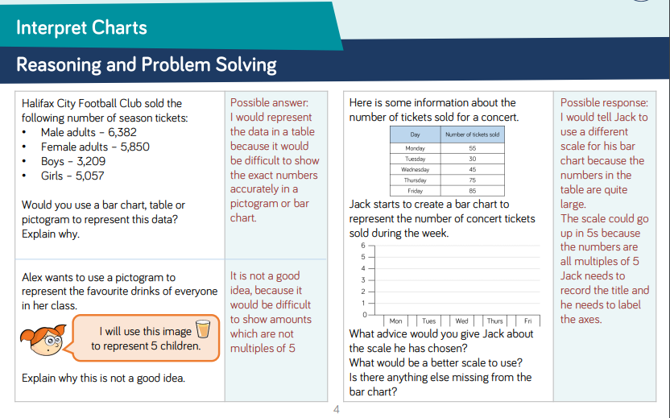
Maths – White Rose Home Learning
Each small step has notes and guidance for the topic and fluency suggestions. The second page provides reasoning and problem solving questions that the children can try to consolidate their learning.

Slide 12
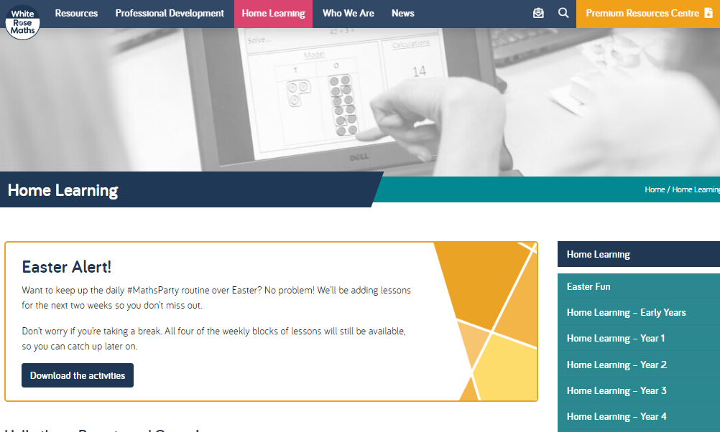
Maths – White Rose Home Learning
In school as we follow the White Rose scheme of learning. Their website has put together free lessons and resources that link to the learning taking place in school. Please visit: https://whiterosemaths.com/homelearning/

Slide 13
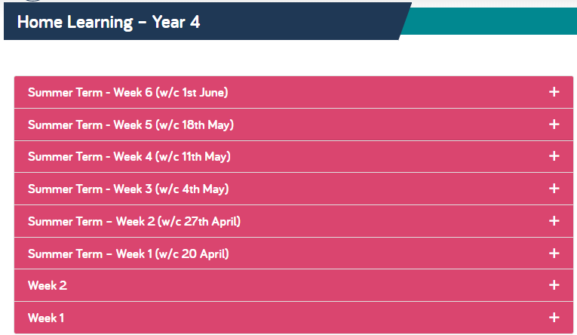
Maths – White Rose Home Learning
Complete Summer Term-Week 4, Lesson 3-4 and then move onto Summer Term-Week 5, Lessons 1-2 throughout the week. Each Lesson has linked a PowerPoint video to explain how to do that specific maths activity. HOWEVER please note: the website have stopped showing the worksheets on the website, but I have attached a worksheet to complete on the next couple of slides. This worksheet should work alongside the videos from the website.

Slide 14
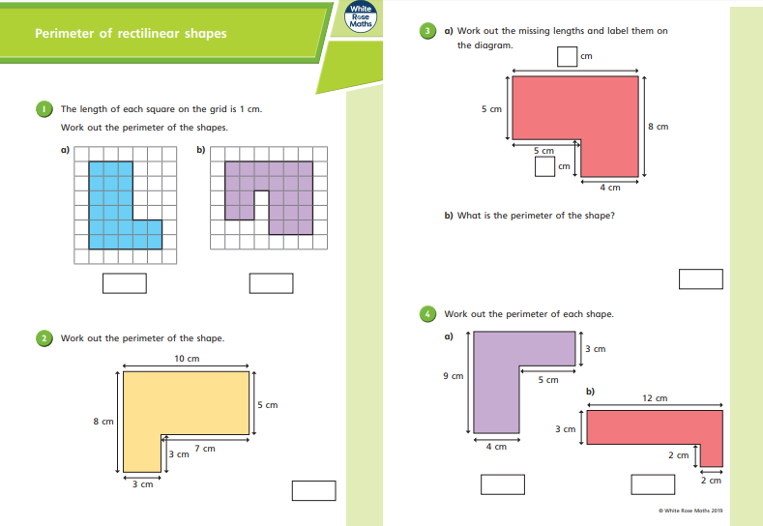

Slide 15
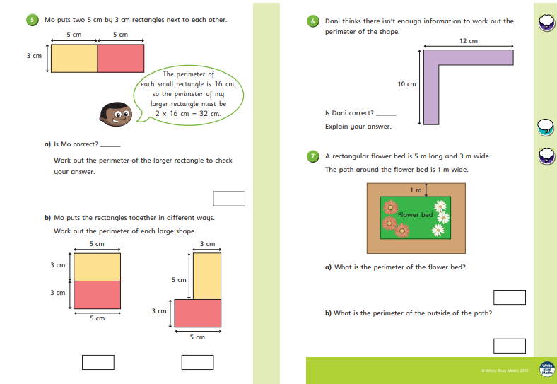

Slide 16
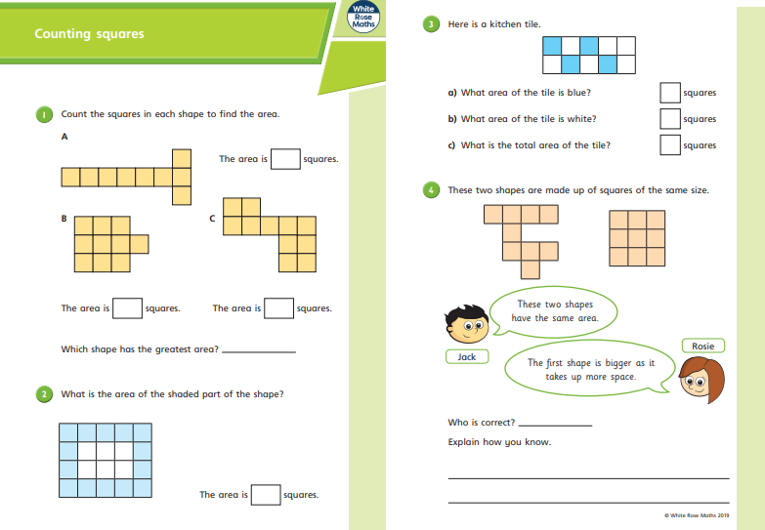

Slide 17
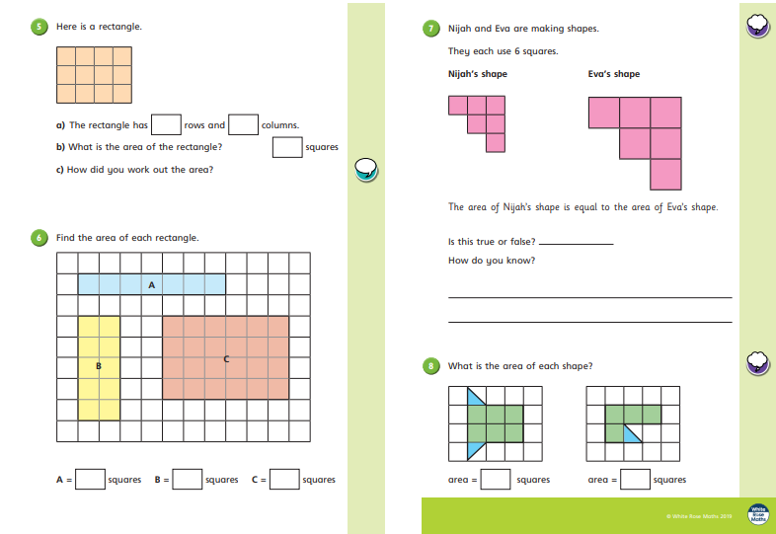

Slide 18
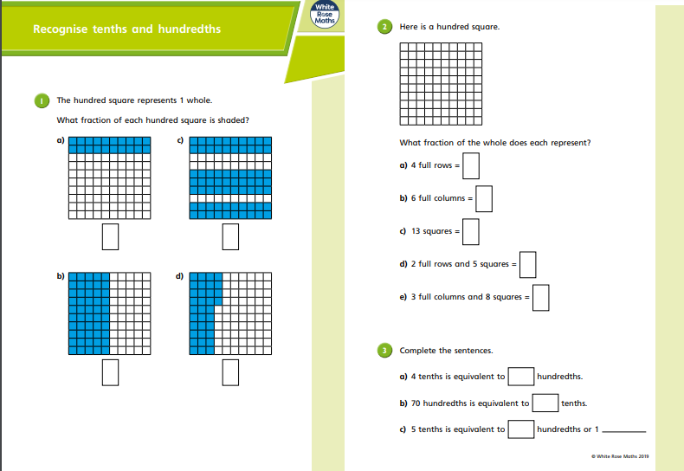

Slide 19
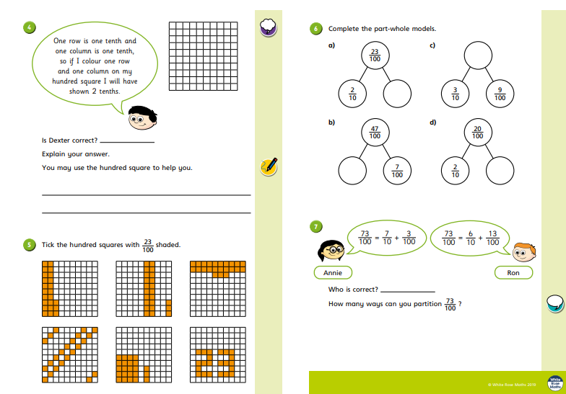

Slide 20
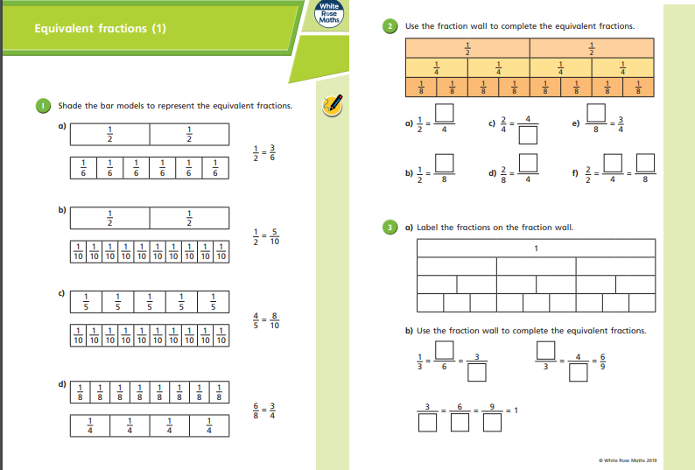

Slide 21
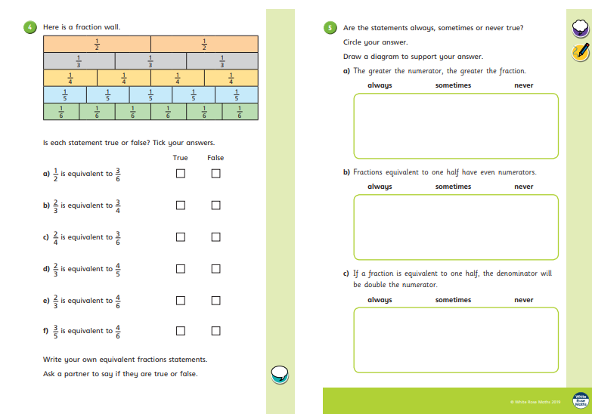

Slide 22



TT Rockstars
To access TT Rockstars please visit: https://play.ttrockstars.com/auth/school
Start typing in the school name or the post code (ME99NL)
Pupils type in their username and password, usually written in their reading record.
Pupils can practice all tables
I have specifically allocated different times tables for you to practise each week.

Slide 23

Accessing Twinkl
Many educational content providers are offering free access to their resources. Twinkl is a website that we use from time to time to resource our lessons to aid in teacher input and pupil activities.
We will be able to direct you towards activities and learning via this website based on lessons that may be missed due to absence. To access Twinkl please visit: www.twinkl.co.uk/offer
You will have to sign up and put in the offer code: UKTWINKLHELPS

Slide 24
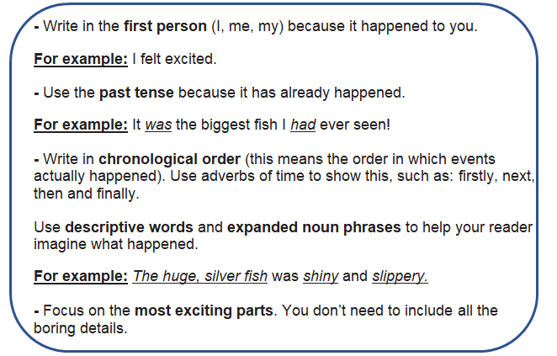
English
Task:
1. Click on the link and watch the video - https://www.bbc.co.uk/bitesize/articles/zkpvbdm
2. These are the features of a recount:

Slide 25
English Task
3. Think of a time that only you experienced.
- Did you go on an adventure?
- Did you meet someone amazing?

Slide 26
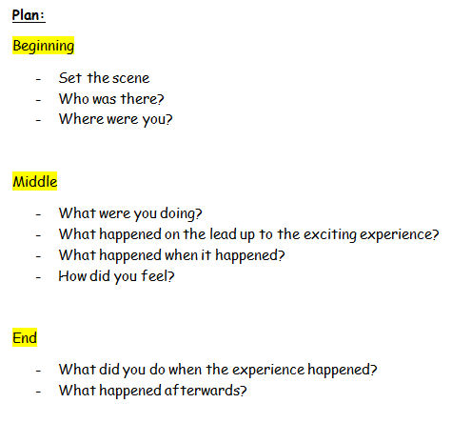
English Task.
4. Write a recount using the features above and use the plan below to help you order your thoughts.

Slide 27
Spelling list…
You can practice and learn these spellings in whichever way suits you best (just like your homework, e.g. look, cover, write, check):
  Envious
  Furious
  Various
  Mountainous
  Poisonous
  Dangerous
  Courageous
  Spacious
  Famous
  Monstrous

Slide 28
Task 3: Applying the spellings and optional additional spelling tasks…
Choose one of the options from below to revise the spellings.
Write a definition for each of the words.
Write sentences including each of the words.
Write a small passage trying to include as many of the words as you can.
Dictation – can an adult in your house tell you a sentence with the word in and you have to write the sentence and check your spellings are correct?

Slide 29
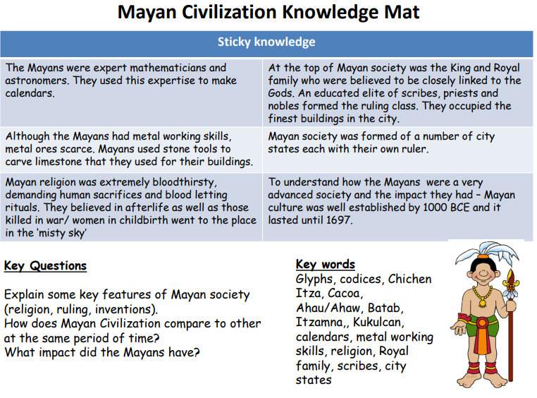
Research Topic- Mayan’s
Activity this week “Who Were The Mayans?” - to write an information text for the Year 3s explaining who the Maya were and what you have learned about their religion and their everyday lives. This should be at least half a page in length, and use vocabulary from the Knowledge Mat.

Slide 30

P.E.
It is important to keep your children active. If it is safe to do so, ensure they have some time outside throughout the day. Please visit Joe Wicks YouTube channel (https://www.youtube.com/channel/UCAxW1XT0iEJo0TYlRfn6rYQ), which has lots of exercise videos for children. He will also be hosting a live P.E. lessons Monday to Friday at 9:00am.

Slide 31



Music
Collins are also providing home learning activities https://collins.co.uk/pages/support-learning-at-home.
You can access free Music Express songs and activities by clicking on the free children's song bank. Some of these the children will recognise from class music lessons with Mrs Julier .
Go to Collins Connect and click on the Teacher portal and enter:
Username: parents@harpercollins.co.uk
Password: Parents20!
Click Login.
Once you’ve logged into Collins Connect, select Music Express from the menu page. To access the Song Bank click the link on the welcome page.​
'Out of the Ark' music have created 'Out of the Ark at Home' via this website https://www.outoftheark.co.uk/ootam-at-home/​
There are 4 weeks on the website so far and when you click on e.g week 1, there is a lively fun song video for every single day. Definitely something you might enjoy and could work well as a brain break, when needed.

Slide 32

Classroom Secrets
The site classroom secrets https://classroomsecrets.co.uk/free-home-learning-packs/ has free class packs which provide some great additional ideas and resources you can use.

