Slide 1

Home Learning
Year 4 Term 6 Week 1

Slide 2
Message from the class teacher
Good Morning Year 4,
I hope you have enjoyed your half term and have had a chance to enjoy the sunshine. Perhaps you played with your siblings or maybe you kicked a ball around in the garden. I personally baked some Scones and a Pavlova. Welcome back to another term can you believe it, we are now into our final term of the year and what an unusual year it has been. For this week I decided to let you finished your story from before half term and have left some of the usual math activities. Alongside this I have left a topic activity. Have fun and Stay safe!
Best Wishes,
Miss Solomon

Slide 3

Reading
Hopefully you have access to books at home, but we have sent home extra books with your child.
Accelerated Reading
Home quizzing is not always recommended but in this case we have adjusted the settings to allow quizzing to happen at home.
If your child wants to read a book from home, please check that there is a quiz available for the book and that the book level (BL) is within or near to your child’s reading range. Also take note of the quiz number for future reference.
To check books please visit: https://www.arbookfind.co.uk/
Go to the next page for how to quiz.

Slide 4



AR quizzing at home.
To log into AR to take a quiz please visit: https://ukhosted27.renlearn.co.uk/2240835/
Your child should know what to do from here and should know their login details. If they are not aware, most details are written in their reading record.
Click on Accelerated reader.
Type in the name the book or the quiz number.
We advise students complete quizzes unaided. If parents/carers wish to support their child, they can do so in the following ways:
Discuss the book with your child as the book is being read
Ask your child to read the question out loud
Re-word questions for your child, if necessary
Ask your child which answers are not correct

Slide 5

Visit http://readon.myon.co.uk

Slide 6

Choose an area that interests you or use the search option.

Slide 7


Using My Maths
Children should know their way round My Maths but here are some reminders on how access the lessons. Visit: www.mymaths.co.uk
bapchild
divide162

Slide 8

Using My Maths
Access any lesson based on what your child is learning in class or search the topic in the search bar.
Use the login portal to access specific homework and lessons that your teacher has set.

Slide 9
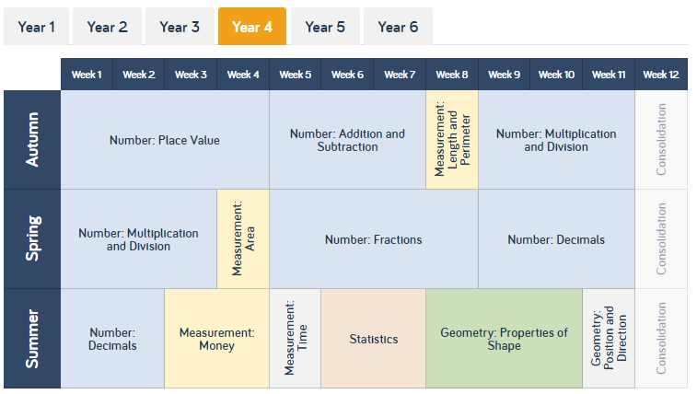
Maths – White Rose Home Learning
As well as the work that can be accessed through My Maths and TT Rockstars, you can see below the future topics we would be covering.
To find further support for the rest of our year curriculum, visit the White Rose website for the schemes of learning. (https://whiterosemaths.com/resources/schemes-of-learning/primary-sols/)
Here, you can find everything we should be covering across year 4 and the small steps within this. For example…

Slide 10
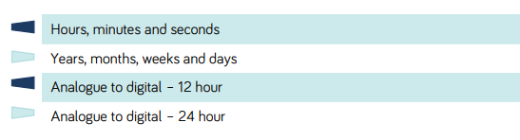
Maths – White Rose Home Learning
CONGRATULATIONS, well done for completing the topic on measurement. Our new topic within maths is going to be time. If you follow that link from the previous slide, it’ll open up a PDF that shows me all the information for that topic.
I’ve put a star next to the areas we are going to focus on this week. My tip would be to focus on the small steps and to try not too rush. Take your time!

Slide 11
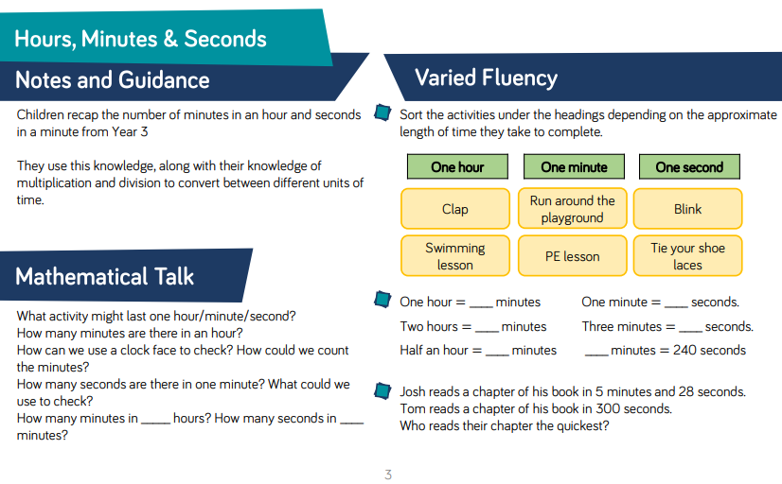
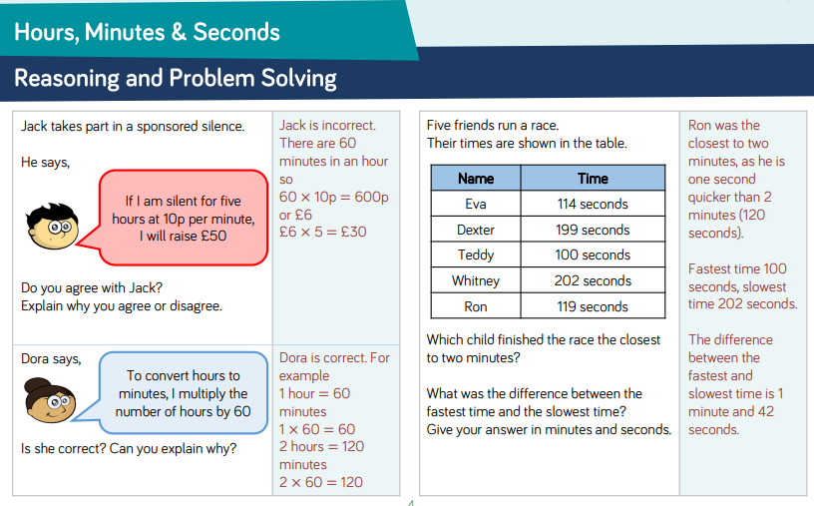
Maths – White Rose Home Learning
Each small step has notes and guidance for the topic and fluency suggestions. The second page provides reasoning and problem solving questions that the children can try to consolidate their learning.

Slide 12
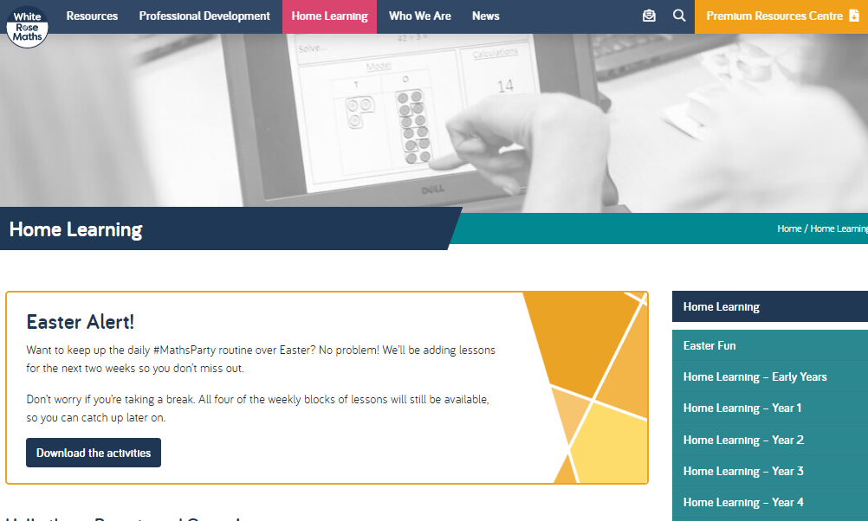
Maths – White Rose Home Learning
In school as we follow the White Rose scheme of learning. Their website has put together free lessons and resources that link to the learning taking place in school. Please visit: https://whiterosemaths.com/homelearning/

Slide 13
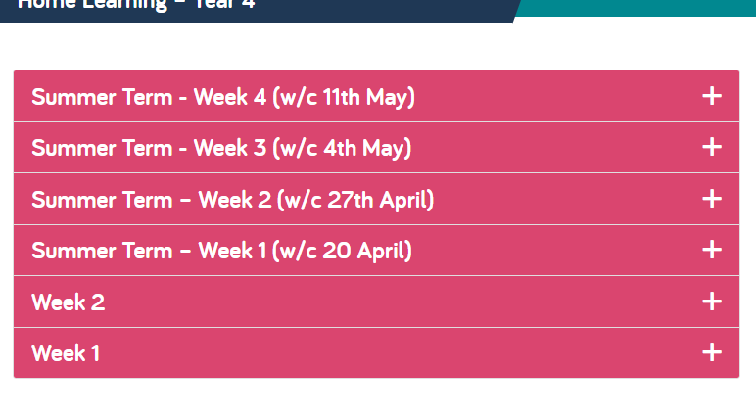
Maths – White Rose Home Learning
Complete Summer Term-Week 3, Lesson 3-4 and then move onto Summer Term-Week 4, Lessons 1-2 throughout the week. Each Lesson has linked a PowerPoint video to explain how to do that specific maths activity. HOWEVER please note: when you get to Summer Term- Week 4 the website have stopped showing the worksheets, but I have attached a worksheet to complete on the next couple of slides. This worksheet should work alongside the videos from the website.

Slide 14
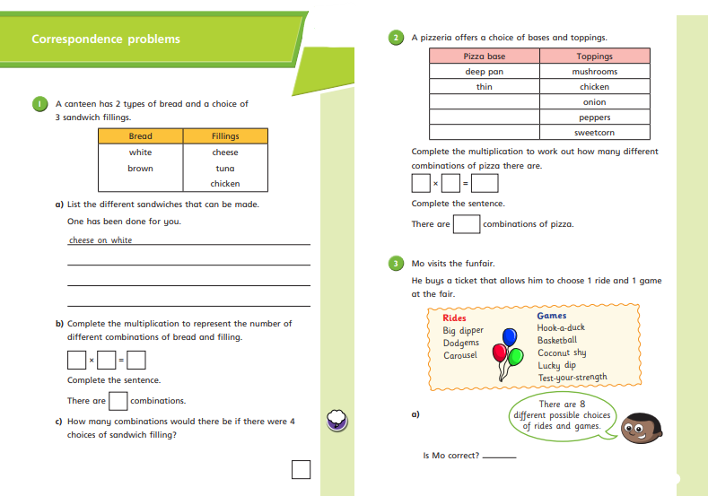

Slide 15
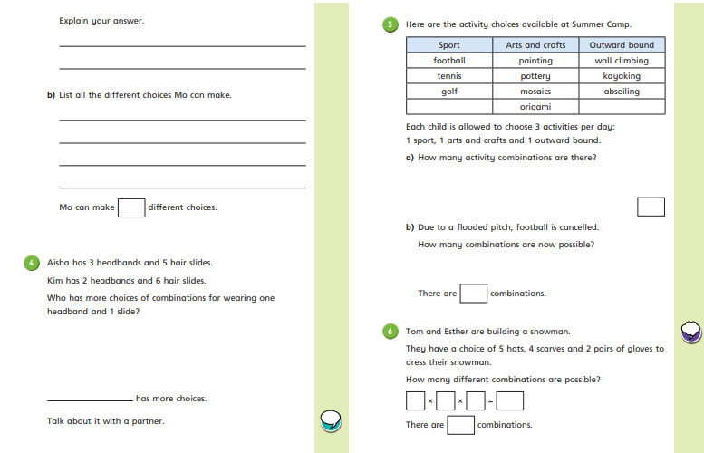

Slide 16
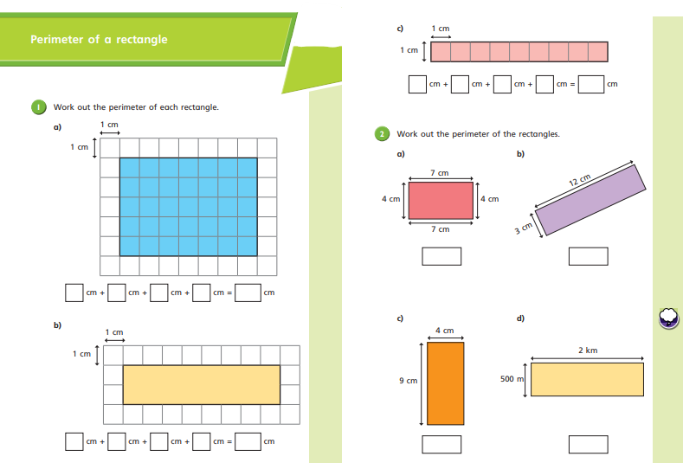

Slide 17
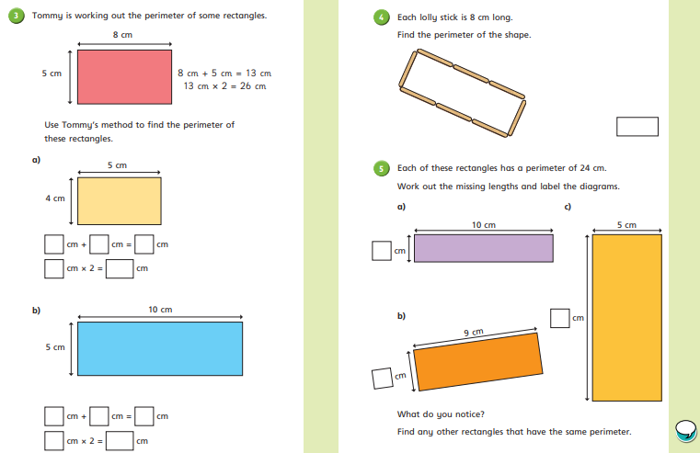

Slide 18



TT Rockstars
To access TT Rockstars please visit: https://play.ttrockstars.com/auth/school
Start typing in the school name or the post code (ME99NL)
Pupils type in their username and password, usually written in their reading record.
Pupils can practice all tables
I have specifically allocated different times tables for you to practise each week.

Slide 19

Accessing Twinkl
Many educational content providers are offering free access to their resources. Twinkl is a website that we use from time to time to resource our lessons to aid in teacher input and pupil activities.
We will be able to direct you towards activities and learning via this website based on lessons that may be missed due to absence. To access Twinkl please visit: www.twinkl.co.uk/offer
You will have to sign up and put in the offer code: UKTWINKLHELPS

Slide 20
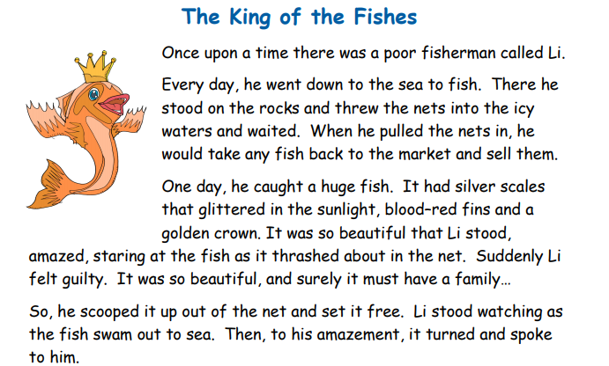
English
Task:
Re-read the story from last week and then complete the tasks

Slide 21
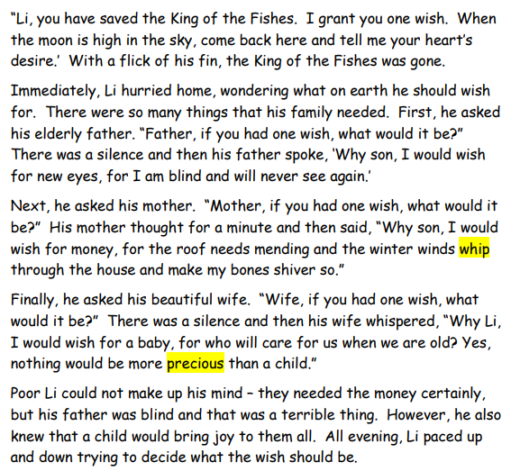

Slide 22
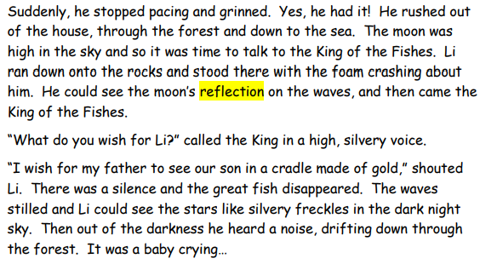

Slide 23
English
Task:
Now it’s time to write your story from the week before last! I’ll give you a bit of help on each section.
Use your boxed-up planner to help you.
I will help you through each step, using a step by step guide through each slide.
Begin by Introducing your main character and how the main character is poor;
Then give a bit more detail about your main character’s daily life by using a fronted adverbial like ‘every day’ or ‘each week’ or ‘during her working hours.’

Slide 24
First Section of the Story
Here’s my first paragraph. Use it to help you write yours:
The Queen of the Oysters
A long time ago in a land of sea and stars, there lived a poor oyster diver named Zoe. When the tide was right, she went deep, deep down in the sea to catch oysters. There she would swim, desperately searching for the secret shells. After her dive, she would take her catch to the market to sell for coins.
Check your punctuation and spelling. Have you remembered full stops? Are there capital letters after the full stops?
Have you remembered the comma after your fronted adverbials?

Slide 25
Second Section of the Story
Use your boxed-up planner to help you. Look back at the model text to help you too. In this section I want you to:
Introduce the new character who is ‘helped’ in some way by the main character;
Describe the new character in detail.
Here’s my second paragraph. Use it to help you write yours:
One night, she caught an unusually large oyster. She couldn’t help herself and she peaked inside. It had diamonds on its shell that glittered in the moonlight, a shimmering pearl and an angelic voice. As the oyster sang its mournful moan, Zoe froze in the water. She was mesmerised. Instantly, she realised that she couldn’t take this oyster, so she placed it back on the seabed.
Check your punctuation and spelling. Have you remembered full stops? Are there capital letters after the full stops?
Have you remembered the comma after your fronted adverbials? Remember to do this for the next section as well!

Slide 26
Third Section of the Story
In this section I want you to grant the main character a wish. Here’s my third paragraph. Use it to help you write yours.
As soon as the oyster touched the sand, it spoke to Zoe. “Zoe, you have saved the Queen of the Oysters. I will grant you one wish. Come back to me when the moonlight dances on the waves and I will give you what your heart desires.”
Check your punctuation and spelling. Have you remembered full stops? Are there capital letters after the full stops?
Have you remembered the comma after your fronted adverbials?

Slide 27
Fourth Section of the Story
In this section I want you to:
Make sure your main character thinks about what her fa
Here’s my fourth paragraph. Use it to help you write yours.
So that night Zoe returned home and tried to listen to what her heart desired. One the one hand, her mum could not walk so it would be wonderful if she could be cured. On the other hand, Zoe’s family were so poor that their roof was leaking in two places, so they really needed money for a new house. Zoe dreamed of having a puppy of her very own. She wanted all of these things, but there was only one wish. How was she going to decide?
Check your punctuation and spelling. Have you remembered full stops? Are there capital letters after the full stops?
Have you remembered the comma after your fronted adverbials?

Slide 28
Fifth Section of the Story
In this section I want you to:
-Have your main character return to the wish-granting character;
-Combine the needs of your MC’s friends or family into one wish;
-Describe the setting.
Here’s my fourth paragraph. Use it to help you write yours.
As quick as a flick, it came to her! She knew what to wish for. The sun was setting, and the moon was beginning to take over the day. Zoe could see the moon’s light reflecting on the surface of the waves. It was time to talk to the Queen of the Oysters. Down, down, down she swam. The Queen of the Oysters was there, waiting. Zoe used her hands to wish underwater. She used actions and hand signals to ask for her heart’s desire: “I wish for my mum to be chasing my puppy around my mansion’s garden.”
Check your punctuation and spelling. Have you remembered full stops? Are there capital letters after the full stops?
Have you remembered the comma after your fronted adverbials?

Slide 29
Final Section of the Story
Use your boxing up planner to help you. Look back at The King of the Fishes model text to help you too.
In this section I want you to:
- Have the wish come true;
Make sure your reader knows that your main character has changed because of the wish, like the example below:
Suddenly, the oyster shimmered. The water felt cooler and the seaweed seemed to stand still. Zoe swan up to the surface and as soon as she broke into the air, she heard it: a dog barking in the distance. Zoe smiled. Her worries were finally over, and she walked back to her mansion in the moonlight.

Slide 30
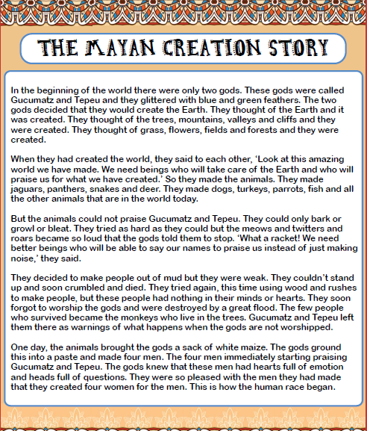
Research Topic- Mayan’s
Complete the table on ‘The Mayan Creation Story’, from the next two slides. I have provided two different versions to help you complete the worksheet. The first one which has been started for you and the second is a blank document. You DON’T need to complete two. You only need to choice the best one to help you complete it.

Slide 31
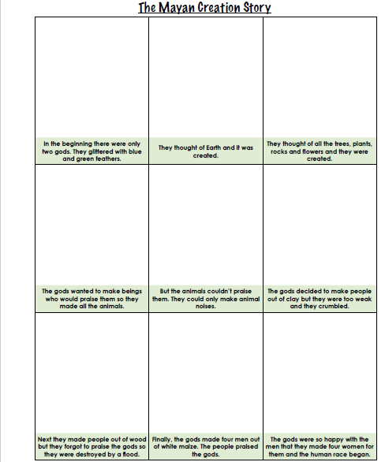

Slide 32
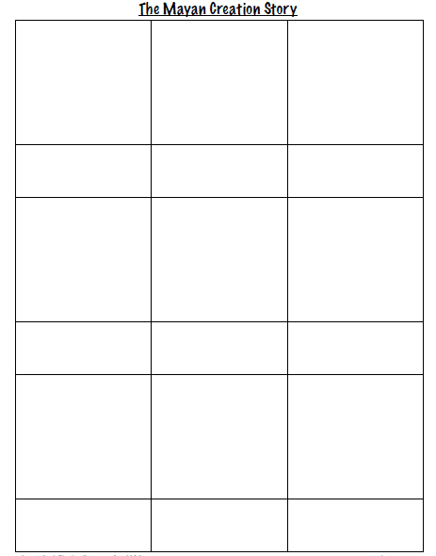

Slide 33

P.E.
It is important to keep your children active. If it is safe to do so, ensure they have some time outside throughout the day. Please visit Joe Wicks YouTube channel (https://www.youtube.com/channel/UCAxW1XT0iEJo0TYlRfn6rYQ), which has lots of exercise videos for children. He will also be hosting a live P.E. lessons Monday to Friday at 9:00am.

Slide 34



Music
Collins are also providing home learning activities https://collins.co.uk/pages/support-learning-at-home.
You can access free Music Express songs and activities by clicking on the free children's song bank. Some of these the children will recognise from class music lessons with Mrs Julier .
Go to Collins Connect and click on the Teacher portal and enter:
Username: parents@harpercollins.co.uk
Password: Parents20!
Click Login.
Once you’ve logged into Collins Connect, select Music Express from the menu page. To access the Song Bank click the link on the welcome page.​
'Out of the Ark' music have created 'Out of the Ark at Home' via this website https://www.outoftheark.co.uk/ootam-at-home/​
There are 4 weeks on the website so far and when you click on e.g week 1, there is a lively fun song video for every single day. Definitely something you might enjoy and could work well as a brain break, when needed.

Slide 35

Classroom Secrets
The site classroom secrets https://classroomsecrets.co.uk/free-home-learning-packs/ has free class packs which provide some great additional ideas and resources you can use.

