Slide 1

Home Learning
Year 4 Half Term

Slide 2
Message from the class teacher
Hello Year 4!
Congratulations! You have made it to half term! Although it must have been difficult at times, you have done it and all of us at Bapchild are extremely pound of all that you have achieved. It is still al little unclear to when you all will return but I really look forward to seeing your smiling faces. Just know that, you have all been amazing and I know you will continue the great efforts to stay safe and keep up with your learning. If you are looking for something to keep your busy over half term then I have sorted a couple of activities out for you to do…when you get bored. Missing you all millions!
Best wishes,
Miss Solomon

Slide 3

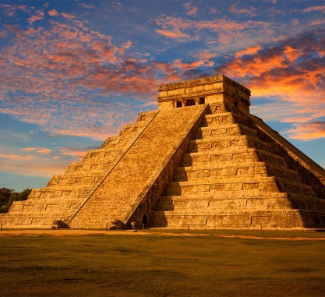
Activities During Half Term
Keep up with your reading!
Visit http://readon.myon.co.uk , to help choose a book that interests you.
Complete the Times Tables set on TT Rockstars
Have a go at one of the following:
Make a poster about the history of the NHS
OR
Draw a picture of Chichen Itza as it is linked to our topic on the Mayans.

