Slide 1

Home Learning
Year 4 Term 5 Week 6

Slide 2
Message from the class teacher
Good Morning Year 4,
I hope you all enjoy the bank holiday weekend last weekend and had some VE celebrations.
Well Done in completing another week in Term 5. I hope you have enjoyed another week of Home Learning and have been finding a variety of ways to keep busy and active.
This week we have moved our focus in Maths to Measurement, specifically Money from Decimals. Good Luck and keep up the great work. Remember to take it all in small steps.
We our continuing to study ‘The King of Fishes’ story in preparation for our write next week. Alongside this instead of R.E we have a research topic.
Good Luck and remember HAVE FUN!
Best Wishes,
Miss Solomon

Slide 3

Reading
Hopefully you have access to books at home, but we have sent home extra books with your child.
Accelerated Reading
Home quizzing is not always recommended but in this case we have adjusted the settings to allow quizzing to happen at home.
If your child wants to read a book from home, please check that there is a quiz available for the book and that the book level (BL) is within or near to your child’s reading range. Also take note of the quiz number for future reference.
To check books please visit: https://www.arbookfind.co.uk/
Go to the next page for how to quiz.

Slide 4



AR quizzing at home.
To log into AR to take a quiz please visit: https://ukhosted27.renlearn.co.uk/2240835/
Your child should know what to do from here and should know their login details. If they are not aware, most details are written in their reading record.
Click on Accelerated reader.
Type in the name the book or the quiz number.
We advise students complete quizzes unaided. If parents/carers wish to support their child, they can do so in the following ways:
Discuss the book with your child as the book is being read
Ask your child to read the question out loud
Re-word questions for your child, if necessary
Ask your child which answers are not correct

Slide 5

Visit http://readon.myon.co.uk

Slide 6

Choose an area that interests you or use the search option.

Slide 7


Using My Maths
Children should know their way round My Maths but here are some reminders on how access the lessons. Visit: www.mymaths.co.uk
bapchild
divide162

Slide 8

Using My Maths
Access any lesson based on what your child is learning in class or search the topic in the search bar.
Use the login portal to access specific homework and lessons that your teacher has set.

Slide 9
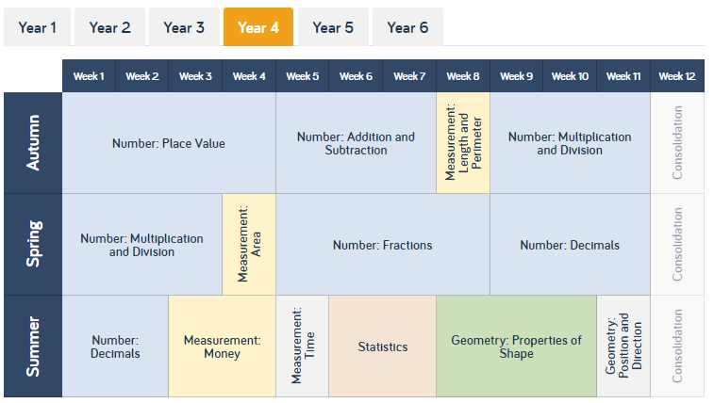
Maths – White Rose Home Learning
As well as the work that can be accessed through My Maths and TT Rockstars, you can see below the future topics we would be covering.
To find further support for the rest of our year curriculum, visit the White Rose website for the schemes of learning. (https://whiterosemaths.com/resources/schemes-of-learning/primary-sols/)
Here, you can find everything we should be covering across year 4 and the small steps within this. For example…

Slide 10
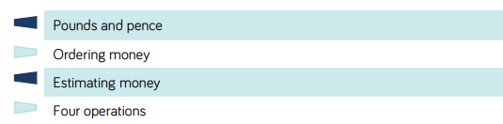
Maths – White Rose Home Learning
CONGRADULATIONS, well done for completing the topic on decimals. Our next topic within maths is going to be measurement, specifically money. If you follow that link from the previous slide, it’ll open up a PDF that shows me all the information for that topic.
I’ve put a star next to the areas we are going to focus on this week. My tip would be to focus on the small steps and to try not too rush. Take your time!

Slide 11
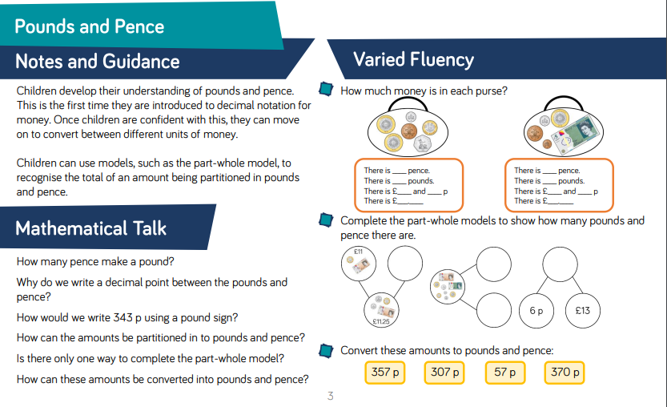
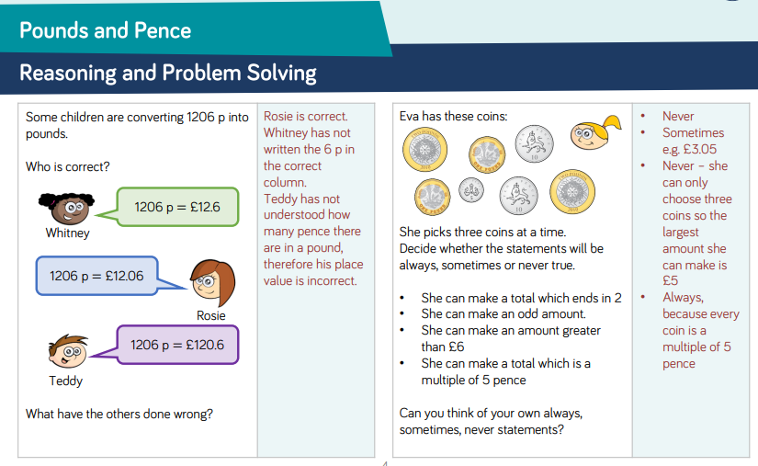
Maths – White Rose Home Learning
Each small step has notes and guidance for the topic and fluency suggestions. The second page provides reasoning and problem solving questions that the children can try to consolidate their learning.

Slide 12
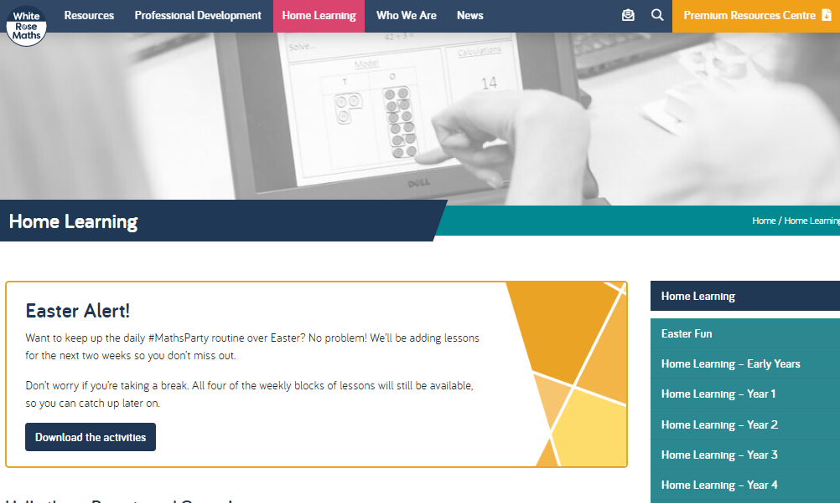
Maths – White Rose Home Learning
In school as we follow the White Rose scheme of learning. Their website has put together free lessons and resources that link to the learning taking place in school. Please visit: https://whiterosemaths.com/homelearning/

Slide 13
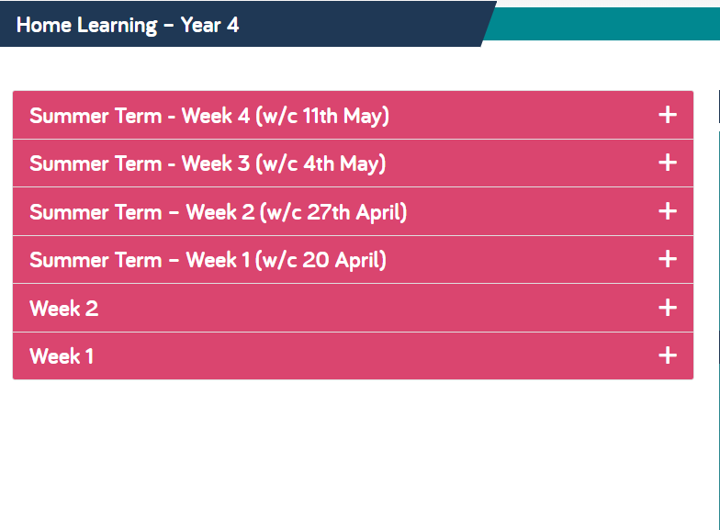
Maths – White Rose Home Learning
Complete Summer Term-Week 2, Lesson 3-4 and then move onto Summer Term-Week 3, Lessons 1-2 throughout the week. Each Lesson has linked a PowerPoint video to explain how to do that specific maths activity. It also contains an activity with the answers which you can complete and check after.

Slide 14



TT Rockstars
To access TT Rockstars please visit: https://play.ttrockstars.com/auth/school
Start typing in the school name or the post code (ME99NL)
Pupils type in their username and password, usually written in their reading record.
Pupils can practice all tables
I have specifically allocated different times tables for you to practise each week.

Slide 15

Accessing Twinkl
Many educational content providers are offering free access to their resources. Twinkl is a website that we use from time to time to resource our lessons to aid in teacher input and pupil activities.
We will be able to direct you towards activities and learning via this website based on lessons that may be missed due to absence. To access Twinkl please visit: www.twinkl.co.uk/offer
You will have to sign up and put in the offer code: UKTWINKLHELPS

Slide 16
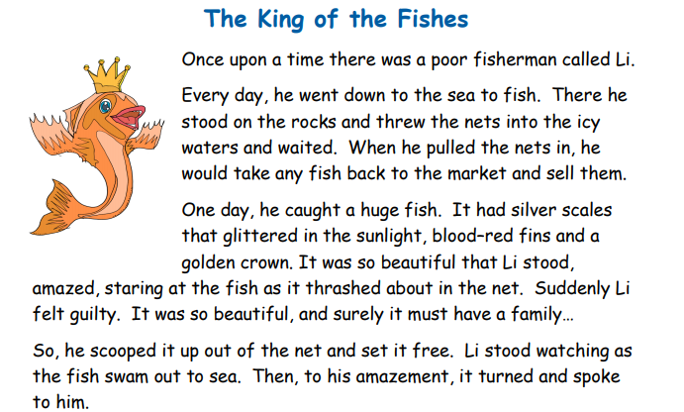
English
Task:
Re-read the story from last week and then complete the tasks

Slide 17
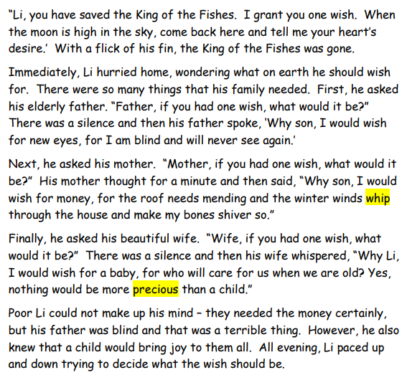

Slide 18
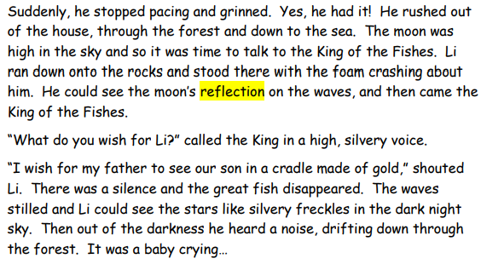

Slide 19
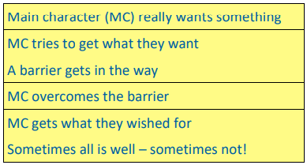
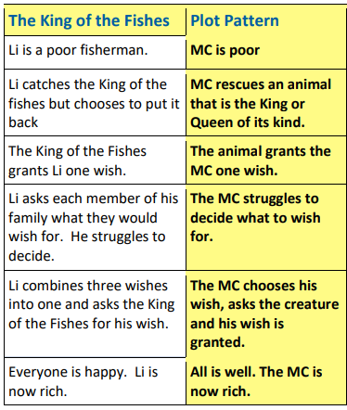
English
Task:
The King of the Fishes is a wishing tale.
Let’s look at the underlying pattern of the story by putting each section of the plot into a separate box. (As seen in the bigger box, to the right)
Then complete the task on the next slide.

Slide 20
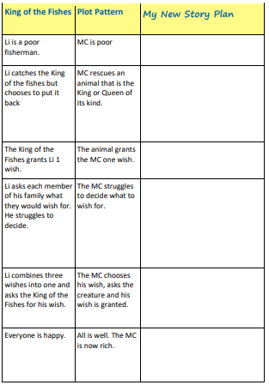
Plan your Story
Looking at the box to the right, can you now complete your own new story plan, in preparation for writing your story next week.

Slide 21
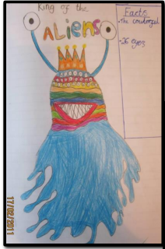
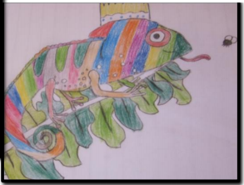
English Task 2
In your story, your main character will need to rescue a King or a Queen of a species.
Here’s a chance to get creative. Pick an animal and draw or describe what the King or Queen of its kind would look like. You could use paper and coloured pens or pencils. You could make a model or use a computer. Here are two examples

Slide 22
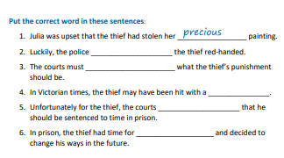

English Task:

Slide 23
Spelling list…
You can practice and learn these spellings in whichever way suits you best (just like your homework, e.g. look, cover, write, check):
  Remember
  Different
  Difficult
  Knew
  Group
  Earth
  Thought
  Decide
  Quarter
  Perhaps

Slide 24
Task 3: Applying the spellings and optional additional spelling tasks…
Choose one of the options from below to revise the spellings.
Write a definition for each of the words.
Write sentences including each of the words.
Write a small passage trying to include as many of the words as you can.
Dictation – can an adult in your house tell you a sentence with the word in and you have to write the sentence and check your spellings are correct?

Slide 25
Research Topic- The Mayan’s
Read the information below and complete research on the Mayan’s. Then complete the table on the next slide.
The Mayan Religion
Gods lived everywhere, but especially in the heavens. The Maya believed in a heaven, an earth, and an underworld. Earth was for the living.
Heaven was the home of the gods. A piece of the heavens was reserved for the Maya afterlife. They believed their ancestors lived in this little piece of heaven, but kept a watchful eye on their relatives still alive on earth. The poor buried their dead under the floor of the house, to make it easier for their ancestors to know what was going on. Nobles were buried in tombs, but they too believed that their ancestors watched over them.
The Maya also believed in an underworld. This was the Place of Awe. The Maya underworld was not a good place. It was a place where demons lived. If the Maya people did not worship in the right way, the demons would be released and able to leave the underworld and attack the Maya people. This was a huge fear. The Maya held many religious ceremonies to make sure the demons and other evil creatures who lived in the underworld stayed in the underworld. Priests wore masks and costumes at these religious ceremonies to scare the demons. They wanted to appear stronger and more fierce than the demons, so the demons would stay away.

Slide 26
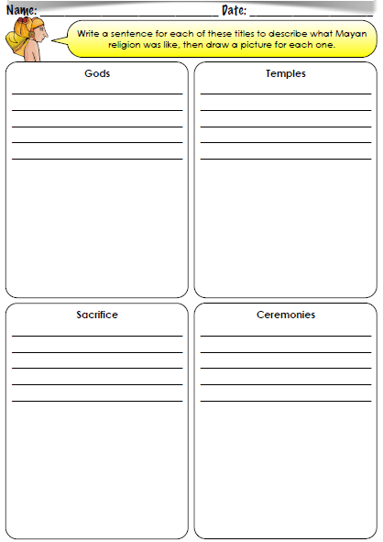

Slide 27

P.E.
It is important to keep your children active. If it is safe to do so, ensure they have some time outside throughout the day. Please visit Joe Wicks YouTube channel (https://www.youtube.com/channel/UCAxW1XT0iEJo0TYlRfn6rYQ), which has lots of exercise videos for children. He will also be hosting a live P.E. lessons Monday to Friday at 9:00am.

Slide 28



Music
Collins are also providing home learning activities https://collins.co.uk/pages/support-learning-at-home.
You can access free Music Express songs and activities by clicking on the free children's song bank. Some of these the children will recognise from class music lessons with Mrs Julier .
Go to Collins Connect and click on the Teacher portal and enter:
Username: parents@harpercollins.co.uk
Password: Parents20!
Click Login.
Once you’ve logged into Collins Connect, select Music Express from the menu page. To access the Song Bank click the link on the welcome page.​
'Out of the Ark' music have created 'Out of the Ark at Home' via this website https://www.outoftheark.co.uk/ootam-at-home/​
There are 4 weeks on the website so far and when you click on e.g week 1, there is a lively fun song video for every single day. Definitely something you might enjoy and could work well as a brain break, when needed.

Slide 29

Classroom Secrets
The site classroom secrets https://classroomsecrets.co.uk/free-home-learning-packs/ has free class packs which provide some great additional ideas and resources you can use.

