Slide 1

Home Learning
Year 4 Term 5 Week 4

Slide 2
Message from the class teacher
Hi Year 4,
You all have done great so far! So many of you have shown a lot of resilience over the last number of weeks, through adapting into school life being at home, during this lockdown. Over the last week you may have noticed a video created by all the teachers. Well that’s what I have spent my week helping to edit together. If you haven’t had a chance to see it. I would recommend you heading towards the school website to find a link to the video on YouTube. It was all for a bit of fun and I hope it brought a little smile to your faces, as much as it brought to the teachers whilst they were making their videos. Remember stay safe and hopefully see you all soon.
Best Wishes,
Miss Solomon

Slide 3

Reading
Hopefully you have access to books at home, but we have sent home extra books with your child.
Accelerated Reading
Home quizzing is not always recommended but in this case we have adjusted the settings to allow quizzing to happen at home.
If your child wants to read a book from home, please check that there is a quiz available for the book and that the book level (BL) is within or near to your child’s reading range. Also take note of the quiz number for future reference.
To check books please visit: https://www.arbookfind.co.uk/
Go to the next page for how to quiz.

Slide 4



AR quizzing at home.
To log into AR to take a quiz please visit: https://ukhosted27.renlearn.co.uk/2240835/
Your child should know what to do from here and should know their login details. If they are not aware, most details are written in their reading record.
Click on Accelerated reader.
Type in the name the book or the quiz number.
We advise students complete quizzes unaided. If parents/carers wish to support their child, they can do so in the following ways:
Discuss the book with your child as the book is being read
Ask your child to read the question out loud
Re-word questions for your child, if necessary
Ask your child which answers are not correct

Slide 5

Visit http://readon.myon.co.uk

Slide 6

Choose an area that interests you or use the search option.

Slide 7


Using My Maths
Children should know their way round My Maths but here are some reminders on how access the lessons. Visit: www.mymaths.co.uk
bapchild
divide162

Slide 8

Using My Maths
Access any lesson based on what your child is learning in class or search the topic in the search bar.
Use the login portal to access specific homework and lessons that your teacher has set.

Slide 9
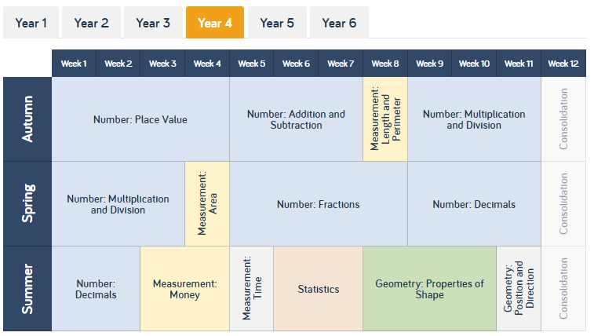
Maths – White Rose Home Learning
As well as the work that can be accessed through My Maths and TT Rockstars, you can see below the future topics we would be covering.
To find further support for the rest of our year curriculum, visit the White Rose website for the schemes of learning. (https://whiterosemaths.com/resources/schemes-of-learning/primary-sols/)
Here, you can find everything we should be covering across year 4 and the small steps within this. For example…

Slide 10
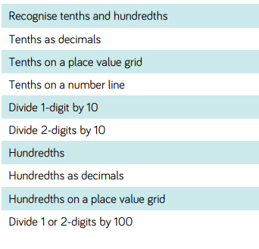
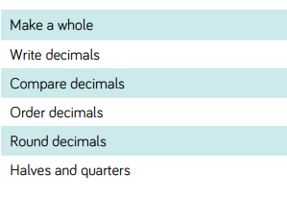
Maths – White Rose Home Learning
Our next topic within maths was going to be looking at Decimals so if I follow that link from the previous slide, it’ll open up a PDF that shows me all the information for that topic.
I’ve put a star next to the areas we are going to focus on this week. My tip would be to focus on the small steps and to try not too rush. Take your time!

Slide 11
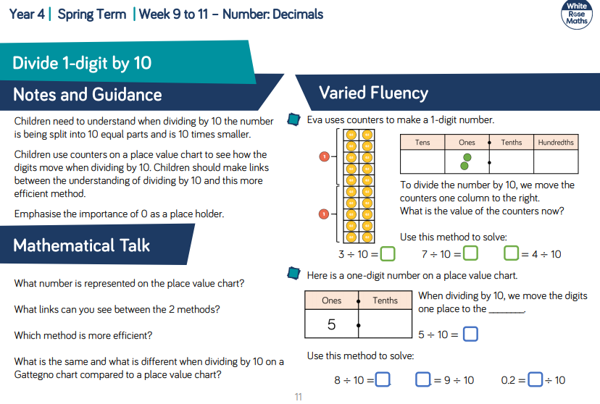
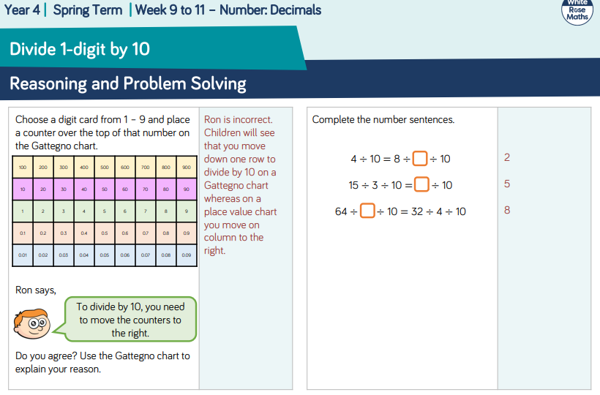
Maths – White Rose Home Learning
Each small step has notes and guidance for the topic and fluency suggestions. The second page provides reasoning and problem solving questions that the children can try to consolidate their learning.

Slide 12
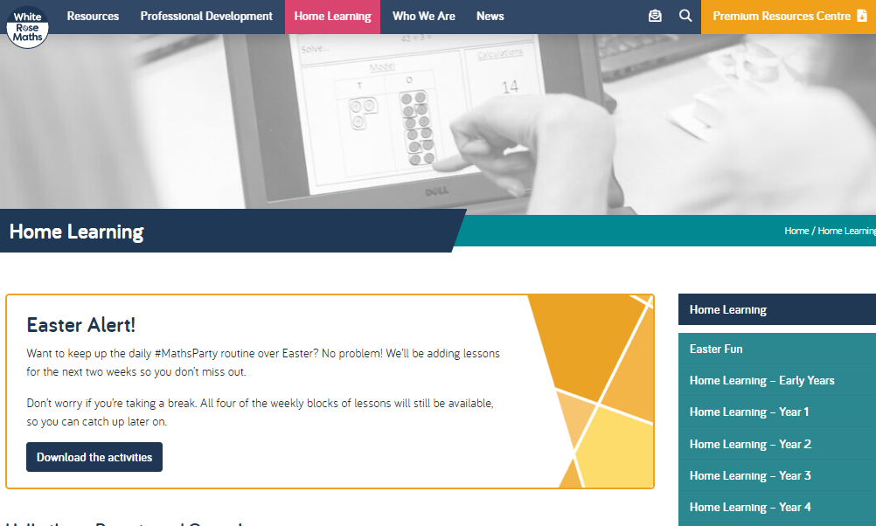
Maths – White Rose Home Learning
In school as we follow the White Rose scheme of learning. Their website has put together free lessons and resources that link to the learning taking place in school. Please visit: https://whiterosemaths.com/homelearning/

Slide 13
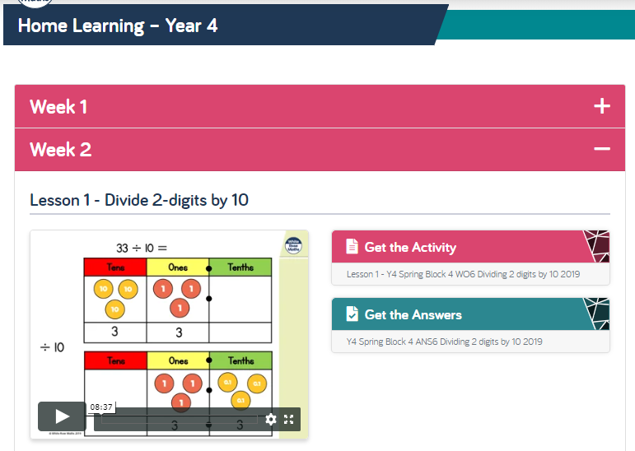
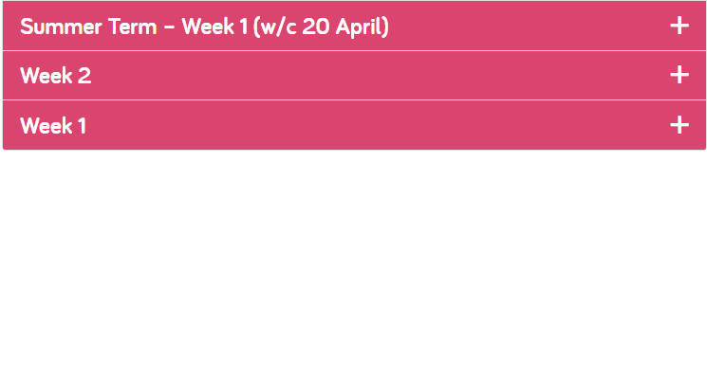
Maths – White Rose Home Learning
Complete Week 2, Lesson 4-5 and then move onto Summer Term-Week 1, Lessons 1-2 throughout the week. Each Lesson has linked a PowerPoint video to explain how to do that specific maths activity. It also contains an activity with the answers which you can complete and check after.

Slide 14



TT Rockstars
To access TT Rockstars please visit: https://play.ttrockstars.com/auth/school
Start typing in the school name or the post code (ME99NL)
Pupils type in their username and password, usually written in their reading record.
Pupils can practice all tables
I have specifically allocated different times tables for you to practise each week.

Slide 15

Accessing Twinkl
Many educational content providers are offering free access to their resources. Twinkl is a website that we use from time to time to resource our lessons to aid in teacher input and pupil activities.
We will be able to direct you towards activities and learning via this website based on lessons that may be missed due to absence. To access Twinkl please visit: www.twinkl.co.uk/offer
You will have to sign up and put in the offer code: UKTWINKLHELPS

Slide 16
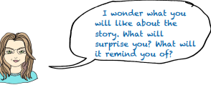
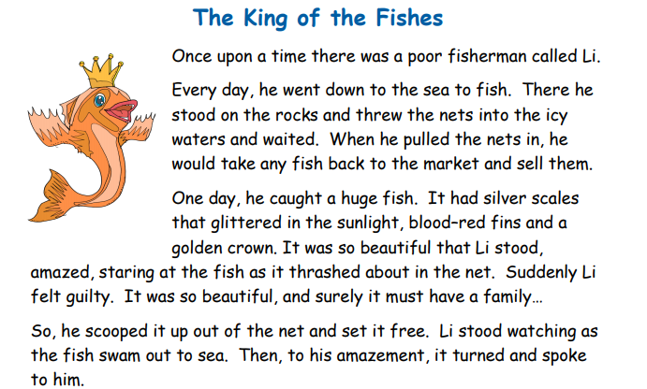
English
Task 1:
Read the question in the speech bubble and then read the story over the next three slides and then answer the questions.

Slide 17
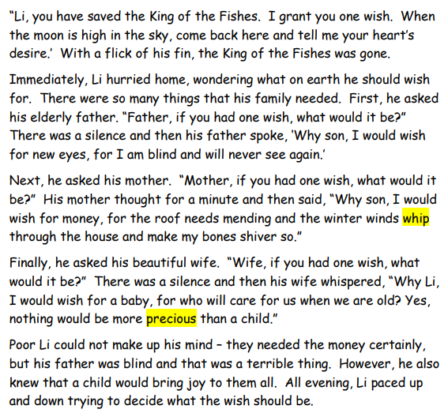

Slide 18
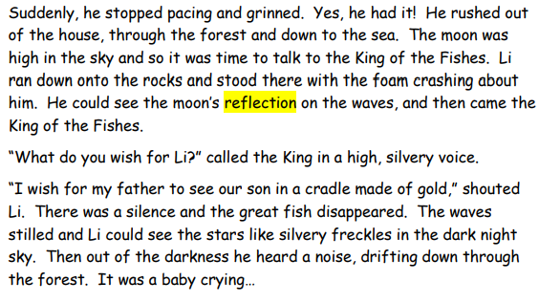

Slide 19
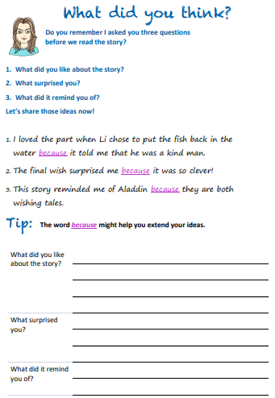

Slide 20
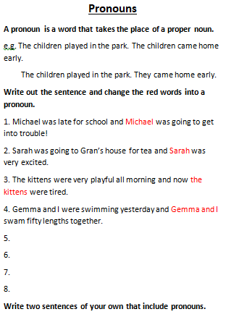
English Task 2

Slide 21
Spelling list…
You can practice and learn these spellings in whichever way suits you best (just like your homework, e.g. look, cover, write, check):
  enough
  Length
  strength
  potatoes
  separate
  suppose
  particular
  peculiar
  pressure
  grammar

Slide 22
Task 3: Applying the spellings and optional additional spelling tasks…
Choose one of the options from below to revise the spellings.
Write a definition for each of the words.
Write sentences including each of the words.
Write a small passage trying to include as many of the words as you can.
Create your own word search/crossword puzzle.
Dictation – can an adult in your house tell you a sentence with the word in and you have to write the sentence and check your spellings are correct?

Slide 23
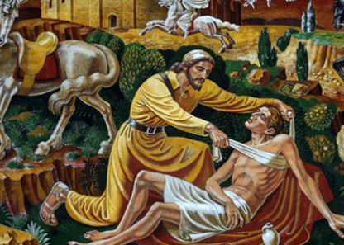
R.E
The Good Samaritan (Luke 10:25-37)
We are going to continue to focus on this passage from last week. The passage is highlighted above and if you do not have a Bible at home, you can use this link to search for the passage: https://www.biblegateway.com/
Following on from the questions from last week I would now like you to draw a picture of yourself in the centre of a piece of paper. Surround yourself with pictures of people who have been good Samaritans to you.
Can you note down how they have been good Samaritans?

Slide 24

P.E.
It is important to keep your children active. If it is safe to do so, ensure they have some time outside throughout the day. Please visit Joe Wicks YouTube channel (https://www.youtube.com/channel/UCAxW1XT0iEJo0TYlRfn6rYQ), which has lots of exercise videos for children. He will also be hosting a live P.E. lessons Monday to Friday at 9:00am.

Slide 25



Music
Collins are also providing home learning activities https://collins.co.uk/pages/support-learning-at-home.
You can access free Music Express songs and activities by clicking on the free children's song bank. Some of these the children will recognise from class music lessons with Mrs Julier .
Go to Collins Connect and click on the Teacher portal and enter:
Username: parents@harpercollins.co.uk
Password: Parents20!
Click Login.
Once you’ve logged into Collins Connect, select Music Express from the menu page. To access the Song Bank click the link on the welcome page.​
'Out of the Ark' music have created 'Out of the Ark at Home' via this website https://www.outoftheark.co.uk/ootam-at-home/​
There are 4 weeks on the website so far and when you click on e.g week 1, there is a lively fun song video for every single day. Definitely something you might enjoy and could work well as a brain break, when needed.

Slide 26

Classroom Secrets
The site classroom secrets https://classroomsecrets.co.uk/free-home-learning-packs/ has free class packs which provide some great additional ideas and resources you can use.

