Slide 1

We have missed you!

Slide 2

Schools were closed

Slide 3
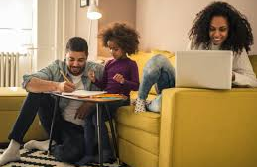
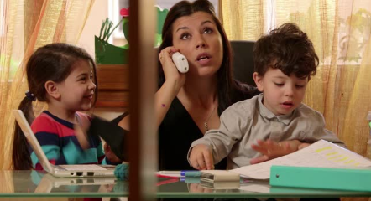
Why we stayed at home?
We stayed at home to stop the Covid germ spreading quickly.

Slide 4
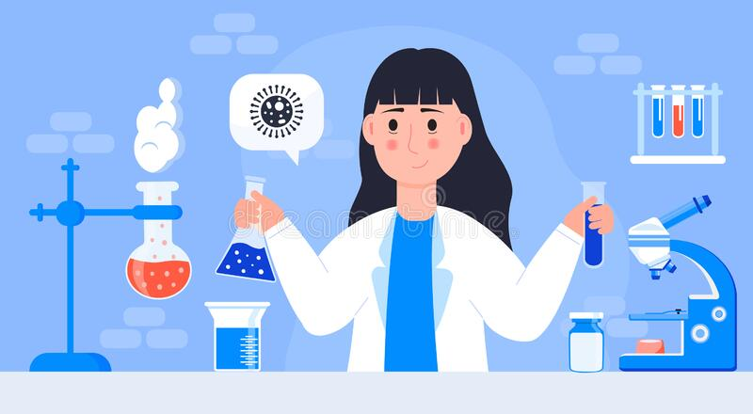

Scientists made special medicine to stop people catching Covid.
While we stayed at home…
Hooray!

Slide 5
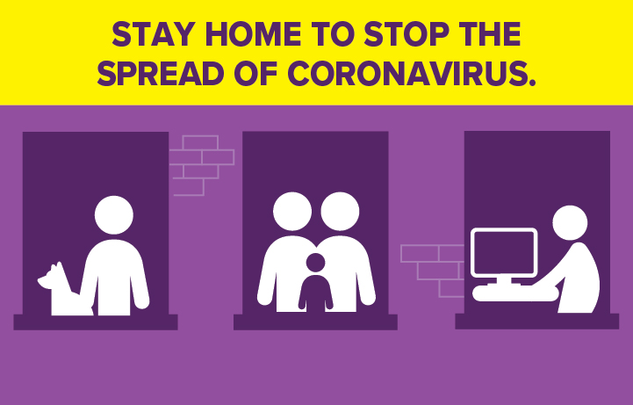
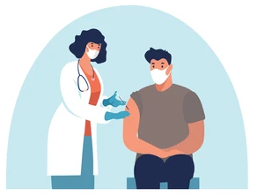
Doctors and Nurses have been giving special medicine (vaccinations) to stop people catching Covid.
While we stayed at home…

Slide 6

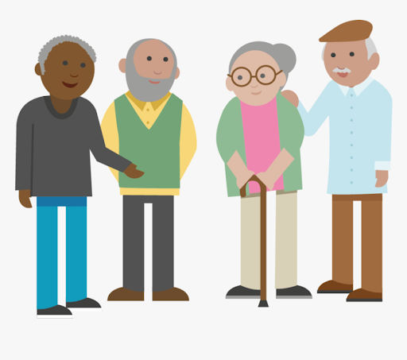
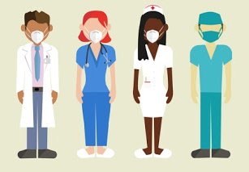
Many adults and people who get ill easily have had their special medicine (vaccination).
So schools are ready to open again.
This is ok.

Slide 7

We can now go…

Slide 8
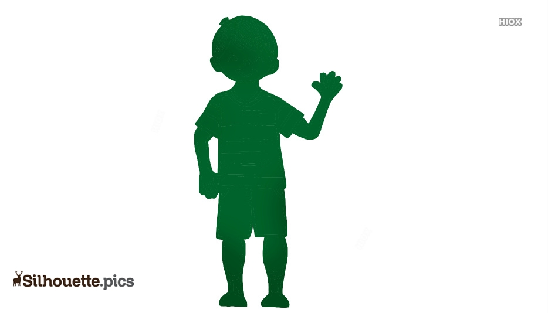

We can now see some of our friends at school.

Slide 9
What will be the same at school?
We will see friends
We can learn
We can have fun
We can feel excited
We will see teachers
We can feel happy

Slide 10
School might still be different. This is ok.
My timetable might be different. There will be a visual timetable on the wall each day.
I will still use my own pencil, ruler, rubber and everything else I need on my desk.
Sometimes I might have a different teacher.
Playtime and lunchtime will be with my class
My classroom might look different. I might sit at my own desk.
Some parents, teachers and children might wear masks.

Slide 11
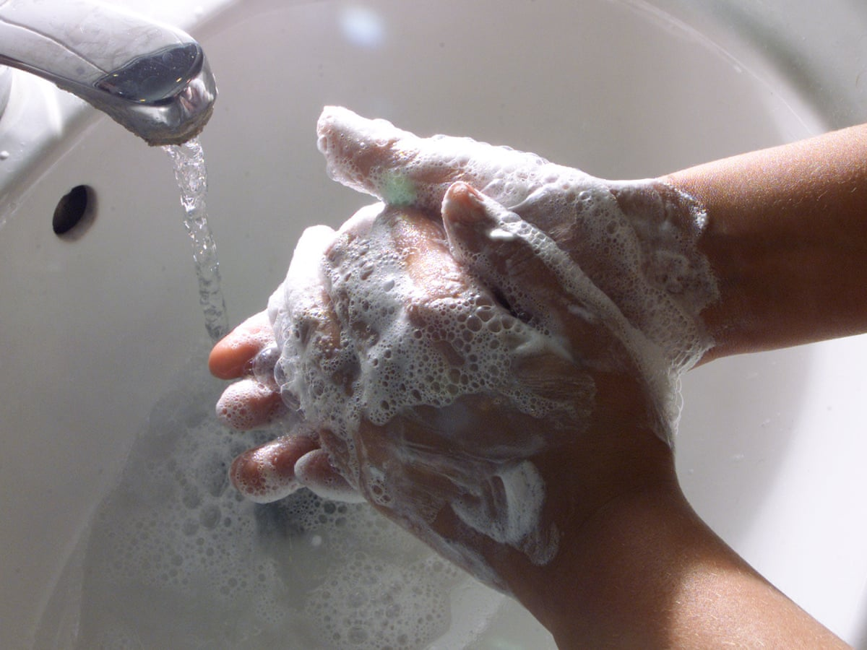
I will wash my hands more often.
This will help keep me safe.

Slide 12

My teachers will let me know when things are back to normal.
I can ask my teacher any questions I have.

Slide 13
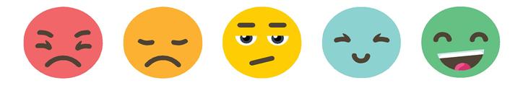
I might feel mixed emotions

Slide 14

I might feel anxious. This is ok.
If this happens I can talk to my family, teacher and TA.
This will help me feel less anxious.

Slide 15

I might feel excited. This is ok too.
I might be happy to see my friends.
I might be happy to see my teachers.
I might be happy to get back to school.
I might be happy to have more to do again.

Slide 16
How I am feeling…
What I can do to help me.
How you can help me.

Slide 17
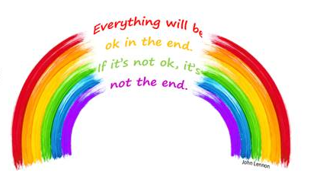

Things will get back to normal…

