Slide 1

Home Learning
Year 3 Term 6 Week 7

Slide 2
Message from the class teacher
Well Year Three, we made it! What a very strange school year we had. Although the last few months have been very different to what we had planned for you, we did fit in…
Monsters in the classroom, water cycles in a bag, making Sea Wigs, painting in the style of Monet, James and the Giant Peach, a trip to the Thames Barrier, building battery powered cars, learning the ‘Stone Age Boy’ story, painting with mud and berries… what else can you remember?
As this week is the last week of term (and we would usually be finishing off work and having some fun) I have given you some fun activities for your home learning this week. Enjoy!
Thank you for being a wonderful class this year. We will really miss you next year but will see you around the school in September.
Have a fab summer. Stay safe.

Slide 3

Reading
Hopefully you have access to books at home, but we have sent home extra books with your child.
Accelerated Reading
Home quizzing is not always recommended but in this case we have adjusted the settings to allow quizzing to happen at home.
If your child wants to read a book from home, please check that there is a quiz available for the book and that the book level (BL) is within or near to your child’s reading range. Also take note of the quiz number for future reference.
To check books please visit: https://www.arbookfind.co.uk/
Go to the next page for how to quiz.

Slide 4



AR quizzing at home.
To log into AR to take a quiz please visit: https://ukhosted27.renlearn.co.uk/2240835/
Your child should know what to do from here and should know their login details. If they are not aware, most details are written in their reading record.
Click on Accelerated reader.
Type in the name the book or the quiz number.
We advise students complete quizzes unaided. If parents/carers wish to support their child, they can do so in the following ways:
Discuss the book with your child as the book is being read
Ask your child to read the question out loud
Re-word questions for your child, if necessary
Ask your child which answers are not correct

Slide 5

Visit http://readon.myon.co.uk

Slide 6

Choose an area that interests you or use the search option.

Slide 7


Using My Maths
Children should know their way round My Maths but here are some reminders on how access the lessons. Visit: www.mymaths.co.uk
bapchild
divide162

Slide 8

Using My Maths
Access any lesson based on what your child is learning in class or search the topic in the search bar.
Use the login portal to access specific homework and lessons that your teacher has set.

Slide 9

Maths – White Rose Home Learning
In school we follow the White Rose scheme of learning. Their website has put together free lessons and resources that link to the learning taking place in school. Please visit: https://whiterosemaths.com/homelearning/

Slide 10



TT Rockstars
To access TT Rockstars please visit: https://play.ttrockstars.com/auth/school
Start typing in the school name or the post code (ME99NL)
Pupils type in their username and password, usually written in their reading record.
Pupils can practice all tables but Year 2 should be practicing 2, 5, and 10’s
Year 3: 2,5,10,3,4,8’s
Year 4,5,6: all tables

Slide 11

Accessing Twinkl
Many educational content providers are offering free access to their resources. Twinkl is a website that we use from time to time to resource our lessons to aid in teacher input and pupil activities.
We will be able to direct you towards activities and learning via this website based on lessons that may be missed due to absence. To access Twinkl please visit: www.twinkl.co.uk/offer
You will have to sign up and put in the offer code: UKTWINKLHELPS

Slide 12

English Learning Task 1
Use this to help you crack the code for some summer words.
Look at the words below. Find the letters on the bottom row and swap them for the ones above them to figure out the real words. (/ means a space between words).
r v h h p l
a e p / e l p z h
r p z r a f p
4. x z e z b a c i
5. r v i / e l p z h
6. r b z n / r z u p
Challenge: Can you use the words to crate your own words or message in code? Ask a sibling or parent to work out your message.

Slide 13










English Task 2 - Emoji Book Quiz
Look at the emoji clues and work out the book title.
Challenge: Can you write or find out who the authors are?
1.
2.
3.
4.
5.
6.
7.
8.
9.
10.

Slide 14
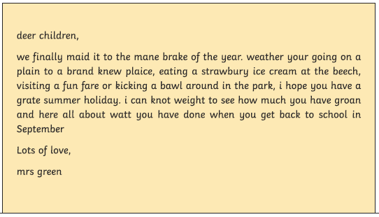
English Learning Task 3
You can certainly tell that it’s the end of the year! I have completely forgotten how to write. Can you help me by correcting this letter? Watch out for those tricky homophones (words that sound the same but with different meanings or spellings e.g. meet and meat).

Slide 15
Maths Learning

Slide 16
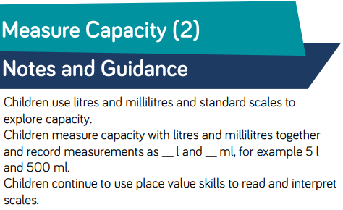
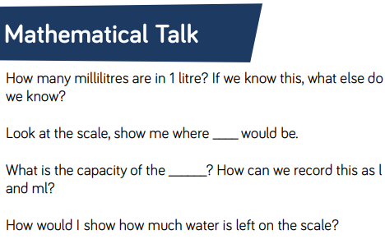
Lesson 1 : Capacity Part 2

Slide 17
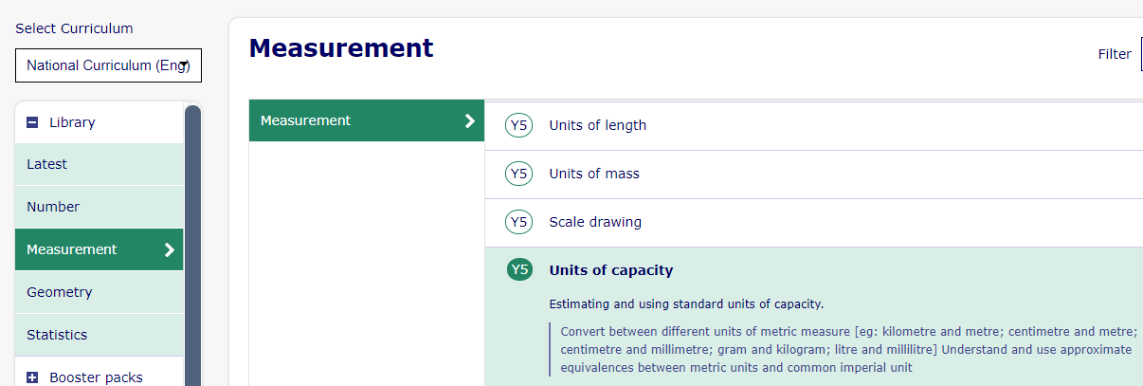
Lesson 1 : Capacity Part 2
Complete slides 1-4 on Units of Capacity.
https://app.mymaths.co.uk/295-lesson/units-of-capacity

Slide 18
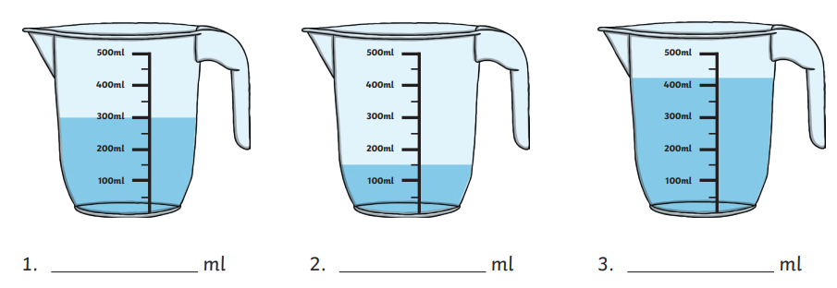
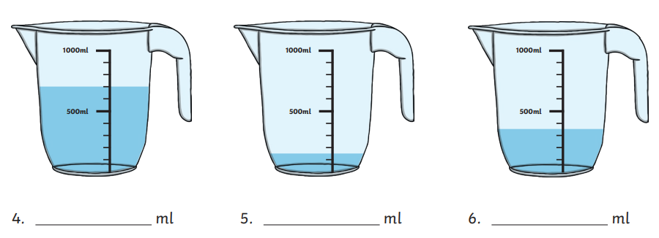
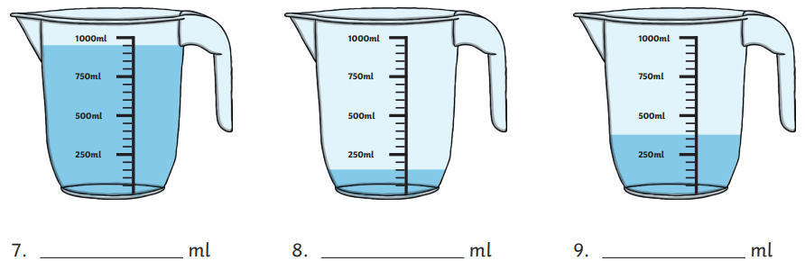
Lesson 1 : Capacity Part 2

Slide 19
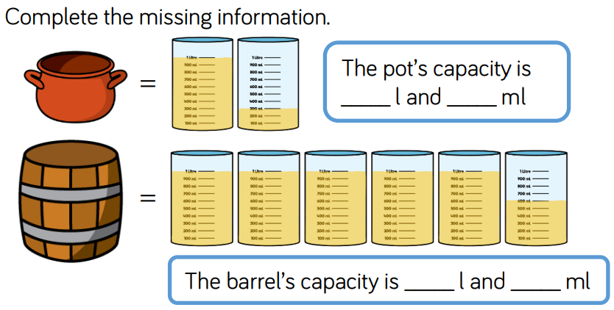
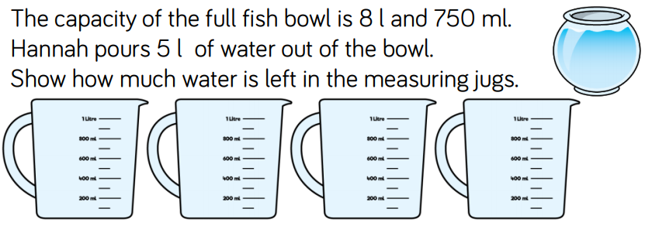
Lesson 1 : Capacity Part 2

Slide 20
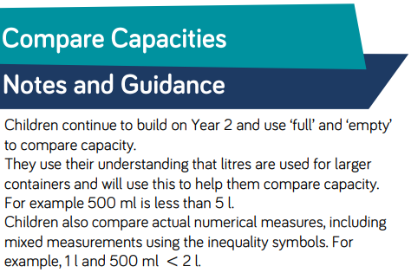
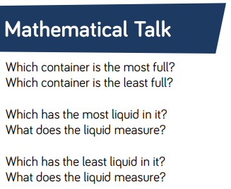
Lesson 2: Comparing Capacities

Slide 21
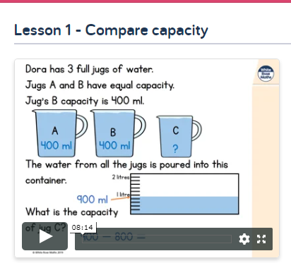
Lesson 2: Comparing Capacities
Lets go back to the White Rose Home learning pages and watch this lesson video.
https://whiterosemaths.com/homelearning/year-3/

Slide 22





Lesson 2: Comparing Capacities
Ordering by Capacity
Sort these containers in order of capacity from smallest to greatest.
2 l
1
2
1 litre
500ml
0
330ml
7l
5ml

Slide 23

Lesson 2: Comparing Capacities
Ordering by Capacity
Sort these containers in order of capacity from greatest to smallest.
First, convert each capacity to ml.
7l
1 litre
500ml
330ml
5ml
330ml
7000ml
1500ml
5ml
2500ml
Next, order the measurements.
7000ml
2500ml
1500ml
330ml
5ml
Finally, match the objects to the newly ordered measurements.
7l
1 litre
500ml
330ml
5ml

Slide 24
Lesson 2: Comparing Capacities
Comparing Capacity
Use <, > or = to complete these statements.
320ml |  | 320l
1000ml |  | 1l
3¼l |  | 3200ml
2l 30ml |  | 2300ml
2500ml |  | 2½l

Slide 25
Lesson 2: Comparing Capacities
Comparing Capacity
Use <, > or = to complete these statements.
<
Millilitres are less than litres.
320ml |  | 320l
1000ml |  | 1l
3¼l |  | 3200ml
2l 30ml |  | 2300ml
2500ml |  | 2½l
=
1 litre is 1000 millilitres.
>
3¼l is 3 litres 250ml or 3250ml.
<
2l 30 ml is 2030ml.
=
½l is 500ml so 2½l is 2500ml.

Slide 26
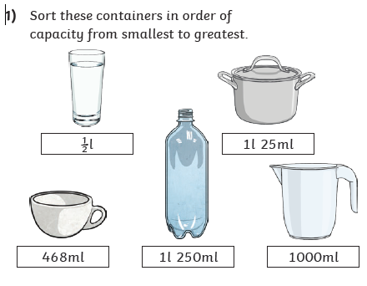
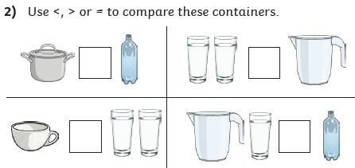
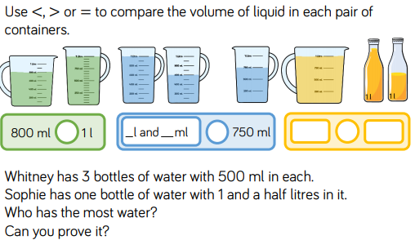
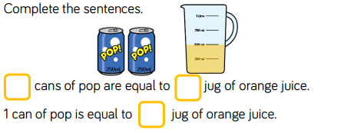
Lesson 2: Comparing Capacities
4)
3)
5)

Slide 27
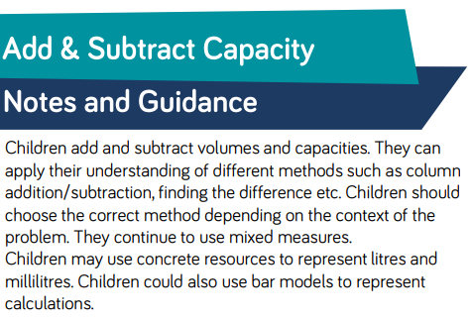
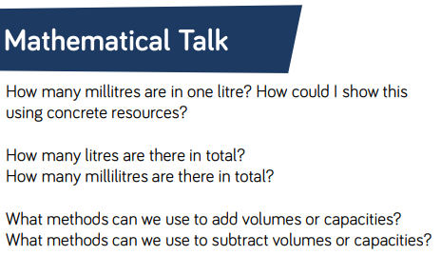
Lesson 3: Add and Subtract Capacity

Slide 28
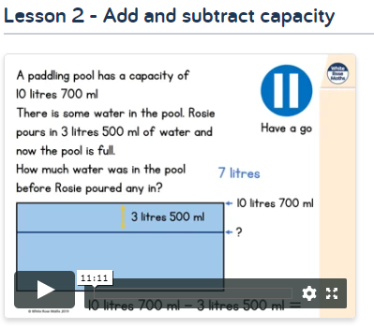
Lesson 3: Add and Subtract Capacity
Lets go back to the White Rose Home learning pages and watch this lesson video.
https://whiterosemaths.com/homelearning/year-3/

Slide 29

Lesson 3: Add and Subtract Capacity
What’s the Total?
Jenna is mixing fruit juice. What is the total volume of liquid?
1tbsp = 15ml
1200ml
350ml
75ml
+ 30ml
1655ml
(1l is 1000ml)
1l 200ml fizzy water
350ml orange juice
75ml lime juice
2 tbsp. lemon juice
(2 × 15 is 30ml)
The total volume is 1655ml.
This is 1 litre 655ml.

Slide 30
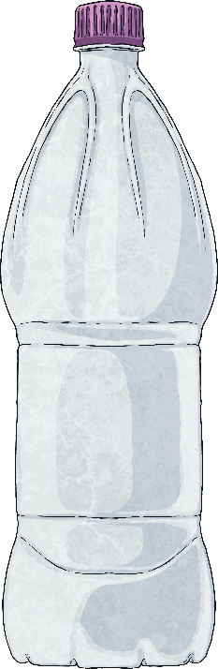
Lesson 3: Add and Subtract Capacity
What’s Left?
Felix has a bottle with a capacity of 2 litres to store the juice Jenna has made. Jenna made 1l 655ml of her fruit juice.
How much more liquid could be used to fill the bottle?
345ml
2000ml
- 1655ml
345ml
(2l is 2000ml)
(1l 655ml is 1655ml)
345ml more liquid could be added.
1l 655ml
2 litres

Slide 31

Lesson 3: Add and Subtract Capacity
Is There Too Much?
A jug has a capacity of 1l 250ml. Carter says that all of the recipes can be made in a jug of this size. Do you agree?
1tsp = 5ml
1tbsp = 15ml
Are there any recipes which total exactly 1l 250ml?
600ml fizzy water
½ litre orange juice
100ml raspberry
juice
3tbsp pomegranate
juice
1tsp strawberry
syrup
½ litre = 500ml
3tbsp = 3 × 15 = 45ml
1tsp = 5ml
600ml + 500ml + 100ml + 45ml + 5ml = 1250ml
1250ml = 1 litre 250 ml
700ml cola
¼ litre coconut water
150ml lime juice
800ml lemonade
½ litre apple juice
25ml peppermint oil
½ litre = 500ml
800ml + 500ml + 25ml = 1325ml
1325ml = 1 litre 325ml
¼ litre = 250ml
700ml + 250ml + 150ml = 1100ml
1100ml = 1 litre 100ml
This will fit in the jug.
This is too
much for the jug to hold.
This is the
exact capacity
of the jug.

Slide 32



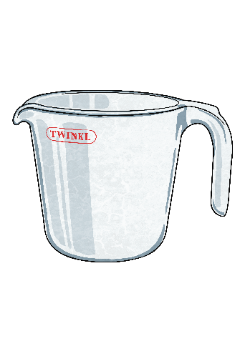

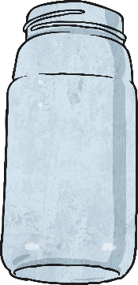
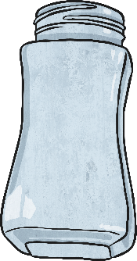
Lesson 3: Add and Subtract Capacity
Work It Out!
Choose four different ingredients to make a juice.
What is the smallest volume you can make?
What is the largest volume?
To make the smallest volume, choose the four ingredients with the smallest volume.
pomegranate juice (300ml) + peppermint oil (20ml) +
cherry juice (150ml) +
strawberry syrup (60ml) +
= 530ml
water | pomegranate juice | orange juice | peppermint oil | cherry juice | apple juice | strawberry syrup
1l
To make the largest volume, choose the four ingredients with the largest volume.
water (1250ml) +
pomegranate juice (300ml) orange juice (1000ml) + apple juice (500ml) = 3050ml
1l
1l
1l 250ml
1l 250ml
20ml
20ml
500ml
500ml
60ml
½ litre
60ml
0ml
½ litre
1l
0ml
1l
0
0
0
The smallest volume is 530ml.
water
orange juice
The largest volume is
3 litres 50ml.
pomegranate juice
cherry juice
apple juice
strawberry
syrup
pomegranate juice
peppermint oil

Slide 33
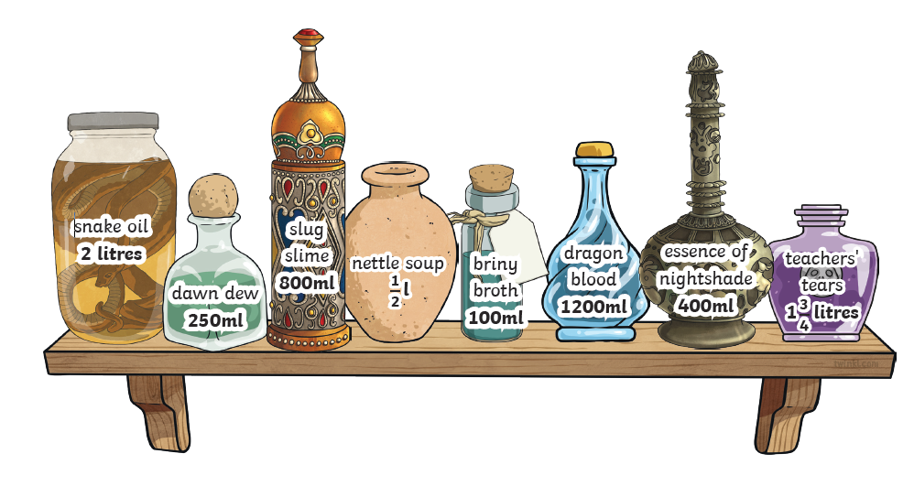
Lesson 3: Add and Subtract Capacity
Use the potions on this self to complete the questions on the next slide.

Slide 34
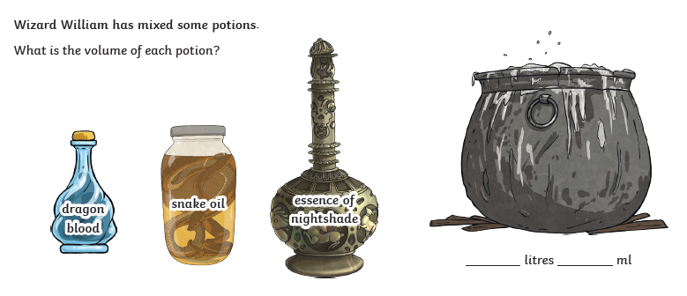
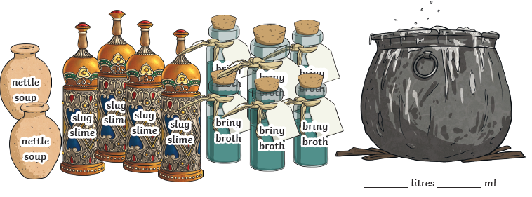
Lesson 3: Add and Subtract Capacity

Slide 35
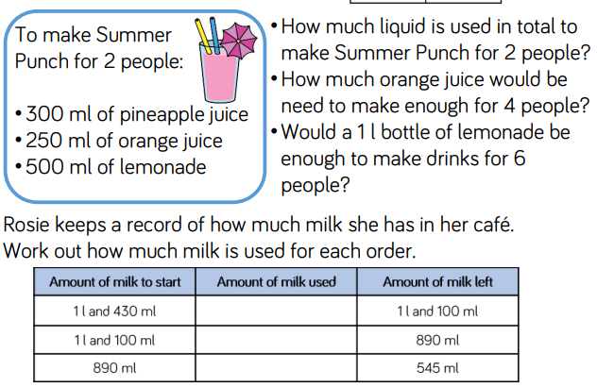
Lesson 3: Add and Subtract Capacity

Slide 36

Oh the Places You’ll Go!
https://www.youtube.com/watch?v=fmOCyP4VyP4
Oh the Places You’ll Go is one of my favourite books by Dr. Seuss. I want you to think about the following questions about yourself to tell Miss Solomon for next year:
What are you good at? (Not just school subjects).
How would your best friend describe you in 3 words?
What would you like to be better at?
What do you find difficult or scary?
Who do you want to become?
Create a poster or fact file about yourself to give to Miss Solomon in September. Create it to represent you as a whole person. Use your imagination.

Slide 37

P.E.
It is important to keep your children active. If it is safe to do so, ensure they have some time outside throughout the day. Please visit Joe Wicks YouTube channel (https://www.youtube.com/channel/UCAxW1XT0iEJo0TYlRfn6rYQ), which has lots of exercise videos for children. He will also be hosting a live P.E. lessons Monday to Friday at 9:00am.

Slide 38

Classroom Secrets
The site classroom secrets https://classroomsecrets.co.uk/free-home-learning-packs/ has free class packs which provide some great additional ideas and resources you can use.

