Slide 1

Home Learning
Year 3 Term 6 Week 6

Slide 2
Message from the class teacher
Hi Year Three,
Here we are again; two more weeks to go until the end of the school year. It was lovely to see some of you in school last week and it has been great to hear some of your voices over the phone. It’s been lovely to hear what you’ve been up to during this very unusual time.
This is the last week of your ‘jungle adventure’ English task, and this week you have got a practical task for Science. Keep up with the reading an quizzing on AR; I will be checking who has been quizzing and will be sending out some Marvellous Me badges later in the week.
Stay safe and thank you for your continued support.

Slide 3

Reading
Hopefully you have access to books at home, but we have sent home extra books with your child.
Accelerated Reading
Home quizzing is not always recommended but in this case we have adjusted the settings to allow quizzing to happen at home.
If your child wants to read a book from home, please check that there is a quiz available for the book and that the book level (BL) is within or near to your child’s reading range. Also take note of the quiz number for future reference.
To check books please visit: https://www.arbookfind.co.uk/
Go to the next page for how to quiz.

Slide 4



AR quizzing at home.
To log into AR to take a quiz please visit: https://ukhosted27.renlearn.co.uk/2240835/
Your child should know what to do from here and should know their login details. If they are not aware, most details are written in their reading record.
Click on Accelerated reader.
Type in the name the book or the quiz number.
We advise students complete quizzes unaided. If parents/carers wish to support their child, they can do so in the following ways:
Discuss the book with your child as the book is being read
Ask your child to read the question out loud
Re-word questions for your child, if necessary
Ask your child which answers are not correct

Slide 5

Visit http://readon.myon.co.uk

Slide 6

Choose an area that interests you or use the search option.

Slide 7


Using My Maths
Children should know their way round My Maths but here are some reminders on how access the lessons. Visit: www.mymaths.co.uk
bapchild
divide162

Slide 8

Using My Maths
Access any lesson based on what your child is learning in class or search the topic in the search bar.
Use the login portal to access specific homework and lessons that your teacher has set.

Slide 9

Maths – White Rose Home Learning
In school we follow the White Rose scheme of learning. Their website has put together free lessons and resources that link to the learning taking place in school. Please visit: https://whiterosemaths.com/homelearning/

Slide 10



TT Rockstars
To access TT Rockstars please visit: https://play.ttrockstars.com/auth/school
Start typing in the school name or the post code (ME99NL)
Pupils type in their username and password, usually written in their reading record.
Pupils can practice all tables but Year 2 should be practicing 2, 5, and 10’s
Year 3: 2,5,10,3,4,8’s
Year 4,5,6: all tables

Slide 11

Accessing Twinkl
Many educational content providers are offering free access to their resources. Twinkl is a website that we use from time to time to resource our lessons to aid in teacher input and pupil activities.
We will be able to direct you towards activities and learning via this website based on lessons that may be missed due to absence. To access Twinkl please visit: www.twinkl.co.uk/offer
You will have to sign up and put in the offer code: UKTWINKLHELPS

Slide 12
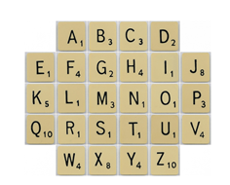
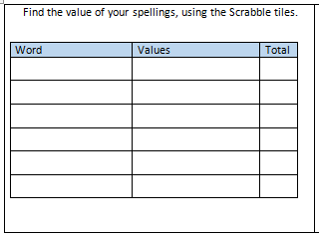
English Learning
English Learning
Task 1: spelling activity – choose 6 words from the year 3 / 4 word list and work out which word is worth the most in scrabble letters.
Example: fruit
F = 4 R = 1 U = 1 I = 1 T = 1
4 + 1 + 1 + 1 + 1 = 8

Slide 13
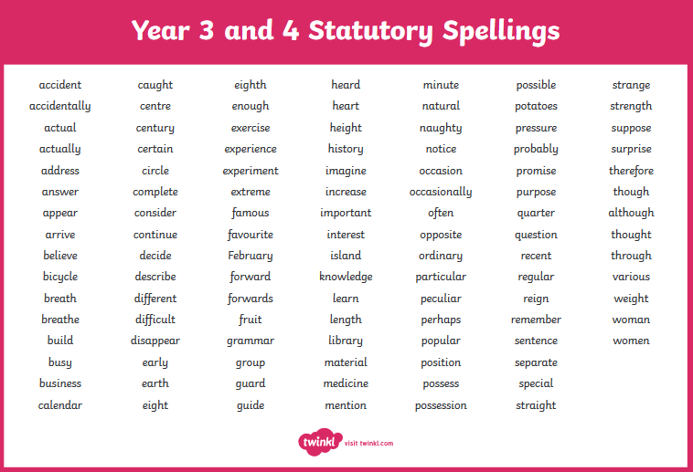

Slide 14
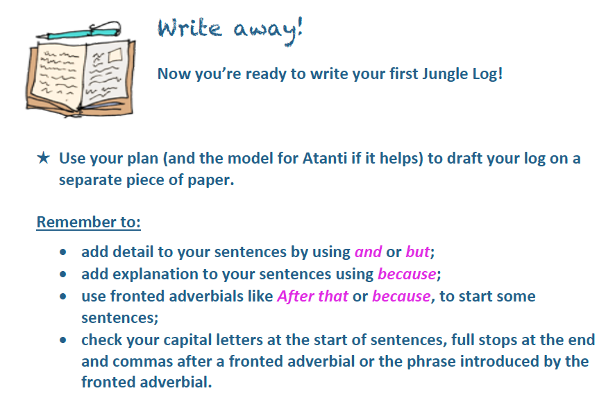
Task 2: write your Jungle Log
Use all the work you have done this term to help you write an amazing jungle log. Imagine you have walked through the magic door to the jungle you designed.
What did you see? Hear? Touch? How did you feel? Who did you meet?
Use past tense verbs – trudged, swam, climbed, lugged etc. Use exciting adjectives like dense, mesmerising etc.
Remember this is your first draft so keep reading through it and change bits if you think it needs improving.

Slide 15
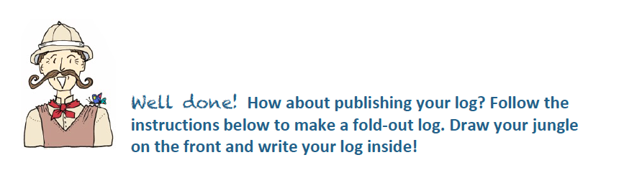
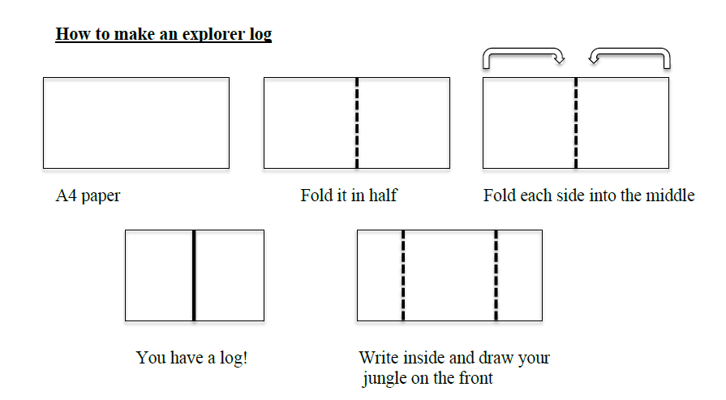
Task 3: publish your jungle log in your best handwriting.

Slide 16
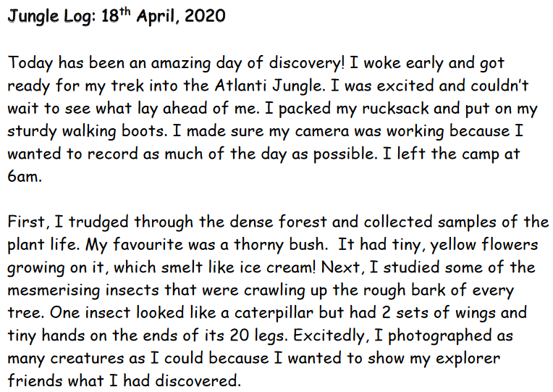

Slide 17
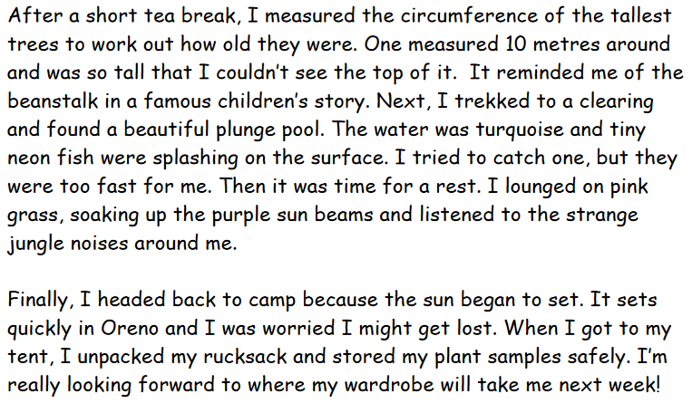

Slide 18
Maths Learning

Slide 19
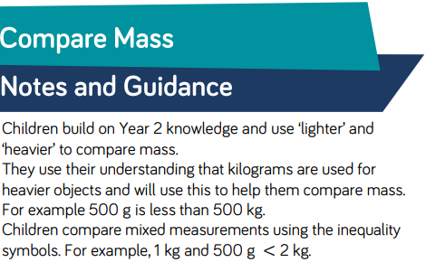
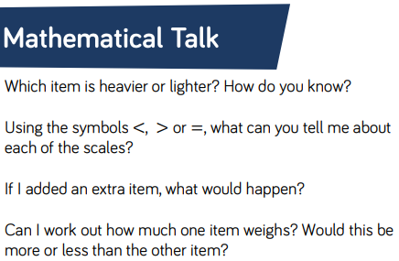
Lesson 1 : Comparing Mass

Slide 20
Lesson 1 : Comparing Mass
Converting Kilograms
and Grams
?
How do we convert a measurement in kilograms to grams?
We multiply the amount by 1000.
Match the kilogram measurements to their equivalent in grams.
1.5kg
2.9kg
3.55kg
4.65kg
1.765kg
2.455kg
2900g
1765g
3550g
1500g
2455g
4650g
Answers

Slide 21
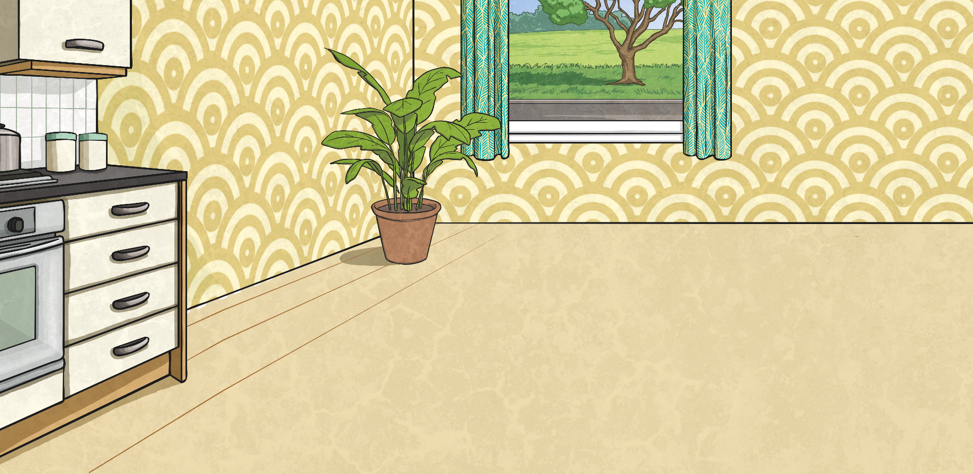
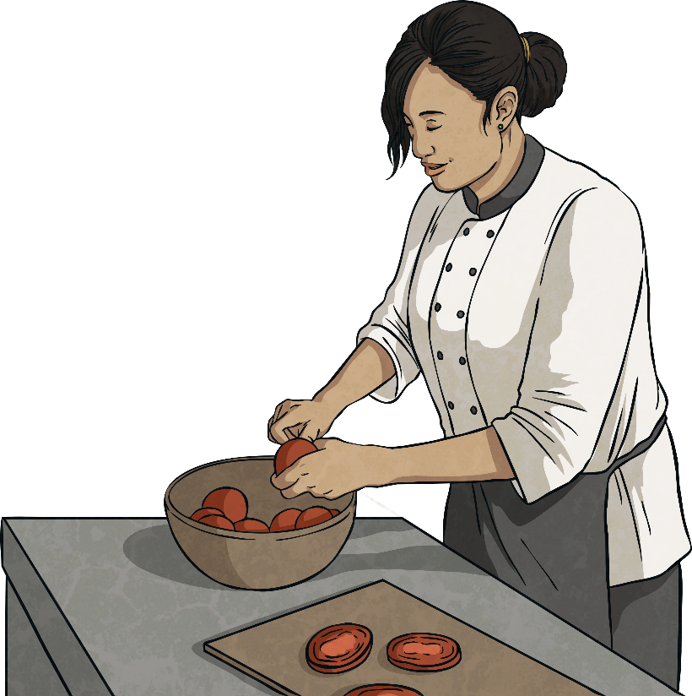
Lesson 1 : Comparing Mass
Converting Kilograms
and Grams
Complete the table by converting the mass measurements.
Kilograms | = | Grams
2.7kg | =
 | = | 4950g
1.875kg | =
 | = | 2750g
3.1kg | =
 | = | 4235g
2700g
4.95kg
1875g
2.75kg
3100g
4.235kg

Slide 22
Lesson 1 : Comparing Mass
Comparing Mass
Use <, > or = to complete these statements.
250g
250kg
1000g
1kg
2½kg
2400g
¾kg
600g
1kg 50g
1050g

Slide 23
Lesson 1 : Comparing Mass
Comparing Mass
Use <, > or = to complete these statements.
< means ‘is less than’ or ‘is lighter than’.
> means ‘is greater than’ or ‘is heavier than’.
= means ‘is equal to’ or ‘is the same mass as’.
250g
<
250kg
Grams are lighter than kilograms.
1000g
=
1kg
1kg is the same as 1000g.
2½kg
>
2400g
2½kg is 2kg and 500g or 2500g.
Therefore, it is heavier than 2400g.
¾kg
>
600g
¾ kg is 750g, which is heavier than 600g.
1kg 50g
=
1050g
1kg 50g is 1000g + 50g, which is the same as 1050g.

Slide 24




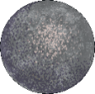
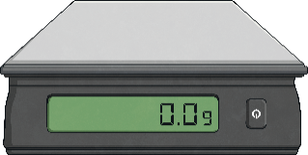
Lesson 1 : Comparing Mass
Ordering by Mass
Sort these objects in order of mass from the lightest to heaviest.
625g
7kg 100g
58g
½kg
7¼kg

Slide 25





Lesson 1 : Comparing Mass
Ordering by Mass
First, convert each mass to grams.
625g
7kg 100g
58g
7100g
½kg
7¼kg
500g
7250g
58g
500g
625g
7100g
7250g
Next, order those measurements from lightest to heaviest.
58g
625g
500g
7100g
7250g
Finally, match the objects to the newly ordered measurements.

Slide 26
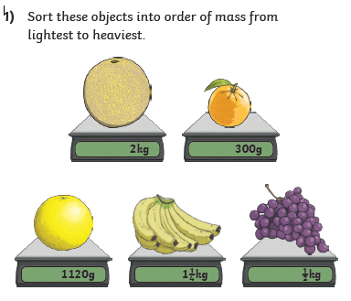
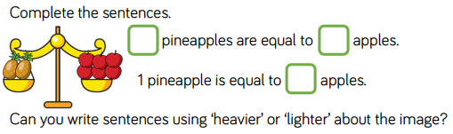
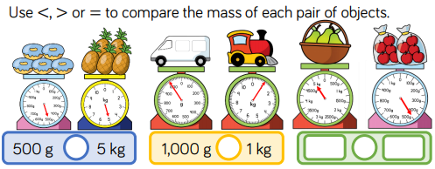
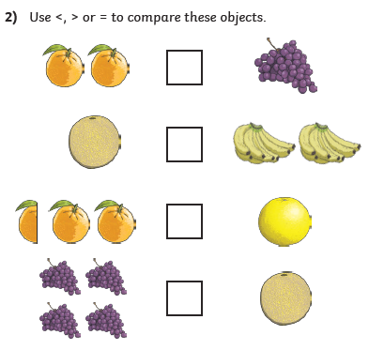
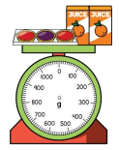
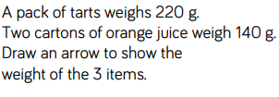
Lesson 1 : Comparing Mass
3)
4)
5)

Slide 27
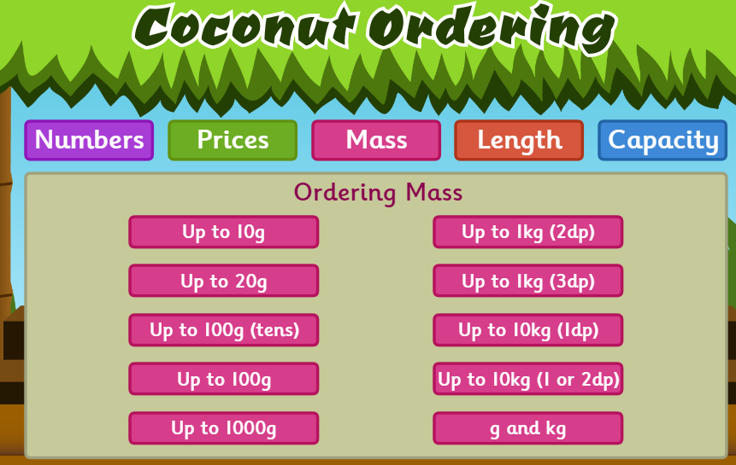
Lesson 1 : Comparing Mass
Play this game. https://www.topmarks.co.uk/ordering-and-sequencing/coconut-ordering Select mass and then choose the level.

Slide 28
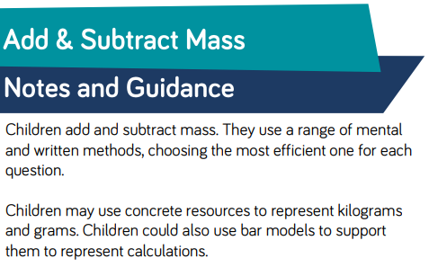
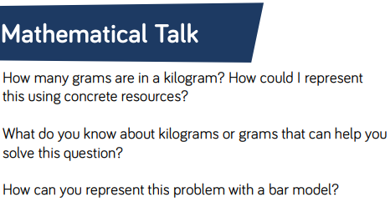
Lesson 2 : Add and Subtract Mass

Slide 29


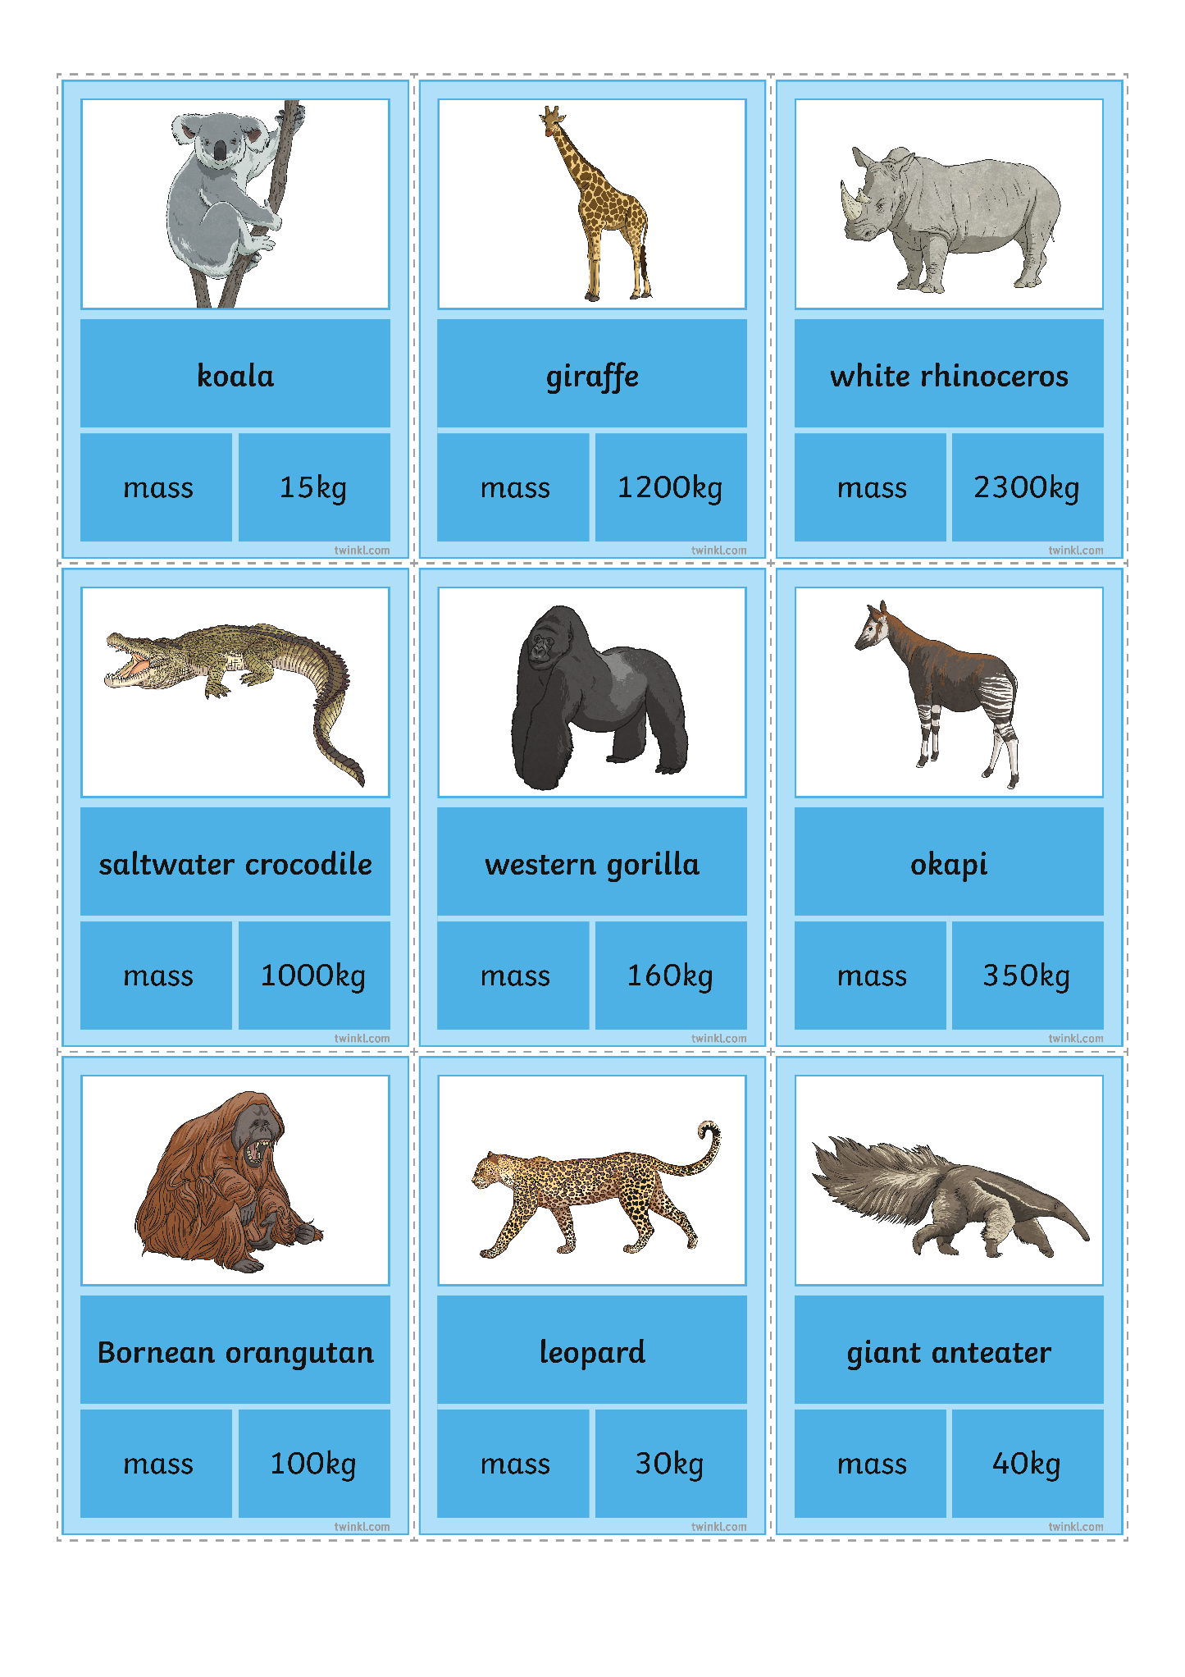
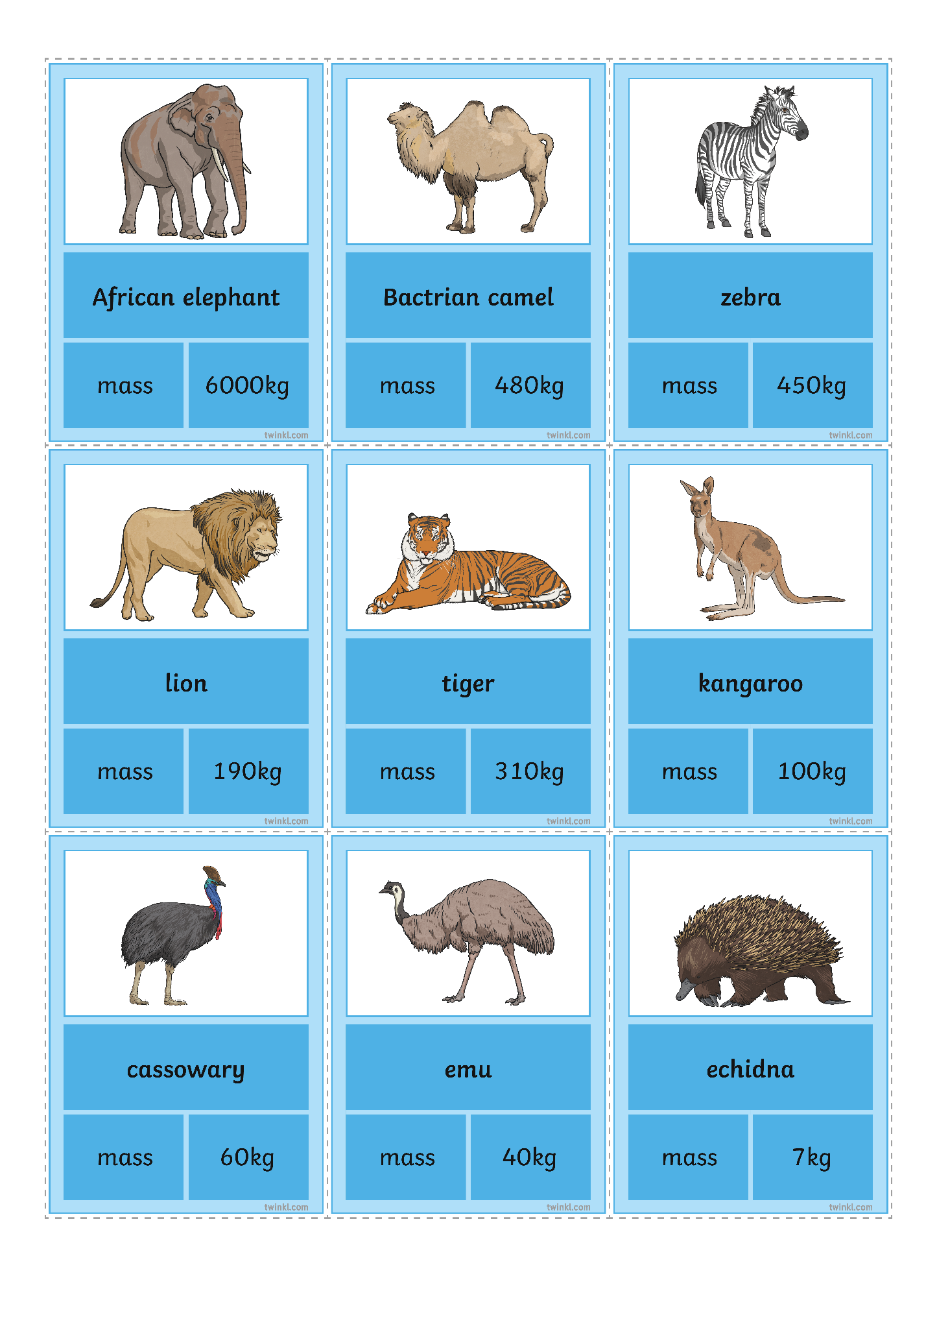
Lesson 2 : Add and Subtract Mass
What Is their Combined Mass?
Zookeeper Zina is calculating the combined mass of certain animals.
Can you help her with the calculations?
200kg
160kg + 40kg =

Slide 30
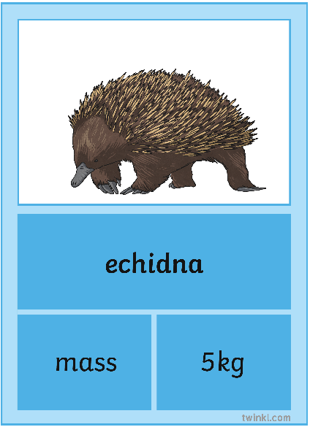
Lesson 2 : Add and Subtract Mass
What Is their Combined Mass?
Zookeeper Zina is calculating the combined mass of certain animals.
Can you help her with the calculations?
20kg
15kg + 5kg =

Slide 31
Lesson 2 : Add and Subtract Mass
What Is their Combined Mass?
Zookeeper Zina is calculating the combined mass of certain animals.
Can you help her with the calculations?
350kg
40kg + 310kg =

Slide 32
Lesson 2 : Add and Subtract Mass
What Is their Combined Mass?
Zookeeper Zina is calculating the combined mass of certain animals.
Can you help her with the calculations?
440kg
60kg + 30kg + 350kg =

Slide 33
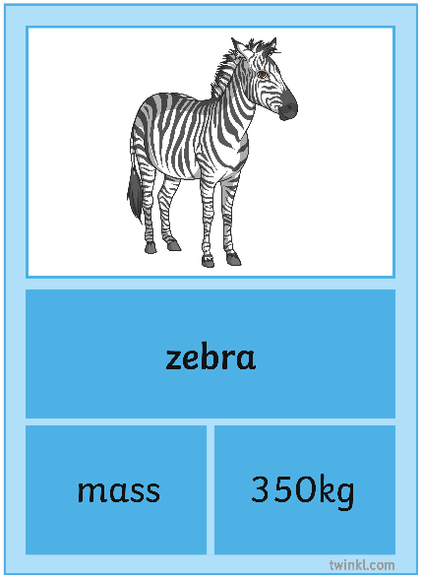
Lesson 2 : Add and Subtract Mass
What Is their Combined Mass?
Can you help Zina work out the difference in mass
between the animals?
250kg
350kg - 100kg =

Slide 34
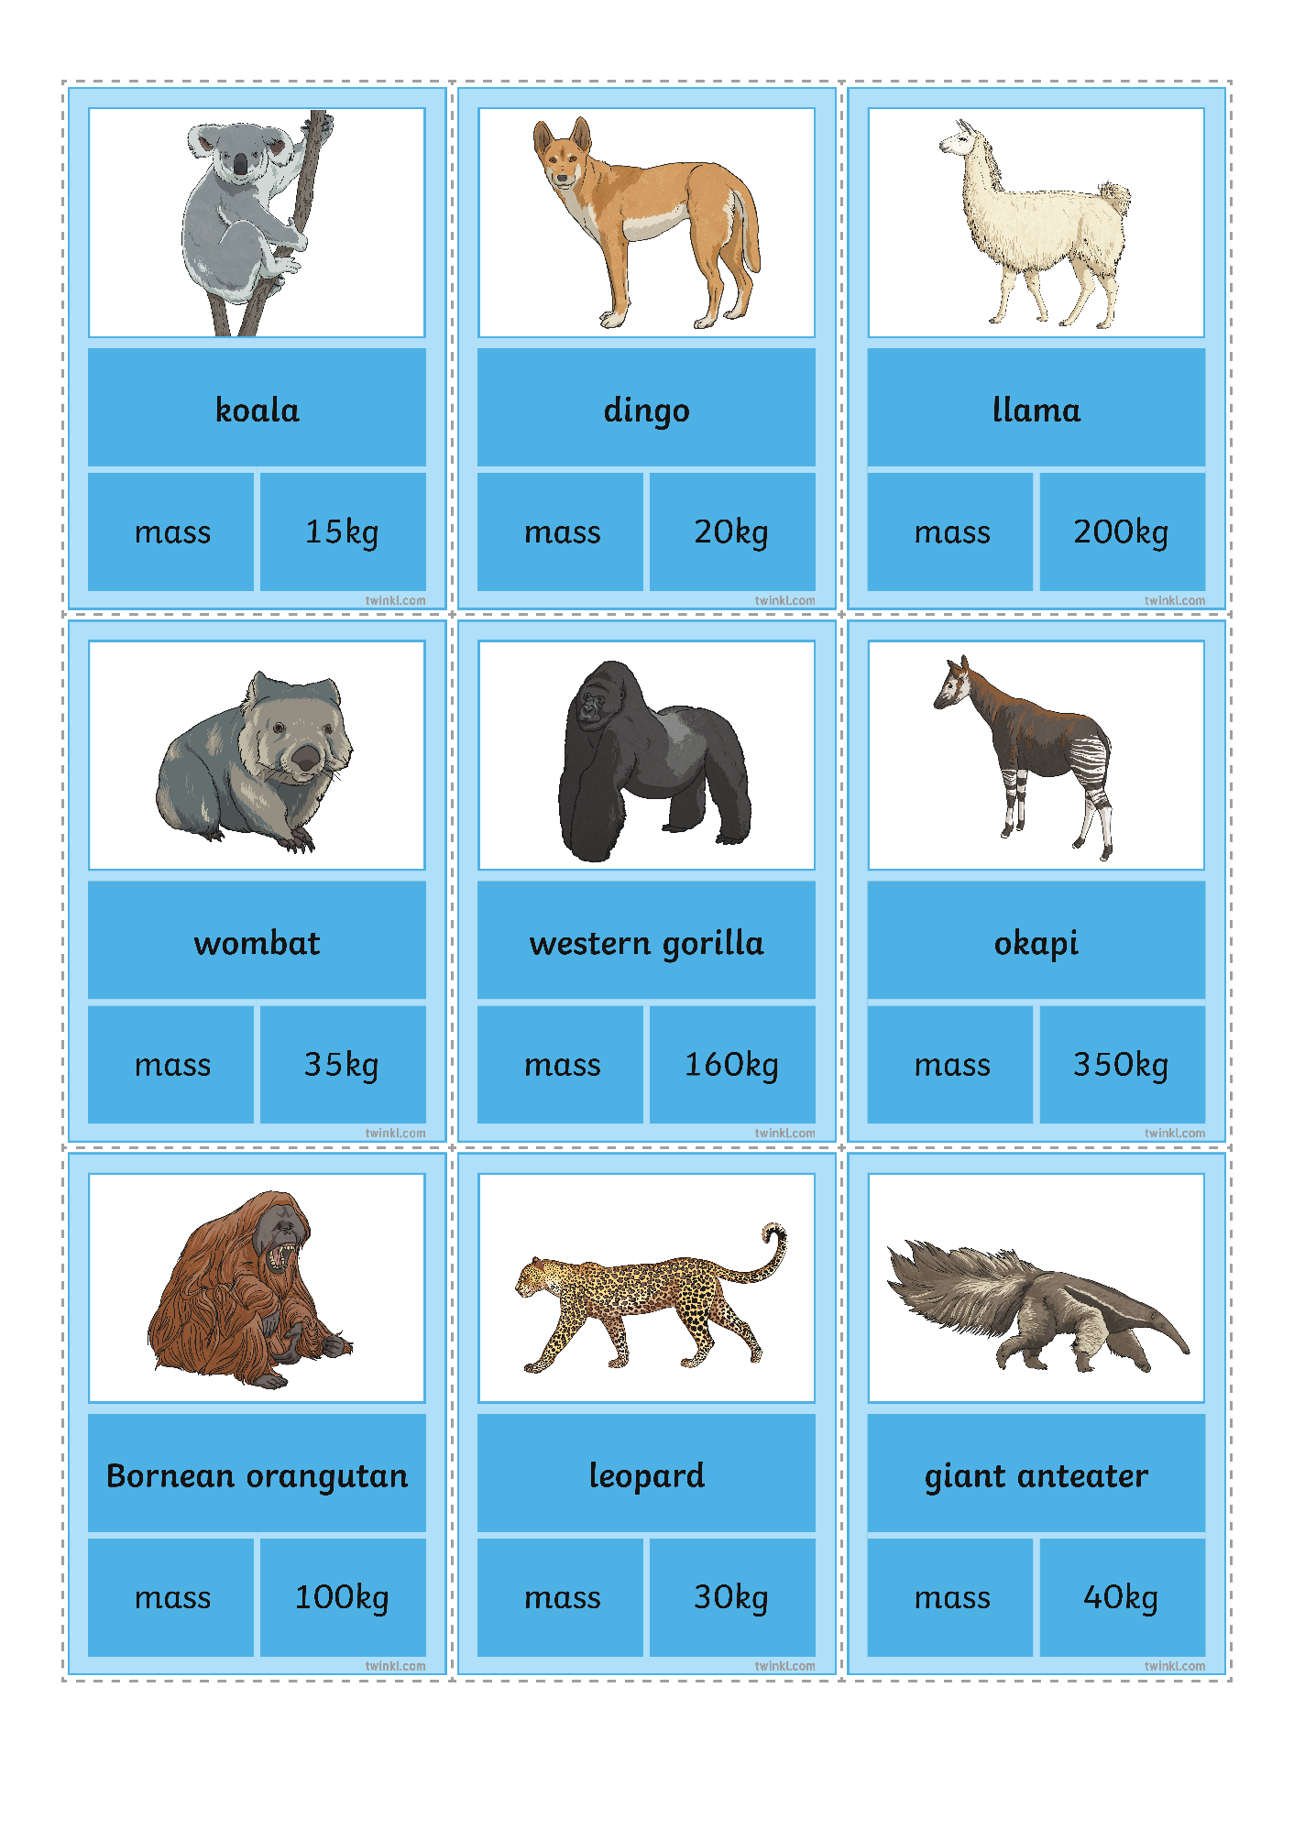
Lesson 2 : Add and Subtract Mass
What Is their Combined Mass?
Can you help Zina work out the difference in mass
between the animals?
165kg
200kg - 35kg =

Slide 35
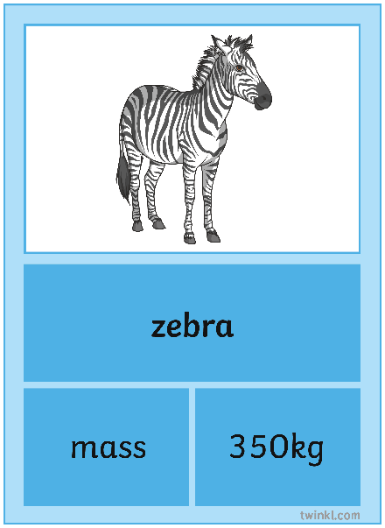
Lesson 2 : Add and Subtract Mass
What Is their Combined Mass?
Can you help Zina work out the difference in mass
between the animals?
130kg
480kg - 350kg =

Slide 36
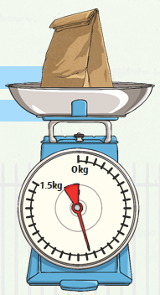
Lesson 2 : Add and Subtract Mass
What’s Left?
Aria works at the zoo. She bought a bag of food with a mass of 1kg 500g.
How much food is left?
Each interval is worth 50g. The pointer is showing 3 and a half intervals less than 1kg. 3 × 50 = 150 and ½ of 50 = 25.
150 + 25 = 175. 1000 - 175 = 825
There are 825g left.
How much food did Aria use?
1kg 500g is 1500g.
1500 - 825 = 675
Aria used 675g of food.

Slide 37
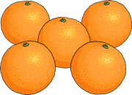
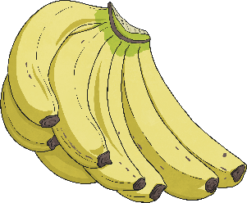
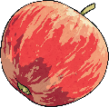
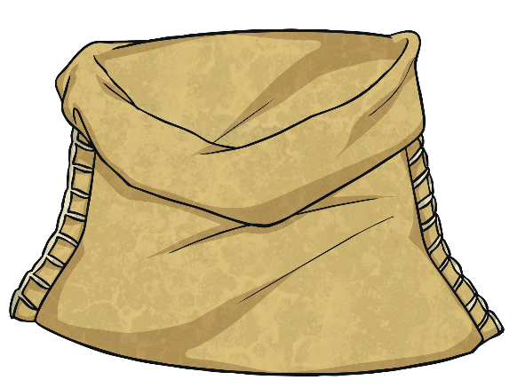


Lesson 2 : Add and Subtract Mass
What’s the Total?
Quinn put this leftover fruit into a bowl.
1kg 150g
1kg 90g
260g
What is the total mass of the fruit in the bowl?
1150
1090
+ 260
2500
1kg 150g is 1150g.
1kg 90g is 1090g.
1kg is 1000g so 2500g is 2kg 500g.
The total mass is 2kg 500g.

Slide 38
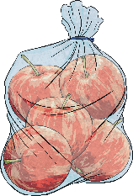





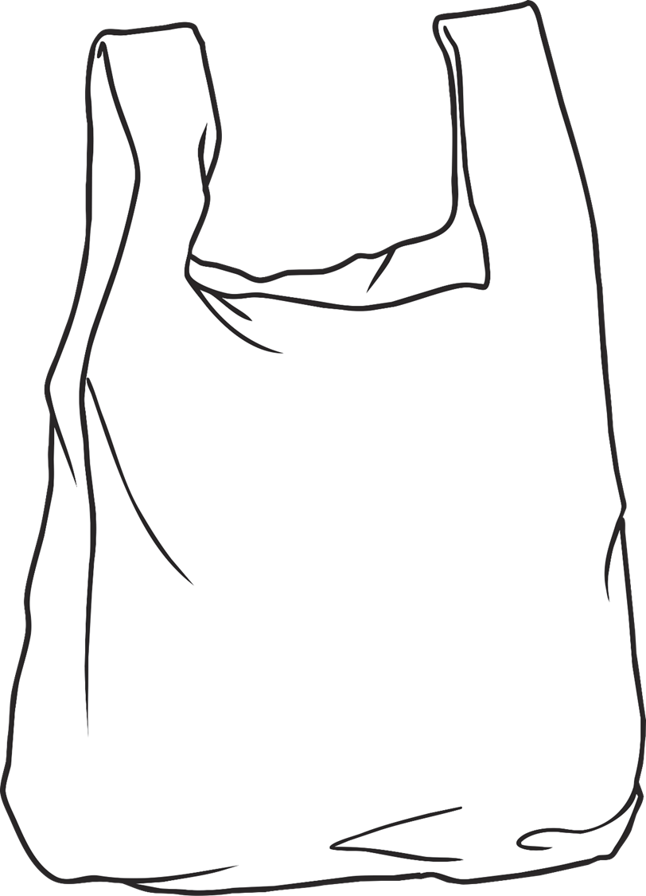






















Lesson 2 : Add and Subtract Mass
Too Much?
A bag can hold a mass of 3kg.
1kg 750g
1kg 200g
300g
Which combinations will break the bag and which will be OK?
1kg 200g + 1kg 200g = 2kg 400g
That is less than 3kg.
The bag will be OK.
1kg 750g + 1kg 200g = 2kg 950g
That is less
than 3kg.
The bag will be OK.
5 × 300g = 1500g
1kg 500g + 1kg 750g = 3kg 250g
That is more
than 3kg.
The bag will break.
3 × 300g = 900g
900g + 1kg 750g = 2kg 650g
That is less
than 3kg.
The bag will be OK.

Slide 39
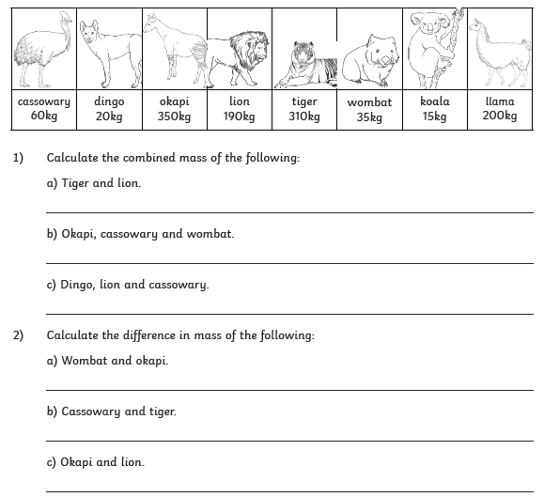
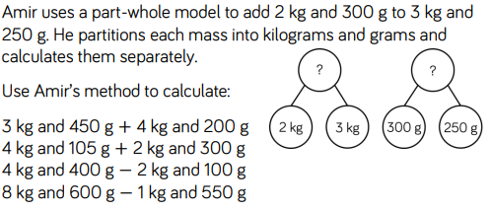


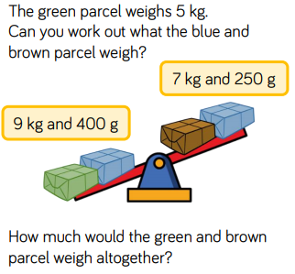
Lesson 2 : Add and Subtract Mass
3)
4)
5)

Slide 40
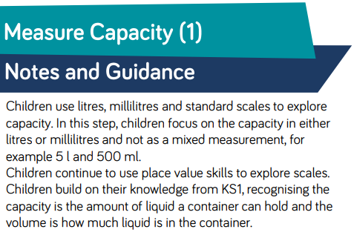
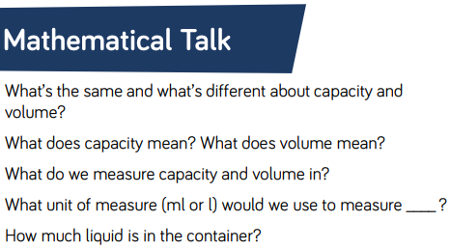
Lesson 3 : Measure Capacity

Slide 41
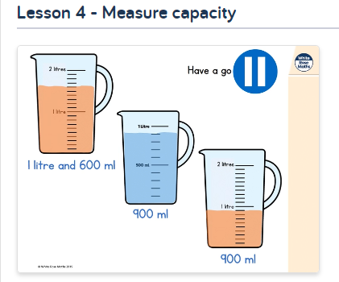
Lesson 3 : Measure Capacity
Lets go back to the White Rose Home learning pages and watch this lesson video.
https://whiterosemaths.com/homelearning/year-3/

Slide 42
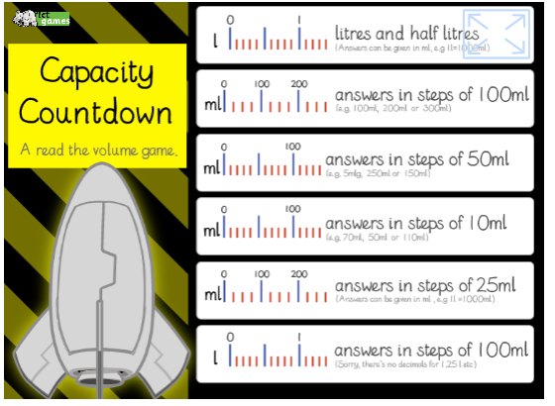
Lesson 3 : Measure Capacity
Have a go at playing this game.
http://www.ictgames.com/mobilePage/capacity/index.html

Slide 43
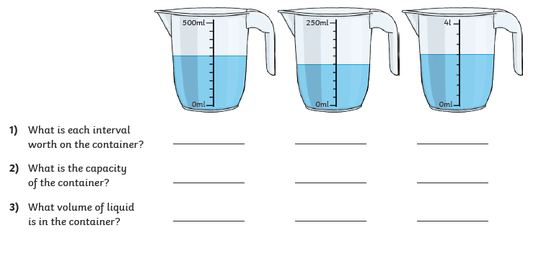
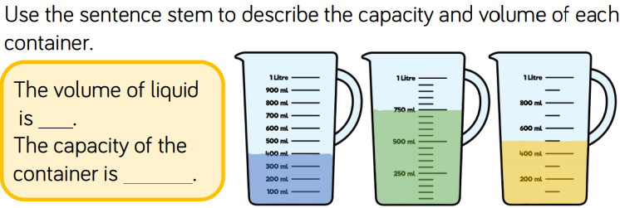
Lesson 3 : Measure Capacity

Slide 44
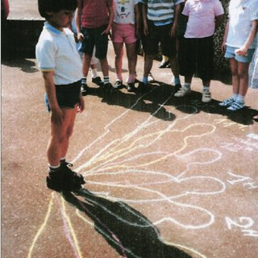
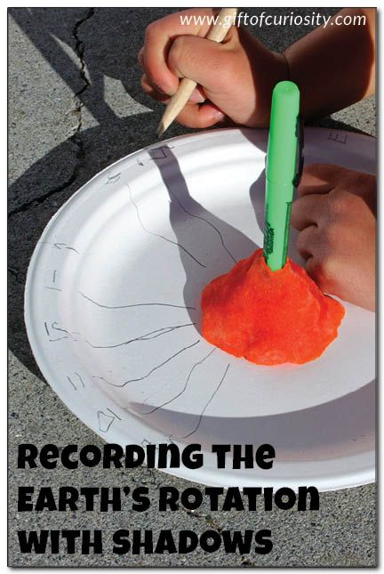
Science Learning
Watch the video clip below. It’s all about how important the sun is for us on Earth. It talks about how shadows can be longer and shorter, depending where it is in the sky.
https://www.bbc.co.uk/bitesize/clips/z6fnvcw
Pick an activity from the two below to show how shadows can help us tell what time of day it is.
Stand outside and draw around your shadow with chalk. Stand in the same spot and draw round your shadow every hour from 9am – 5pm. Take a photo of the finished result.
Make a sun dial. Using a paper plate or round piece of card, put a stick or pen in the middle. Every hour, put it in the same place outside, record the shadow and label the time.

Slide 45

P.E.
It is important to keep your children active. If it is safe to do so, ensure they have some time outside throughout the day. Please visit Joe Wicks YouTube channel (https://www.youtube.com/channel/UCAxW1XT0iEJo0TYlRfn6rYQ), which has lots of exercise videos for children. He will also be hosting a live P.E. lessons Monday to Friday at 9:00am.

Slide 46

Classroom Secrets
The site classroom secrets https://classroomsecrets.co.uk/free-home-learning-packs/ has free class packs which provide some great additional ideas and resources you can use.

