Slide 1

Home Learning
Year 3 Term 6 Week 5

Slide 2
Message from the class teacher
Hi Year Three,
We hope you have all been enjoying the hot weather and have been outside riding your bikes, playing in your paddling pools and eating ice lollies to keep yourselves cool. Don’t forget to stay safe in the sun and apply sun cream and wear hats!
We are really missing you and can’t believe we are so close to the end of the school year already. Here are this week’s home learning tasks. Keep going – we are nearly at the Summer Holidays! We hope to see some of you in school over the next few weeks or hear from you over the phone.
Stay safe and thank you for your continued support.

Slide 3

Reading
Hopefully you have access to books at home, but we have sent home extra books with your child.
Accelerated Reading
Home quizzing is not always recommended but in this case we have adjusted the settings to allow quizzing to happen at home.
If your child wants to read a book from home, please check that there is a quiz available for the book and that the book level (BL) is within or near to your child’s reading range. Also take note of the quiz number for future reference.
To check books please visit: https://www.arbookfind.co.uk/
Go to the next page for how to quiz.

Slide 4



AR quizzing at home.
To log into AR to take a quiz please visit: https://ukhosted27.renlearn.co.uk/2240835/
Your child should know what to do from here and should know their login details. If they are not aware, most details are written in their reading record.
Click on Accelerated reader.
Type in the name the book or the quiz number.
We advise students complete quizzes unaided. If parents/carers wish to support their child, they can do so in the following ways:
Discuss the book with your child as the book is being read
Ask your child to read the question out loud
Re-word questions for your child, if necessary
Ask your child which answers are not correct

Slide 5

Visit http://readon.myon.co.uk

Slide 6

Choose an area that interests you or use the search option.

Slide 7


Using My Maths
Children should know their way round My Maths but here are some reminders on how access the lessons. Visit: www.mymaths.co.uk
bapchild
divide162

Slide 8

Using My Maths
Access any lesson based on what your child is learning in class or search the topic in the search bar.
Use the login portal to access specific homework and lessons that your teacher has set.

Slide 9

Maths – White Rose Home Learning
In school we follow the White Rose scheme of learning. Their website has put together free lessons and resources that link to the learning taking place in school. Please visit: https://whiterosemaths.com/homelearning/

Slide 10



TT Rockstars
To access TT Rockstars please visit: https://play.ttrockstars.com/auth/school
Start typing in the school name or the post code (ME99NL)
Pupils type in their username and password, usually written in their reading record.
Pupils can practice all tables but Year 2 should be practicing 2, 5, and 10’s
Year 3: 2,5,10,3,4,8’s
Year 4,5,6: all tables

Slide 11

Accessing Twinkl
Many educational content providers are offering free access to their resources. Twinkl is a website that we use from time to time to resource our lessons to aid in teacher input and pupil activities.
We will be able to direct you towards activities and learning via this website based on lessons that may be missed due to absence. To access Twinkl please visit: www.twinkl.co.uk/offer
You will have to sign up and put in the offer code: UKTWINKLHELPS

Slide 12
English Learning
English Learning
Task 1: spelling activity.
Task 1: spelling activity.
Pick 3 words from the Year 3 / 4 Spelling list on the next slide.
Complete the following for each word.
Example: accident
Write the definition An incident that happens unexpectedly that might cause damage or harm.
Split the word into its syllables Ac-ci -dent
Colour code (vowels in one accident
colour, consonants in another)
Identify the tricky part ac c ident (c sounds like s)
Draw the word Draw a picture of the word.
Write the word in a sentence I dropped my drink by accident.

Slide 13
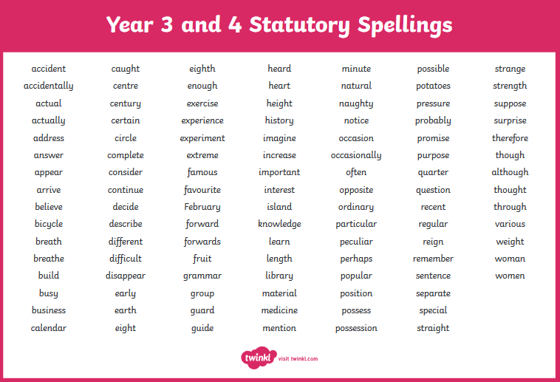

Slide 14
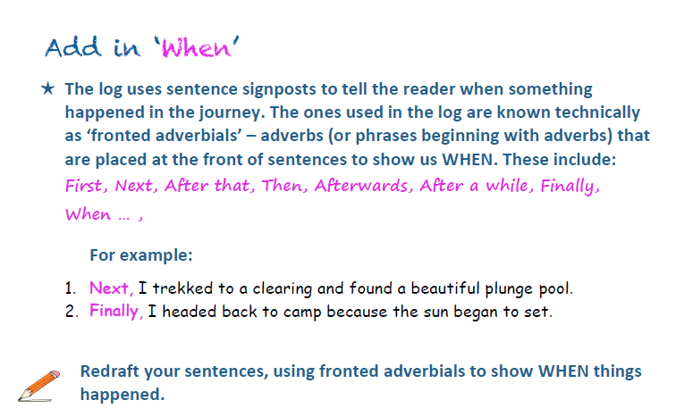
Task 2: grammar; using when.

Slide 15
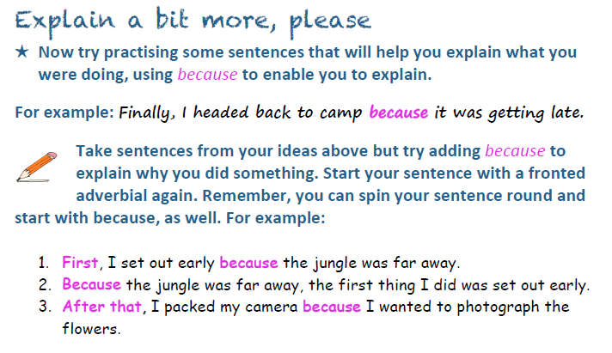
Task 3: grammar; using because.
Challenge: try and use FANBOYS to connect two main clauses. (For, And, Nor, But, Or, Yet, So). I set out early yet … I hadn’t seen anything like it before nor had I heard… All around me were very short trees but they had very long…

Slide 16
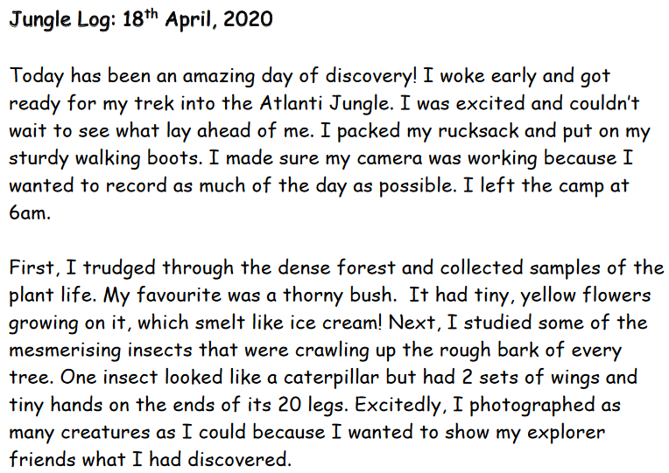

Slide 17
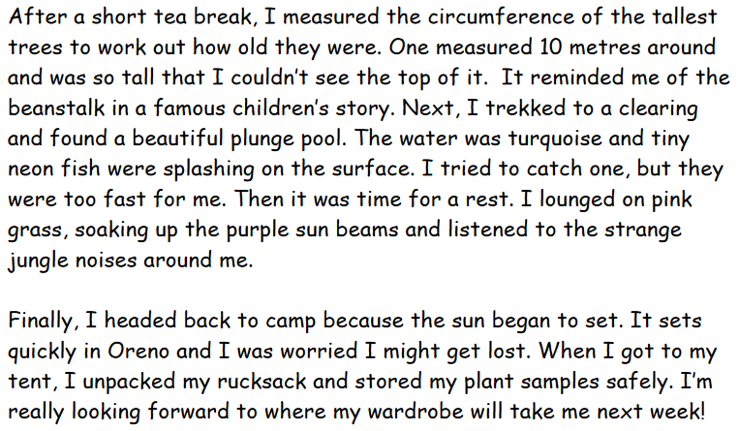

Slide 18
Maths Learning

Slide 19
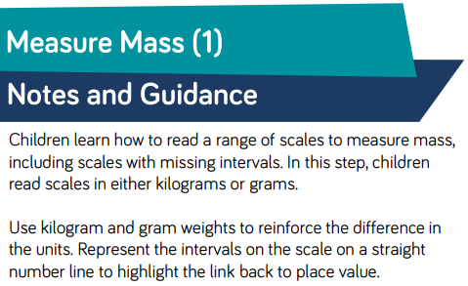
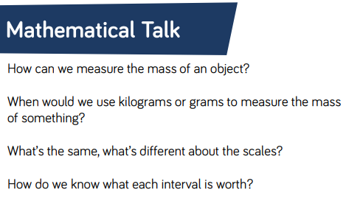
Lesson 1 : Measuring Mass

Slide 20
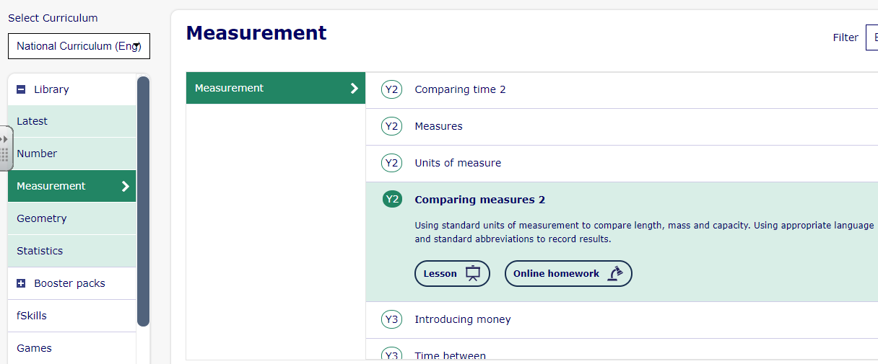
Lesson 1 : Measuring Mass
Go to the My Maths lesson on Comparing Measures 2 and complete pages 4, 5 and 6 only.
https://app.mymaths.co.uk/5933-lesson/comparing-measures-2

Slide 21
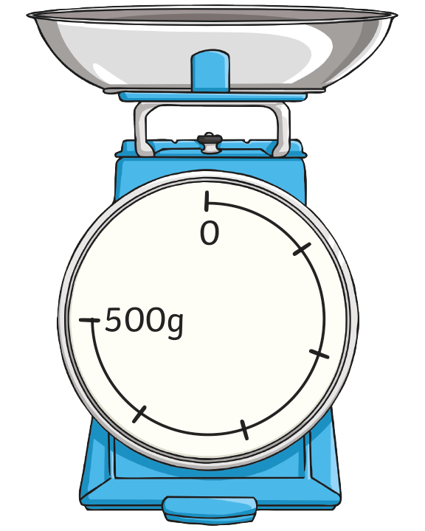
Lesson 1 : Measuring Mass
Intervals on Scales
What is each interval worth?
What mass is shown on
these scales?
Show where 200g would be on these scales.

Slide 22
Lesson 1 : Measuring Mass
Intervals on Scales
What is each interval worth?
There are 5 intervals between 0 and 500.
500 ÷ 5 = 100.
Each interval is worth 100g.
What mass is shown on these scales?
The pointer is after the fourth interval.
Each interval is 100g. The pointer shows
4 × 100g, or 400g.
Show where 200g would be on
these scales.
Each interval is worth 100g. 200 ÷ 100 = 2, so 200g would be after the second interval.

Slide 23
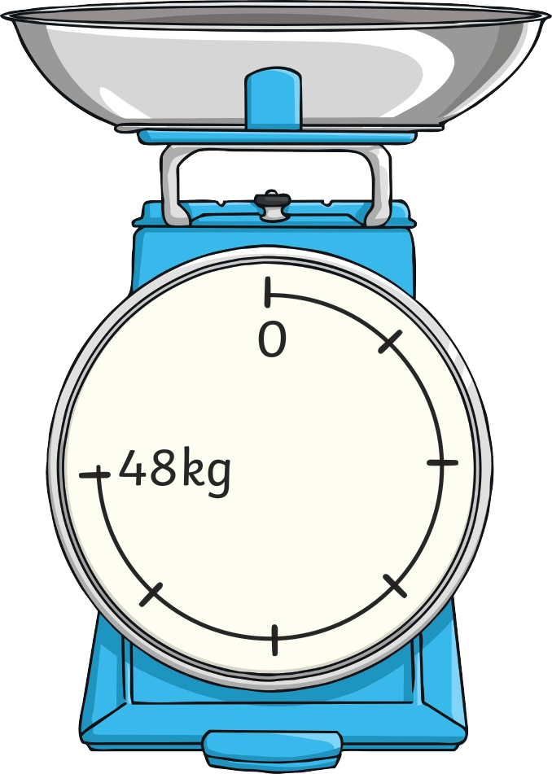
Lesson 1 : Measuring Mass
Intervals on Scales
What is each interval worth?
What mass is shown on
these scales?
Show where 32kg would be on these scales.

Slide 24
Lesson 1 : Measuring Mass
Intervals on Scales
What is each interval worth?
There are 6 intervals between 0 and 48.
48 ÷ 6 = 8.
Each interval is worth 8kg.
What mass is shown on these scales?
The pointer is after the third interval.
Each interval is 8kg. The pointer shows 3 × 8kg, or 24kg.
Show where 32kg would be on
these scales.
Each interval is 8kg. 32 ÷ 8 = 4, so the pointer would be after the fourth interval.

Slide 25
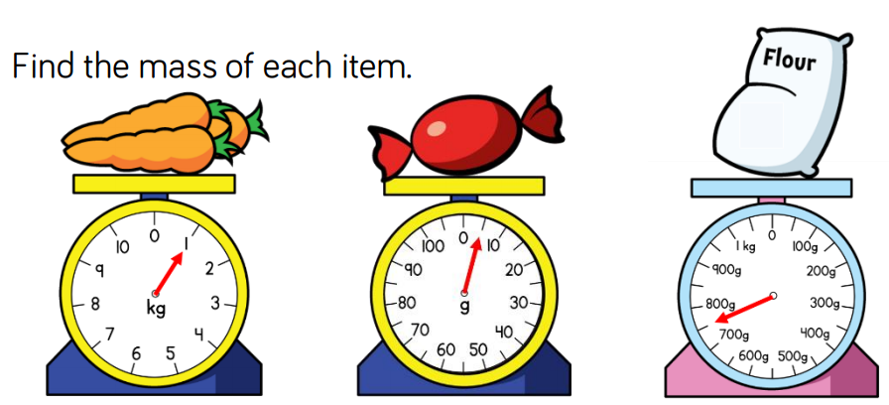
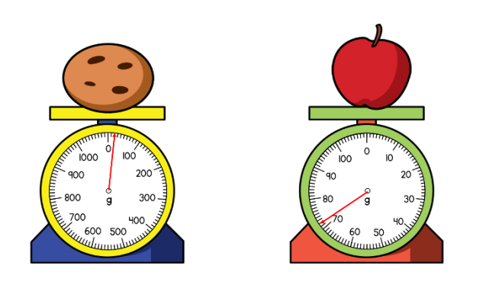
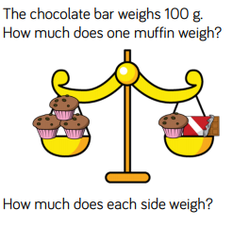
Lesson 1 : Measuring Mass

Slide 26

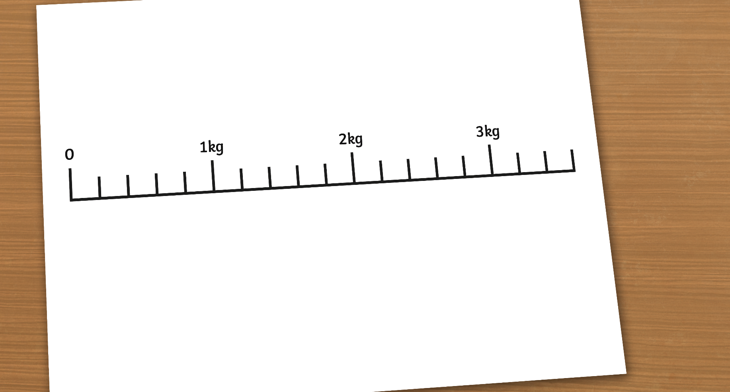
Lesson 2: Measuring Mass part 2
Reading Scales to Measure Kilograms
If we are going to measure objects in kilograms, we need to calculate
what the small intervals on the scale measure.
2000g
3000g
1000g
This scale has 5 intervals between each kilogram. To find out which interval is worth, we divide 1000 by 5.
1000 ÷ 5 = 200,
so each interval is worth 200g.
First, we need to convert kilograms to grams.
1 kilogram = 1000 grams.

Slide 27

Lesson 2: Measuring Mass part 2
Reading Scales to Measure Kilograms
I’m pointing at 3 intervals after 2kg.
As each interval is worth 200g, 3 intervals makes 600g.
I am pointing to
2kg + 600g = 2kg 600g

Slide 28
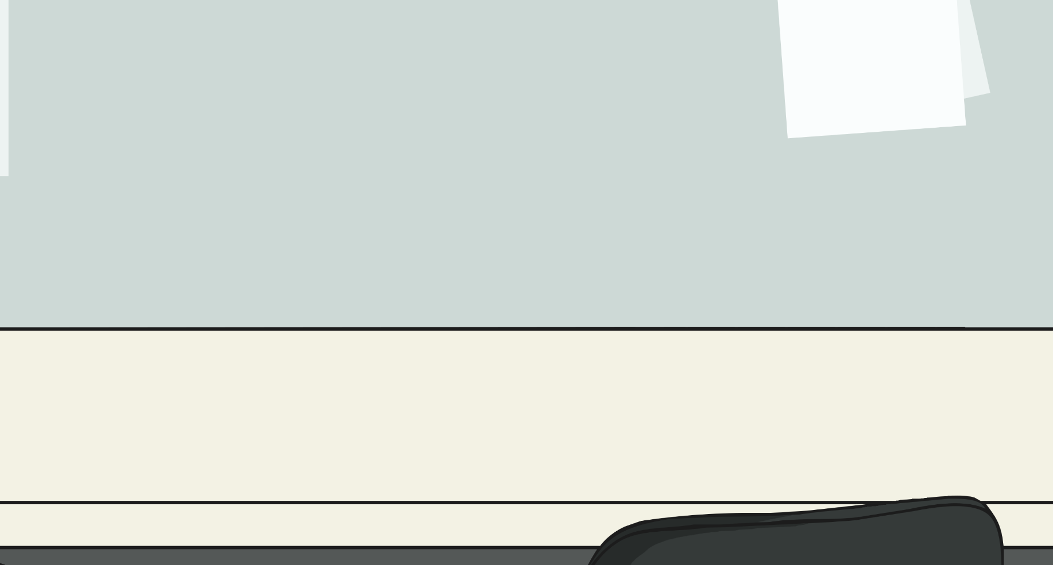
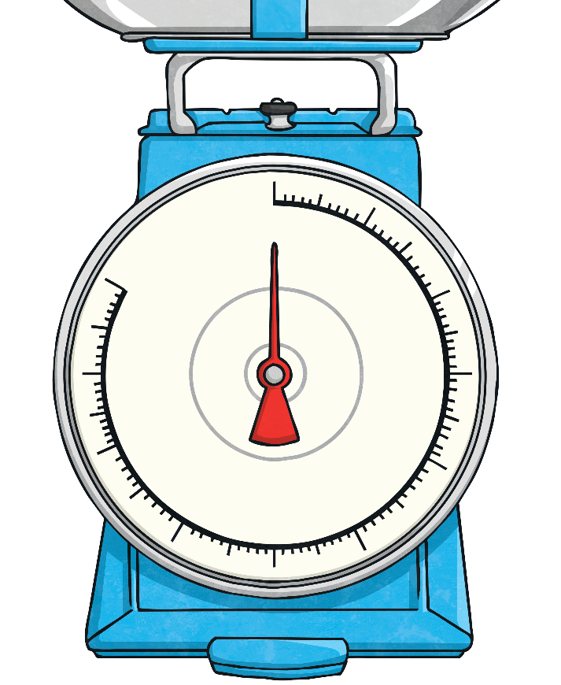
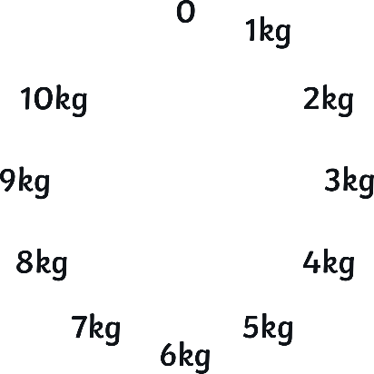

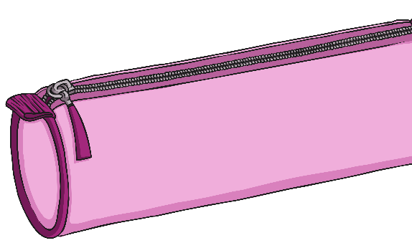
Lesson 2: Measuring Mass part 2
Reading Scales to Measure Kilograms
With your partner, calculate the mass that each arrow is pointing to.
C
A
B

Slide 29
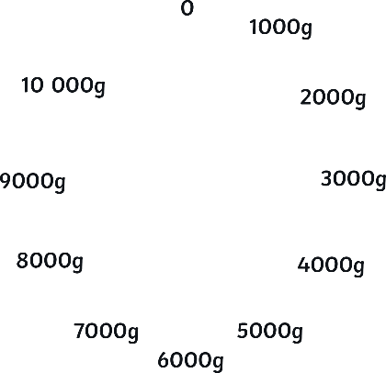
Lesson 2: Measuring Mass part 2
Reading Scales to Measure Kilograms
First change kg to g.
C
A
B
1000 ÷ 10 = 100, so each interval is worth 100g.
To work out what each interval is worth, we divide 1000 by 10.

Slide 30
Lesson 2: Measuring Mass part 2
Reading Scales to Measure Kilograms
Arrow A is pointing 5 intervals after 2kg.
A
2kg + 500g = 2kg 500g

Slide 31
Lesson 2: Measuring Mass part 2
Reading Scales to Measure Kilograms
Arrow B is pointing 2 intervals after 5kg.
B
5kg + 200g = 5kg 200g

Slide 32
Lesson 2: Measuring Mass part 2
Reading Scales to Measure Kilograms
Arrow C is pointing 6 intervals after 9kg.
C
9kg + 600g = 9kg 600g

Slide 33
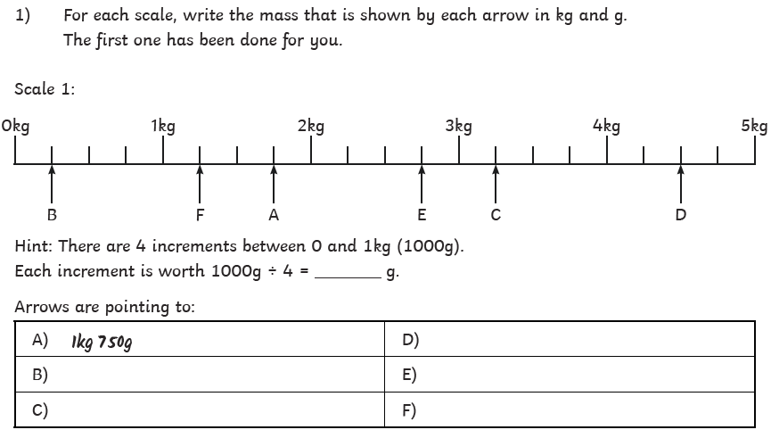
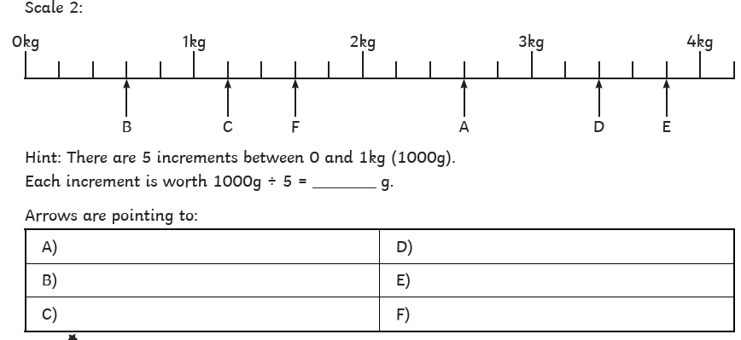
Lesson 2: Measuring Mass part 2

Slide 34
Lesson 3: Arithmetic
Back when we used to be in school, many moons ago, most lessons would have started with Awesome Arithmetic. These were questions that covered concepts across the year that mainly focused on the four operations.
I have uploaded two arithmetic tests to complete. You can just do one or two it is up to you.
You can print it out or just complete on paper from the screen. It might be best to work with your child next to you, one question at a time. Otherwise, you can just let them get on with it and go through it with them at the end. It is important that the children show their workings out and are able to explain how they got to the answer.
Careful, the answers are on the last page!

Slide 35
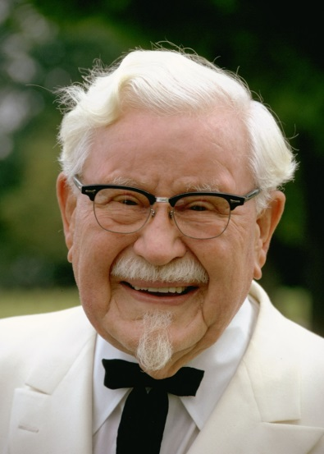
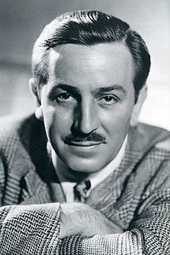
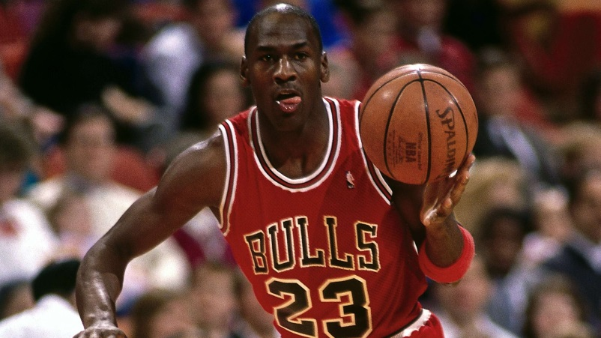
PSHE
Theme: No way through isn’t true!
In life you will have things that are going well and you are getting better at. However, at the same there are things that you will be struggling with. Being determined and persevering with things that are hard is difficult but worth doing.
Look at these famous people who never gave up!
Michael Jordan didn’t get put into his school basketball team but went on to be known as the greatest basketball player of all time. He has lost games, missed shots and failed over and over again but he says that this made him become better and better.
Colonel Sanders, the founder of KFC, was rejected by over 1,000 restaurants before one agreed to his idea. Now he has more than 23,000 restaurants in the world.
Walt Disney was fired from a newspaper for having no good ideas. He went on to create Mickey Mouse and the rest is history.
TASK: Create a poster encouraging others to persevere and never give up. Use these examples or find your own famous people who never gave up.

Slide 36

P.E.
It is important to keep your children active. If it is safe to do so, ensure they have some time outside throughout the day. Please visit Joe Wicks YouTube channel (https://www.youtube.com/channel/UCAxW1XT0iEJo0TYlRfn6rYQ), which has lots of exercise videos for children. He will also be hosting a live P.E. lessons Monday to Friday at 9:00am.

Slide 37

Classroom Secrets
The site classroom secrets https://classroomsecrets.co.uk/free-home-learning-packs/ has free class packs which provide some great additional ideas and resources you can use.

