Slide 1

Home Learning
Year 3 Term 6 Week 3

Slide 2
Message from the class teacher
Hi Year Three,
Here we are, week 3 of the final term of the year. It’s not quite as we had planned but we hope you are all ok.
The weather has been a bit wet recently but we’re keeping everything crossed that the sunshine reappears this week so you can all get back to riding your bikes and playing outside. If not, pop on your wellies and go dancing in the rain.
Here are this week’s tasks. Don’t forget to keep reading and quizzing. There are lots of free books on http://readon.myon.co.uk
Stay safe and thank you for your continued support.

Slide 3

Reading
Hopefully you have access to books at home, but we have sent home extra books with your child.
Accelerated Reading
Home quizzing is not always recommended but in this case we have adjusted the settings to allow quizzing to happen at home.
If your child wants to read a book from home, please check that there is a quiz available for the book and that the book level (BL) is within or near to your child’s reading range. Also take note of the quiz number for future reference.
To check books please visit: https://www.arbookfind.co.uk/
Go to the next page for how to quiz.

Slide 4



AR quizzing at home.
To log into AR to take a quiz please visit: https://ukhosted27.renlearn.co.uk/2240835/
Your child should know what to do from here and should know their login details. If they are not aware, most details are written in their reading record.
Click on Accelerated reader.
Type in the name the book or the quiz number.
We advise students complete quizzes unaided. If parents/carers wish to support their child, they can do so in the following ways:
Discuss the book with your child as the book is being read
Ask your child to read the question out loud
Re-word questions for your child, if necessary
Ask your child which answers are not correct

Slide 5

Visit http://readon.myon.co.uk

Slide 6

Choose an area that interests you or use the search option.

Slide 7


Using My Maths
Children should know their way round My Maths but here are some reminders on how access the lessons. Visit: www.mymaths.co.uk
bapchild
divide162

Slide 8

Using My Maths
Access any lesson based on what your child is learning in class or search the topic in the search bar.
Use the login portal to access specific homework and lessons that your teacher has set.

Slide 9

Maths – White Rose Home Learning
In school we follow the White Rose scheme of learning. Their website has put together free lessons and resources that link to the learning taking place in school. Please visit: https://whiterosemaths.com/homelearning/

Slide 10



TT Rockstars
To access TT Rockstars please visit: https://play.ttrockstars.com/auth/school
Start typing in the school name or the post code (ME99NL)
Pupils type in their username and password, usually written in their reading record.
Pupils can practice all tables but Year 2 should be practicing 2, 5, and 10’s
Year 3: 2,5,10,3,4,8’s
Year 4,5,6: all tables

Slide 11

Accessing Twinkl
Many educational content providers are offering free access to their resources. Twinkl is a website that we use from time to time to resource our lessons to aid in teacher input and pupil activities.
We will be able to direct you towards activities and learning via this website based on lessons that may be missed due to absence. To access Twinkl please visit: www.twinkl.co.uk/offer
You will have to sign up and put in the offer code: UKTWINKLHELPS

Slide 12
English Learning
Task 1: spelling activity.
Pick 3 words from the Year 3 / 4 Spelling list on the next slide.
Complete the following for each word.
Example: accident
Write the definition An incident that happens unexpectedly that might cause damage or harm.
Split the word into its syllables Ac-ci -dent
Colour code (vowels in one accident
colour, consonants in another)
Identify the tricky part ac c ident (c sounds like s)
Draw the word Draw a picture of the word.
Write the word in a sentence I dropped my drink by accident.

Slide 13
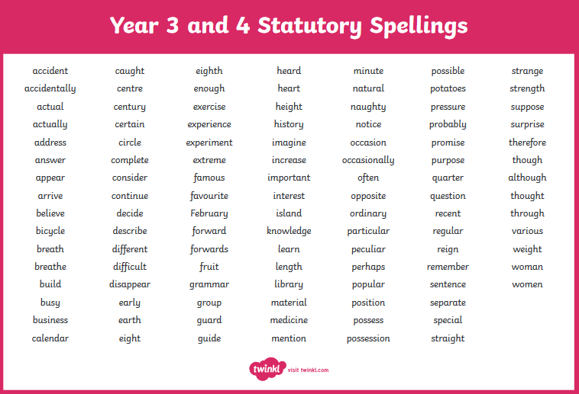

Slide 14
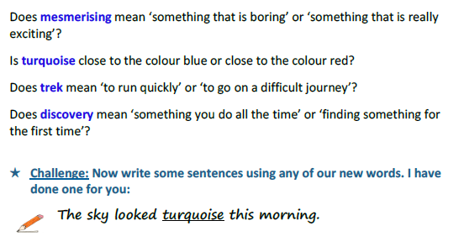
Task 2: vocabulary from the text (on the next slides).
Look at the words below and decide which definition is correct.

Slide 15
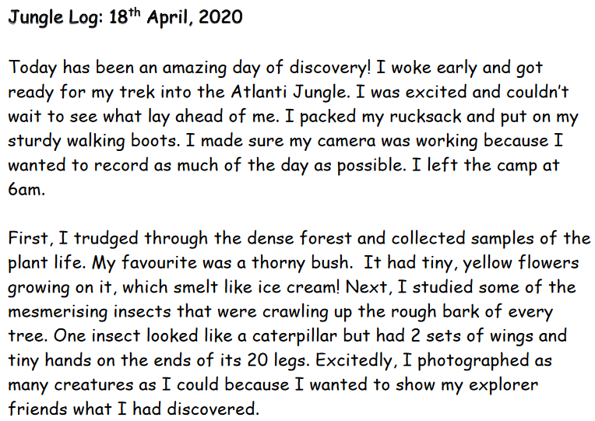

Slide 16
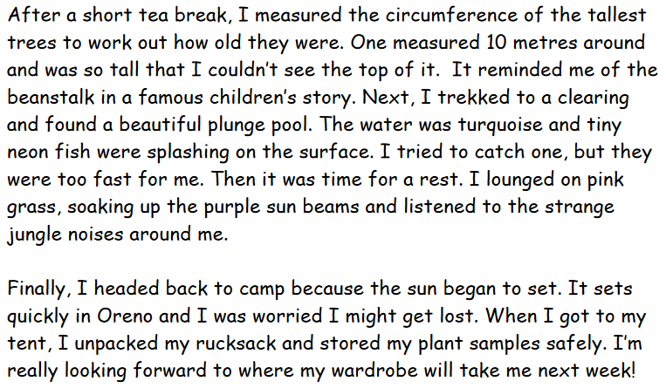

Slide 17
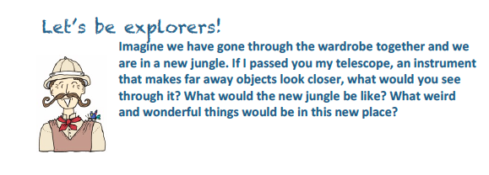
Task 3: create a jungle scene.
Design a jungle that you find when you walk through the wardrobe.
Think about:
What plants can you see? What are the colours, shapes? What are the flowers like? What do they smell of?
What fruit might be growing on the trees or bushes? What do they taste like?
What animals can you see? Are they a mixture of 2 animals you know in the real world? What noises do they make?
Are there any streams or rivers? What colour are they?
Use your imagination to create your jungle and create it. This could be drawing, colouring, painting, collage, printing, 3D anything at all. Label some of the features as we will be using this to write about in a few weeks’ time.

Slide 18
Maths Learning
Over the next few weeks we will be looking at angles and shapes. The best way to view this learning is by downloading the PowerPoint so that some of the animations will play on the slides.

Slide 19
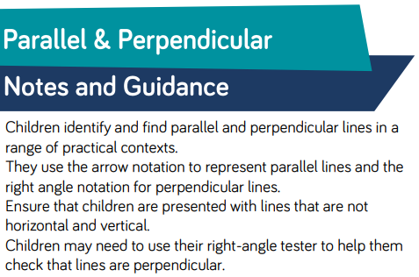
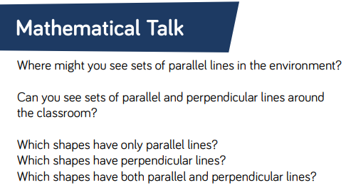
Lesson 1: Parallel and Perpendicular Lines

Slide 20
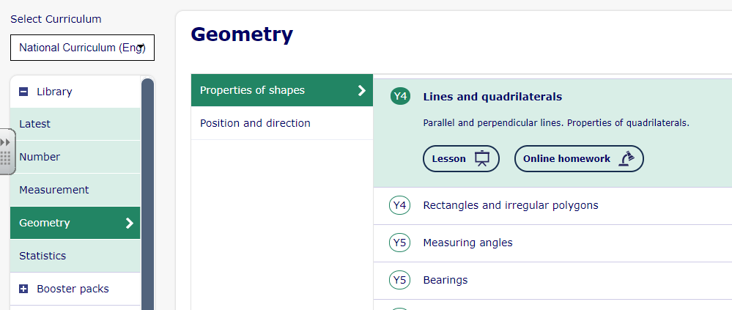
Lesson 1: Parallel and Perpendicular Lines
Complete pages 1-3 only on Year 4 Lesson on Lines and Quadrilaterals.
https://app.mymaths.co.uk/245-lesson/lines-and-quadrilaterals

Slide 21
Lesson 1: Parallel and Perpendicular Lines
Parallel lines run alongside each other in pairs.
They would never meet if they carried on.
They are always the same distance apart.
They are shown, in maths, with these arrows.

Slide 22
Lesson 1: Parallel and Perpendicular Lines
Perpendicular lines are pairs of lines that meet at a right angle.
They are usually marked by using the right-angle symbol at the point where they meet.

Slide 23
Lesson 1: Parallel and Perpendicular Lines
Look at these shapes.
How many pairs of parallel lines can you see in each shape?
How many pairs of perpendicular lines can you see in each shape?

Slide 24
Lesson 1: Parallel and Perpendicular Lines
Which dots should I join up to make a pair of perpendicular lines?
Remember, we can label lines by naming them after the points they start and end at.
B
C
D
Lines AB and BD will be perpendicular to each other.
A
E

Slide 25
Lesson 1: Parallel and Perpendicular Lines
Which statements about this shape are false?
B
A
D
C
D
Line BD is parallel to line AC.
Line AB is perpendicular to BD.
Line AB is parallel to line CD.
Line AB is not perpendicular to any other lines.
.



Slide 26
Lesson 1: Parallel and Perpendicular Lines
We can prove that lines are parallel by continuing them and showing that they will not meet.
If I continue these lines, will they meet eventually?

Slide 27
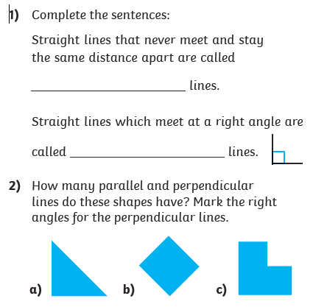

Lesson 1: Parallel and Perpendicular Lines
3) Identify a pair of parallel lines and a pair of perpendicular lines in this picture:

Slide 28
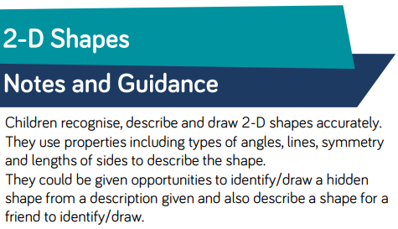
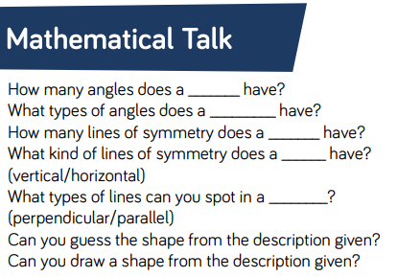
Lesson 2: 2D Shapes

Slide 29
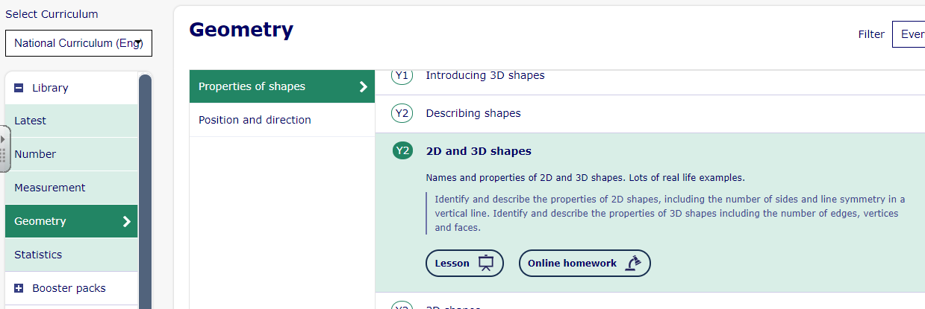
Lesson 2: 2D Shapes
Complete pages 1-3 only on Year 2 Lesson on https://app.mymaths.co.uk/241-lesson/2d-and-3d-shapes

Slide 30
Lesson 2: 2D Shapes
Describe one of the shapes below. Think about the sides and vertices (corners).
oval
circle
trapezium
triangle
heptagon
nonagon
octagon
semi-circle
square
decagon
hexagon
pentagon
rectangle

Slide 31


Lesson 2: 2D Shapes
Which of these descriptions match this shape?
I have 5 straight sides.
I have 6 angles.
I am a hexagon.
I have 6 straight sides.
I have 8 angles.
I am a pentagon.
I have 8 straight sides.
I have 5 angles.
I am an octagon.

Slide 32

Lesson 2: 2D Shapes
Which of these descriptions match this shape?
I have 5 straight sides.
I have 6 angles.
I am a hexagon.
I have 6 straight sides.
I have 8 angles.
I am a pentagon.
I have 8 straight sides.
I have 5 angles.
I am an octagon.

Slide 33


Lesson 2: 2D Shapes
Can you think of a shape which:
has two pairs of equal sides;
has four equal angles;
is symmetrical?
rectangle

Slide 34
Lesson 2: 2D Shapes
True or false? An octagon always has eight sides but doesn’t always have eight angles.
False! A 2D shape made of straight lines always
has the same number of angles as sides.

Slide 35
Lesson 2: 2D Shapes
Which shapes below are pentagons?
How do you know?

Slide 36
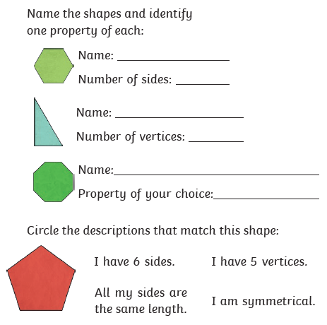
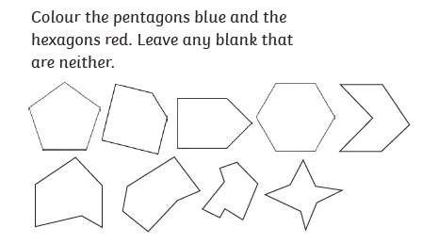
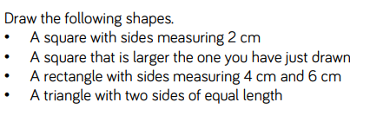
Lesson 2: 2D Shapes
1)
3)
2)
4)

Slide 37
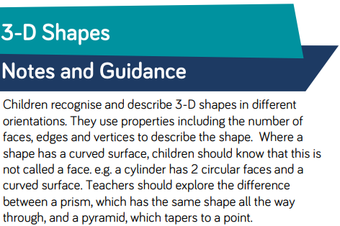
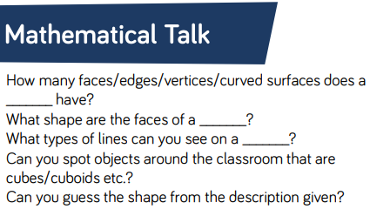
Lesson 3: 3D Shapes

Slide 38
Lesson 3: 3D Shapes
Complete pages 4-9 only on Year 2 Lesson on 3D shapes. https://app.mymaths.co.uk/241-lesson/2d-and-3d-shapes
Once you have completed the slides then complete the online homework for this lesson. Either log in to your portal where the homework has been set for you or just click the link next to the lesson.

Slide 39
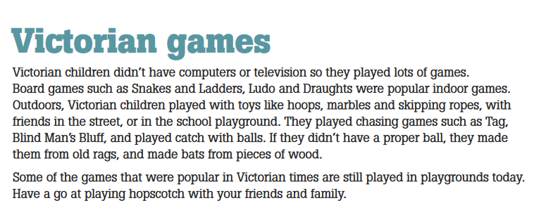
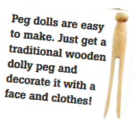
Topic
Have a go at playing some of the games Victorian children would have played this week.
You’ll find some ideas of Victorian toys to make on the next slides. Have a go at making one.

Slide 40
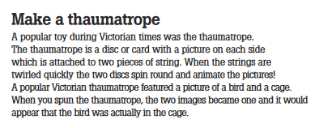
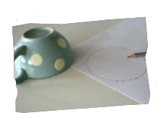
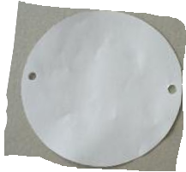
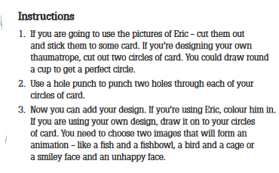
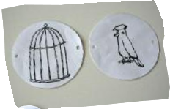
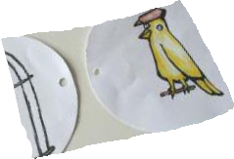

Slide 41
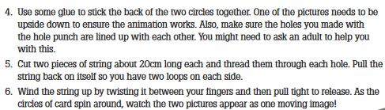
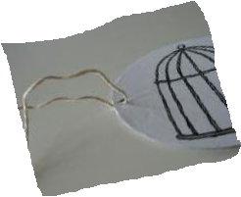
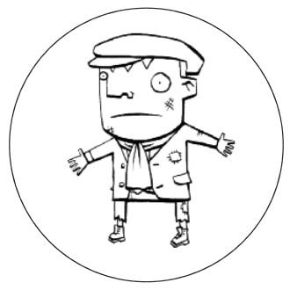

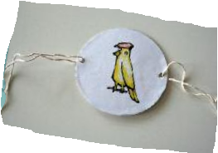
Print, cut and colour these or draw your own. You could even use 2 photos of yourself!

Slide 42

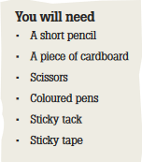
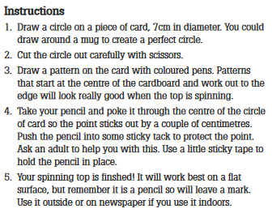

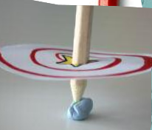
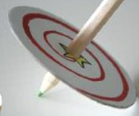

Slide 43

P.E.
It is important to keep your children active. If it is safe to do so, ensure they have some time outside throughout the day. Please visit Joe Wicks YouTube channel (https://www.youtube.com/channel/UCAxW1XT0iEJo0TYlRfn6rYQ), which has lots of exercise videos for children. He will also be hosting a live P.E. lessons Monday to Friday at 9:00am.

Slide 44

Classroom Secrets
The site classroom secrets https://classroomsecrets.co.uk/free-home-learning-packs/ has free class packs which provide some great additional ideas and resources you can use.

