Slide 1

Home Learning
Year 3 Term 6 Week 2

Slide 2
Message from the class teachers
Hi Year Three,
We hope you are all happy and keeping safe.
This week we have been into school for a couple days with a few children from different classes. It’s been very strange not to have our whole class together as normal (we missed seeing your smiling faces) but it has been nice to get back to school after all this time away.
We look forward to hearing from you soon about what you’ve been up to.
Here are this week’s tasks. Don’t forget to keep reading and quizzing. There are lots of free books on http://readon.myon.co.uk
Stay safe and thank you for your continued support.

Slide 3

Reading
Hopefully you have access to books at home, but we have sent home extra books with your child.
Accelerated Reading
Home quizzing is not always recommended but in this case we have adjusted the settings to allow quizzing to happen at home.
If your child wants to read a book from home, please check that there is a quiz available for the book and that the book level (BL) is within or near to your child’s reading range. Also take note of the quiz number for future reference.
To check books please visit: https://www.arbookfind.co.uk/
Go to the next page for how to quiz.

Slide 4



AR quizzing at home.
To log into AR to take a quiz please visit: https://ukhosted27.renlearn.co.uk/2240835/
Your child should know what to do from here and should know their login details. If they are not aware, most details are written in their reading record.
Click on Accelerated reader.
Type in the name the book or the quiz number.
We advise students complete quizzes unaided. If parents/carers wish to support their child, they can do so in the following ways:
Discuss the book with your child as the book is being read
Ask your child to read the question out loud
Re-word questions for your child, if necessary
Ask your child which answers are not correct

Slide 5

Visit http://readon.myon.co.uk

Slide 6

Choose an area that interests you or use the search option.

Slide 7


Using My Maths
Children should know their way round My Maths but here are some reminders on how access the lessons. Visit: www.mymaths.co.uk
bapchild
divide162

Slide 8

Using My Maths
Access any lesson based on what your child is learning in class or search the topic in the search bar.
Use the login portal to access specific homework and lessons that your teacher has set.

Slide 9

Maths – White Rose Home Learning
In school we follow the White Rose scheme of learning. Their website has put together free lessons and resources that link to the learning taking place in school. Please visit: https://whiterosemaths.com/homelearning/

Slide 10



TT Rockstars
To access TT Rockstars please visit: https://play.ttrockstars.com/auth/school
Start typing in the school name or the post code (ME99NL)
Pupils type in their username and password, usually written in their reading record.
Pupils can practice all tables but Year 2 should be practicing 2, 5, and 10’s
Year 3: 2,5,10,3,4,8’s
Year 4,5,6: all tables

Slide 11

Accessing Twinkl
Many educational content providers are offering free access to their resources. Twinkl is a website that we use from time to time to resource our lessons to aid in teacher input and pupil activities.
We will be able to direct you towards activities and learning via this website based on lessons that may be missed due to absence. To access Twinkl please visit: www.twinkl.co.uk/offer
You will have to sign up and put in the offer code: UKTWINKLHELPS

Slide 12
English Learning
Task 1: spelling activity.
Use the High Frequency word list on the next slide to hold a spelling bee.
Ask an adult to test you on the words you find tricky and you spell them out loud. (You could try and persuade your grown up to give you a sweet treat if you get over 10 right in a row!)
Challenge: how many words from the list can you write in a single sentence?
If there are enough of you in your family, play a game of sparkle.
(If your child is confident with this list, complete these activities using the Year 3 / 4 word list).

Slide 13
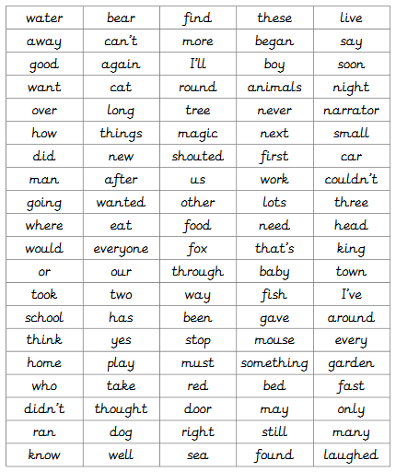

Slide 14
Task 2: comprehension. Answer these questions from the jungle log.
and why?

Slide 15
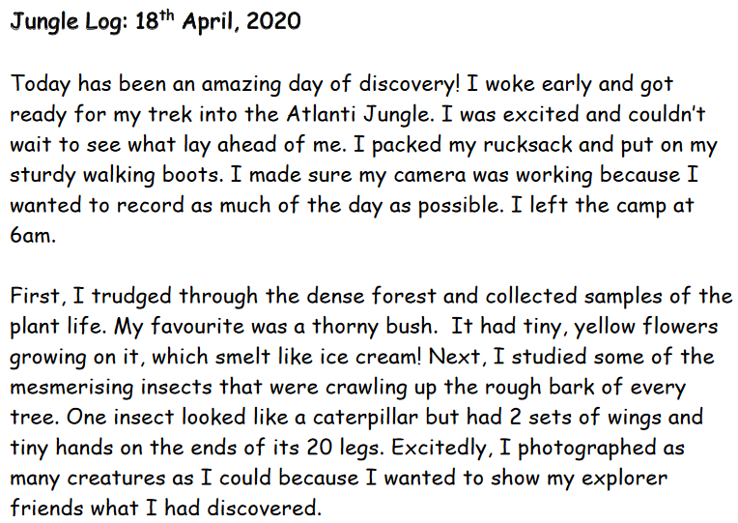

Slide 16
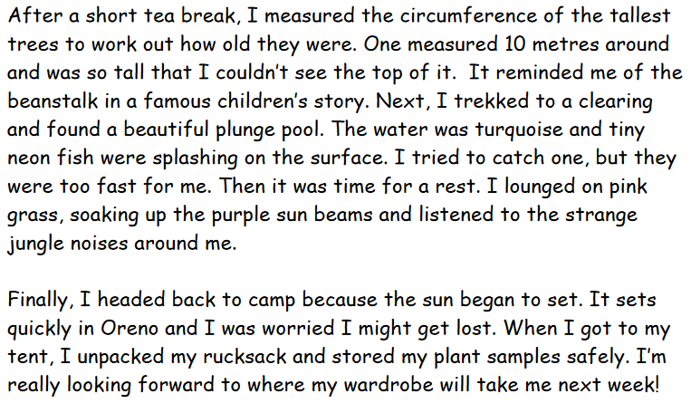

Slide 17
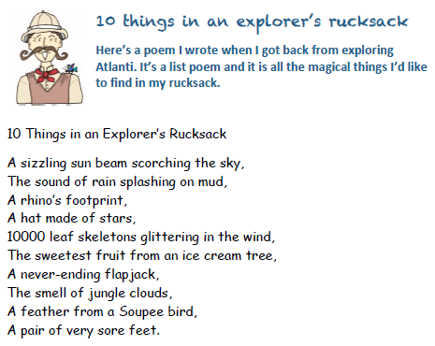

Slide 18
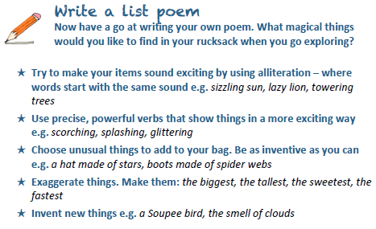
Task 3: list poem.
Feel free to borrow (magpie) any good words from the poem and even the last line.
Challenge: can you write up your poem in your best handwriting and decorate it?

Slide 19
Maths Learning
Over the next few weeks we will be looking at angles and shapes. The best way to view this learning is by downloading the PowerPoint so that some of the animations will play on the slides.

Slide 20
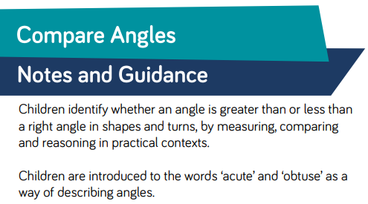
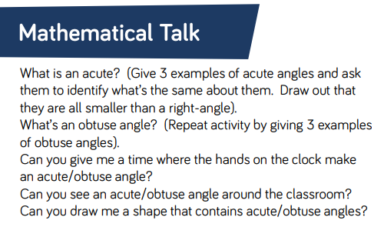
Lesson 1: Comparing Angles

Slide 21
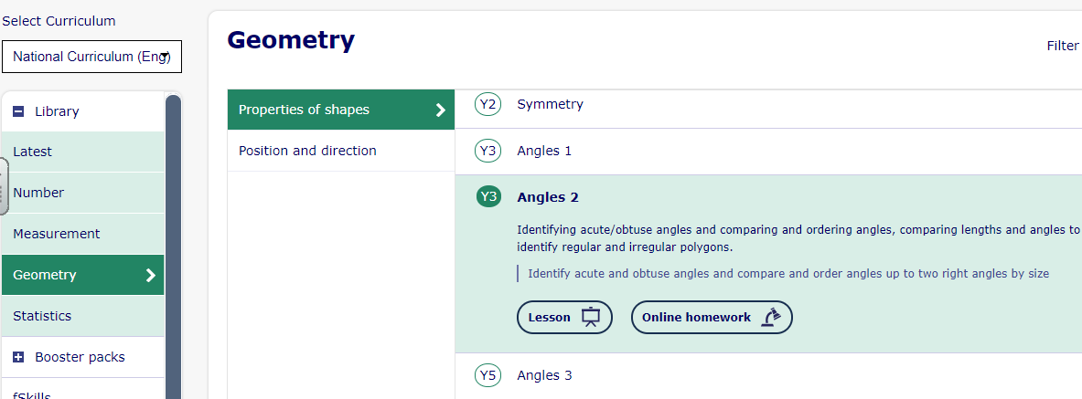
Lesson 1: Comparing Angles
Just do pages 1-4 of this lesson; Angles 2. I have just tried putting in a hyperlink to the lesson so you can just copy and paste or click the link and it should throw you to the lesson. You may be prompted to sign in first though. Otherwise, just do it the usual way.
https://app.mymaths.co.uk/1752-lesson/angles-2

Slide 22
Lesson 1: Comparing Angles
Click on these angles to match with their descriptions.
A right angle is 90 degrees, or a quarter turn.
An angle bigger than a right angle, but not a straight line or half turn (90-179 degrees) is called an obtuse angle.
An angle smaller than a right angle (less than 90 degrees) is called an acute angle.

Slide 23

Lesson 1: Comparing Angles
Can you tell if these angles are acute, obtuse or right angles?
acute
obtuse
obtuse
right angle
acute

Slide 24
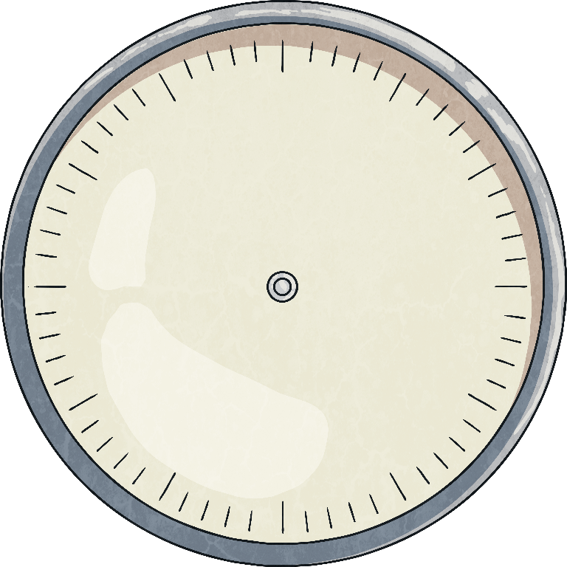

Lesson 1: Comparing Angles
Look at this clock face.
Is the angle between the hour hand and the minute hand acute, obtuse or a right angle?

Slide 25

Lesson 1: Comparing Angles
Look at this clock face.
Is the angle between the minute hand and the hour hand acute, obtuse or a right angle?

Slide 26

Lesson 1: Comparing Angles
Look at this clock face.
Is the angle between the hour hand and the minute hand acute, obtuse or a right angle?

Slide 27
Lesson 1: Comparing Angles
Look at these letters. Can you see any acute, obtuse or right angles where the lines meet?
A F N
obtuse and acute angles
right angles
acute angles

Slide 28
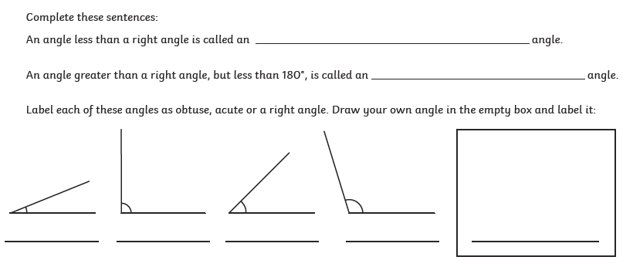
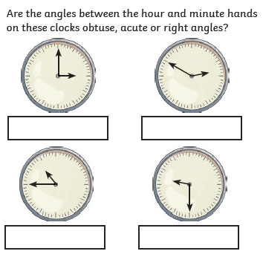
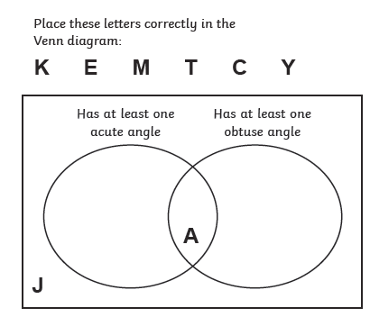
Lesson 1: Comparing Angles

Slide 29
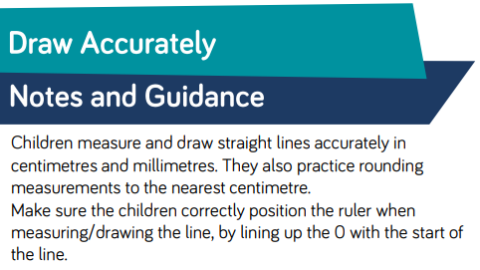
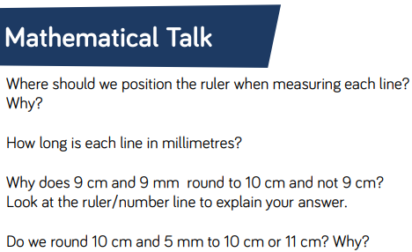
Lesson 2: Draw Accurately

Slide 30
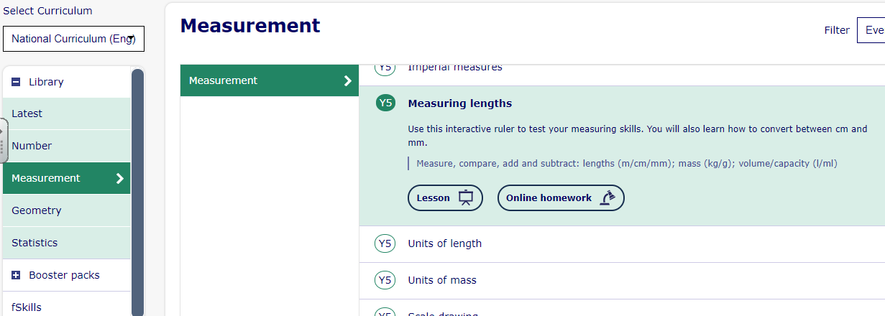
Lesson 2: Draw Accurately
Open up this Year 5 lesson on Measuring Lengths. Only do slides 1-3. After you complete slide 3, if you click on slide 2 and then back to slide 3 you will get a new set of lines.
https://app.mymaths.co.uk/292-lesson/measuring-lengths

Slide 31
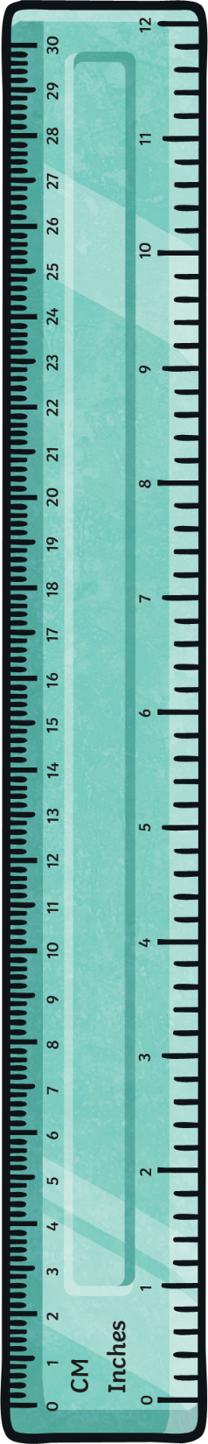


Lesson 2: Draw Accurately
Use a ruler to draw a line which is:
7cm long
43mm long

Slide 32

Lesson 2: Draw Accurately
Use a ruler to accurately measure your pencil to the nearest cm.
Check your partner’s measuring to see if you agree.
Remember to line up the end of your pencil with 0cm on the ruler.

Slide 33


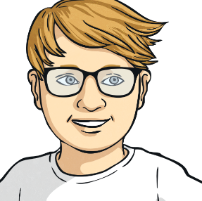
Lesson 2: Draw Accurately
Aleesha and Kieran measure the same line.
What has each done wrong?
Aleesha
“The line is 22cm long.”
Kieran
“The line is 6.7cm long.”

Slide 34
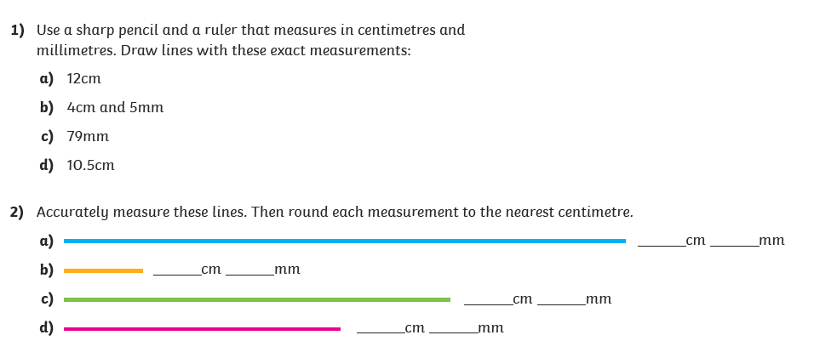
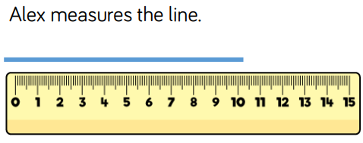
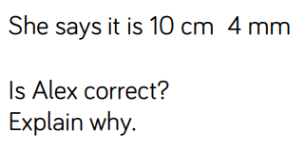
Lesson 2: Draw Accurately

Slide 35
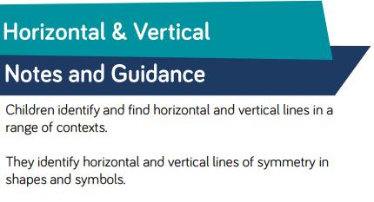
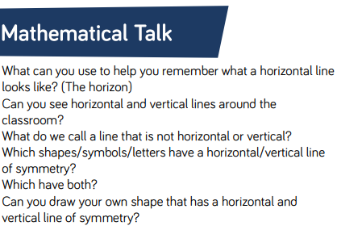
Lesson 3: Horizontal and Vertical Lines

Slide 36
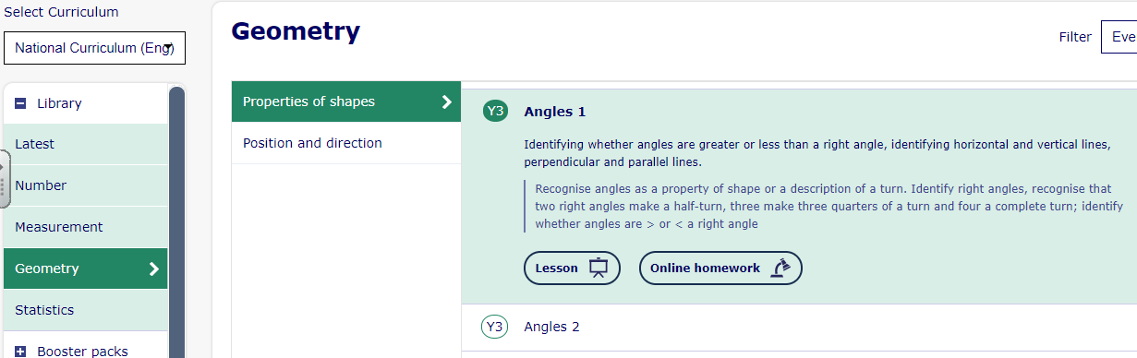
Lesson 3: Horizontal and Vertical Lines
Go back to this Year 3 Lesson on Angles 1. Only do slides 8 and 9 about horizontal and vertical lines.
https://app.mymaths.co.uk/1755-lesson/angles-1

Slide 37
Lesson 3: Horizontal and Vertical Lines
We can describe lines as horizontal or vertical.
A horizontal line runs across, from left to right (or right to left):
A vertical line runs up and down:

Slide 38
Lesson 3: Horizontal and Vertical Lines
Look at this shape.
Where are the horizontal lines?

Slide 39
Lesson 3: Horizontal and Vertical Lines
Remember that some lines may not be either vertical or horizontal.

Slide 40

Lesson 3: Horizontal and Vertical Lines
When we look at symmetry, we can talk about a vertical line
of symmetry.
That means that the line of symmetry goes from top to bottom, like this butterfly:

Slide 41
Lesson 3: Horizontal and Vertical Lines
When we look at symmetry, we can talk about a horizontal line
of symmetry.
That means that the line of symmetry goes from side to side, like this arrow:

Slide 42
Lesson 3: Horizontal and Vertical Lines
Lots of letters have lines of symmetry.
Sort the letters in the box into the Venn diagram:
B
A
F
H
J
C
F
B
X
K
M
A
X
C
M
H
K
J
Vertical line of symmetry
Horizontal line of symmetry

Slide 43
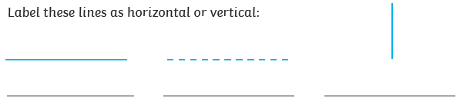
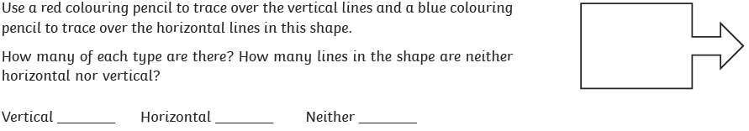
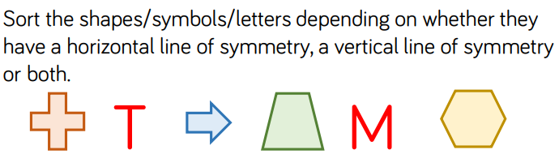
Lesson 3: Horizontal and Vertical Lines

Slide 44
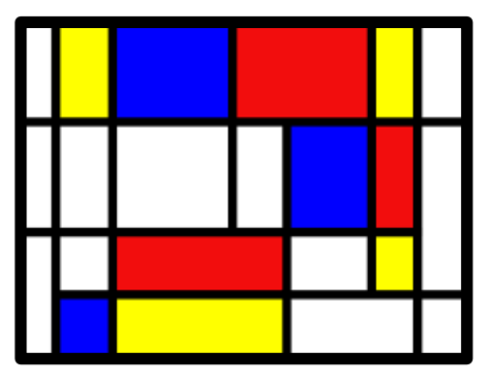
Lesson 3: Horizontal and Vertical Lines
How many horizontal and vertical lines can you spot in this image by Mondrian? Answer on the next slide.
Create your own piece of art work using only horizontal and vertical lines

Slide 45
Lesson 3: Horizontal and Vertical Lines
There are 5 horizontal lines and 8 vertical lines.

Slide 46
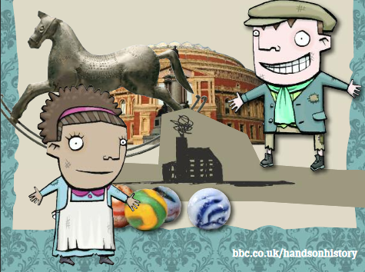
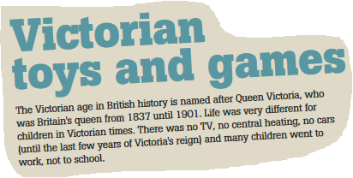
Topic
Task: research some toys and games that were played in The Victorian times.
Print out or draw pictures of the toys and label them.
Challenge: can you put them in a table labelled ‘rich children’ and ‘poor children’.
A good website to use is:
https://victorianchildren.org/victorian-toys-and-victorian-games/

Slide 47

P.E.
It is important to keep your children active. If it is safe to do so, ensure they have some time outside throughout the day. Please visit Joe Wicks YouTube channel (https://www.youtube.com/channel/UCAxW1XT0iEJo0TYlRfn6rYQ), which has lots of exercise videos for children. He will also be hosting a live P.E. lessons Monday to Friday at 9:00am.

Slide 48

Classroom Secrets
The site classroom secrets https://classroomsecrets.co.uk/free-home-learning-packs/ has free class packs which provide some great additional ideas and resources you can use.

