Slide 1

Home Learning
Year 3 Term 6 Week 1

Slide 2
Message from the class teachers
Hi Year Three,
We hope you and your families are all well and have enjoyed the half term break. We have been enjoying the sunshine in the garden and eating lots of ice lollies!
We hope you have been enjoying the work we have set so far. This term’s tasks include some imaginative writing about a magic wardrobe. Where will yours take you?
Don’t forget to keep reading and quizzing. There are lots of free books on http://readon.myon.co.uk
Stay safe and thank you for your continued support.

Slide 3

Reading
Hopefully you have access to books at home, but we have sent home extra books with your child.
Accelerated Reading
Home quizzing is not always recommended but in this case we have adjusted the settings to allow quizzing to happen at home.
If your child wants to read a book from home, please check that there is a quiz available for the book and that the book level (BL) is within or near to your child’s reading range. Also take note of the quiz number for future reference.
To check books please visit: https://www.arbookfind.co.uk/
Go to the next page for how to quiz.

Slide 4



AR quizzing at home.
To log into AR to take a quiz please visit: https://ukhosted27.renlearn.co.uk/2240835/
Your child should know what to do from here and should know their login details. If they are not aware, most details are written in their reading record.
Click on Accelerated reader.
Type in the name the book or the quiz number.
We advise students complete quizzes unaided. If parents/carers wish to support their child, they can do so in the following ways:
Discuss the book with your child as the book is being read
Ask your child to read the question out loud
Re-word questions for your child, if necessary
Ask your child which answers are not correct

Slide 5

Visit http://readon.myon.co.uk

Slide 6

Choose an area that interests you or use the search option.

Slide 7


Using My Maths
Children should know their way round My Maths but here are some reminders on how access the lessons. Visit: www.mymaths.co.uk
bapchild
divide162

Slide 8

Using My Maths
Access any lesson based on what your child is learning in class or search the topic in the search bar.
Use the login portal to access specific homework and lessons that your teacher has set.

Slide 9

Maths – White Rose Home Learning
In school we follow the White Rose scheme of learning. Their website has put together free lessons and resources that link to the learning taking place in school. Please visit: https://whiterosemaths.com/homelearning/

Slide 10



TT Rockstars
To access TT Rockstars please visit: https://play.ttrockstars.com/auth/school
Start typing in the school name or the post code (ME99NL)
Pupils type in their username and password, usually written in their reading record.
Pupils can practice all tables but Year 2 should be practicing 2, 5, and 10’s
Year 3: 2,5,10,3,4,8’s
Year 4,5,6: all tables

Slide 11

Accessing Twinkl
Many educational content providers are offering free access to their resources. Twinkl is a website that we use from time to time to resource our lessons to aid in teacher input and pupil activities.
We will be able to direct you towards activities and learning via this website based on lessons that may be missed due to absence. To access Twinkl please visit: www.twinkl.co.uk/offer
You will have to sign up and put in the offer code: UKTWINKLHELPS

Slide 12
English Learning
Task 1: spelling activity.
Pick 3 words from the Year 3 / 4 Spelling list on the next slide.
Complete the following for each word.
Example: accident
Write the definition An incident that happens unexpectedly that might cause damage or harm.
Split the word into its syllables Ac-ci -dent
Colour code (vowels in one accident
colour, consonants in another)
Identify the tricky part ac c ident (c sounds like s)
Draw the word Draw a picture of the word.
Write the word in a sentence I dropped my drink by accident.

Slide 13
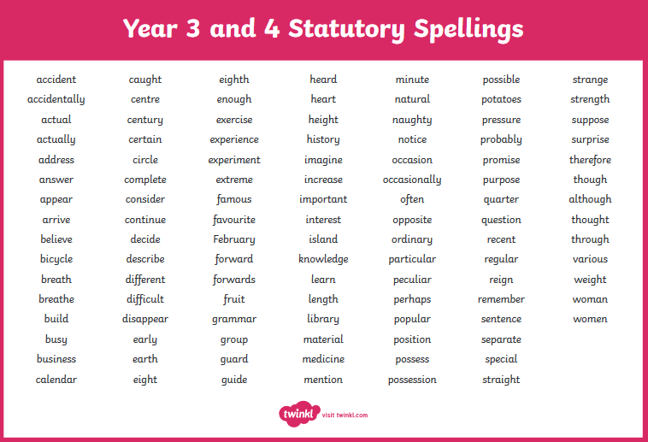

Slide 14
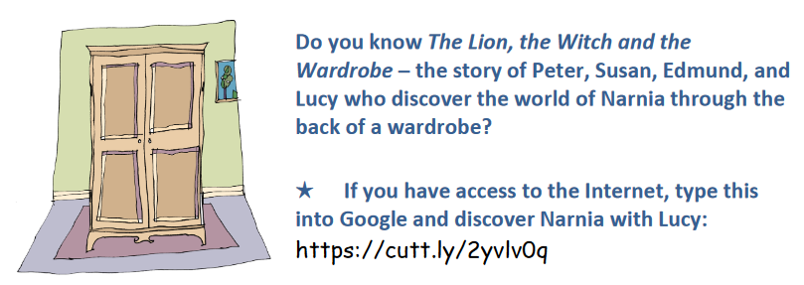
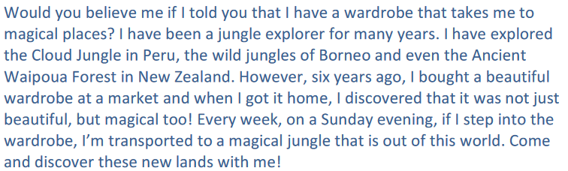
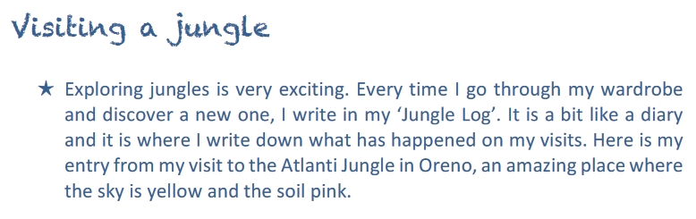

Slide 15
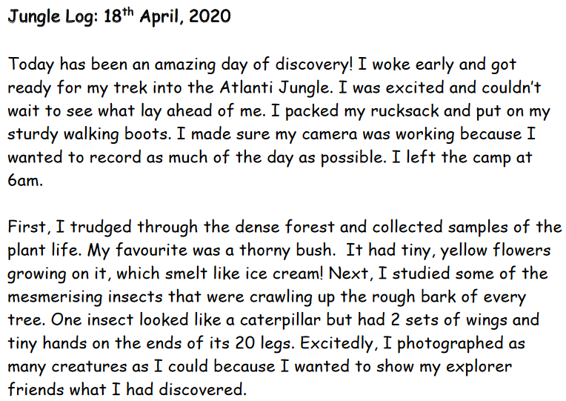

Slide 16
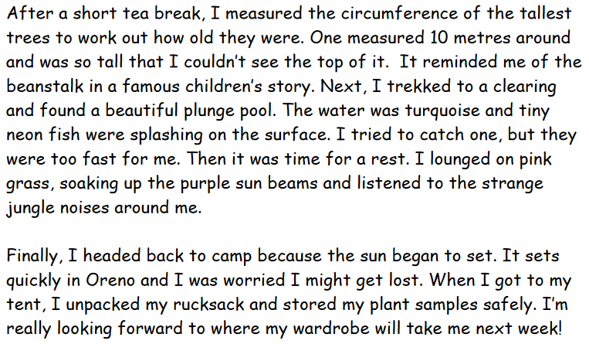

Slide 17
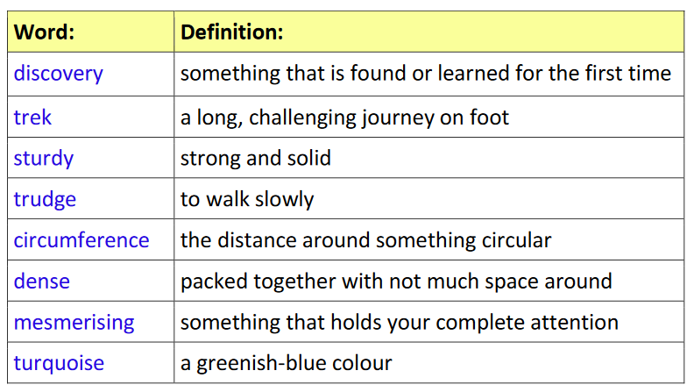
Task 2: vocabulary.
Look at the definitions in the table. Can you draw a picture that best represents the meaning of the following words?
Sturdy
Trudge
Dense
Mesmerising

Slide 18
Task 3: vocabulary.
Use the previous words to find and write a list of of synonyms (words with the same or similar meaning) and then put some of them into sentences. See how they change the meaning of the sentence.
Sturdy
Trudge
Dense
Mesmerising

Slide 19
Maths Learning
Over the next few weeks we will be looking at angles and shapes. The best way to view this learning is by downloading the PowerPoint so that some of the animations will play on the slides.

Slide 20
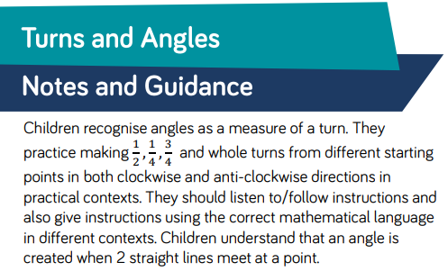
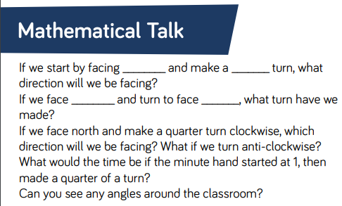
Lesson 1: Turns and Angles

Slide 21

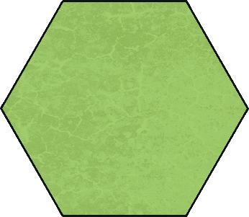
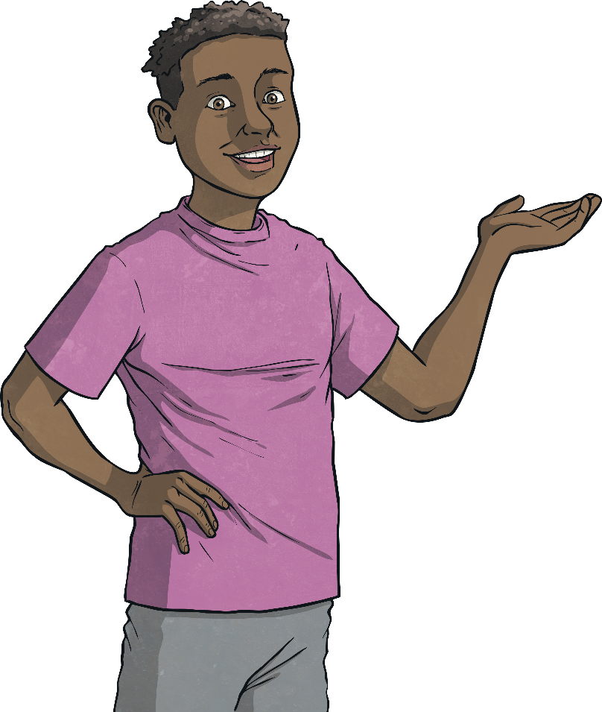
Lesson 1: Turns and Angles
An angle is made when two straight lines meet.
Each of these pictures shows one or more angles.

Slide 22

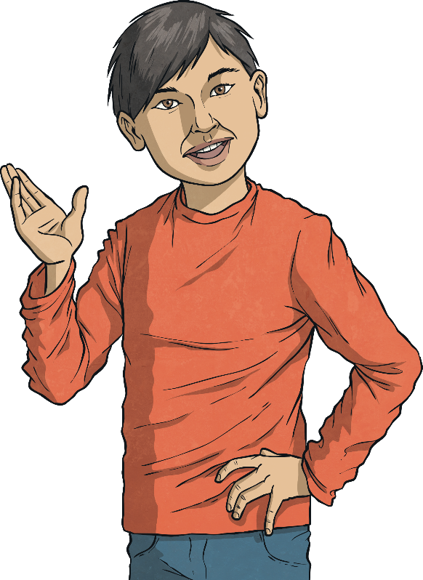

Lesson 1: Turns and Angles
A right angle is made when two lines meet like this:
A quarter turn looks like this:
The size of a right angle is 90°.
When something makes a quarter turn, it turns 90°.

Slide 23




Lesson 1: Turns and Angles
The child is facing the circle. If they make a quarter turn clockwise, which shape will they be facing?

Slide 24
Lesson 1: Turns and Angles
The child is facing the rectangle. If they make a three-quarter turn anticlockwise, which shape will they be facing?

Slide 25
Lesson 1: Turns and Angles
The child makes a quarter turn clockwise to face the circle.
Is there another way he could have turned to end up in the same position?

Slide 26

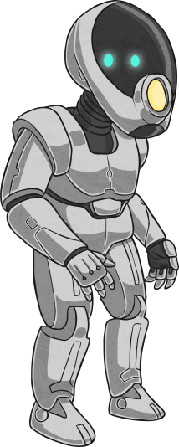


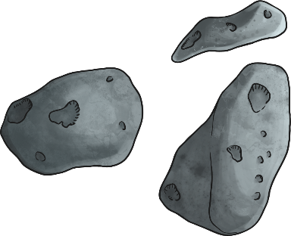

Lesson 1: Turns and Angles
What turning instructions would you give to the robot to escape the maze?

Slide 27
Lesson 1: Turns and Angles
Activity 1
Take your child outside or into a large space so they can practice moving in turns themselves. Label 4 walls/points (for example: North, South, East, West). Give children instructions to encourage them to make ½ , ¼ , ¾ and whole turns from different starting points. Allow your children the opportunity to give instructions to you as well.

Slide 28

Lesson 1: Turns and Angles
Activity 2
The letter ‘X’ has four angles.
Write your name in capital letters. How many angles can you see in each letter? How many angles are there in your full name?

Slide 29
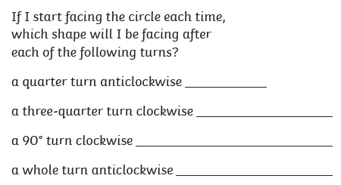
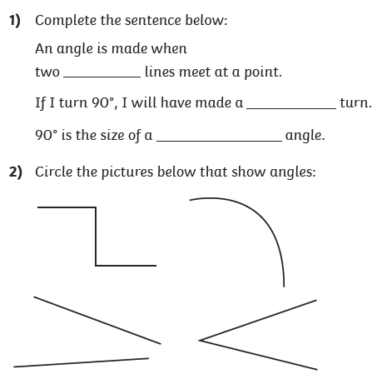
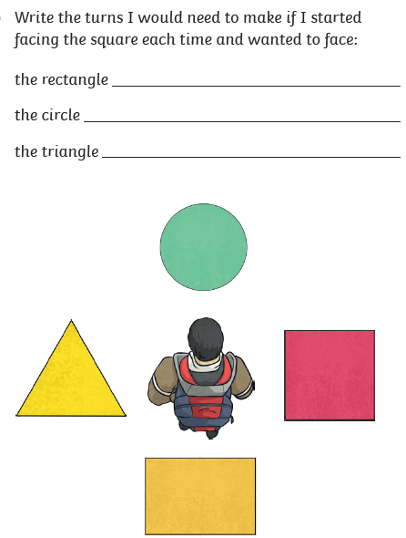
Lesson 1: Turns and Angles

Slide 30
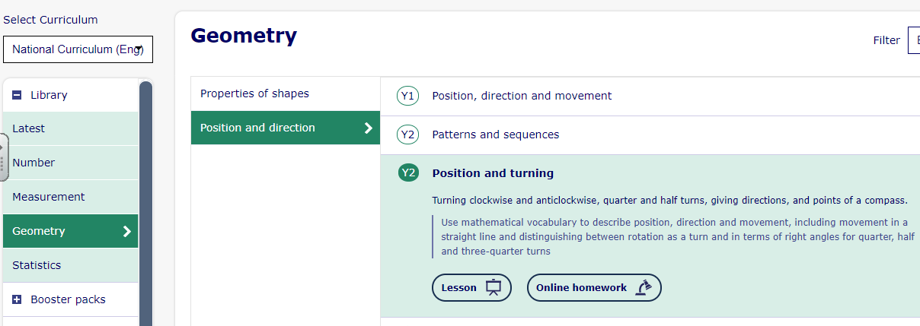
Lesson 2: Turns and angles continued.
Building on from lesson 1. Complete these My Maths slides and the online homework that goes with it. Either log in to your portal or click the link to access the activity for this lesson.

Slide 31
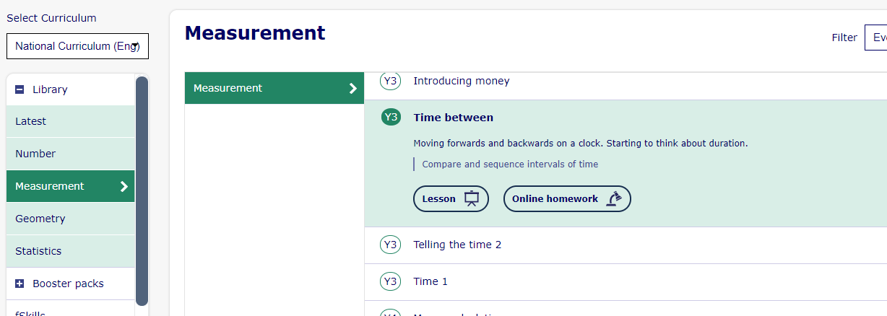
Lesson 1: Finding the Duration
Log in to My Maths and complete all the slides on this lesson Y3 Time Between. I have set the homework for you too if you want to log in to your portal and complete it. Otherwise you can click the online homework button and have a go that way.

Slide 32
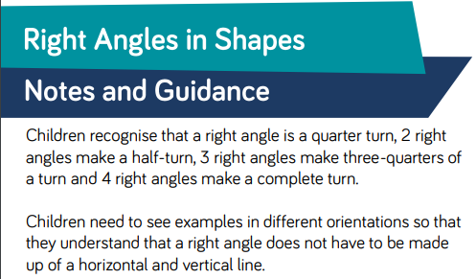
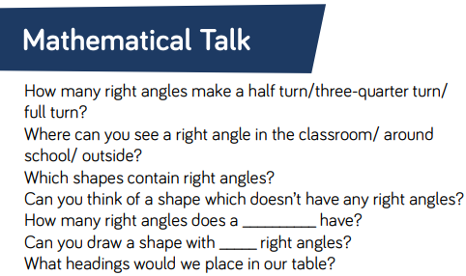
Lesson 3: Right Angles in Shapes

Slide 33



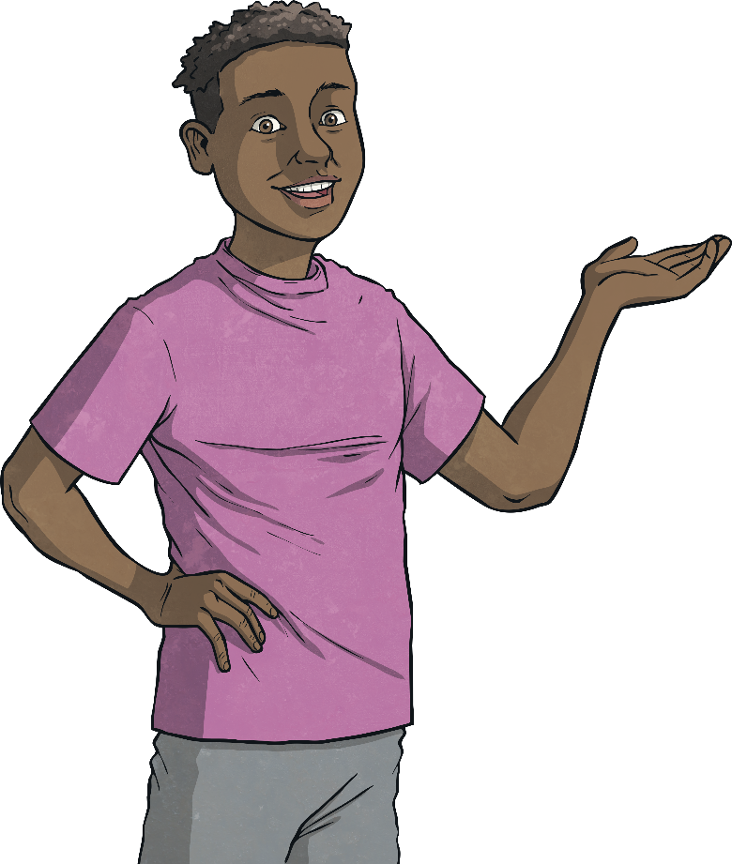
Lesson 3: Right Angles in Shapes
Look at these shapes.
They each have a special type of angle called a right angle in one or more of their corners.

Slide 34
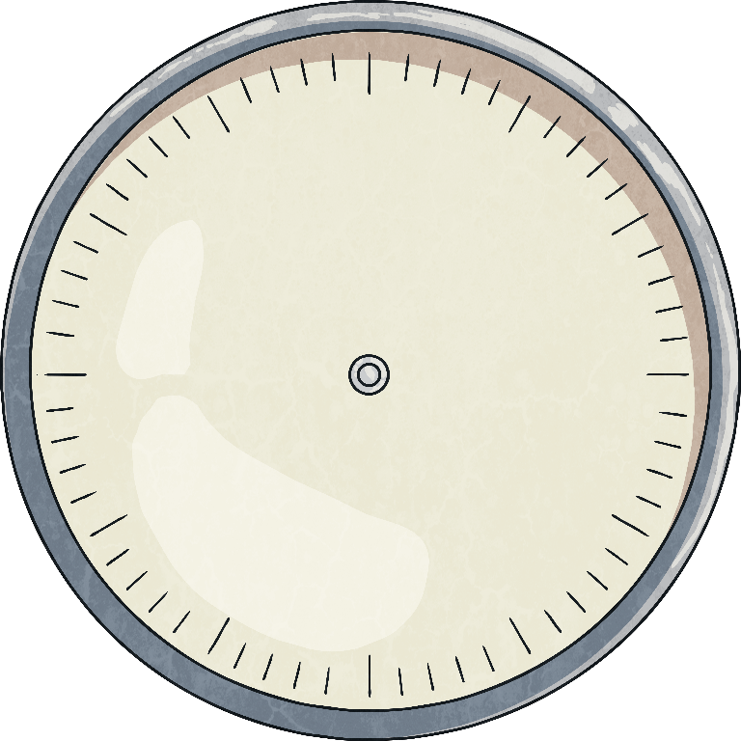
Lesson 3: Right Angles in Shapes
We can also think of a right angle as a quarter turn.
Click to see the arrow make a quarter turn.

Slide 35
Lesson 3: Right Angles in Shapes
Can you see any shapes here that have right angles in them?

Slide 36

Lesson 3: Right Angles in Shapes
Look at these letters:
HEN
Can you see right angles where any of the lines meet?

Slide 37


Lesson 3: Right Angles in Shapes
One of these shapes is different to the others:
Can you explain why?
This triangle is the only shape without a right angle.

Slide 38
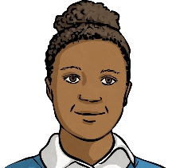
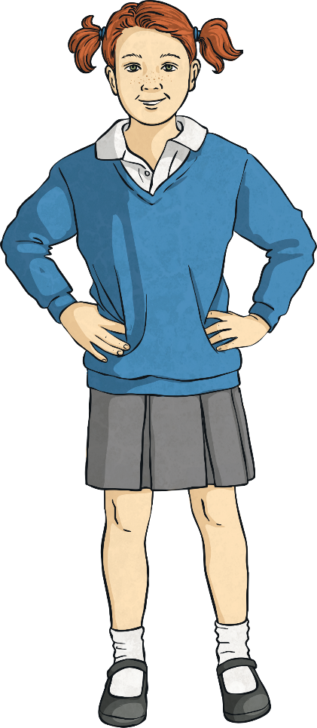
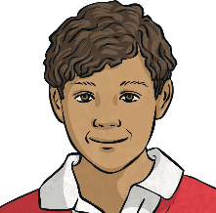
Lesson 3: Right Angles in Shapes
Three children have drawn a shape each.
Can you match the child to their shape from their descriptions?
My shape has half the number of right angles that Joseph’s has.
Penny
My shape has as least double the number of right angles that Joseph’s shape has.
Angelina
My shape has the same number of right angles as a square.
Joseph

Slide 39
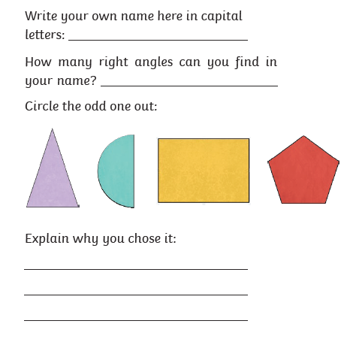

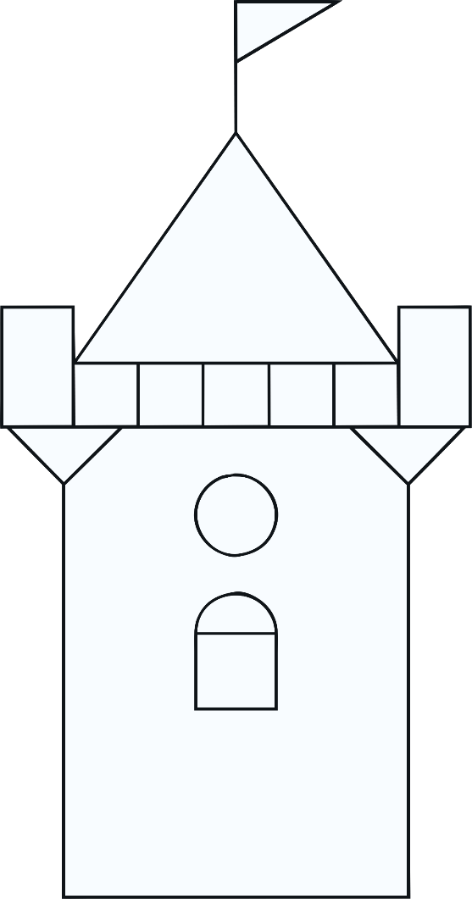
Lesson 3: Right Angles in Shapes
Activity 1
Look at this picture.
Activity 2
How many right angles can you spot in it?
Activity 3

Slide 40
Art
Continuing on from the last Art task, we will be looking at typography – the style and appearance of writing.
Have a look around your house, garden or even on a walk for everyday items. Can you find nuts and bolts in the tool box? Leaves or flowers? Beads? Pegs? Shells?
Task: can you use these items to create its own word?
Eg. Can you create the word ‘stick’ using sticks? Can you create the word ‘leaf’ using leaves? Can you create the word ‘Daisy’ using daisies?
Use your imagination. I look forward to seeing some of your creations!

Slide 41

P.E.
It is important to keep your children active. If it is safe to do so, ensure they have some time outside throughout the day. Please visit Joe Wicks YouTube channel (https://www.youtube.com/channel/UCAxW1XT0iEJo0TYlRfn6rYQ), which has lots of exercise videos for children. He will also be hosting a live P.E. lessons Monday to Friday at 9:00am.

Slide 42

Classroom Secrets
The site classroom secrets https://classroomsecrets.co.uk/free-home-learning-packs/ has free class packs which provide some great additional ideas and resources you can use.

