Slide 1

Home Learning
Year 3 Half Term

Slide 2
Message from the class teachers
Hi Year Three,
What a strange term! It seems forever ago that we were all together in school. We still miss you very much. Here are some possible activities that you can do over the half term.
Have a nice break this week and hopefully there is more sunshine on the way to encourage you to have fun outside. Stay safe!
Thank you for your continued support.

Slide 3

Keep on Reading!
Visit http://readon.myon.co.uk
Choose one (or more) of the following classic stories. If you want to, have a go at writing an alternative ending.
Continue to practise your joined up handwriting. This phrase is a good one as it includes all the letters of the alphabet:
The quick brown fox jumps over the lazy dog.

Slide 4
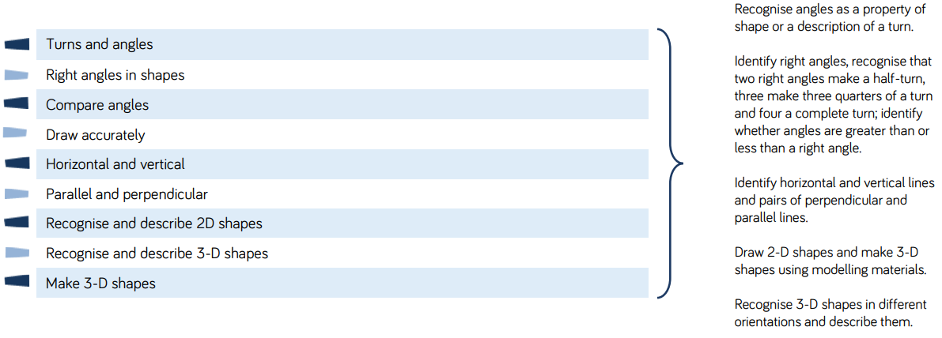
Continue learning and practising your 2, 3, 4, 5, 8 and 10 times tables. Can you make a times table board game?
Below are some of the topics in maths that we will be covering next term if you want to find some games online or search My Maths to get a head start.

Slide 5

Have a go at making a poster, leaflet, PowerPoint or a page for an information book that answers these questions:
What is the NHS?
Who founded it?
When did the NHS begin?
Why do we have an NHS?
How many people work for the NHS?
Why is the NHS so special?
Do all countries have an NHS? Why?
What kind of jobs are involved in the NHS?

