Slide 1

Home Learning
Year 3 Term 5 Week 6

Slide 2
Message from the class teacher
Hi Year Three,
We hope you and your families are all well. School seems a distant memory now but we know that you will all be helping your families through this difficult and very strange time. The weather looks to be coming nice again this week so make sure you get outside in your garden or a safe place and play.
This week brings a longer writing task (using the work you have been doing over the last few weeks) and there is also a nice art task for you this week too. Keep reading and quizzing – we do keep an eye on what you are reading and how you are quizzing.
Take care and we miss you lots and lots.
Thank you for your continued support.

Slide 3

Reading
Hopefully you have access to books at home, but we have sent home extra books with your child.
Accelerated Reading
Home quizzing is not always recommended but in this case we have adjusted the settings to allow quizzing to happen at home.
If your child wants to read a book from home, please check that there is a quiz available for the book and that the book level (BL) is within or near to your child’s reading range. Also take note of the quiz number for future reference.
To check books please visit: https://www.arbookfind.co.uk/
Go to the next page for how to quiz.

Slide 4



AR quizzing at home.
To log into AR to take a quiz please visit: https://ukhosted27.renlearn.co.uk/2240835/
Your child should know what to do from here and should know their login details. If they are not aware, most details are written in their reading record.
Click on Accelerated reader.
Type in the name the book or the quiz number.
We advise students complete quizzes unaided. If parents/carers wish to support their child, they can do so in the following ways:
Discuss the book with your child as the book is being read
Ask your child to read the question out loud
Re-word questions for your child, if necessary
Ask your child which answers are not correct

Slide 5

Visit http://readon.myon.co.uk

Slide 6

Choose an area that interests you or use the search option.

Slide 7


Using My Maths
Children should know their way round My Maths but here are some reminders on how access the lessons. Visit: www.mymaths.co.uk
bapchild
divide162

Slide 8

Using My Maths
Access any lesson based on what your child is learning in class or search the topic in the search bar.
Use the login portal to access specific homework and lessons that your teacher has set.

Slide 9



TT Rockstars
To access TT Rockstars please visit: https://play.ttrockstars.com/auth/school
Start typing in the school name or the post code (ME99NL)
Pupils type in their username and password, usually written in their reading record.
Pupils can practice all tables but Year 2 should be practicing 2, 5, and 10’s
Year 3: 2,5,10,3,4,8’s
Year 4,5,6: all tables

Slide 10

Accessing Twinkl
Many educational content providers are offering free access to their resources. Twinkl is a website that we use from time to time to resource our lessons to aid in teacher input and pupil activities.
We will be able to direct you towards activities and learning via this website based on lessons that may be missed due to absence. To access Twinkl please visit: www.twinkl.co.uk/offer
You will have to sign up and put in the offer code: UKTWINKLHELPS

Slide 11
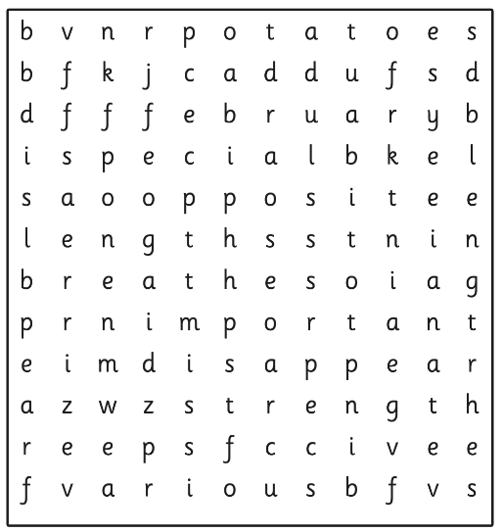
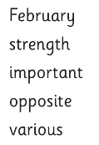
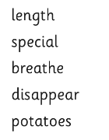
English Learning
Task 1: spelling word search.

Slide 12
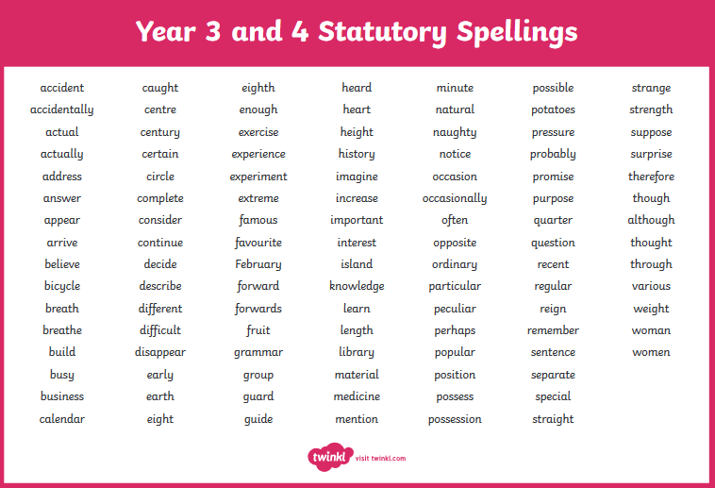

Slide 13
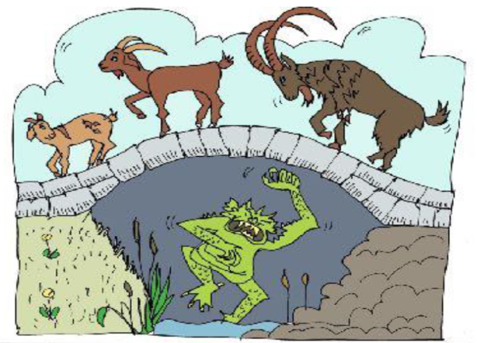
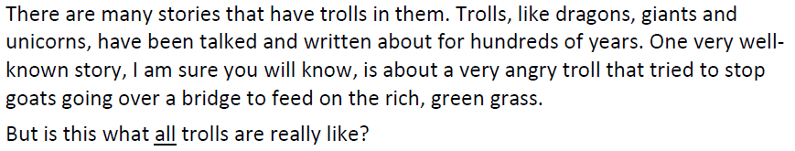
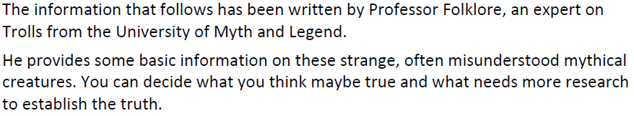
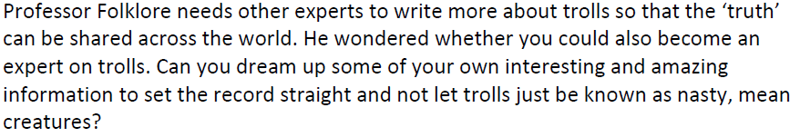
Task 2: The Truth about Ogres

Slide 14
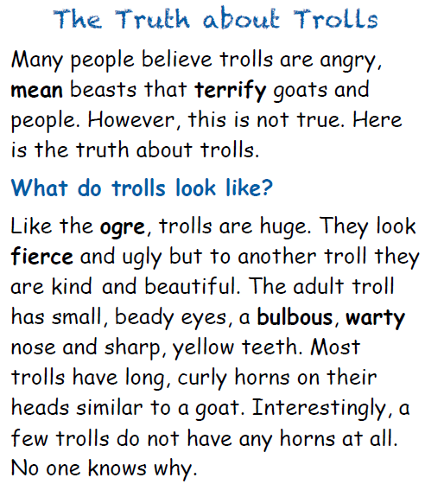

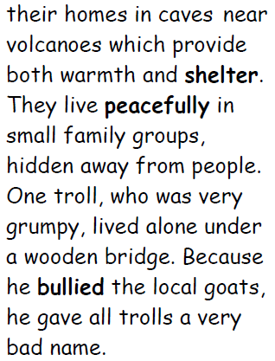
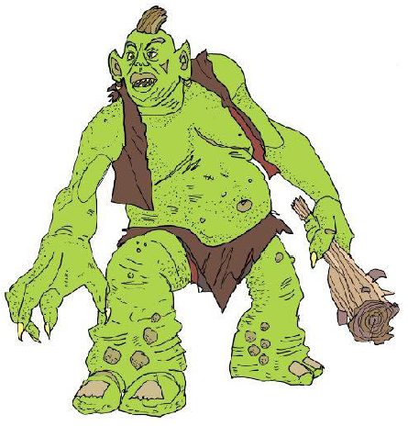

Slide 15
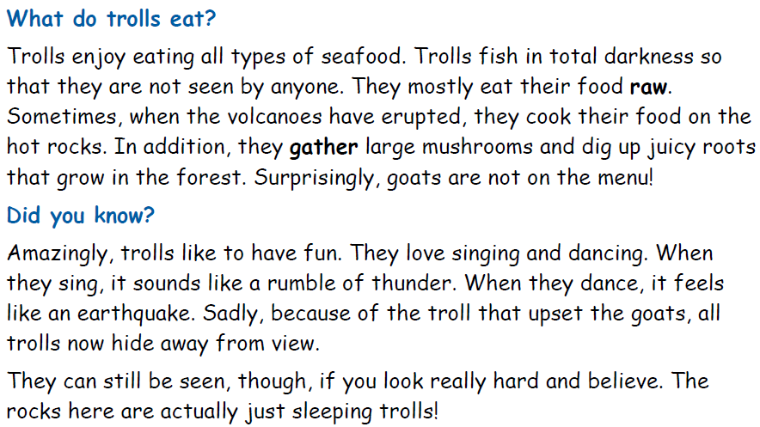
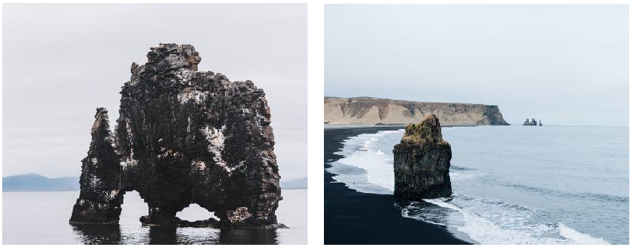

Slide 16
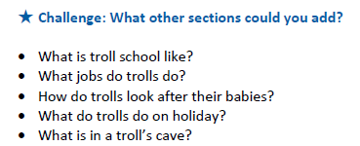
Now is time to link all your work from the last few weeks together.
Task 2: plan a report (non-chronological) about trolls. Base it on the troll you created in week 3.
Just write bullet points at this point.
Heading | Notes
Introduction | Start with a rhetorical question. Have you ever wondered…? Trolls are often seen to be…
What do trolls look like? | Describe appearance and manner.
Where do trolls live? | Describe the trolls habitat.
What do trolls eat? | Tell the reader the things that trolls eat and don’t eat.
Did you know? | Keep your most interesting facts for this paragraph. Use your imagination!!

Slide 17
Task 3: write your report named ‘The Truth about Trolls’.
Remember to include:
Your title;
Your introduction;
Headings underlined;
Exciting adjectives (bulbous) and verbs (gather) – week 3;
Expanded noun phrases (small, beady eyes) – week 4;
Sentence of 3 (wicked eyes, a hooked nose and terrible breath) – week 4;
Add on adverbs (additionally, also, furthermore) – week 5;
Engaging adverbs (Interestingly, surprisingly, amazingly) – week 5;
Conclusion – your most interesting facts.
Use the original report to help you with ideas.
Have fun writing your report and remember to use your imaginations!

Slide 18
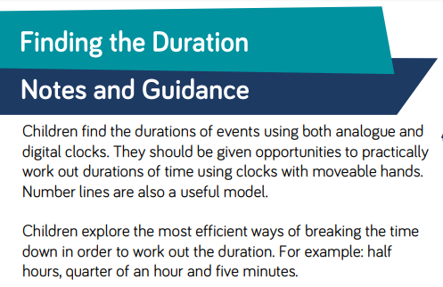
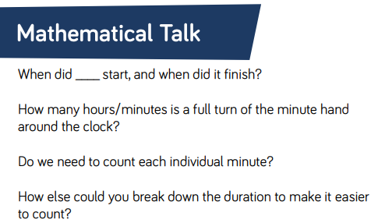
Maths Learning
Lesson 1: Finding the Duration

Slide 19
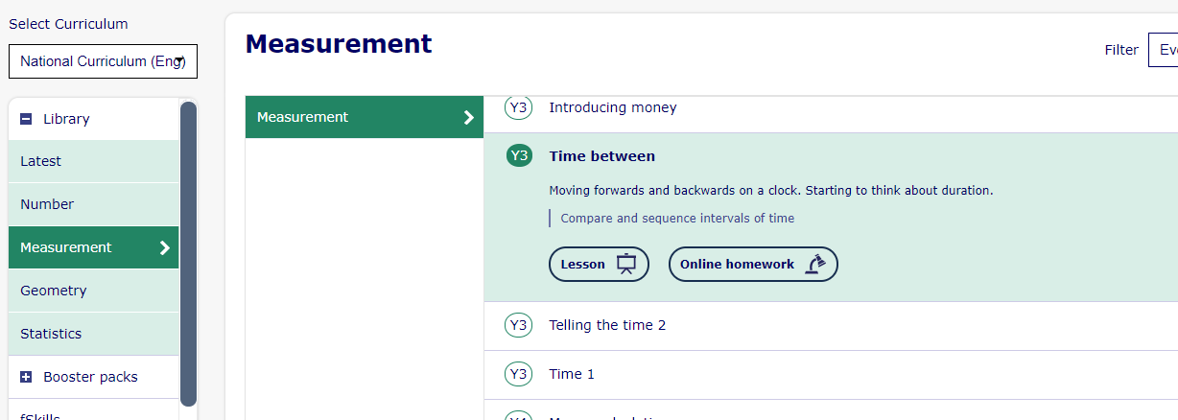
Lesson 1: Finding the Duration
Log in to My Maths and complete all the slides on this lesson Y3 Time Between. I have set the homework for you too if you want to log in to your portal and complete it. Otherwise you can click the online homework button and have a go that way.

Slide 20
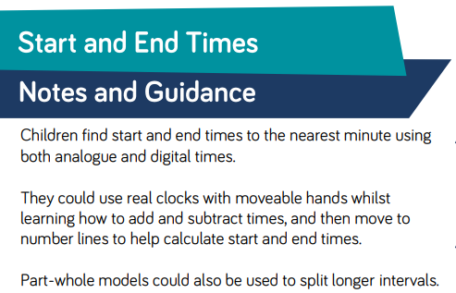
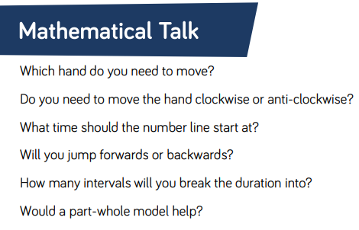
Lesson 2: Start and End Times

Slide 21
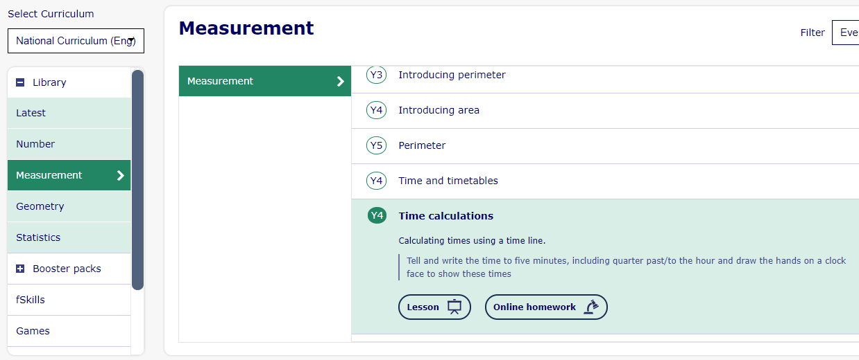
Lesson 2: Start and End Times

Slide 22
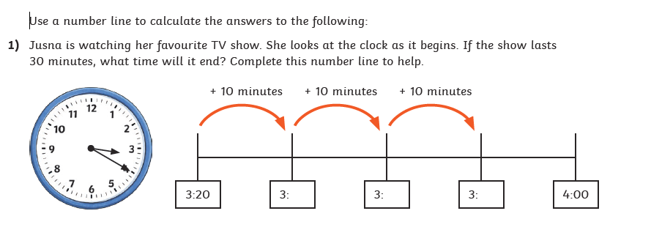
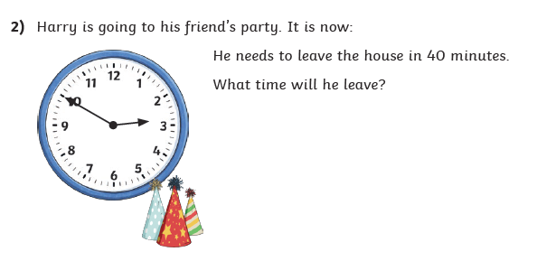


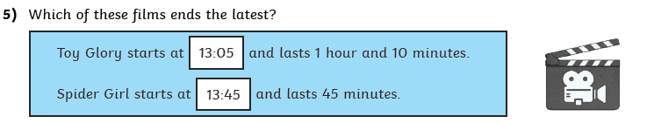
Lesson 2: Start and End Times – Draw number lines to work out the times

Slide 23
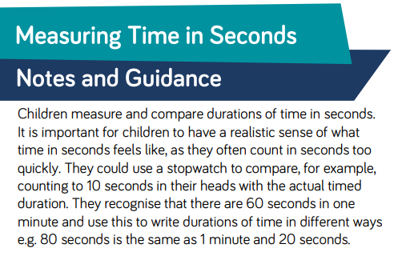

Lesson 3: Time in Seconds
If you don’t have a stopwatch, most smart phones have one in the clock app. Or just google stopwatch on Google and one will come up.

Slide 24

Lesson 3: Time in Seconds
http://www.experiments.cwandt.com/10sec/play.php
Click this link and see if you can count in your head and then stop the timer at 5 seconds. Have a go at 10 seconds. How close can you get?

Slide 25
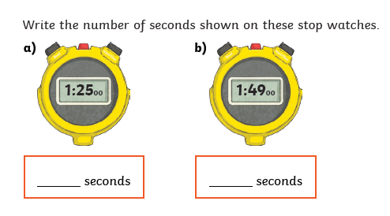
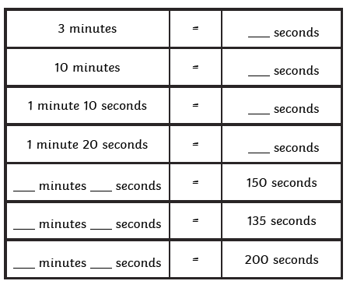
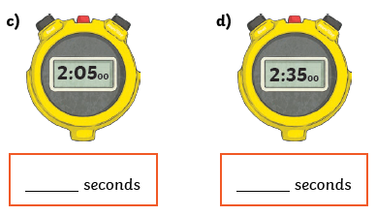
Lesson 3: Time in Seconds
Activity: Use a stopwatch to find the length of time it takes, in seconds, to complete different tasks. For example, run across garden, do 10 star jumps, write your name 5 times, drink a glass of water. How long did each task take? Order the tasks based on the time they took to complete.
Complete the table (remember : 1 min = 60 sec)
Bonus Challenge: Time how long it takes you to clean your room. Then try and beat that time tomorrow and each day after that!!!

Slide 26
Art
Writing is all around us but there are very different and exciting fonts. Try and find as many different fonts around your house as you can. Look at food packages, adverts on telly, brands, in reading books and on toys. Even look on your computer in a word programme or online.
TASK: can you write your name in 10 different fonts?
Mrs Green
Mrs Green
Mrs Green
Mrs Green

Slide 27

P.E.
It is important to keep your children active. If it is safe to do so, ensure they have some time outside throughout the day. Please visit Joe Wicks YouTube channel (https://www.youtube.com/channel/UCAxW1XT0iEJo0TYlRfn6rYQ), which has lots of exercise videos for children. He will also be hosting a live P.E. lessons Monday to Friday at 9:00am.

Slide 28

Classroom Secrets
The site classroom secrets https://classroomsecrets.co.uk/free-home-learning-packs/ has free class packs which provide some great additional ideas and resources you can use.

