Slide 1


Using A.M. and P.M.

Slide 2
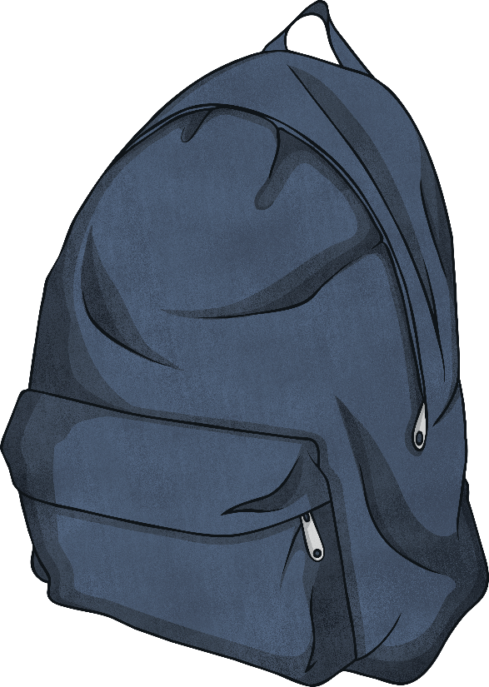
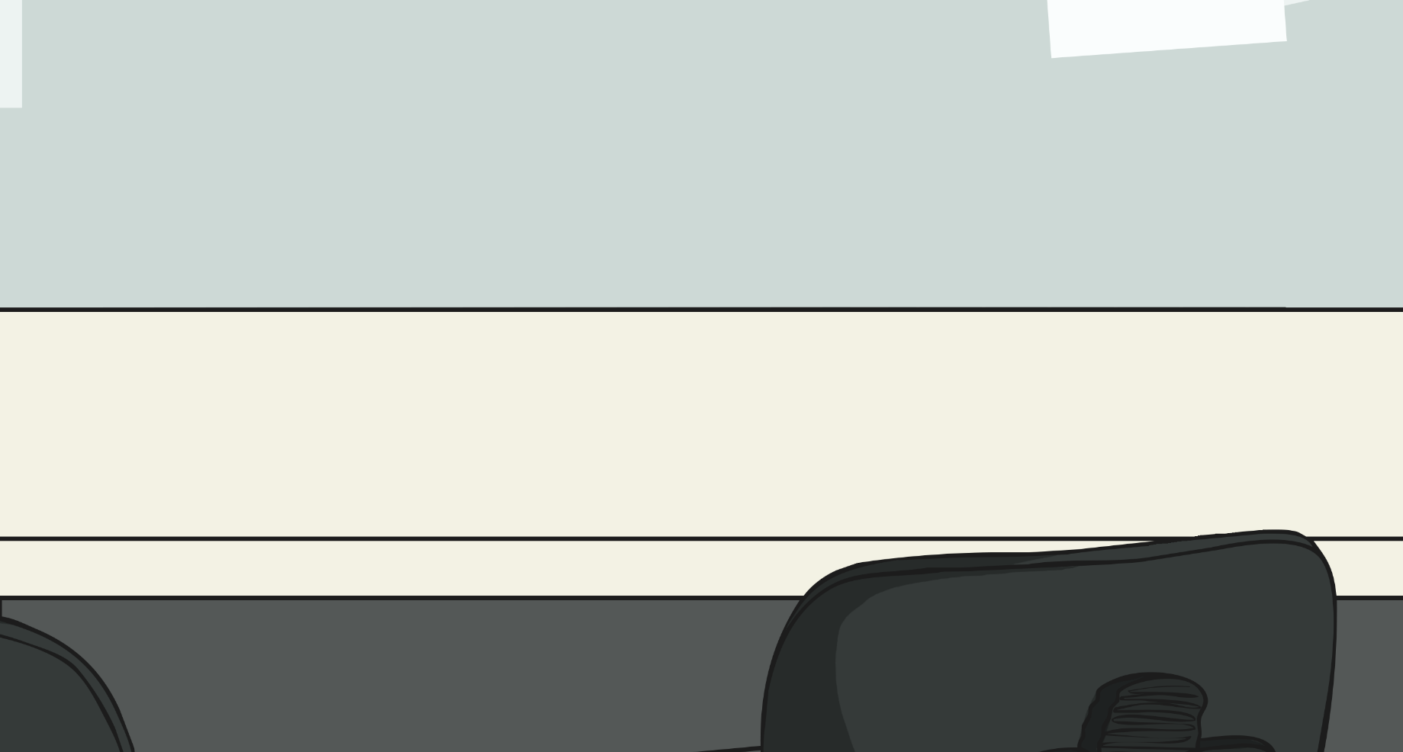
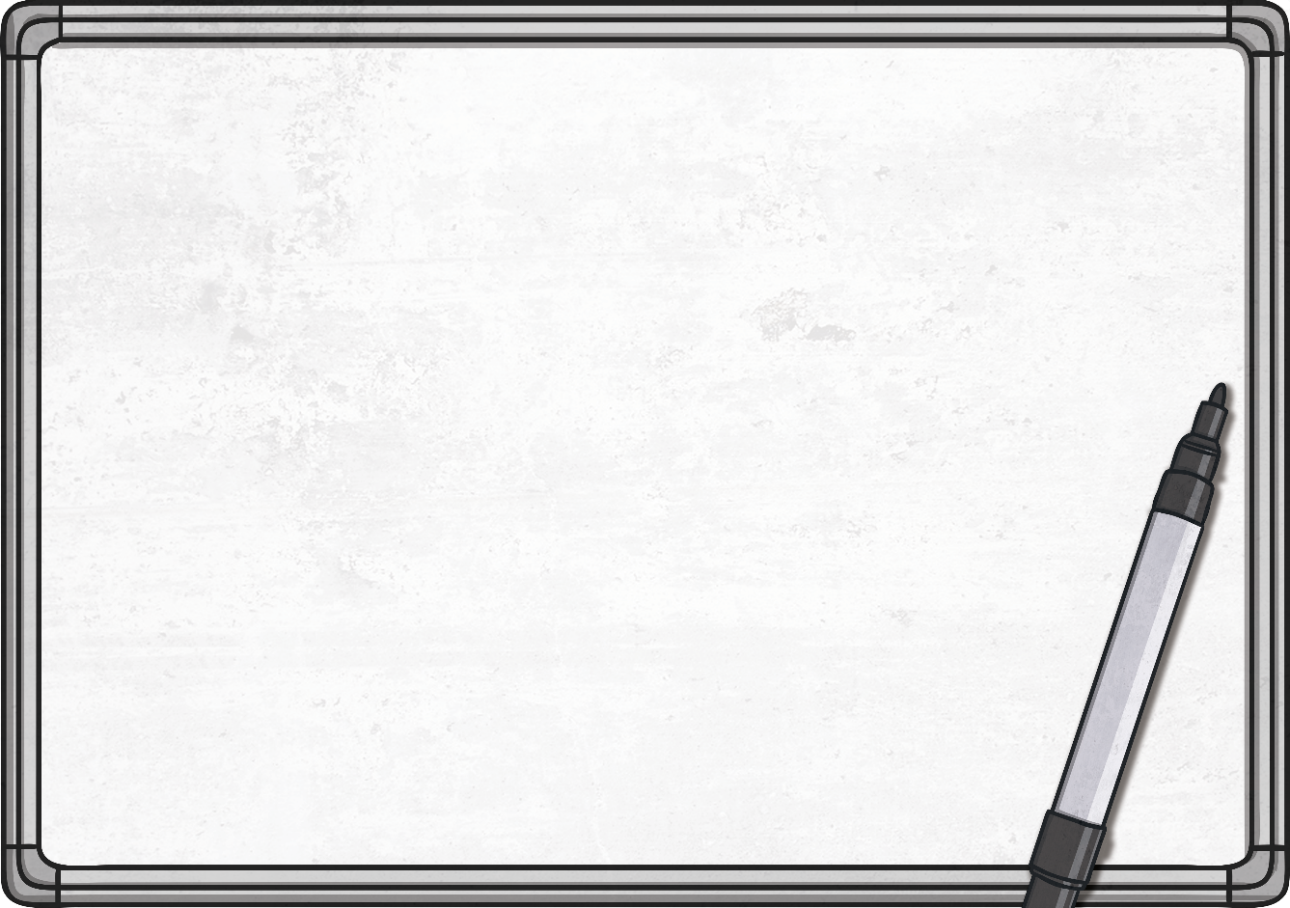
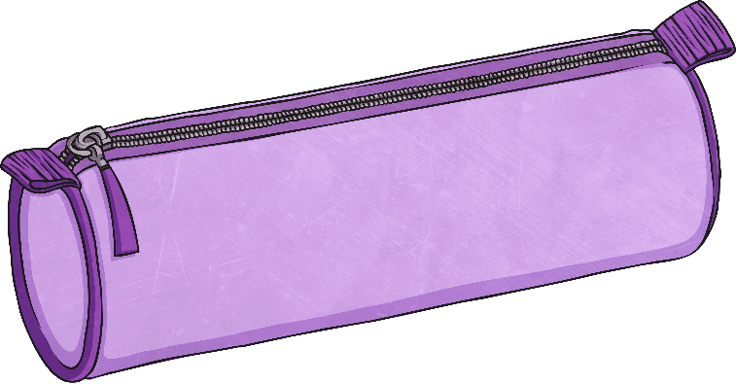
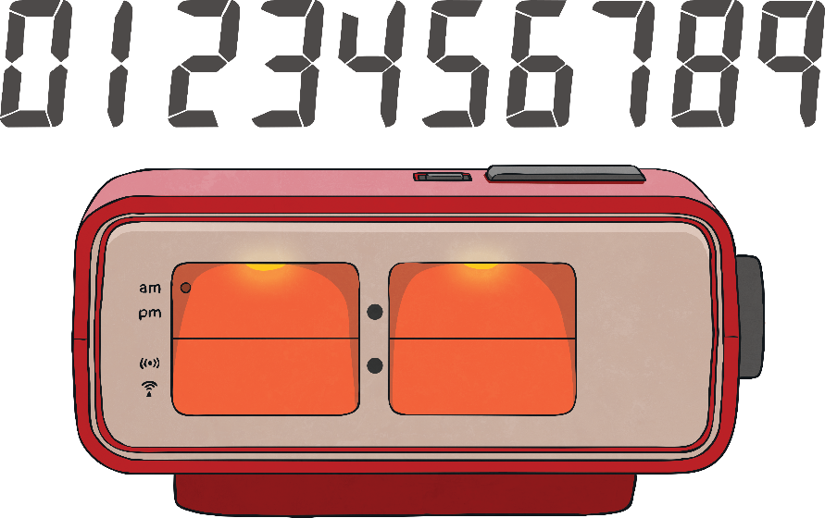

Digital Times
Write the time in numbers and words on a whiteboard.
5 past 5

Slide 3

Digital Times
Write the time in numbers and words on a whiteboard.
25 past 12

Slide 4
Digital Times
Write the time in numbers and words on a whiteboard.
25 to 4

Slide 5
Digital Times
Write the time in numbers and words on a whiteboard.
20 to 9

Slide 6
Digital Times
Write the time in numbers and words on a whiteboard.
5 past 11

Slide 7
Digital Times
Write the time in numbers and words on a whiteboard.
quarter to 5

Slide 8
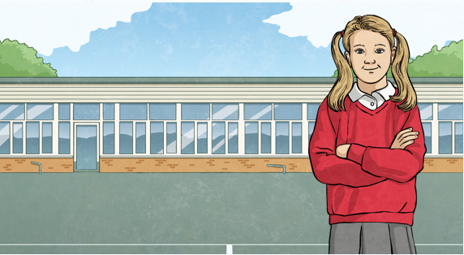
Times of the Day
There are 24 hours in a day, but there are only 12 hours on a clock.
We tell the time by splitting the 24 hours into two.
12 o’clock at night is called midnight.
12 o’clock in the day is called midday,
or noon.
The time between midnight and midday is referred to as a.m..
The time from midday to midnight is referred to as p.m..

Slide 9
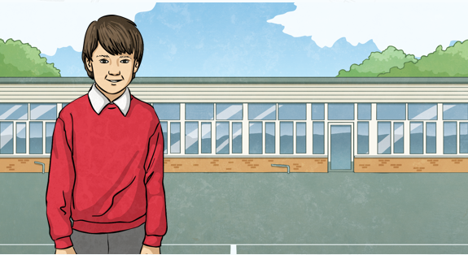
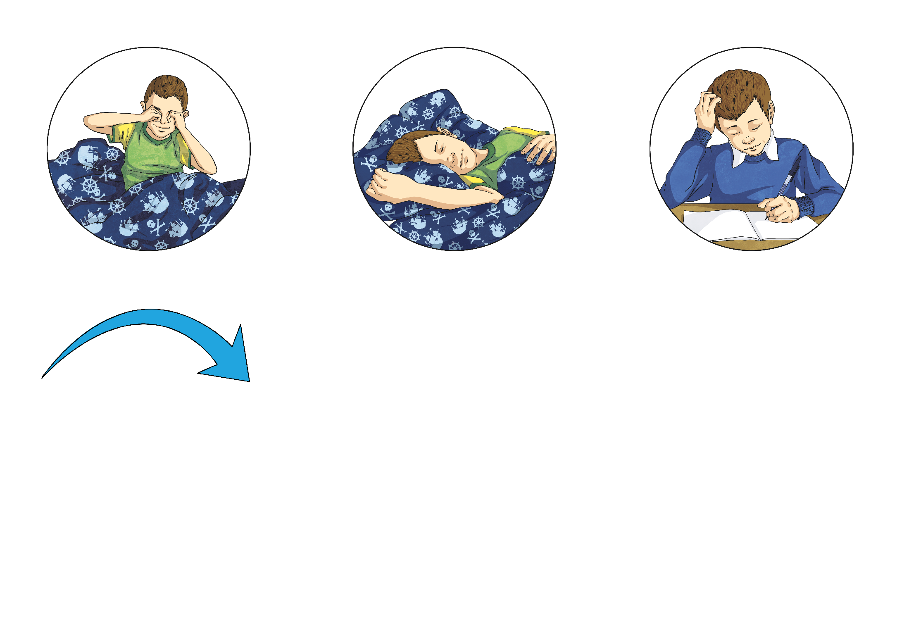
Times of the Day
The day is split into different parts, like the chapters of a book.
Some events in the day happen during a.m. times, like waking up and going to school.
Some events happen at p.m. times, like going home from school and going to bed.
Some events might happen at both a.m.
and p.m. times.
a.m.
p.m.

Slide 10
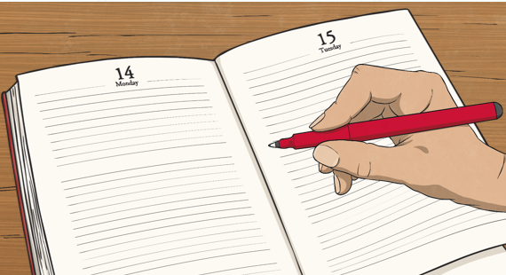
A.M. or P.M. or Both?
Call out if these events usually happen in the a.m. or p.m. or both.
You go to sleep at night.

Slide 11
A.M. or P.M. or Both?
Call out if these events usually happen in the a.m. or p.m. or both.
You eat breakfast.

Slide 12
A.M. or P.M. or Both?
Call out if these events usually happen in the a.m. or p.m. or both.
You brush your teeth.

Slide 13
A.M. or P.M. or Both?
Call out if these events usually happen in the a.m. or p.m. or both.
You wake up in the morning.

Slide 14
A.M. or P.M. or Both?
Call out if these events usually happen in the a.m. or p.m. or both.
You eat your evening meal.

Slide 15
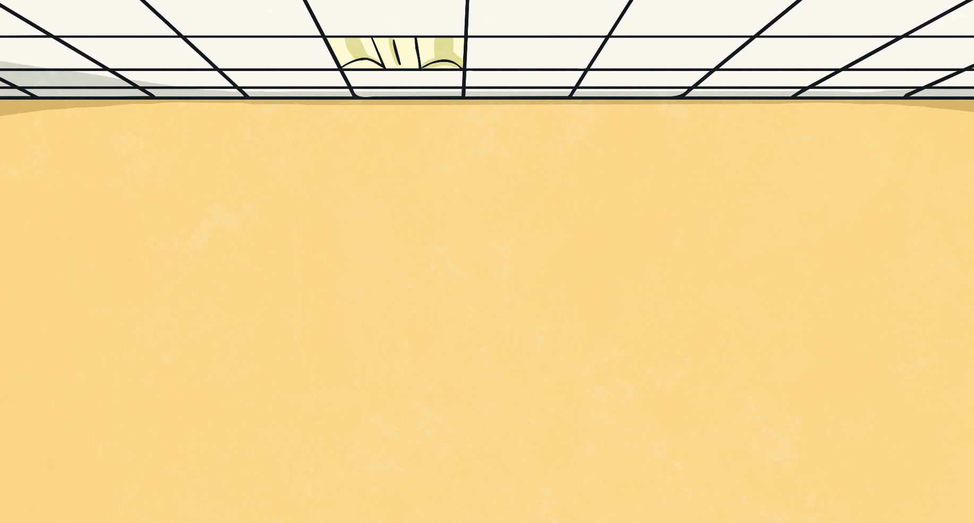
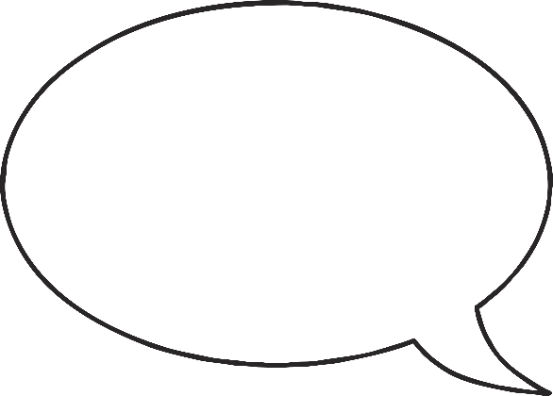
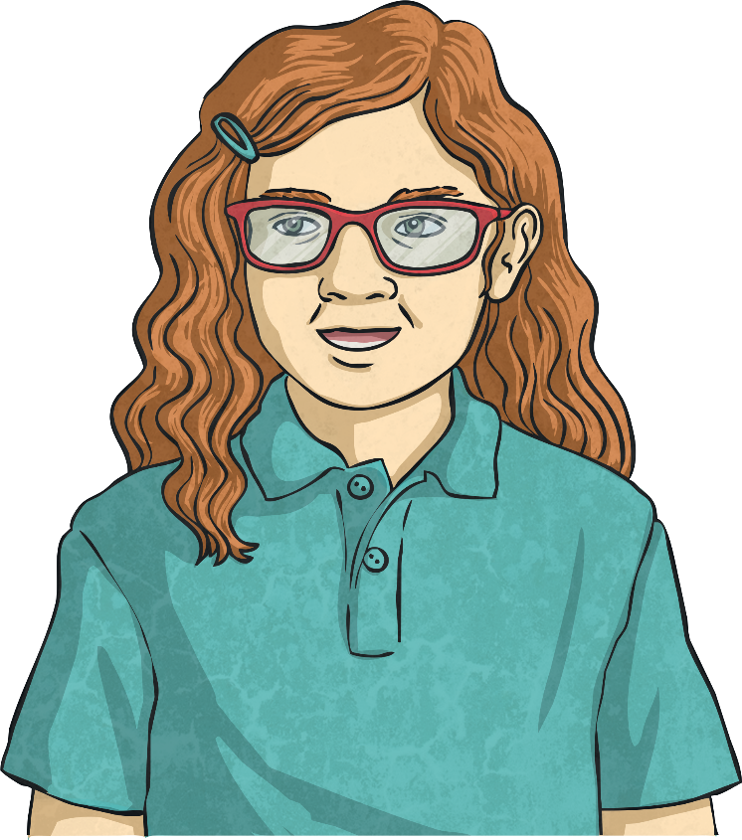
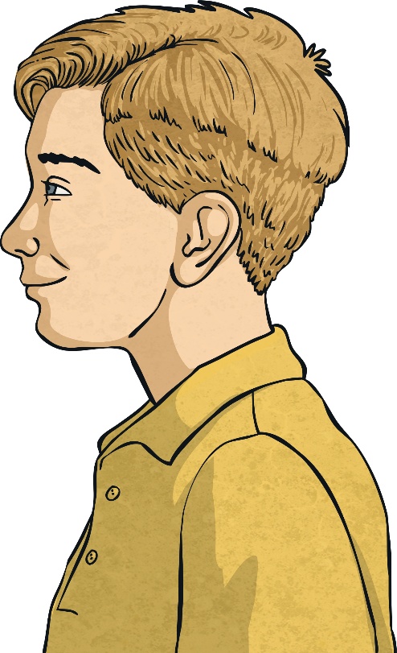
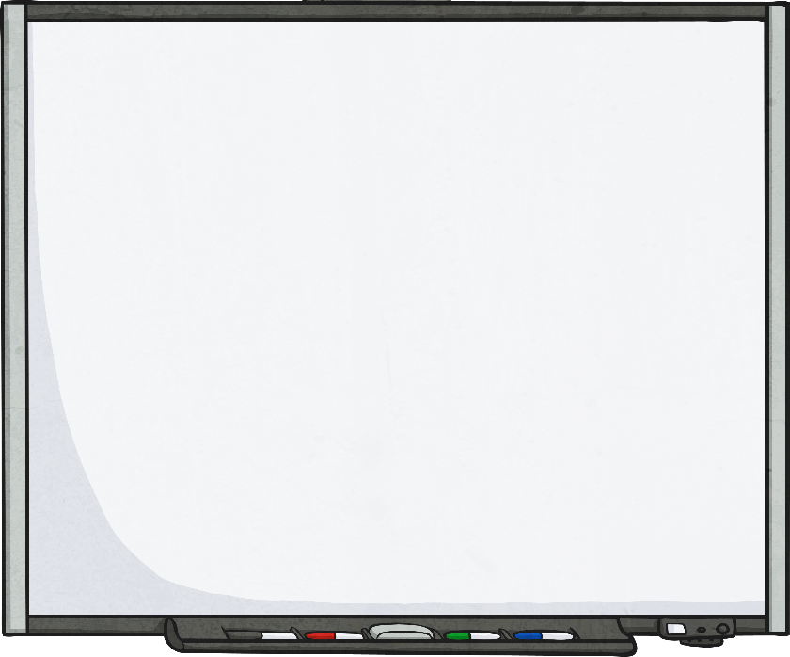
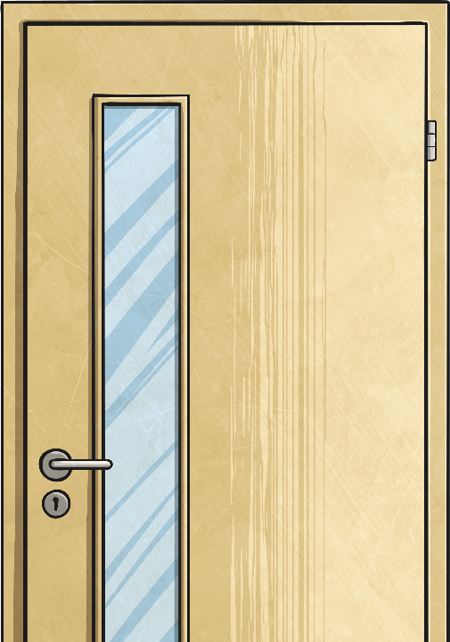

Writing Times Using A.M. and P.M.
Mostly, we use a.m. or p.m. when reading and writing digital times.
So 9 o’clock in the morning would be written as:
And 9 o’clock in the evening would be written as:
9:00 a.m.
9:00 p.m.

Slide 16
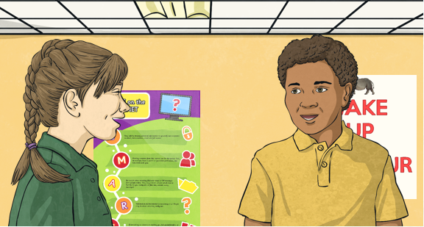
Writing Times Using A.M. and P.M.
Can you change these written times to digital times?
How would you write half past 3 in the afternoon?
3:30 p.m.

Slide 17
Writing Times Using A.M. and P.M.
Can you change these written times to digital times?
How would you write quarter to 8 in the morning?
7:45 a.m.

Slide 18
Writing Times Using A.M. and P.M.
Can you change these written times to digital times?
How would you
write 5 to 4 in the
afternoon?
3:55 p.m.

Slide 19
Writing Times Using A.M. and P.M.
Can you change these written times to digital times?
How would you
write 10 to 12
at night?
11:50 p.m.

Slide 20
Writing Times Using A.M. and P.M.
Can you change these written times to digital times?
How would you
write 20 past 3
in the morning?
3:20 a.m.

Slide 21

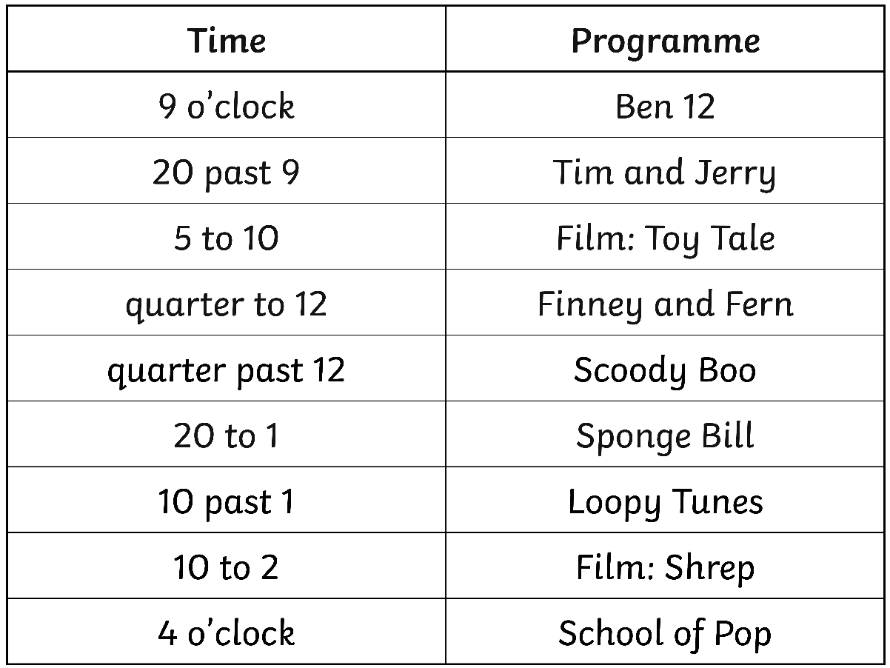
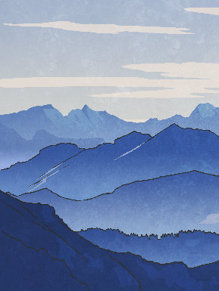
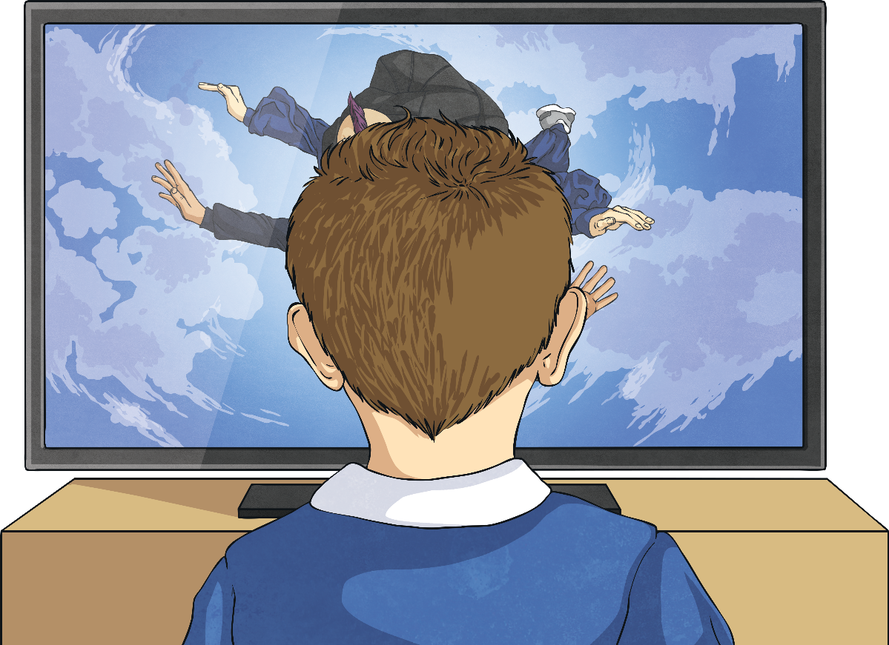
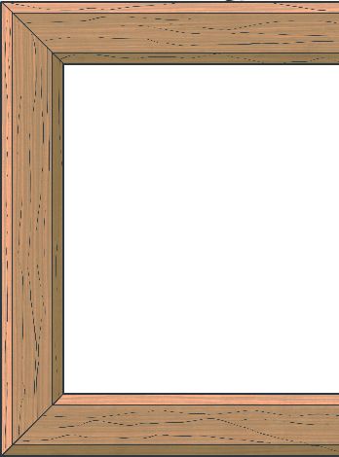
TV Schedule
Here is a TV schedule, starting at 9 o’clock in the morning.

Slide 22
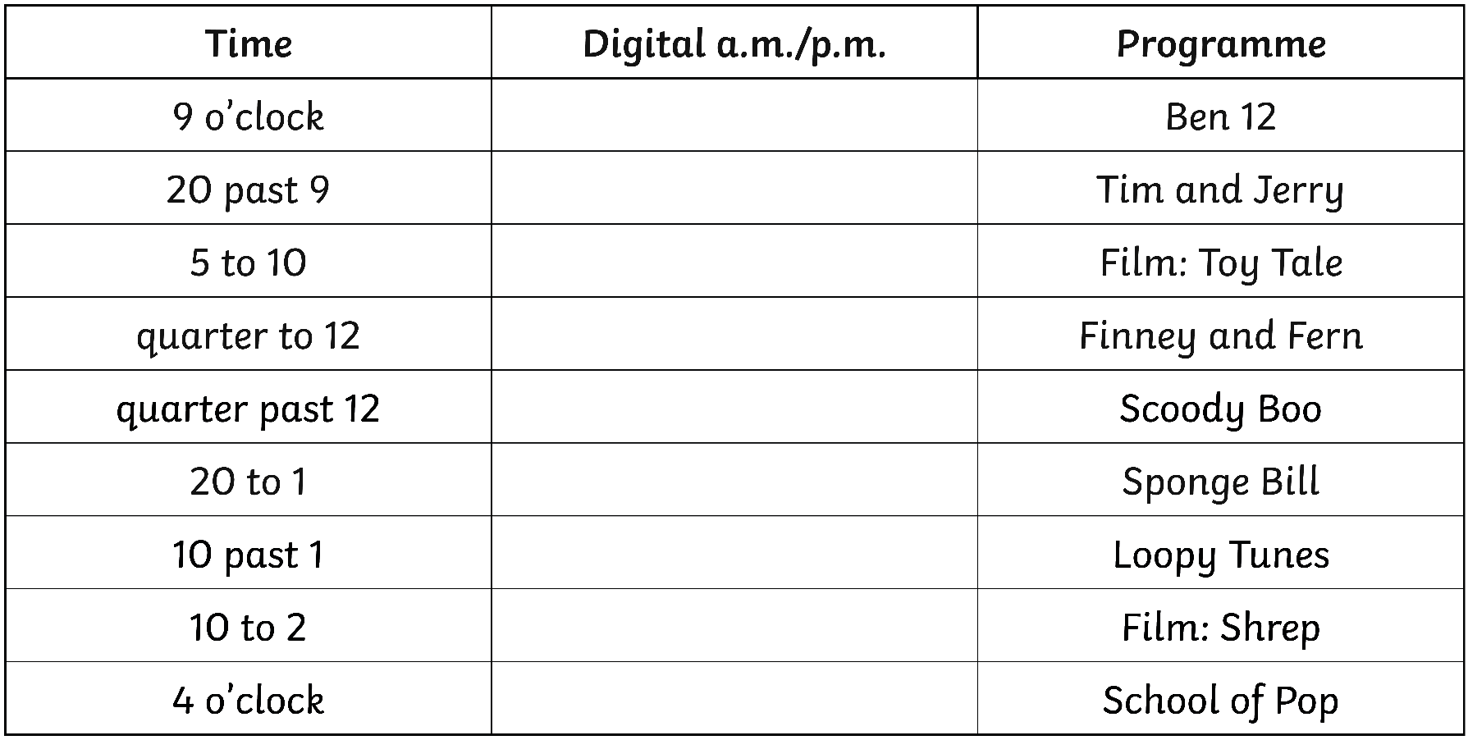
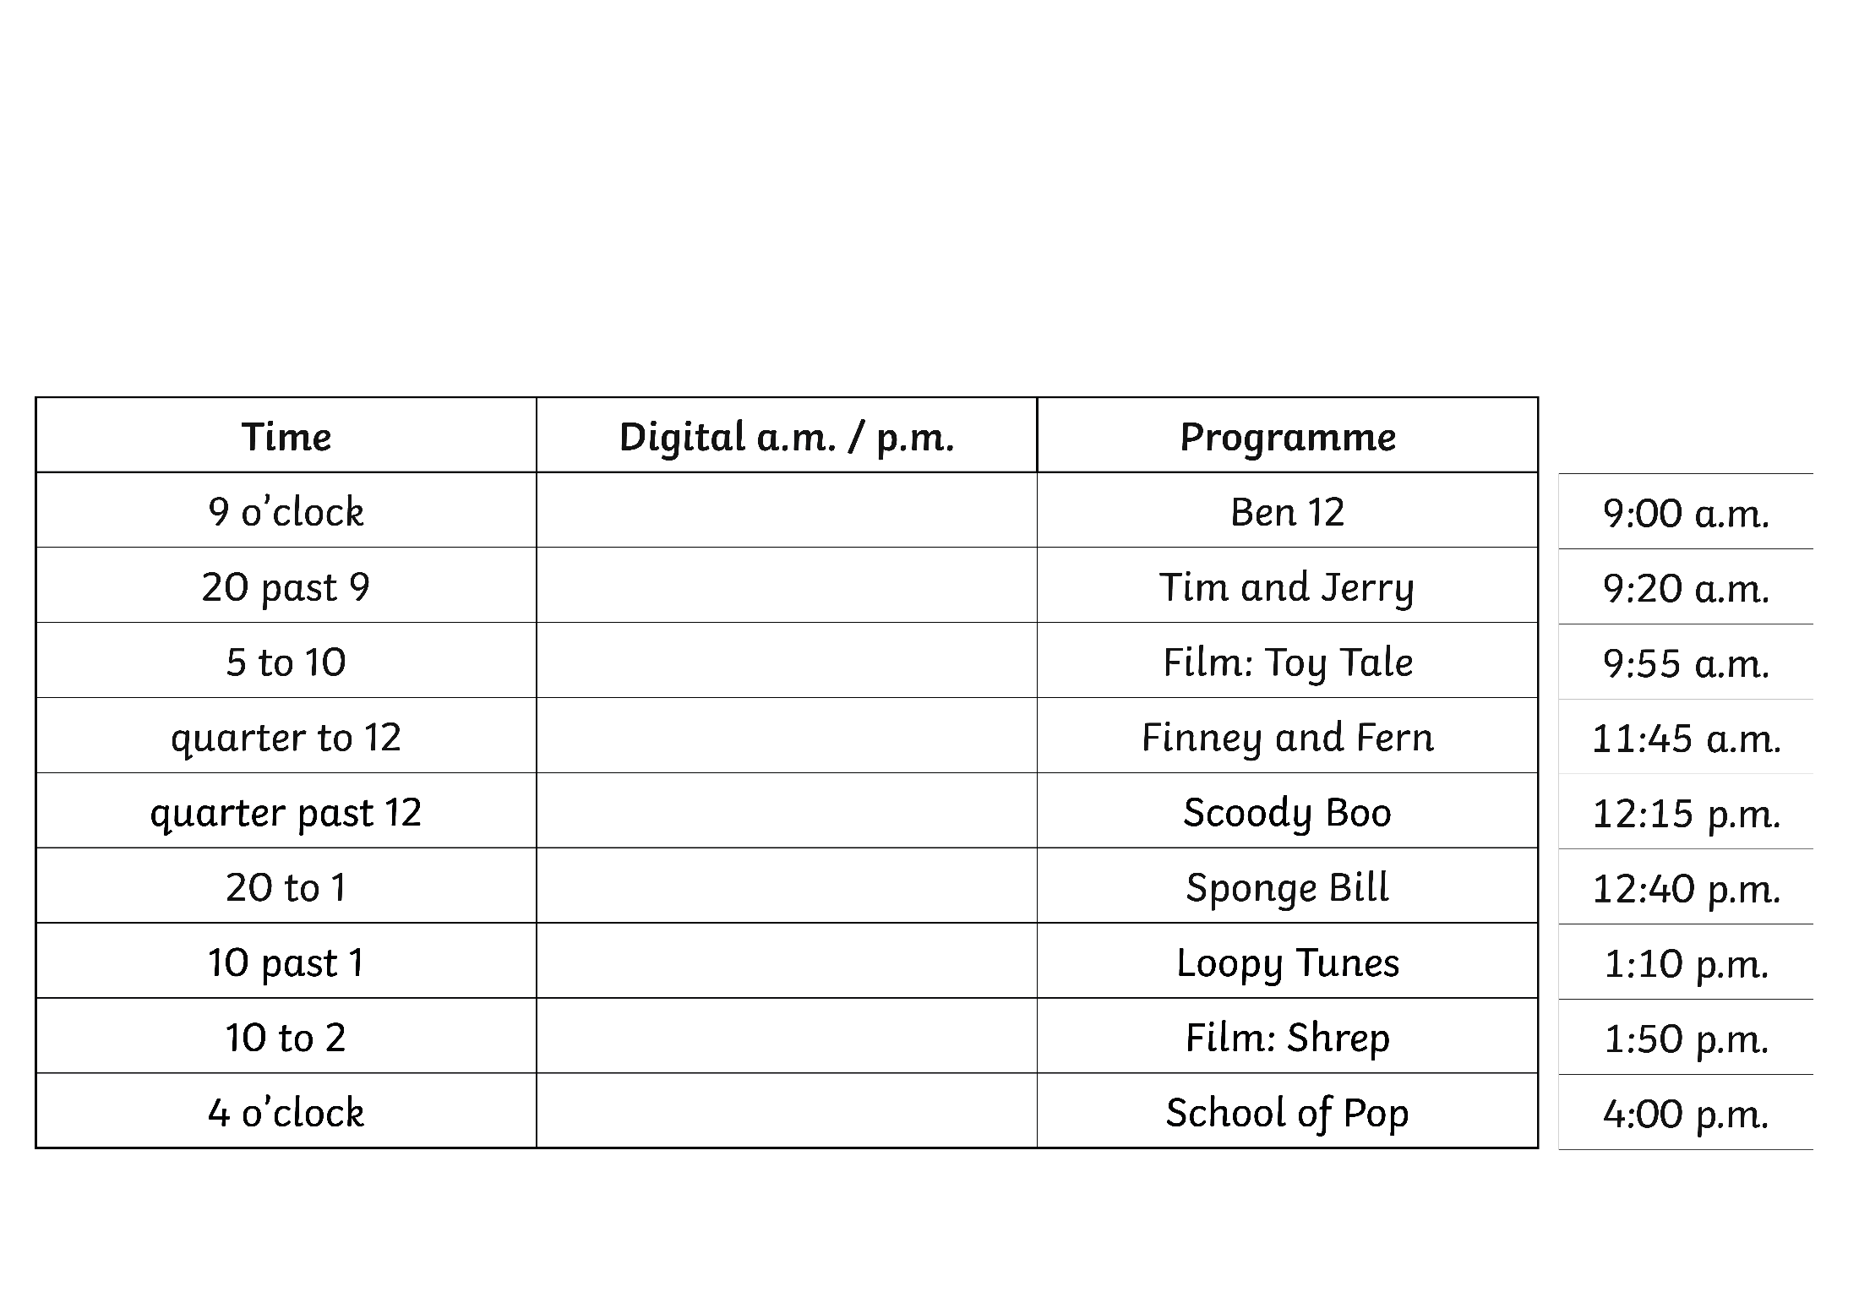



TV Schedule
Change the times to digital times, using a.m. and p.m..

