Slide 1

Home Learning
Year 3 Term 5 Week 5

Slide 2
Message from the class teacher
Hi Year Three,
We hope you have all enjoyed the lovely, sunny bank holiday weekend. You may have been celebrating VE day with bunting, cake, strawberries and fish and chips or just watching some of the things about it on TV. It is currently a difficult time not seeing friends, family and loved ones but we hope you are all well and staying safe!
Here are the home learning tasks for this week. Take care and we miss you lots and lots.
Thank you for your continued support.

Slide 3

Reading
Hopefully you have access to books at home, but we have sent home extra books with your child.
Accelerated Reading
Home quizzing is not always recommended but in this case we have adjusted the settings to allow quizzing to happen at home.
If your child wants to read a book from home, please check that there is a quiz available for the book and that the book level (BL) is within or near to your child’s reading range. Also take note of the quiz number for future reference.
To check books please visit: https://www.arbookfind.co.uk/
Go to the next page for how to quiz.

Slide 4



AR quizzing at home.
To log into AR to take a quiz please visit: https://ukhosted27.renlearn.co.uk/2240835/
Your child should know what to do from here and should know their login details. If they are not aware, most details are written in their reading record.
Click on Accelerated reader.
Type in the name the book or the quiz number.
We advise students complete quizzes unaided. If parents/carers wish to support their child, they can do so in the following ways:
Discuss the book with your child as the book is being read
Ask your child to read the question out loud
Re-word questions for your child, if necessary
Ask your child which answers are not correct

Slide 5

Visit http://readon.myon.co.uk

Slide 6

Choose an area that interests you or use the search option.

Slide 7


Using My Maths
Children should know their way round My Maths but here are some reminders on how access the lessons. Visit: www.mymaths.co.uk
bapchild
divide162

Slide 8

Using My Maths
Access any lesson based on what your child is learning in class or search the topic in the search bar.
Use the login portal to access specific homework and lessons that your teacher has set.

Slide 9



TT Rockstars
To access TT Rockstars please visit: https://play.ttrockstars.com/auth/school
Start typing in the school name or the post code (ME99NL)
Pupils type in their username and password, usually written in their reading record.
Pupils can practice all tables but Year 2 should be practicing 2, 5, and 10’s
Year 3: 2,5,10,3,4,8’s
Year 4,5,6: all tables

Slide 10

Accessing Twinkl
Many educational content providers are offering free access to their resources. Twinkl is a website that we use from time to time to resource our lessons to aid in teacher input and pupil activities.
We will be able to direct you towards activities and learning via this website based on lessons that may be missed due to absence. To access Twinkl please visit: www.twinkl.co.uk/offer
You will have to sign up and put in the offer code: UKTWINKLHELPS

Slide 11
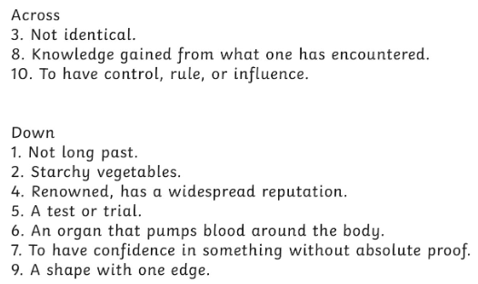
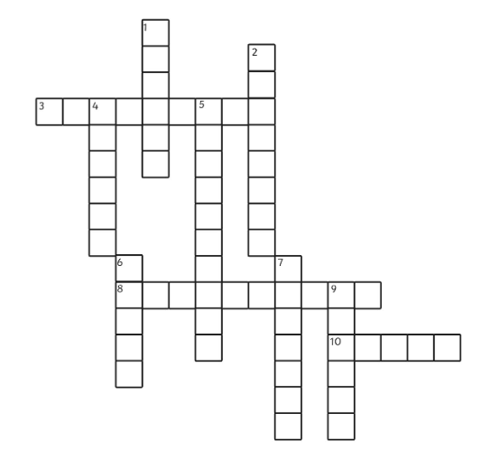
English Learning
Task 1: spelling crossword.

Slide 12
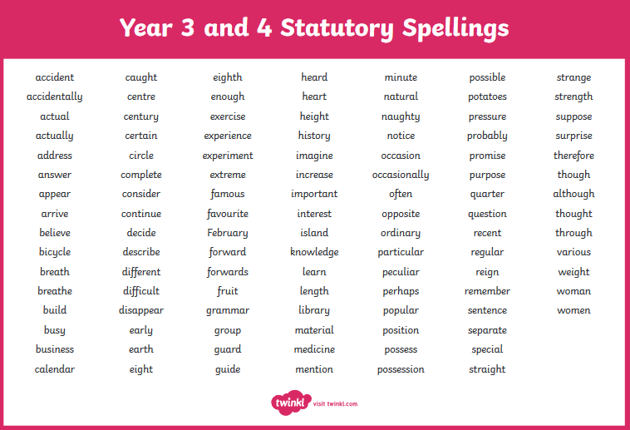

Slide 13
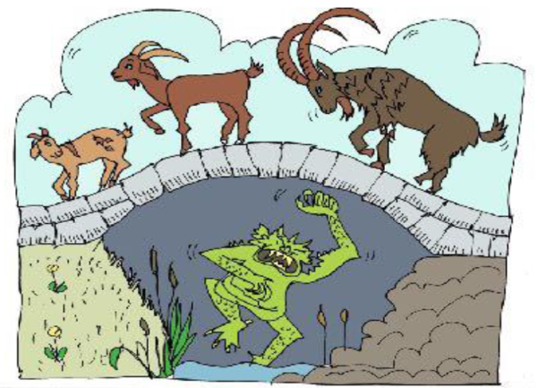
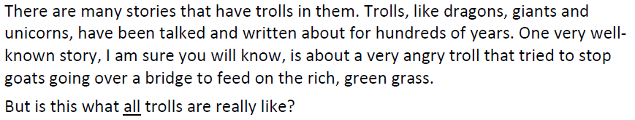
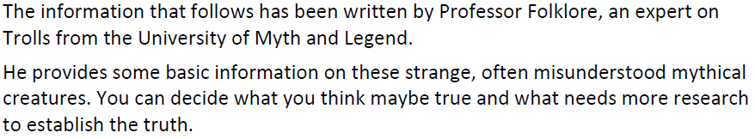
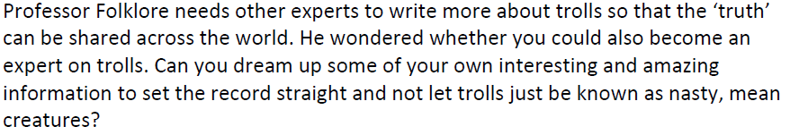
Task 2: The Truth about Ogres

Slide 14
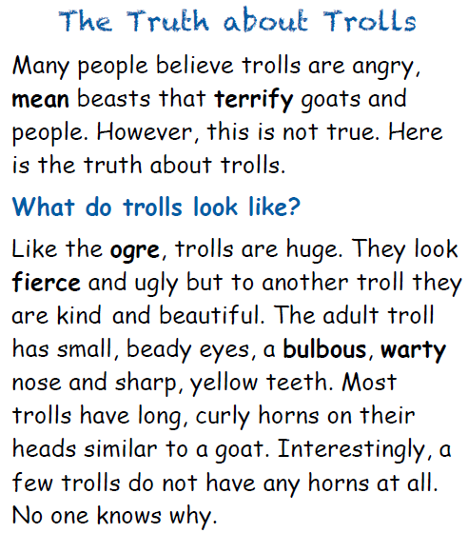

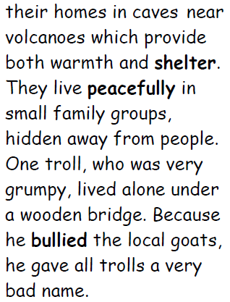
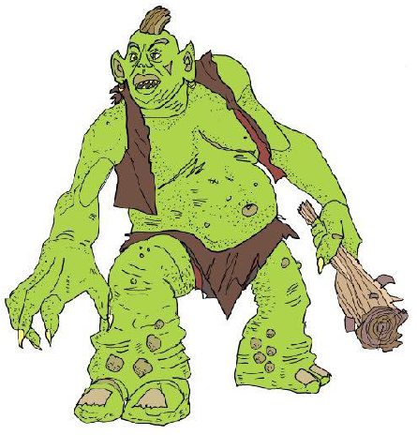

Slide 15
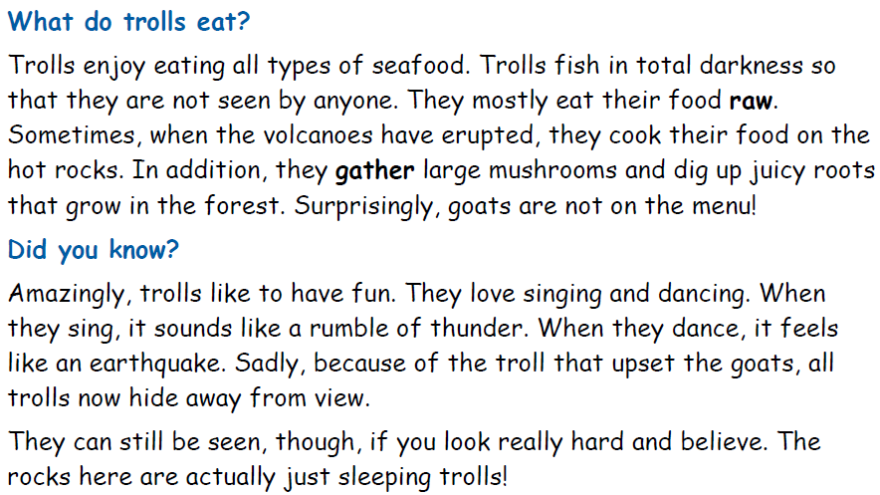
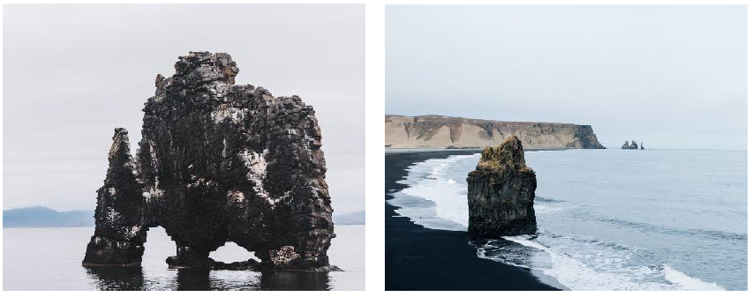

Slide 16
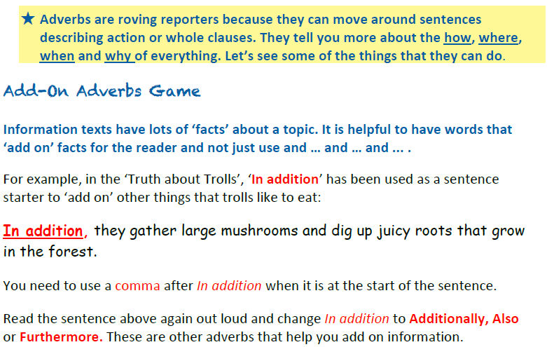
Task 2: Adding more information.
Write a paragraph about what Trolls like (and don’t like) to eat. Add some sentences that begin with ‘In addition,’ ‘Additionally,’ ‘Also,’ or ‘Furthermore,’ to add extra facts.

Slide 17
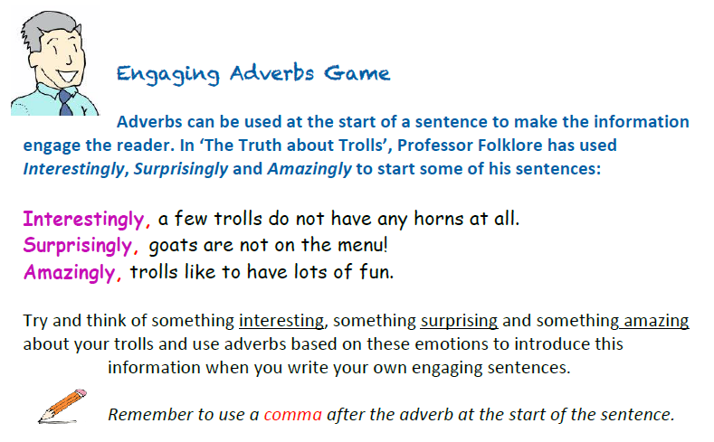
Task 3: Add some sentences to your paragraph about what Trolls like to eat (and don’t like to eat) that people would not know. Start with ‘Interestingly,’ ‘Surprisingly,’ and ‘Amazingly,’

Slide 18
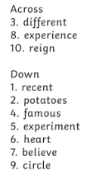
Answers to the crossword

Slide 19
Maths Learning
Still learning about time this week. There is a lot of good resources out there and you can always try to ask you child to tell the time throughout the day on an analogue clock.
Once again I have added worksheet slides at the end of each lesson(lesson 2 is a separate pdf). If you can print them then do so. Otherwise just complete the work on paper the best you can. If you are able to print, remember to only print the slides that have the worksheets (slides 24,29,30), not the entire presentation.

Slide 20
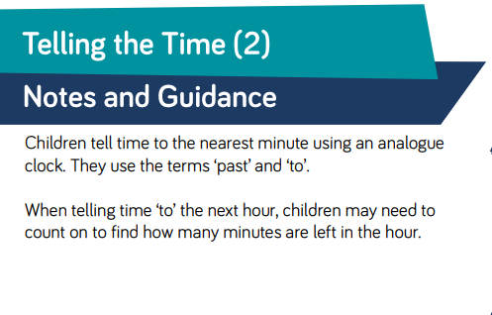
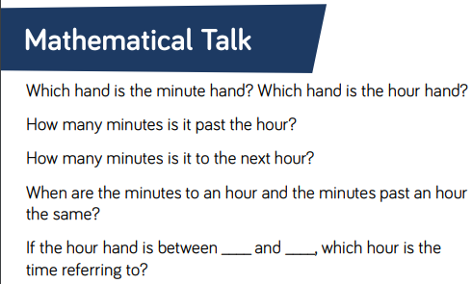
Lesson 1: Telling the time 2

Slide 21
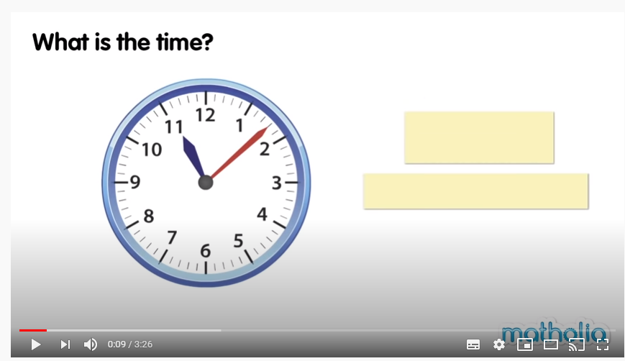
Lesson 1: Telling the time 2
Watch this video as a starting point.
https://www.youtube.com/watch?v=f1AavpvRLvo

Slide 22
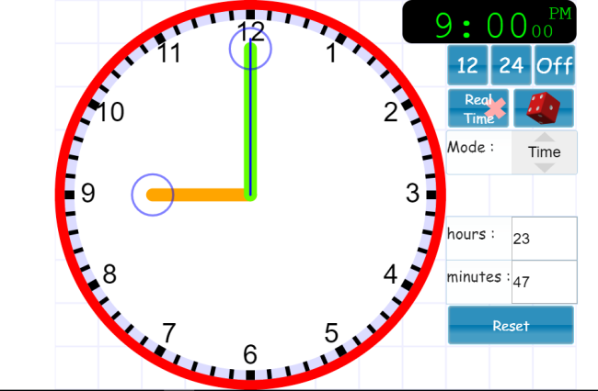
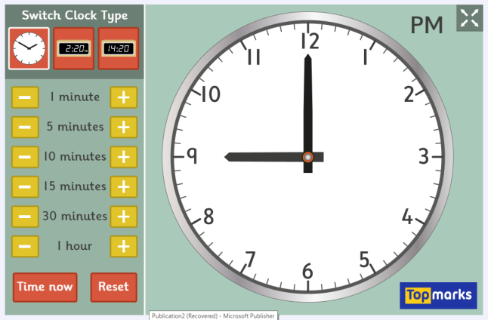
Lesson 1: Telling the time 2
Here are two interactive clocks. Hopefully one will work on your devices. I like the first one because you can drag the hands around and roll the dice for a random time. Switch off the digital clock though.
Copy and paste this link or click the clock.
Activity
Show children various times to the nearest minute for them to read.
Say a time for children to represent to the nearest minute on the clock.
Discuss whether the minute hand is past or to the hour in different times
https://www.visnos.com/demos/clock
https://www.topmarks.co.uk/time/teaching-clock

Slide 23
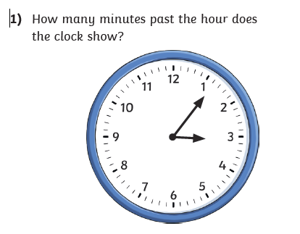
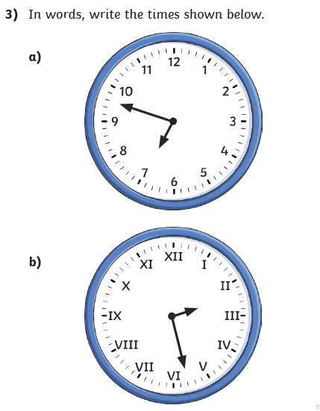
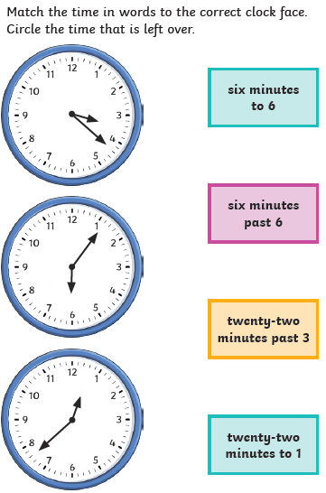
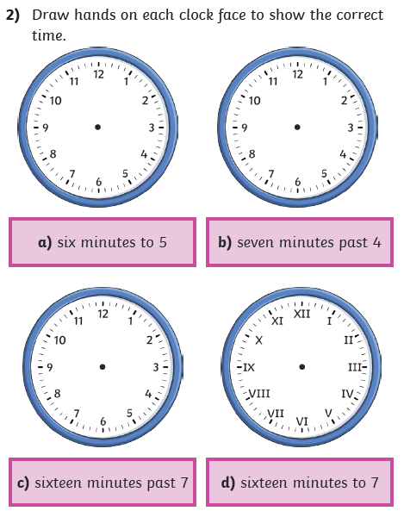
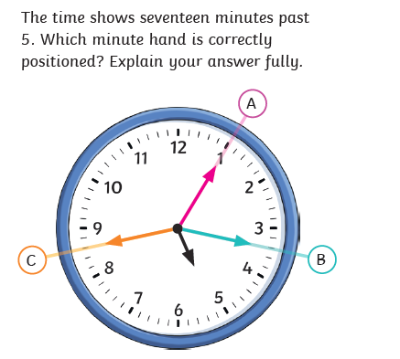
Lesson 1: Telling the time 2 – Worksheet
5)
4)

Slide 24
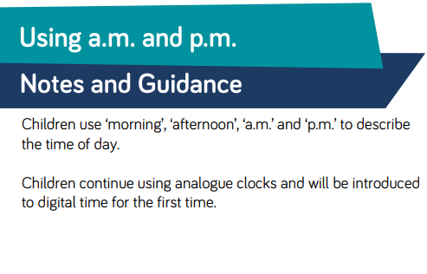
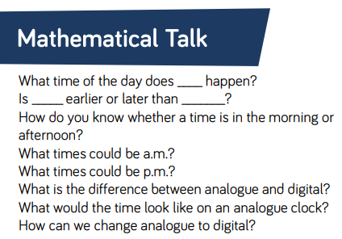
Lesson 2: Using a.m. and p.m.

Slide 25
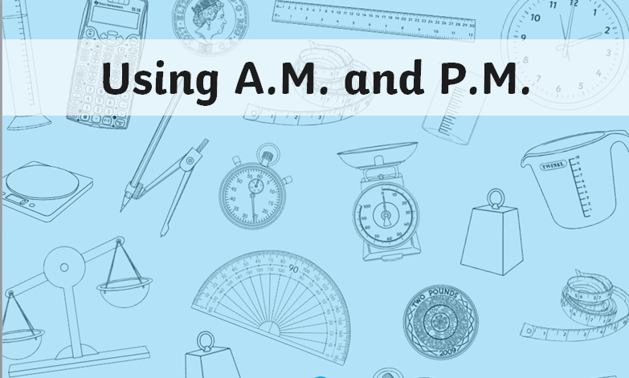
Lesson 2: Using a.m. and p.m.
Download and open up the PowerPoint on a.m. and p.m. that is on the Year 3 home learning page for this week. You can find it on Twinkl if it doesn’t open. Then have a go at the pdf worksheet saved in the same place.

Slide 26
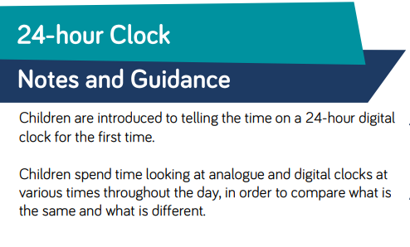
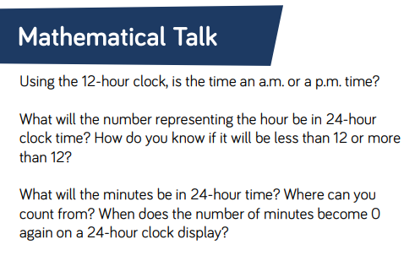
Lesson 3: the 24 hour clock

Slide 27
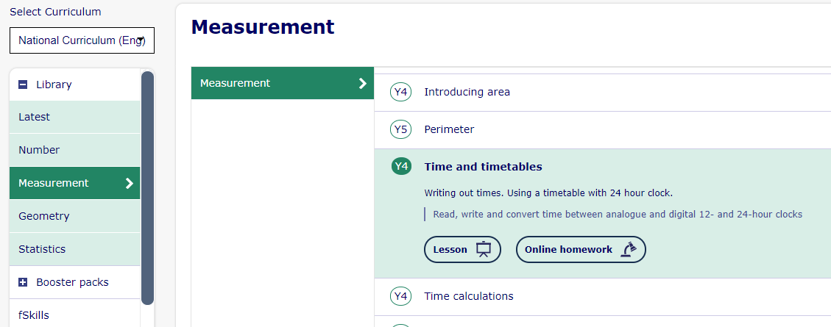
Lesson 3: the 24 hour clock
Log on to My Maths and open up Y4 Time and Timetables lesson.
Complete the slides 1 to 5 only.

Slide 28
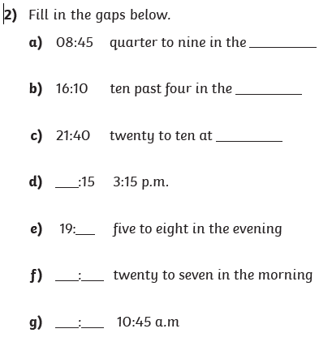
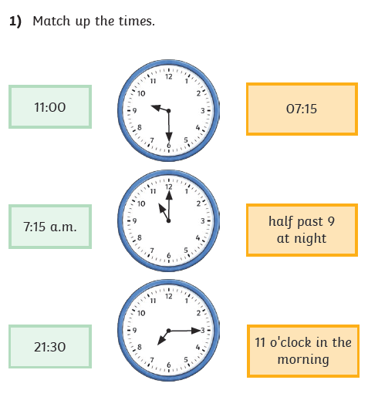
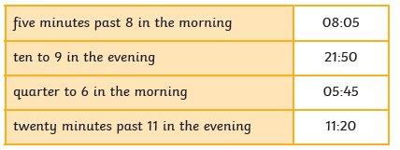
Lesson 3: 24 hour clock - Worksheet
3) Mitchell has been converting the time in words to 24-hour time. His friend tells him that he has made some mistakes. Spot the wrong answers and explain the mistakes Mitchell has made.

Slide 29
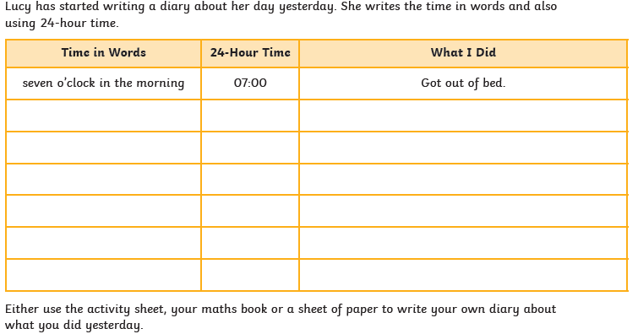
Lesson 3: 24 hour clock - Worksheet
Either use this worksheet or a sheet of paper to write your own diary about what you did yesterday.

Slide 30
R.E. (Week 2 of 2)
What is Faith?
Watch the start of Abraham’s story at: https://www.youtube.com/watch?v=8JeYA2x1OIk
Can you think about the following questions:
Why did Abraham follow God’s command to leave Haran?
What did Abraham, Sarah and Lot have to leave behind?
How would it feel to leave?
How might it feel to have to walk so far, not knowing where you are going?
Abraham had faith. What does the word faith mean?
Activities:
Draw all the items you think Abraham and Sarah packed into their bags for their long journey
List all the ways in which Abraham and Sarah shows they have faith
God makes Abraham a number of promises: Abraham will have lots of descendants; Abraham will be known as a great man; Abraham’s family will be given land. Can you write a list of promises you would like to make. Maybe ask your family what promises they would like to make too.

Slide 31

P.E.
It is important to keep your children active. If it is safe to do so, ensure they have some time outside throughout the day. Please visit Joe Wicks YouTube channel (https://www.youtube.com/channel/UCAxW1XT0iEJo0TYlRfn6rYQ), which has lots of exercise videos for children. He will also be hosting a live P.E. lessons Monday to Friday at 9:00am.

Slide 32

Classroom Secrets
The site classroom secrets https://classroomsecrets.co.uk/free-home-learning-packs/ has free class packs which provide some great additional ideas and resources you can use.

