Slide 1

Home Learning
Year 3 Term 5 Week 4

Slide 2
Message from the class teacher
Here we are, another week. We really miss your smiling faces. We hope you are all ok and are helping your adults (and siblings) at home through this very strange time. We hope that you enjoyed the school lockdown video. We loved making it and it made us really happy when we watched it back. Hope it did the same for you.
Remember:
Wash your hands;
Be kind;
Read, read to someone (even a pet), listen to someone read to you;
Talk about how you feel.
Thank you for your continued support.

Slide 3

Reading
Hopefully you have access to books at home, but we have sent home extra books with your child.
Accelerated Reading
Home quizzing is not always recommended but in this case we have adjusted the settings to allow quizzing to happen at home.
If your child wants to read a book from home, please check that there is a quiz available for the book and that the book level (BL) is within or near to your child’s reading range. Also take note of the quiz number for future reference.
To check books please visit: https://www.arbookfind.co.uk/
Go to the next page for how to quiz.

Slide 4



AR quizzing at home.
To log into AR to take a quiz please visit: https://ukhosted27.renlearn.co.uk/2240835/
Your child should know what to do from here and should know their login details. If they are not aware, most details are written in their reading record.
Click on Accelerated reader.
Type in the name the book or the quiz number.
We advise students complete quizzes unaided. If parents/carers wish to support their child, they can do so in the following ways:
Discuss the book with your child as the book is being read
Ask your child to read the question out loud
Re-word questions for your child, if necessary
Ask your child which answers are not correct

Slide 5

Visit http://readon.myon.co.uk

Slide 6

Choose an area that interests you or use the search option.

Slide 7


Using My Maths
Children should know their way round My Maths but here are some reminders on how access the lessons. Visit: www.mymaths.co.uk
bapchild
divide162

Slide 8

Using My Maths
Access any lesson based on what your child is learning in class or search the topic in the search bar.
Use the login portal to access specific homework and lessons that your teacher has set.

Slide 9

Maths – White Rose Home Learning
In school we follow the White Rose scheme of learning. Their website has put together free lessons and resources that link to the learning taking place in school. Please visit: https://whiterosemaths.com/homelearning/

Slide 10



TT Rockstars
To access TT Rockstars please visit: https://play.ttrockstars.com/auth/school
Start typing in the school name or the post code (ME99NL)
Pupils type in their username and password, usually written in their reading record.
Pupils can practice all tables but Year 2 should be practicing 2, 5, and 10’s
Year 3: 2,5,10,3,4,8’s
Year 4,5,6: all tables

Slide 11

Accessing Twinkl
Many educational content providers are offering free access to their resources. Twinkl is a website that we use from time to time to resource our lessons to aid in teacher input and pupil activities.
We will be able to direct you towards activities and learning via this website based on lessons that may be missed due to absence. To access Twinkl please visit: www.twinkl.co.uk/offer
You will have to sign up and put in the offer code: UKTWINKLHELPS

Slide 12
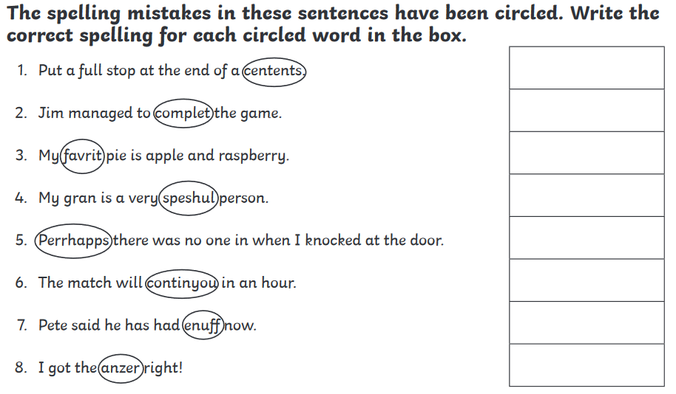
English Learning
Task 1: spelling correction.

Slide 13
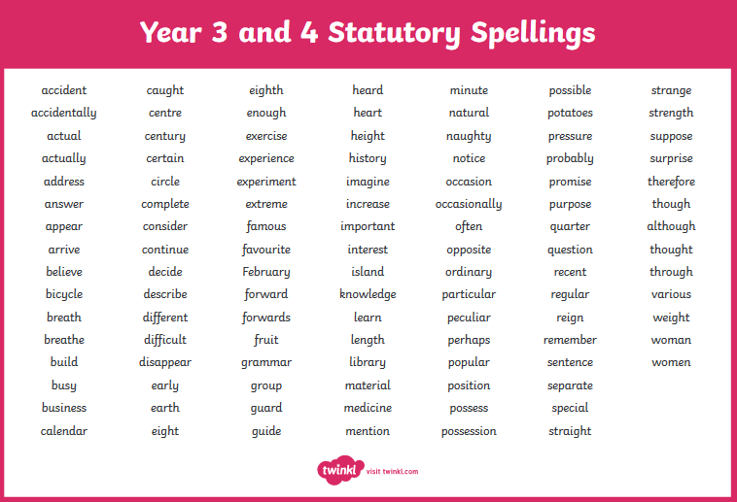

Slide 14
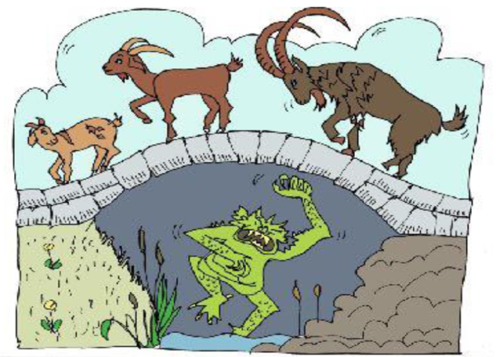
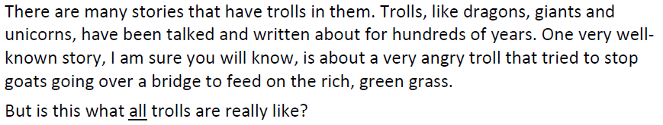
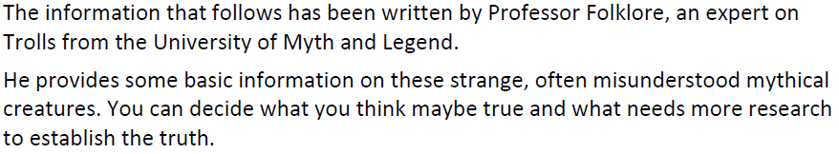
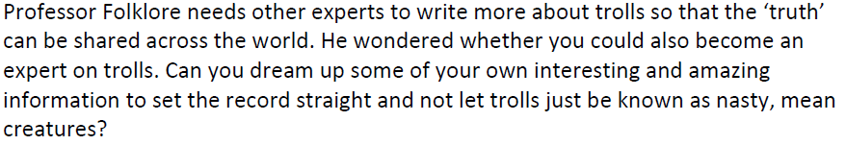
Task 2: The Truth about Ogres

Slide 15
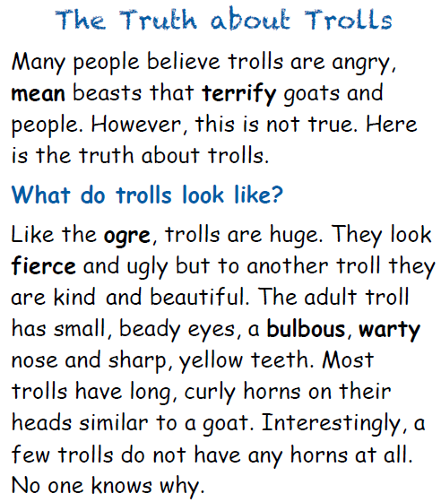

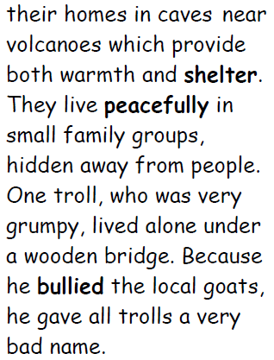
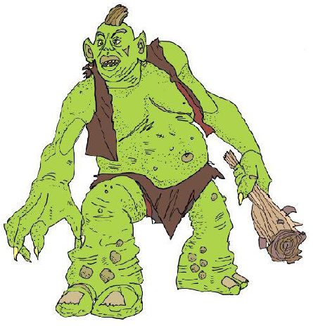

Slide 16
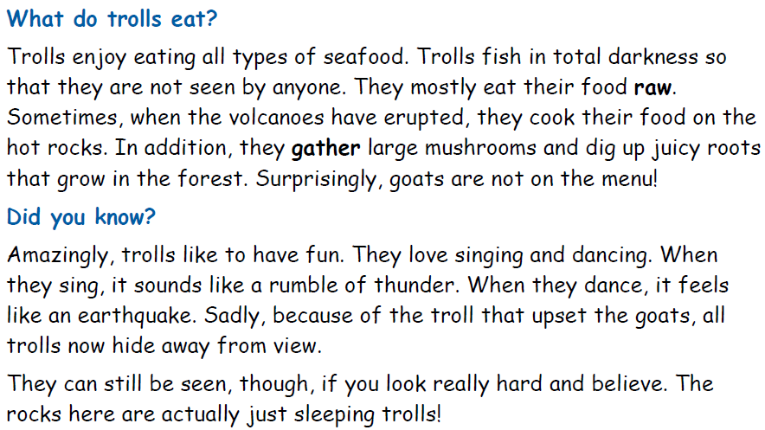
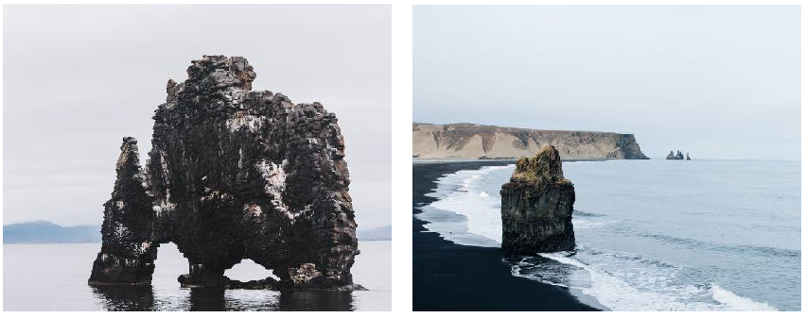

Slide 17
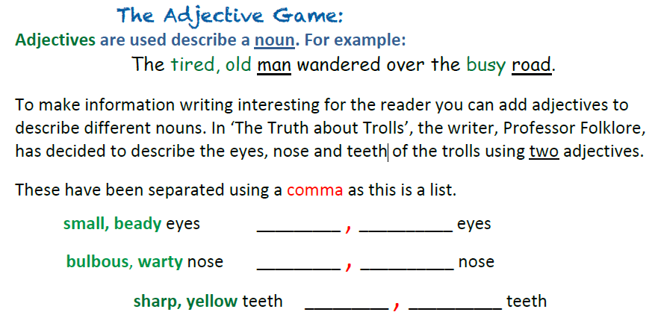
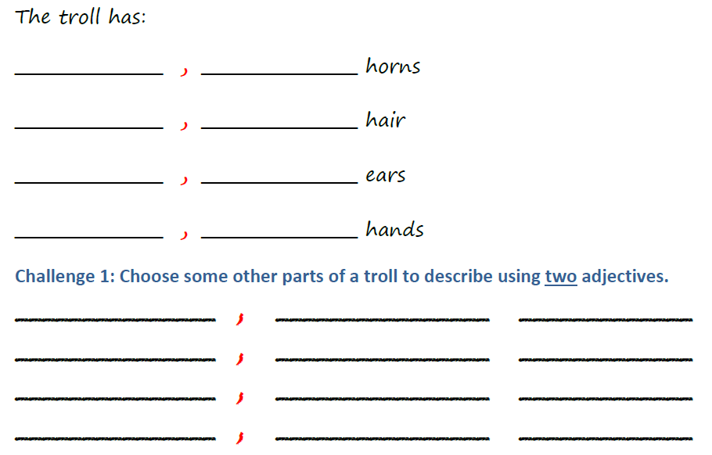
Task 2: adjectives.
Can you come up with expanded noun phrases (2 adjectives separated by a comma) to describe the troll you created last week?

Slide 18
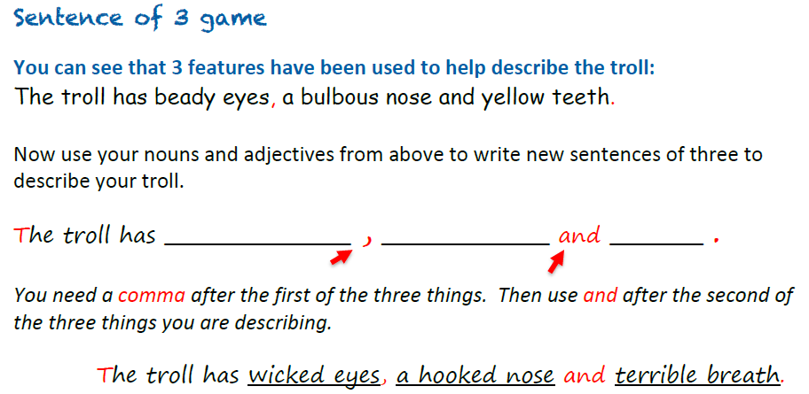
Task 3: more adjectives.
Can you come up with a sentence of 3 for your troll adding to the adjectives you have just come up with?

Slide 19
Maths Learning
You will be happy to know that we are done with fractions.
Now we move on to time.
I will set up the lessons a bit differently as after next week the White Rose Home Learning section is becoming a premium site that you need to pay for to access to their worksheets. I am disappointed they are doing this but there are plenty of other resources out there.
The following 3 lessons are best downloaded as a PowerPoint as some of the animations will work when viewed in slide show mode.
I have added worksheet slides at the end of each lesson. If you can print them then do so. Otherwise just complete the work on paper the best you can. If you are able to print, remember to only print the slides that have the worksheets (slides 22,30,31,40,41), not the entire presentation. I have made that mistake before (x30 for each child)!!!!

Slide 20
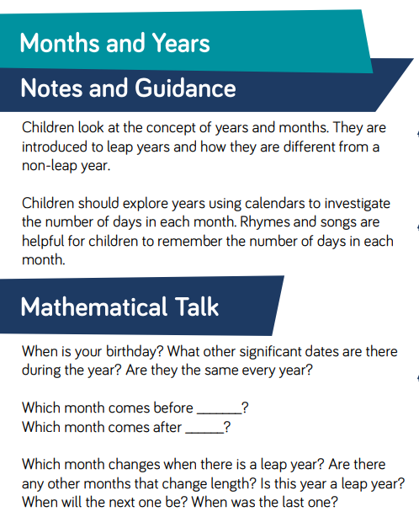
Lesson 1: Months and Years

Slide 21
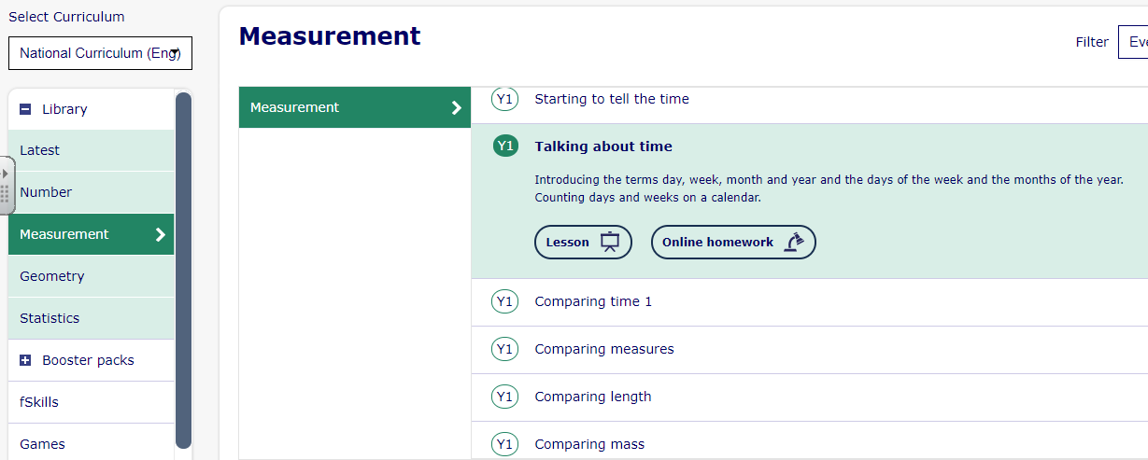
Lesson 1: Months and Years
Children should spend time exploring a real calendar. They sort the months into groups, by the number of days in each month, for both a year and a leap year. Children can use the groups to compare - what is the same and what is different?
As a refresher, start on this lesson. You can start on slide 5 if you like as the first slides are about days of the week. However it doesn’t hurt to review.

Slide 22
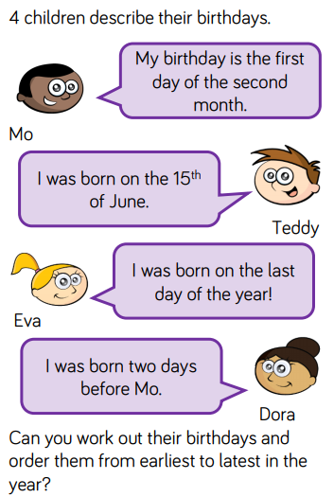
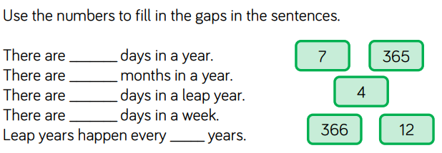
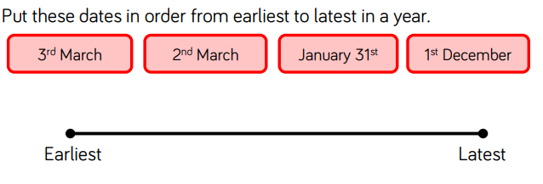
Lesson 1: Months and Years - Worksheet

Slide 23
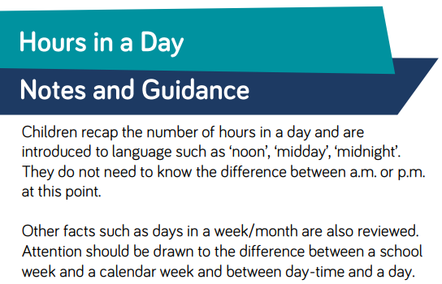
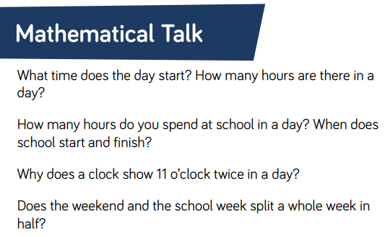
Lesson 2: Hours in a day
Hard to compare hours spent at school and hours spent at home right now but try and use your imagination!!!

Slide 24
Lesson 2: Hours in a day
Which of these times comes first?
evening
midday
morning
afternoon

Slide 25
Lesson 2: Hours in a day
Which of these times comes last?
evening
midday
morning
afternoon

Slide 26
Lesson 2: Hours in a day
Which number can be used to correctly complete the sentence?
There are hours in a day.
1
2
6
12
18
24

Slide 27
Lesson 2: Hours in a day
Which number can be used to correctly complete the sentence?
There are hours in 3 days.
24
48
72
96

Slide 28
Lesson 2: Hours in a day
Match the statements to the correct number.
days in 48 hours
240
hours in 10 days
2
hours in 4 days
96

Slide 29
Lesson 2: Hours in a day
A doctor’s surgery is open Monday to Friday every week. How many days will it be open in this month? Explain your answer.
Mo | Tu | We | Thu | Fri | Sa | Su
 | 1 | 2 | 3 | 4 | 5 | 6
7 | 8 | 9 | 10 | 11 | 12 | 13
14 | 15 | 16 | 17 | 18 | 19 | 20
21 | 22 | 23 | 24 | 25 | 26 | 27
28 | 29 | 30 | 31
There are 3 full working weeks
(15 days) and 8 additional days.
15 + 8 = 23

Slide 30
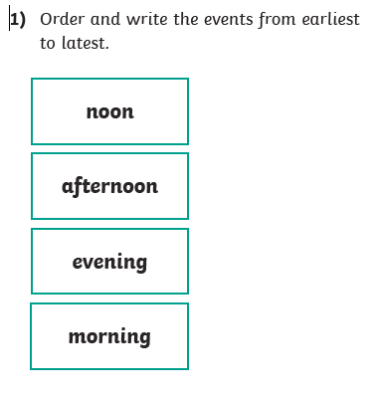
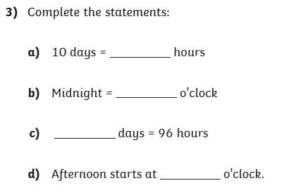
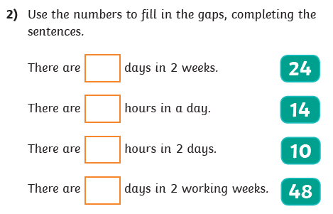
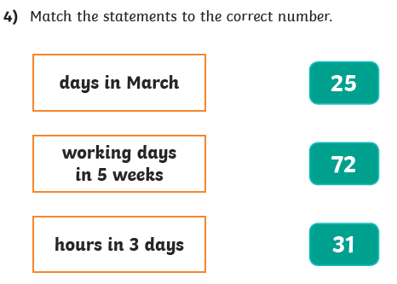
Lesson 2: Hours in a day – Worksheet

Slide 31
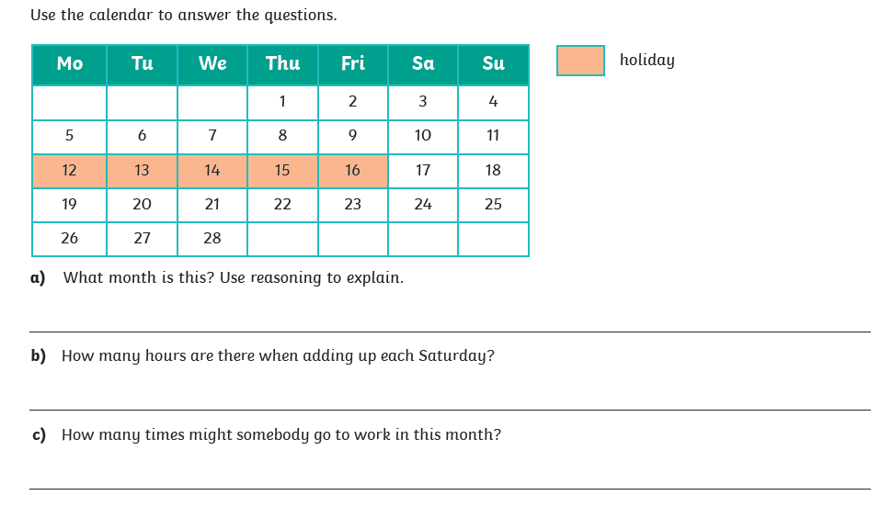
Lesson 2: Hours in a day - Worksheet

Slide 32
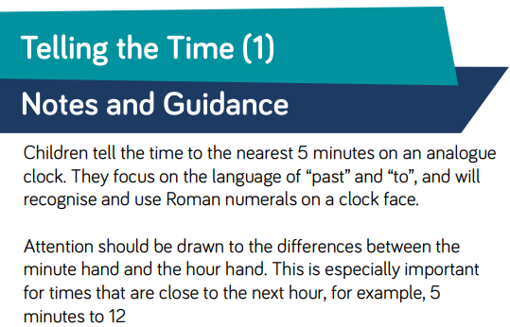
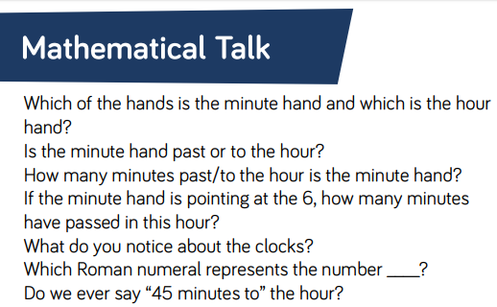
Lesson 3: Telling time (part 1)

Slide 33
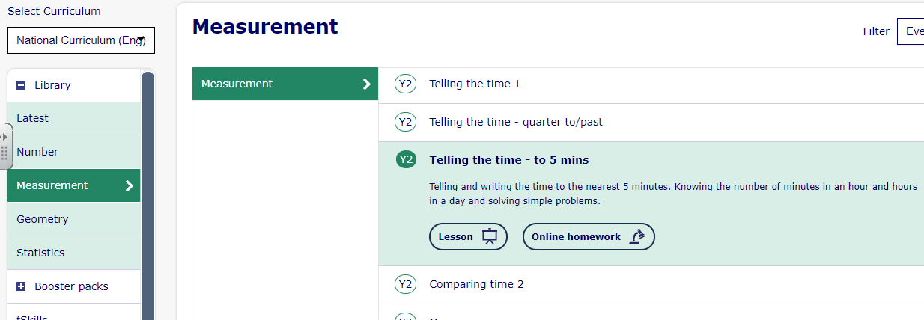
Lesson 3: Telling time (part 1)
Go through all the slides on this lesson; Telling the time – to 5 mins.
If you need to go back and do the lessons above it: Telling the time 1 and
Telling the time – quarter to/past

Slide 34

Lesson 3: Telling time (part 1)
Which of the times match the time shown on the analogue clock?
10 minutes to 4
5 minutes past 10
10 minutes to 1

Slide 35
Lesson 3: Telling time (part 1)
Which of the times match the time shown on the analogue clock?
25 minutes to 2
25 minutes to 3
quarter past 7

Slide 36

Lesson 3: Telling time (part 1)
This clock should show quarter past 7
What Roman numeral should the minute hand be pointing to?
I
II
III

Slide 37
Lesson 3: Telling time (part 1)
This clock should show 6 o’clock.
What Roman numeral should the hour hand be pointing to?
VII
VI
V

Slide 38


Lesson 3: Telling time (part 1)
Match the times in words to the correct clock face.
A
5 minutes past 6
25 to 4
B
20 minutes past 3
20 minutes past 1
C
Which time is not shown on a clock?

Slide 39


Lesson 3: Telling time (part 1)
Each clockface shows a time in the morning.
Order the times from earliest to latest.
5 minutes
to 7
25 minutes past 8
25 minutes past 10
20 minutes past 11

Slide 40
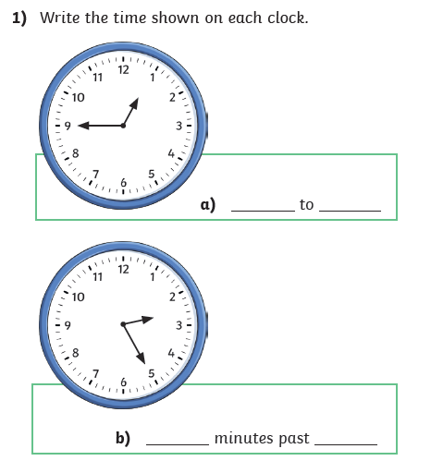
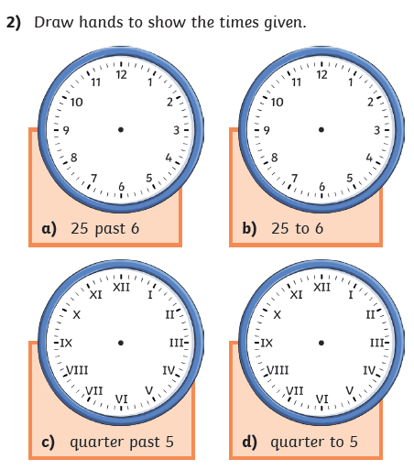
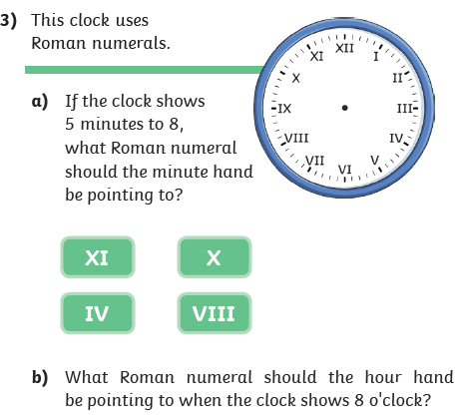
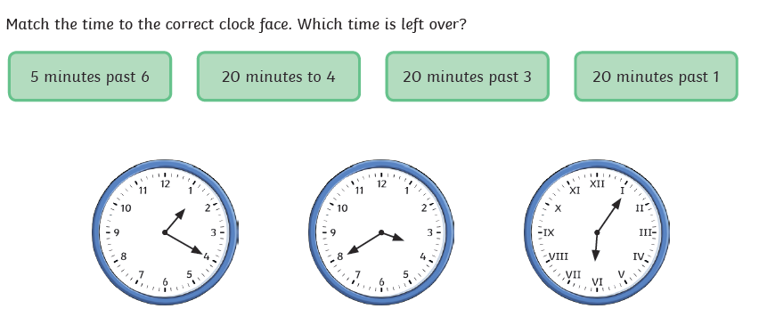
Lesson 3: Telling time (part 1) - Worksheet

Slide 41
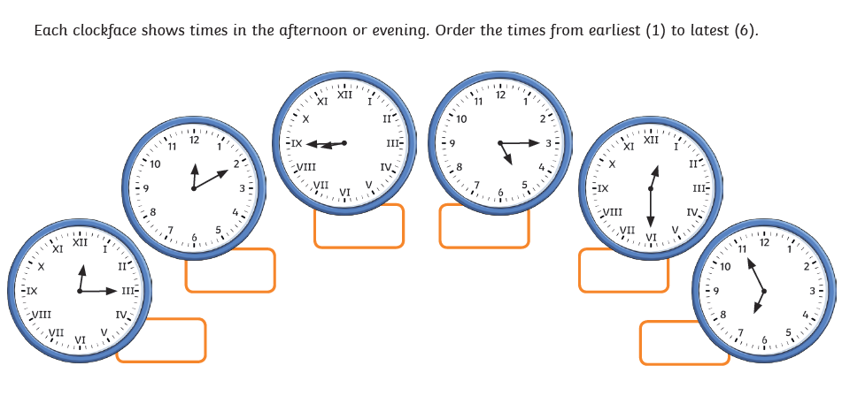
Lesson 3: Telling time (part 1) - Worksheet

Slide 42
R.E. (Two weeks)
What is Faith?
Watch the start of Abraham’s story at: https://www.youtube.com/watch?v=8JeYA2x1OIk
Can you think about the following questions:
Why did Abraham follow God’s command to leave Haran?
What did Abraham, Sarah and Lot have to leave behind?
How would it feel to leave?
How might it feel to have to walk so far, not knowing where you are going?
Abraham had faith. What does the word faith mean?
Activities:
Draw all the items you think Abraham and Sarah packed into their bags for their long journey
List all the ways in which Abraham and Sarah shows they have faith
God makes Abraham a number of promises: Abraham will have lots of descendants; Abraham will be known as a great man; Abraham’s family will be given land. Can you write a list of promises you would like to make. Maybe ask your family what promises they would like to make too.

Slide 43

P.E.
It is important to keep your children active. If it is safe to do so, ensure they have some time outside throughout the day. Please visit Joe Wicks YouTube channel (https://www.youtube.com/channel/UCAxW1XT0iEJo0TYlRfn6rYQ), which has lots of exercise videos for children. He will also be hosting a live P.E. lessons Monday to Friday at 9:00am.

Slide 44

Classroom Secrets
The site classroom secrets https://classroomsecrets.co.uk/free-home-learning-packs/ has free class packs which provide some great additional ideas and resources you can use.

