Slide 1

Home Learning
Year 3 Term 5 Week 3

Slide 2
Message from the class teacher
Thank you for your hard work last week. We hope you are enjoying finding out about Victorian times. It is still such a strange time and we miss you very much. Keep up the good work. Keep moving. Keep reading (books can take you to places without even leaving your chair). Keep smiling. Stay safe!
Thank you for your continued support.

Slide 3

Reading
Hopefully you have access to books at home, but we have sent home extra books with your child.
Accelerated Reading
Home quizzing is not always recommended but in this case we have adjusted the settings to allow quizzing to happen at home.
If your child wants to read a book from home, please check that there is a quiz available for the book and that the book level (BL) is within or near to your child’s reading range. Also take note of the quiz number for future reference.
To check books please visit: https://www.arbookfind.co.uk/
Go to the next page for how to quiz.

Slide 4



AR quizzing at home.
To log into AR to take a quiz please visit: https://ukhosted27.renlearn.co.uk/2240835/
Your child should know what to do from here and should know their login details. If they are not aware, most details are written in their reading record.
Click on Accelerated reader.
Type in the name the book or the quiz number.
We advise students complete quizzes unaided. If parents/carers wish to support their child, they can do so in the following ways:
Discuss the book with your child as the book is being read
Ask your child to read the question out loud
Re-word questions for your child, if necessary
Ask your child which answers are not correct

Slide 5

Visit http://readon.myon.co.uk

Slide 6

Choose an area that interests you or use the search option.

Slide 7


Using My Maths
Children should know their way round My Maths but here are some reminders on how access the lessons. Visit: www.mymaths.co.uk
bapchild
divide162

Slide 8

Using My Maths
Access any lesson based on what your child is learning in class or search the topic in the search bar.
Use the login portal to access specific homework and lessons that your teacher has set.

Slide 9

Maths – White Rose Home Learning
In school we follow the White Rose scheme of learning. Their website has put together free lessons and resources that link to the learning taking place in school. Please visit: https://whiterosemaths.com/homelearning/

Slide 10



TT Rockstars
To access TT Rockstars please visit: https://play.ttrockstars.com/auth/school
Start typing in the school name or the post code (ME99NL)
Pupils type in their username and password, usually written in their reading record.
Pupils can practice all tables but Year 2 should be practicing 2, 5, and 10’s
Year 3: 2,5,10,3,4,8’s
Year 4,5,6: all tables

Slide 11

Accessing Twinkl
Many educational content providers are offering free access to their resources. Twinkl is a website that we use from time to time to resource our lessons to aid in teacher input and pupil activities.
We will be able to direct you towards activities and learning via this website based on lessons that may be missed due to absence. To access Twinkl please visit: www.twinkl.co.uk/offer
You will have to sign up and put in the offer code: UKTWINKLHELPS

Slide 12
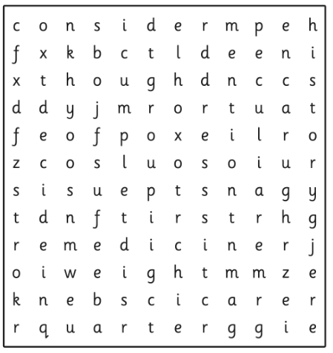


English Learning
Task 1: word search for spellings from the Year 3 / 4 list.

Slide 13
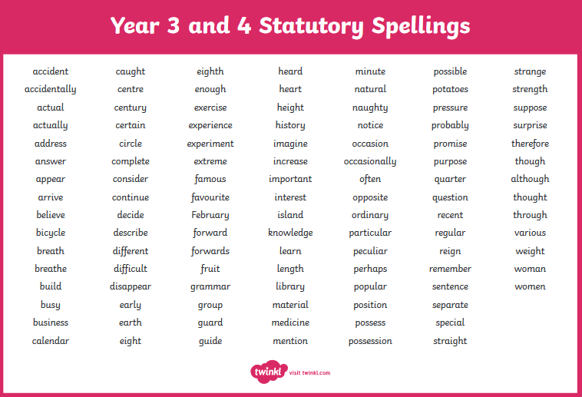

Slide 14
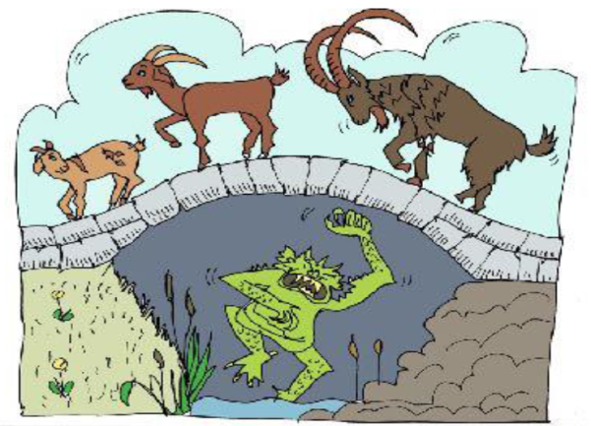
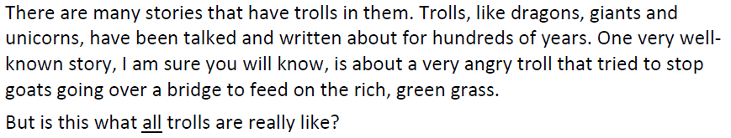
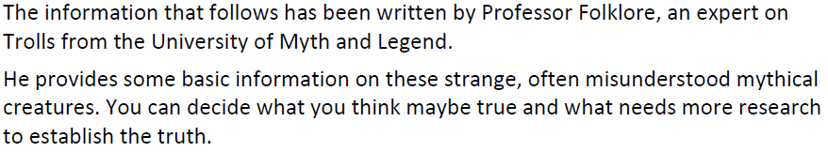
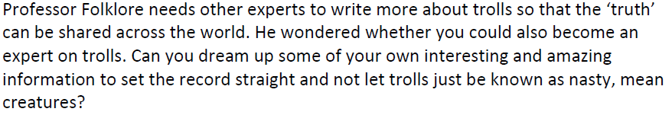
Task 2: The Truth about Ogres

Slide 15
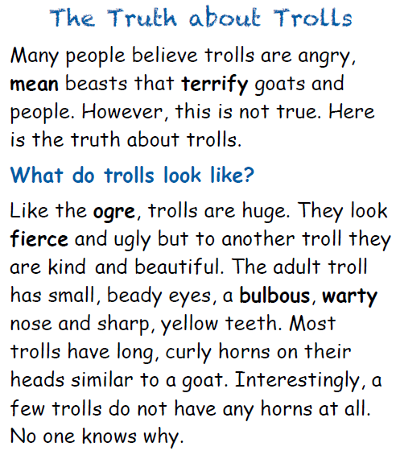

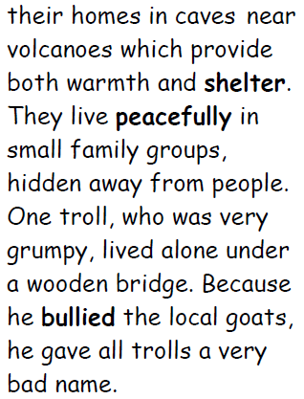
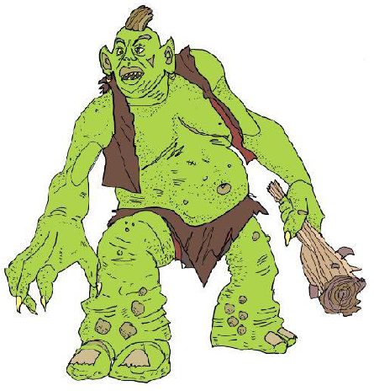

Slide 16
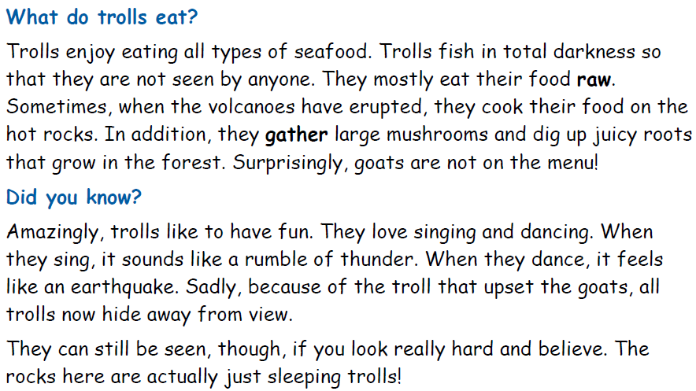
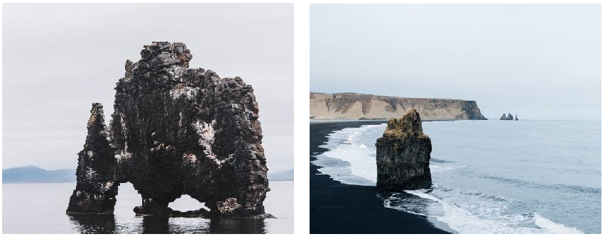

Slide 17
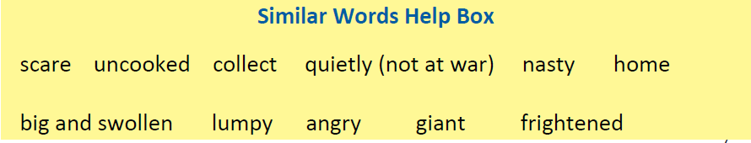
Task 2: Look at the words in bold in the text. Can you write what they mean? Here are some similar words to help you:
If you are still stuck, you can use a dictionary or ask a grown up to help you.
Task 3: Design your own troll.
Draw a picture and colour in your own troll that lives in a mythical land.
Label it with the features it has – eyes, teeth, horns, ears, hair, hands etc. (use your imagination!)
Think:
Where does it live and why does it live there?
What does it eat?
Any other facts about it.

Slide 18
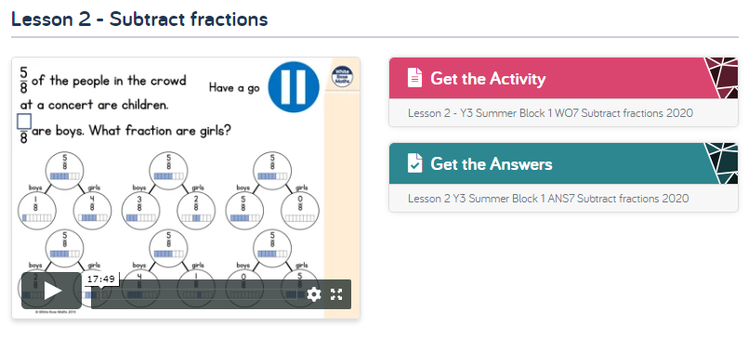
Maths Learning
This should be our last week on fractions! Hooray!
This week have a go at subtracting and adding (from last week) fractions as well as reviewing fractions of amounts. There is an extra lesson of fraction problem solving to do if you dare!!!! But please don’t do it if you are all fractioned out!!! https://whiterosemaths.com/homelearning/year-3/

Slide 19
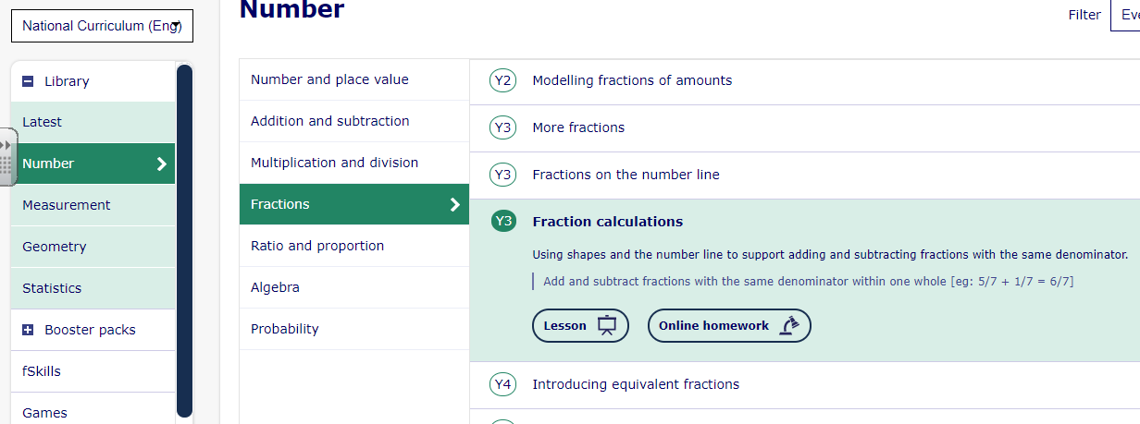
Maths Learning
Find this lesson on fraction calculations on My Maths. I think we covered this before the Easter break but it doesn’t hurt to review. Complete the lesson slides first then sign into your portal and I have set the work for you. Or just click the online homework button to have a go at it that way.

Slide 20
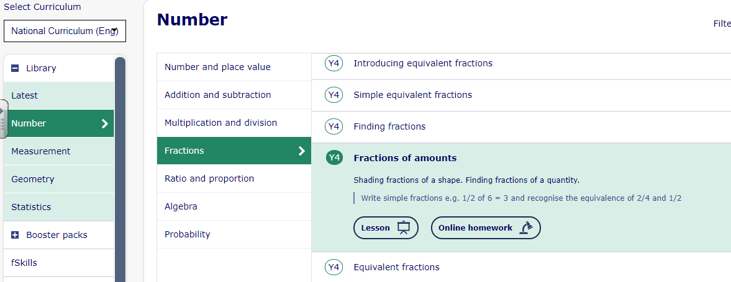
Maths Learning
Find this lesson on fractions of amounts My Maths. Complete the lesson slides first then sign into your portal and I have set the work for you. Or just click the online homework button to have a go at it that way. If you are struggling with this then go back (scroll up) and review the modelling fractions of amounts lesson.

Slide 21
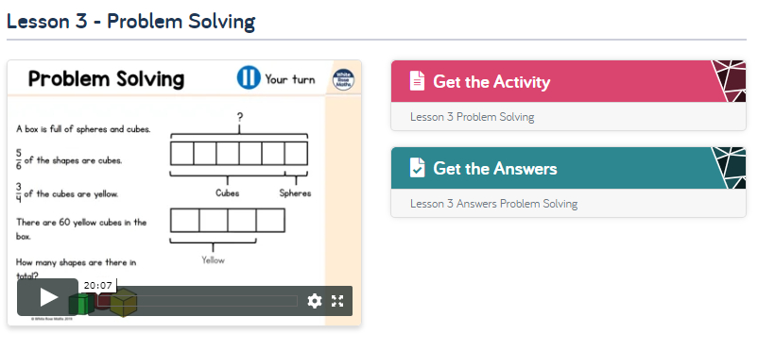
Maths Learning
Bonus work! If you dare!!!

Slide 22
Topic –
Hopefully you found out about these marvellous inventors last week. If not, here is what they are most famous for inventing:
Alexander Grahame Bell – telephone and telegraph.
Isambard Kingdom Brunel – bridges, railways, tunnels and ships.
Alexander Parkes – plastic.
Thomas Edison – light bulb, motion picture.
Kirkpatrick MacMillan – pedal bicycle.
Now comes the tricky part! You need to think about who you think was the most important Victorian inventor. There is no right or wrong answer to this. Think about these to make your decision:
Has it had a good or bad impact on your life today?
What might life have been like without these things being invented?
Write a paragraph to explain your answer.
Challenge: Make a poster about who you think the most important Victorian inventor was and your reasons why.

Slide 23

P.E.
It is important to keep your children active. If it is safe to do so, ensure they have some time outside throughout the day. Please visit Joe Wicks YouTube channel (https://www.youtube.com/channel/UCAxW1XT0iEJo0TYlRfn6rYQ), which has lots of exercise videos for children. He will also be hosting a live P.E. lessons Monday to Friday at 9:00am.

Slide 24

Classroom Secrets
The site classroom secrets https://classroomsecrets.co.uk/free-home-learning-packs/ has free class packs which provide some great additional ideas and resources you can use.

