Slide 1

Home Learning
Year 3 Term 5 Week 2

Slide 2
Message from the class teacher
Thank you for your hard work last week. We hope you have got back into learning now Easter is over (although hope you have some chocolate left to keep you going). Continue to practise your spellings from the Year 3 / 4 word list and always remember to check through your writing regularly and check your answers in maths.
Thank you for your continued support.

Slide 3

Reading
Hopefully you have access to books at home, but we have sent home extra books with your child.
Accelerated Reading
Home quizzing is not always recommended but in this case we have adjusted the settings to allow quizzing to happen at home.
If your child wants to read a book from home, please check that there is a quiz available for the book and that the book level (BL) is within or near to your child’s reading range. Also take note of the quiz number for future reference.
To check books please visit: https://www.arbookfind.co.uk/
Go to the next page for how to quiz.

Slide 4



AR quizzing at home.
To log into AR to take a quiz please visit: https://ukhosted27.renlearn.co.uk/2240835/
Your child should know what to do from here and should know their login details. If they are not aware, most details are written in their reading record.
Click on Accelerated reader.
Type in the name the book or the quiz number.
We advise students complete quizzes unaided. If parents/carers wish to support their child, they can do so in the following ways:
Discuss the book with your child as the book is being read
Ask your child to read the question out loud
Re-word questions for your child, if necessary
Ask your child which answers are not correct

Slide 5

Visit http://readon.myon.co.uk

Slide 6

Choose an area that interests you or use the search option.

Slide 7


Using My Maths
Children should know their way round My Maths but here are some reminders on how access the lessons. Visit: www.mymaths.co.uk
bapchild
divide162

Slide 8

Using My Maths
Access any lesson based on what your child is learning in class or search the topic in the search bar.
Use the login portal to access specific homework and lessons that your teacher has set.

Slide 9

Maths – White Rose Home Learning
In school we follow the White Rose scheme of learning. Their website has put together free lessons and resources that link to the learning taking place in school. Please visit: https://whiterosemaths.com/homelearning/

Slide 10



TT Rockstars
To access TT Rockstars please visit: https://play.ttrockstars.com/auth/school
Start typing in the school name or the post code (ME99NL)
Pupils type in their username and password, usually written in their reading record.
Pupils can practice all tables but Year 2 should be practicing 2, 5, and 10’s
Year 3: 2,5,10,3,4,8’s
Year 4,5,6: all tables

Slide 11

Accessing Twinkl
Many educational content providers are offering free access to their resources. Twinkl is a website that we use from time to time to resource our lessons to aid in teacher input and pupil activities.
We will be able to direct you towards activities and learning via this website based on lessons that may be missed due to absence. To access Twinkl please visit: www.twinkl.co.uk/offer
You will have to sign up and put in the offer code: UKTWINKLHELPS

Slide 12
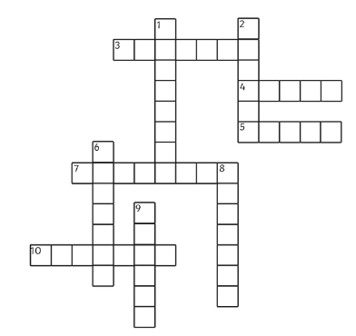
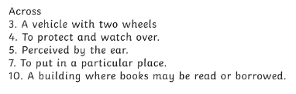
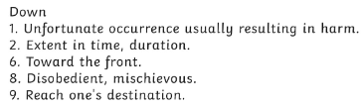
English Learning
Task 1: crossword for spellings from the Year 3 / 4 list.

Slide 13
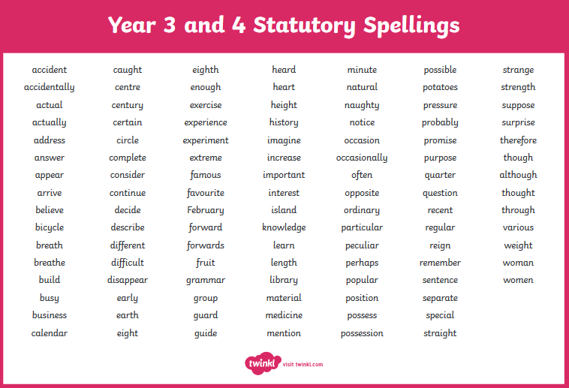

Slide 14
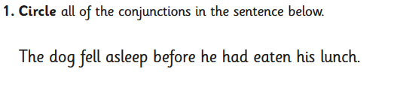
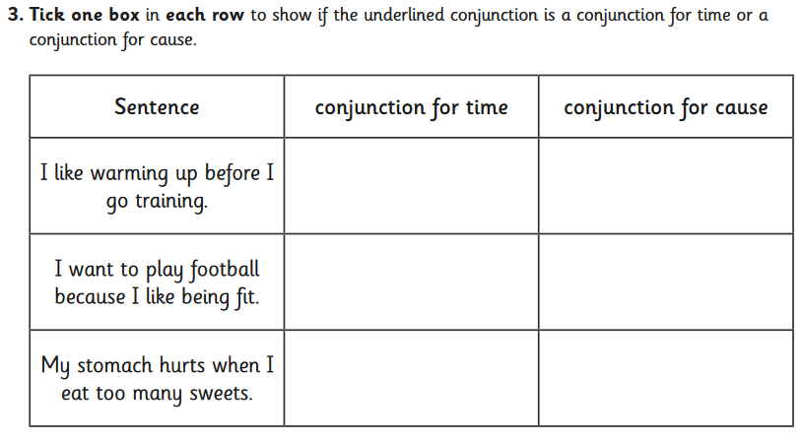
Task 2: conjunctions. Complete the questions.

Slide 15
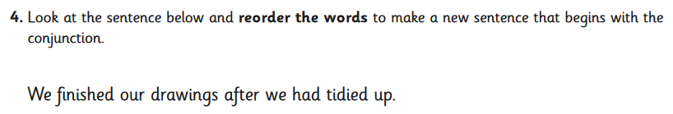
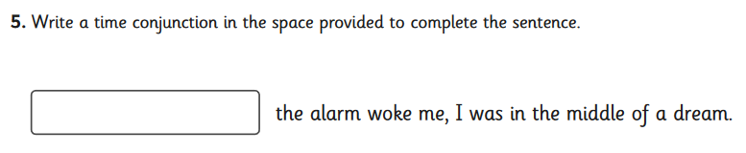
Task 3: conjunctions.
Write some sentences that begin with the conjunctions:
After…,
Before…,
When…,

Slide 16
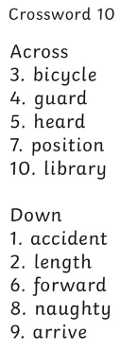


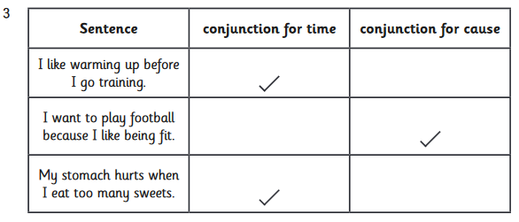
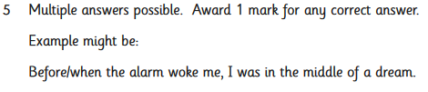
Answers

Slide 17
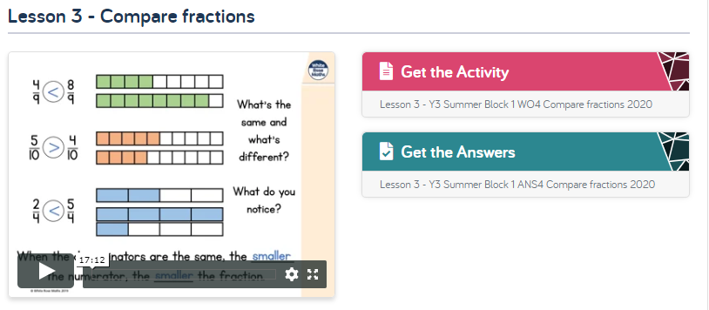
Maths Learning
Still sticking with fractions. Remember to use your best Austrian (Arnold Schwarzenegger) accent when talking about the numerator and denominator. Three things to focus on this week: comparing fractions (remember the crocodile always eats the bigger amount), ordering fractions and a little bit of adding fractions.
https://whiterosemaths.com/homelearning/year-3/

Slide 18
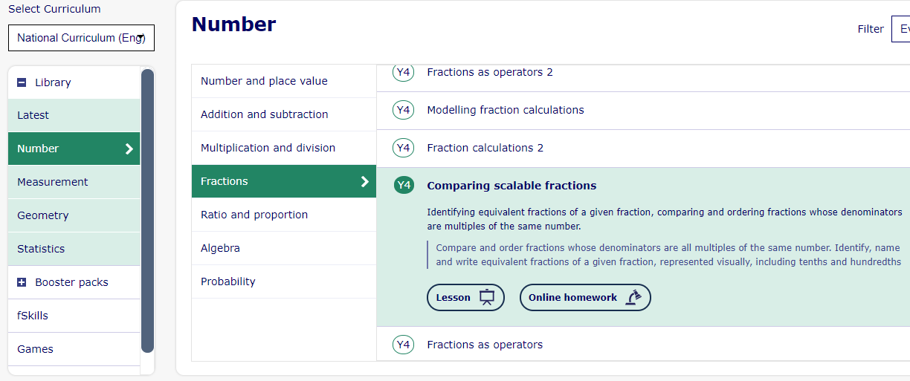
Maths Learning
Visit My Maths to complete more on comparing fractions.

Slide 19
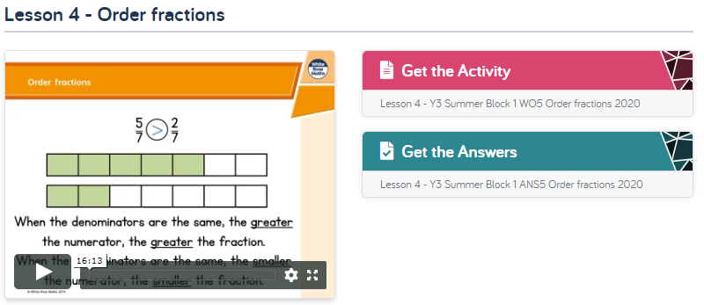
Maths Learning
Ordering Fractions
https://whiterosemaths.com/homelearning/year-3/

Slide 20
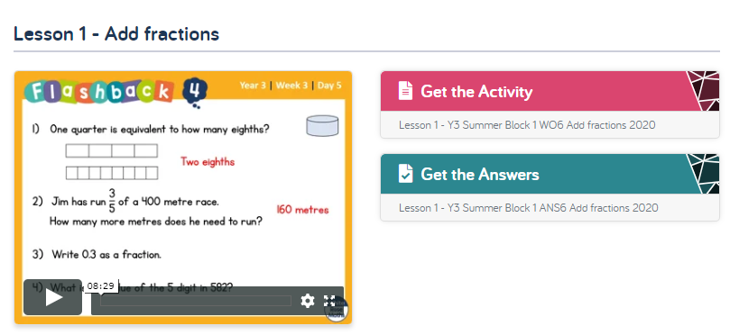
Maths Learning
Adding Fractions
https://whiterosemaths.com/homelearning/year-3/

Slide 21
Topic –
Research these famous inventors that were around in the Victorian period. Write a fact file for at least 3 of them including their name, the years they were born and died, and what they were famous for inventing.
Alexander Grahame Bell
Isambard Kingdom Brunel
Alexander Parkes
Thomas Edison
Kirkpatrick MacMillan

Slide 22
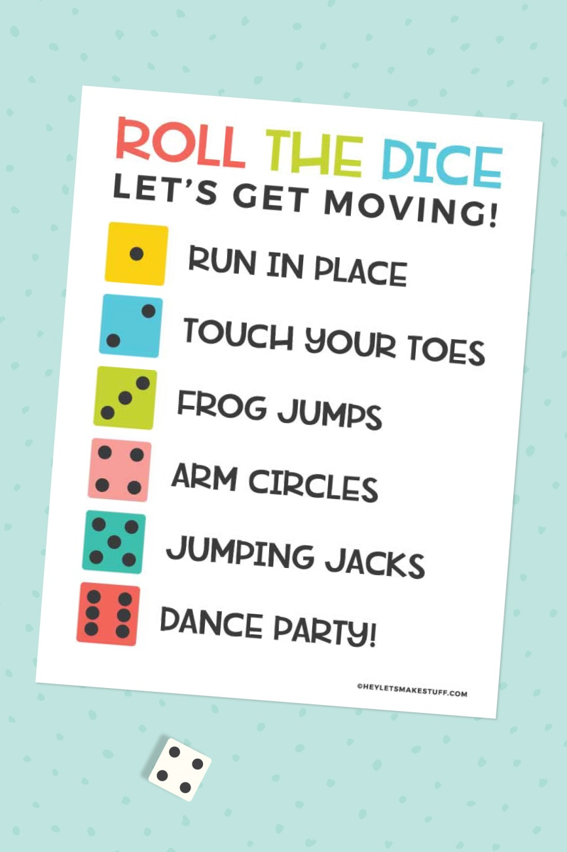

P.E.
Try these with a dice. Do each activity for 1 minute.
It is important to keep your children active. If it is safe to do so, ensure they have some time outside throughout the day. Please visit Joe Wicks YouTube channel (https://www.youtube.com/channel/UCAxW1XT0iEJo0TYlRfn6rYQ), which has lots of exercise videos for children. He will also be hosting a live P.E. lessons Monday to Friday at 9:00am.

Slide 23

Classroom Secrets
The site classroom secrets https://classroomsecrets.co.uk/free-home-learning-packs/ has free class packs which provide some great additional ideas and resources you can use.

