Slide 1

Home Learning
Year 1

Slide 2
Message from the class teacher
Thank you for taking the time to work with your child to complete some of the home learning tasks. In this pack are links and suggested learning in-line with what we are learning in class. We understand that you do not have all the resources that are available at school so please do the best you can to facilitate the learning. There are no expectations that all the work needs to be printed and completed but we advise that keeping a daily routine of educational activities and learning is best practice.
Thank you for your continued support.

Slide 3

Reading
For additional reading at your child’s level please use the Oxford Owl website where you can read books online and then complete comprehension activities about the books. Please continue to keep a record of the books they have read in their reading records.
www.oxfordowl.co.uk
Class login: temple20
Password: Bingbong
(If you are not sure of your child’s level, please check in their reading record book or look at the coloured stickers on the additional reading books that have been sent home.)

Slide 4

Phonics
Please use the games and activities on the Phonicsplay website to continue practsing Phonics.
www.phonicsplay.co.uk
Login: march20
Password: home
Mrs Child’s Phonics group are currently working on Phase 5c (alternative ways of writing sounds we already know e.g. ai, ay, a_e all make the same sound).
Mrs Smith’s group are working on Phase 4.
Additionally, there are many excellent Phonics resources on the Twinkl website(see below for how to get free access). Practising reading “alien words” is a particularly fun and valuable activity.

Slide 5

Writing
Your child has been provided with a writing journal. They are used to using them and know that they need to write the date, write a sentence (about anything they like), draw and colour a picture and then fill any spare lines with handwriting patterns.

Slide 6


Using My Maths
Children should know their way round My Maths but here are some reminders on how to access the lessons. Visit: www.mymaths.co.uk
bapchild
divide162

Slide 7

Using My Maths
Access any lesson based on what your child is learning in class or search the topic in the search bar.
Use the login portal to access specific homework and lessons that your teacher has set.

Slide 8

Maths – White Rose Home Learning
In school we follow the White Rose scheme of learning. Their website has put together free lessons and resources that link to the learning taking place in school. Please visit: https://whiterosemaths.com/homelearning/

Slide 9

Accessing Twinkl
Many educational content providers are offering free access to their resources. Twinkl is a website that we use from time to time to resource our lessons to aid in teacher input and pupil activities.
We will be able to direct you towards activities and learning via this website based on lessons that may be missed due to absence. To access Twinkl please visit: www.twinkl.co.uk/offer
You will have to sign up and put in the offer code: UKTWINKLHELPS

Slide 10
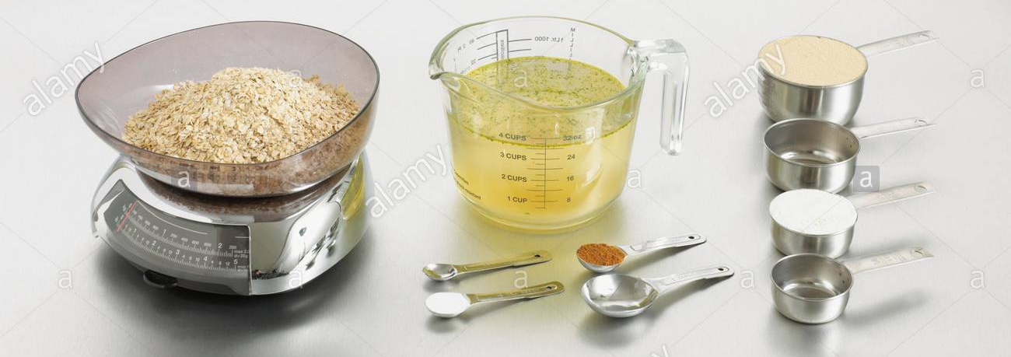
Maths Learning
Year 1’s next unit in Maths would be about Weight and Volume. Please support your child to compare and measure weights and volumes, (perhaps by helping with cooking, gardening, cleaning and tidying!) They need to be able to use the words light, heavy, lighter than, heavier than, lightest, heaviest, full, empty, half full, nearly empty, more than and less than.

Slide 11
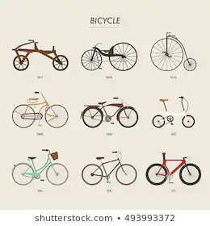
English/Topic Learning
In English we have been learning about Information Texts and we would have been working towards producing our own information pages about Transport. You could pick either a bicycle, car, train, bus or aeroplane and make a poster/information page about how they have changed over time. We would also have learned about Alphabetical Order and there are many resources to support this on Twinkl.

Slide 12
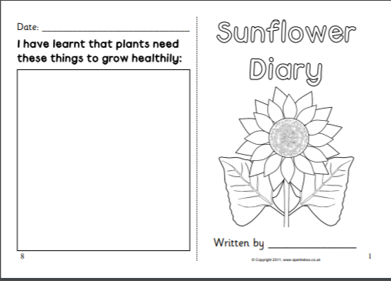
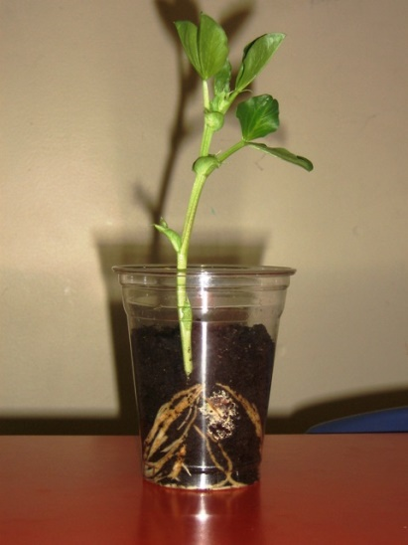
Science Learning
Our next Science topic will be about plants. Your child should have come home with a sunflower seed to plant and look after (very kindly provided by Felix!) and a Sunflower Diary to complete.

Slide 13

P.E.
It is important to keep your children active. If it is safe to do so, ensure they have some time outside throughout the day. Please visit Joe Wicks YouTube channel (https://www.youtube.com/channel/UCAxW1XT0iEJo0TYlRfn6rYQ), which has lots of exercise videos for children. He will also be hosting a live P.E. lessons Monday to Friday at 9:00am.

Slide 14

Classroom Secrets
The site classroom secrets https://classroomsecrets.co.uk/free-home-learning-packs/ has free class packs which provide some great additional ideas and resources you can use.

