Slide 1

Year 1, Year 1,
What do you see?

Slide 2
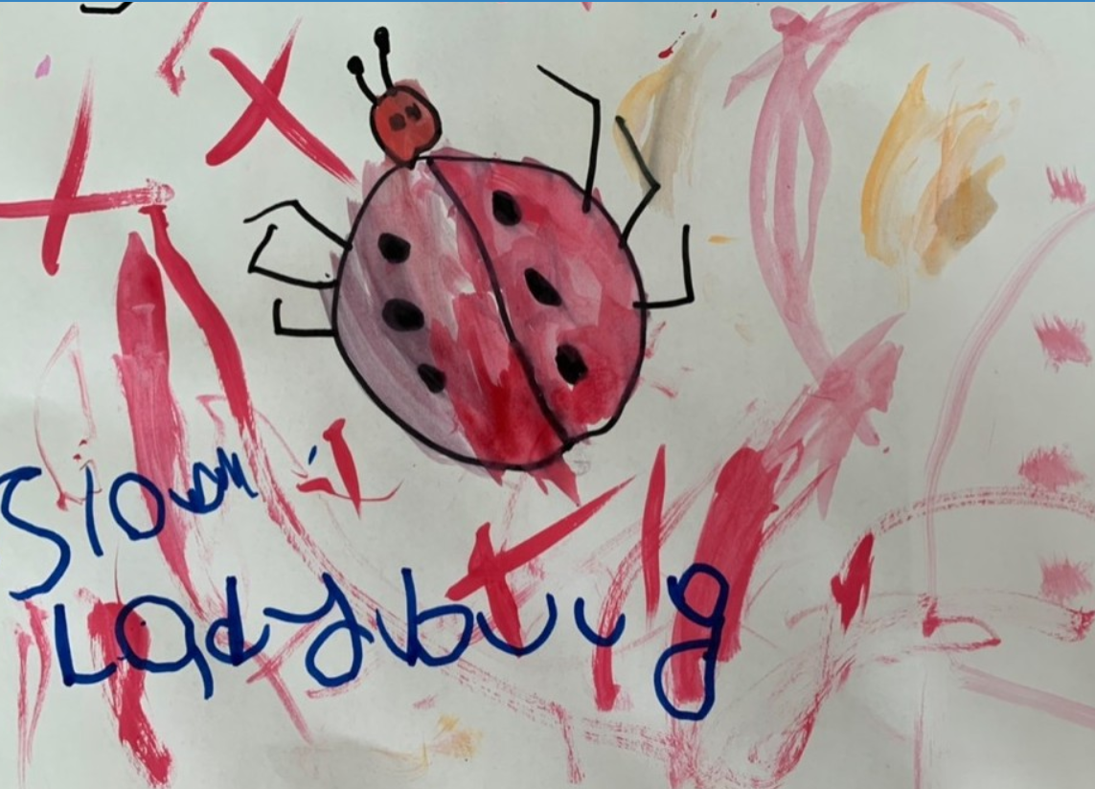
I see a Slow Ladybug looking at me!
by Erin
Slow Ladybug, Slow Ladybug, what do you see?

Slide 3
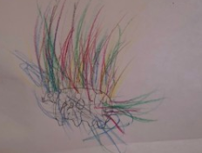
I see a Spiky Hedgehog looking at me!
by Fred
Spiky Hedgehog, Spiky Hedgehog, what do you see?

Slide 4
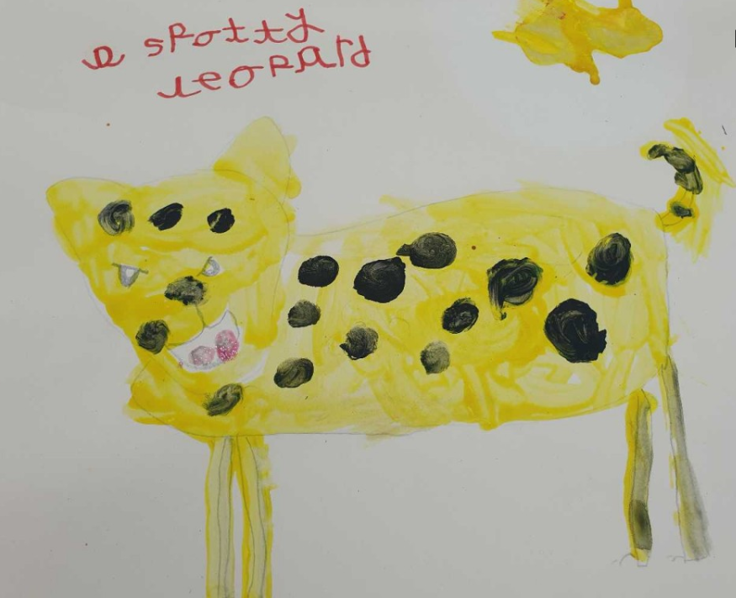
I see a Spotty Leopard looking at me!
by Ernest
Spotty Leopard, Spotty Leopard, what do you see?

Slide 5
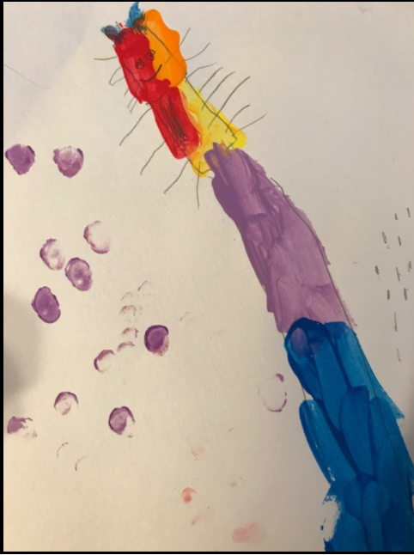
I see a Rainbow Giraffe looking at me!
by Sophia
Rainbow Giraffe, Rainbow Giraffe, what do you see?

Slide 6
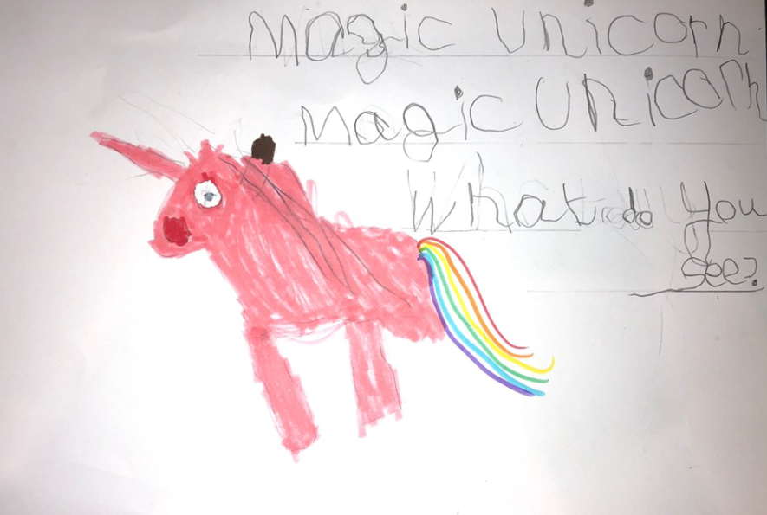
I see a Magic Unicorn looking at me!
by Phoebe
Magic Unicorn, Magic Unicorn, what do you see?

Slide 7
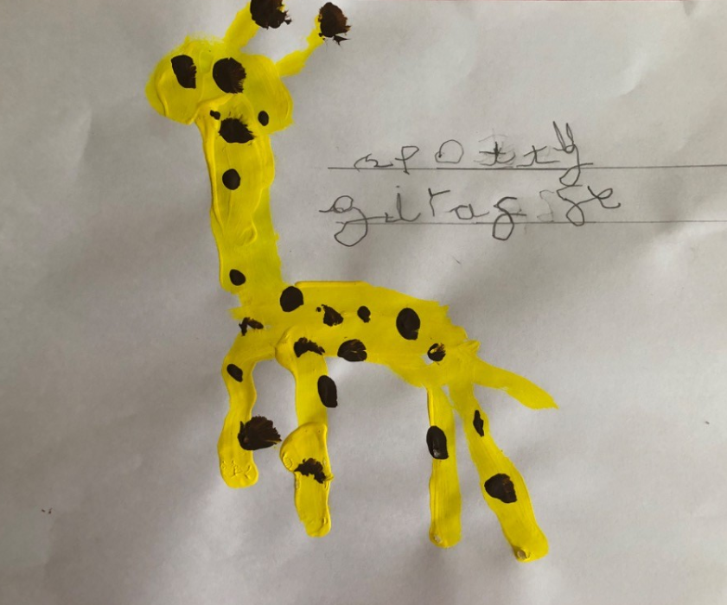
I see a Spotty Giraffe looking at me!
by Casey
Spotty Giraffe, Spotty Giraffe, what do you see?

Slide 8
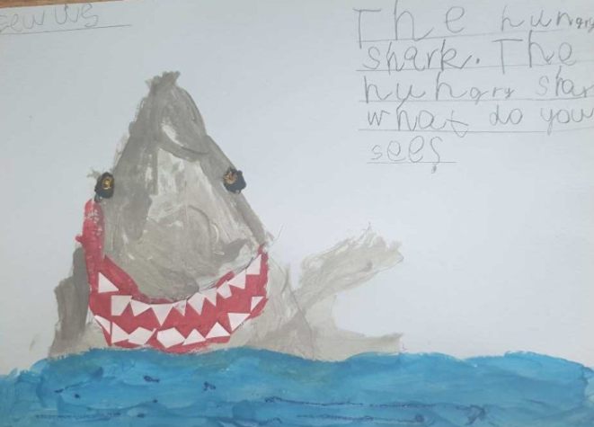
I see a Hungry Shark looking at me!
by Eelis
Hungry Shark, Hungry Shark, what do you see?

Slide 9
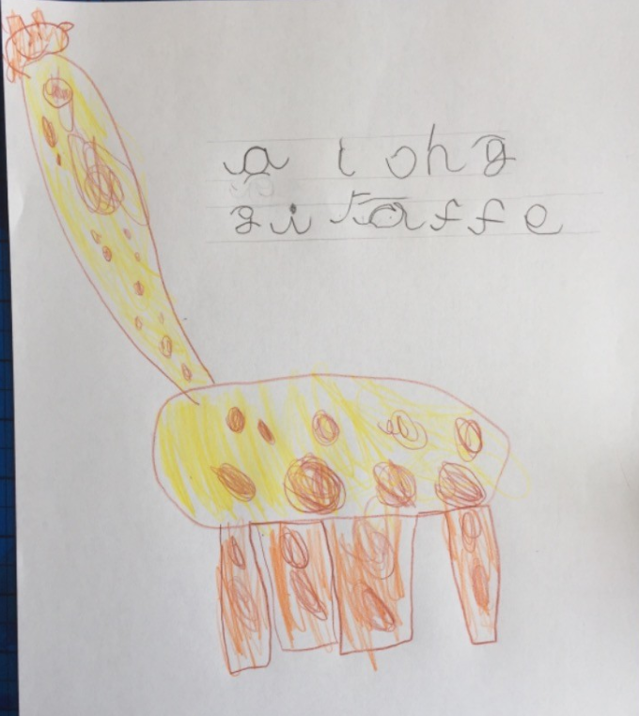
I see a Long Giraffe looking at me!
by Ellen
Long Giraffe, Long Giraffe, what do you see?

Slide 10
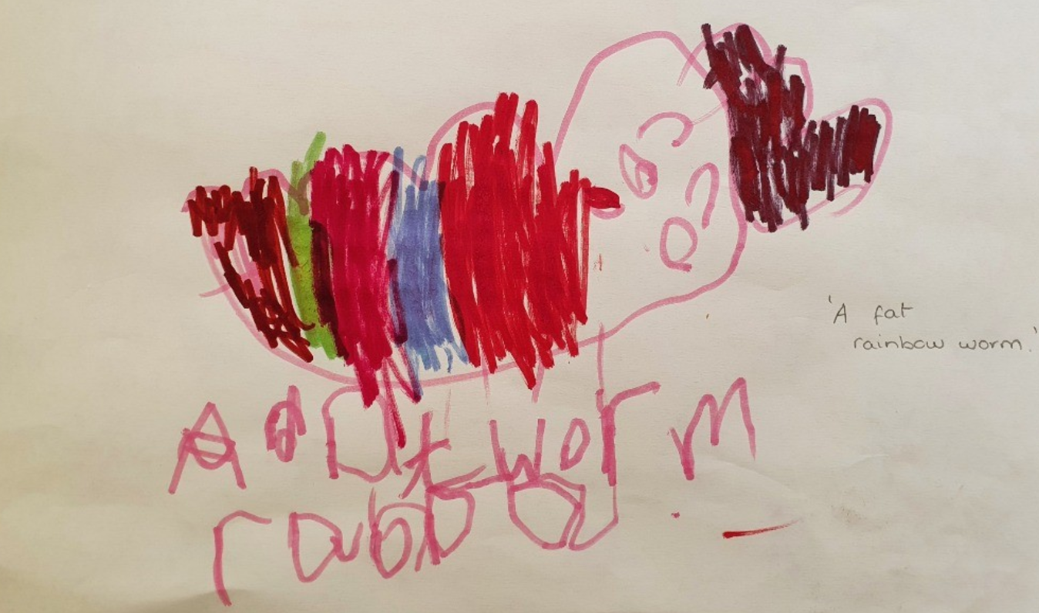
I see a Fat Worm looking at me!
by Samuel
Fat Worm, Fat Worm, what do you see?

Slide 11
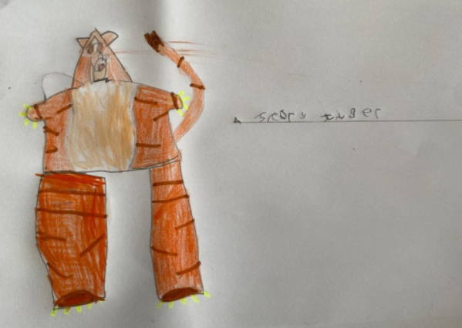
I see a Scary Tiger looking at me!
by Troy
Scary Tiger, Scary Tiger, what do you see?

Slide 12
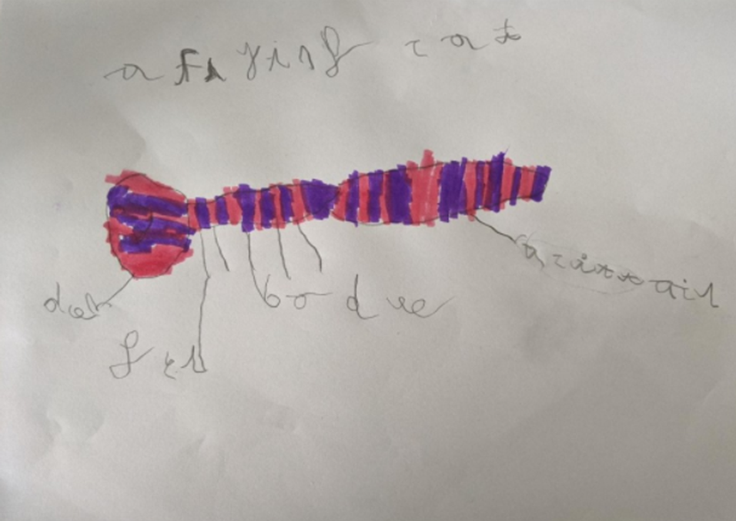
I see a Flying Cat looking at me!
by Edith
Flying Cat, Flying Cat, what do you see?

Slide 13
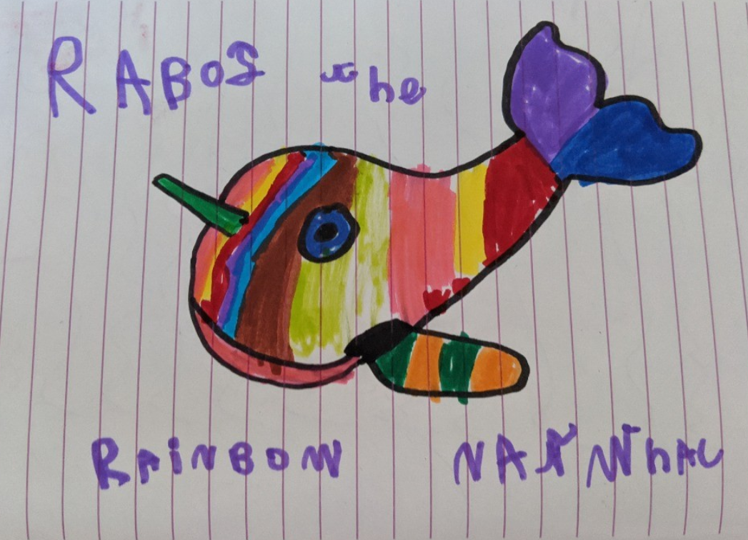
I see a Rainbow Narwhal looking at me!
by Eleesi
Rainbow Narwhal, Rainbow Narwhal, what do you see?

Slide 14
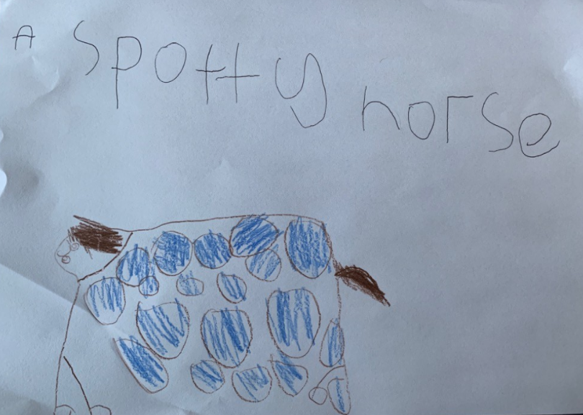
I see a Spotty Horse looking at me!
by Ava
Spotty Horse, Spotty Horse, what do you see?

Slide 15
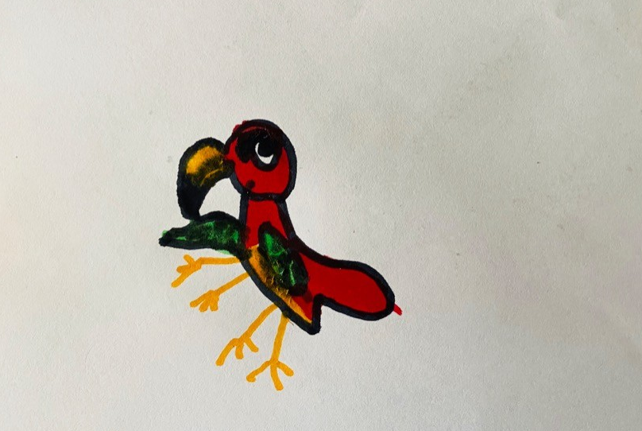
I see a Naughty Parrot looking at me!
by Rae
Naughty Parrot, Naughtly Parrot, what do you see?

Slide 16
I see Year 1 looking at me!

