Slide 1
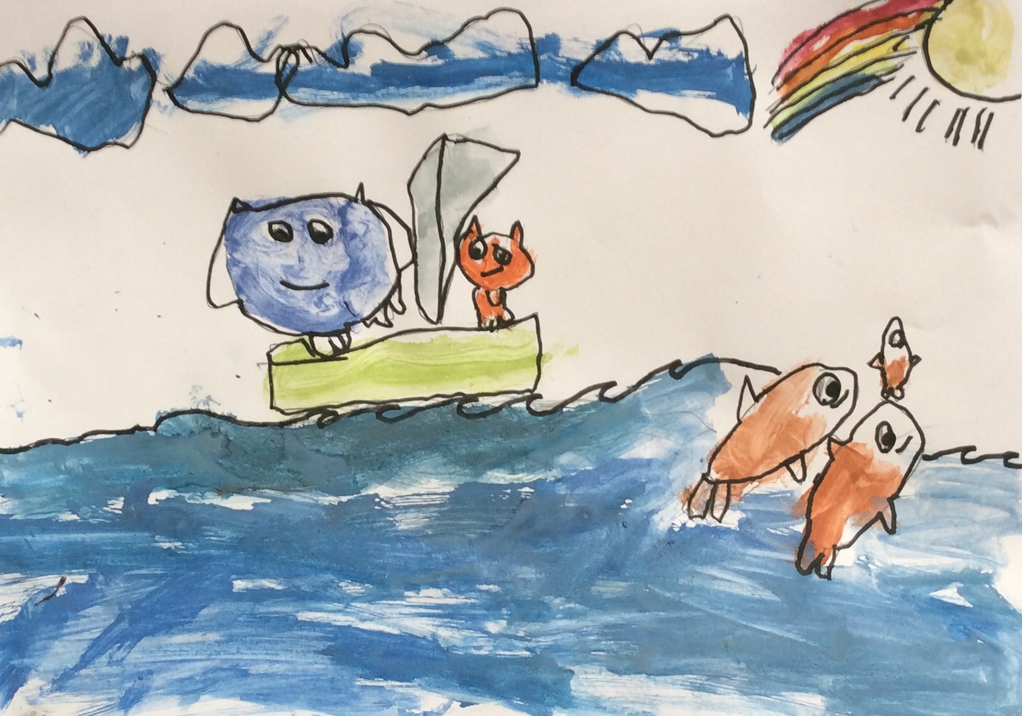
The Owl and the Pussycat went to sea

Slide 2
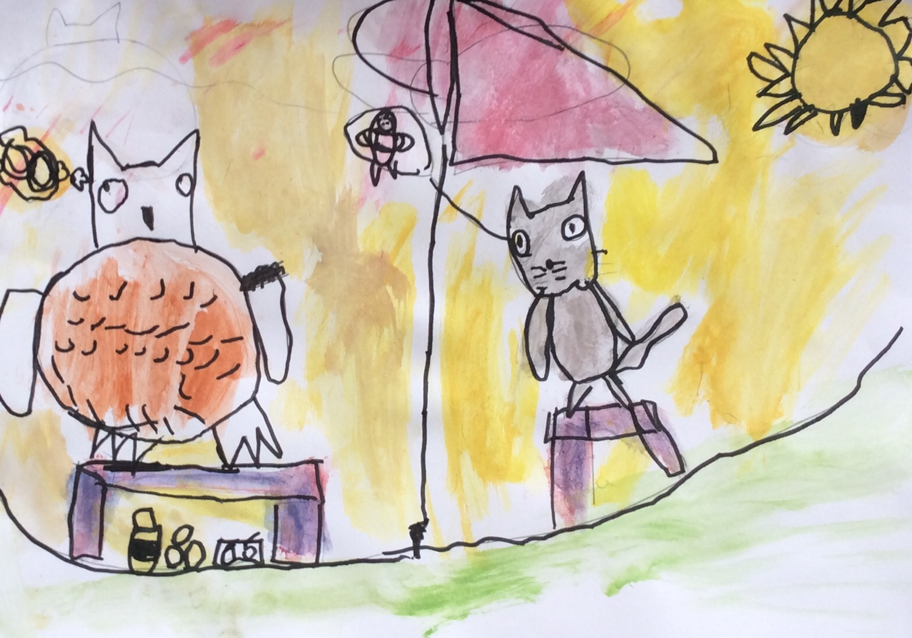
In a beautiful, pea-green boat

Slide 3
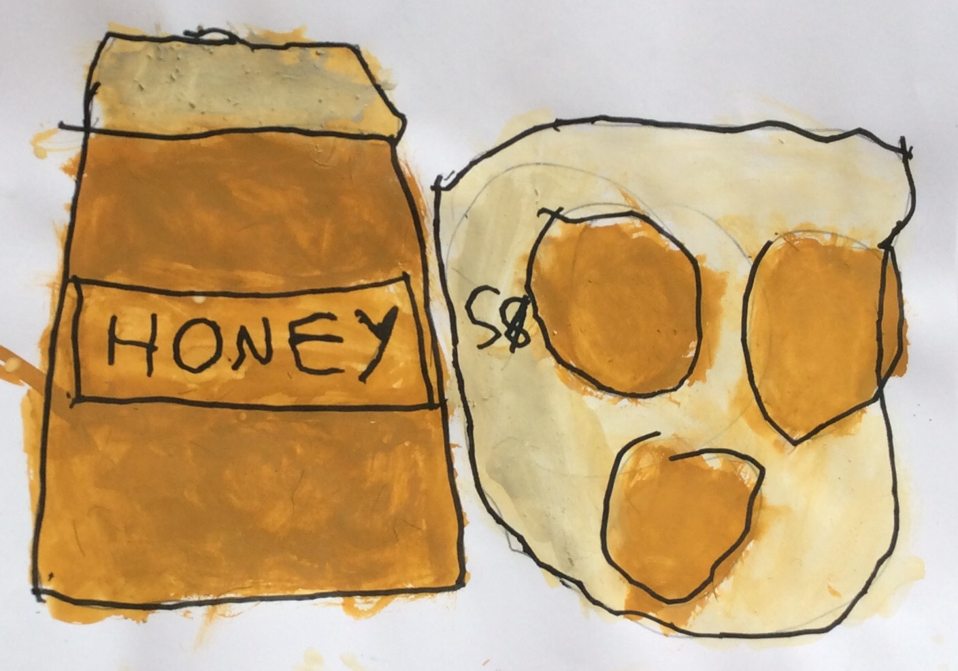
They took some honey and plenty of money
wrapped up in a five pound note

Slide 4
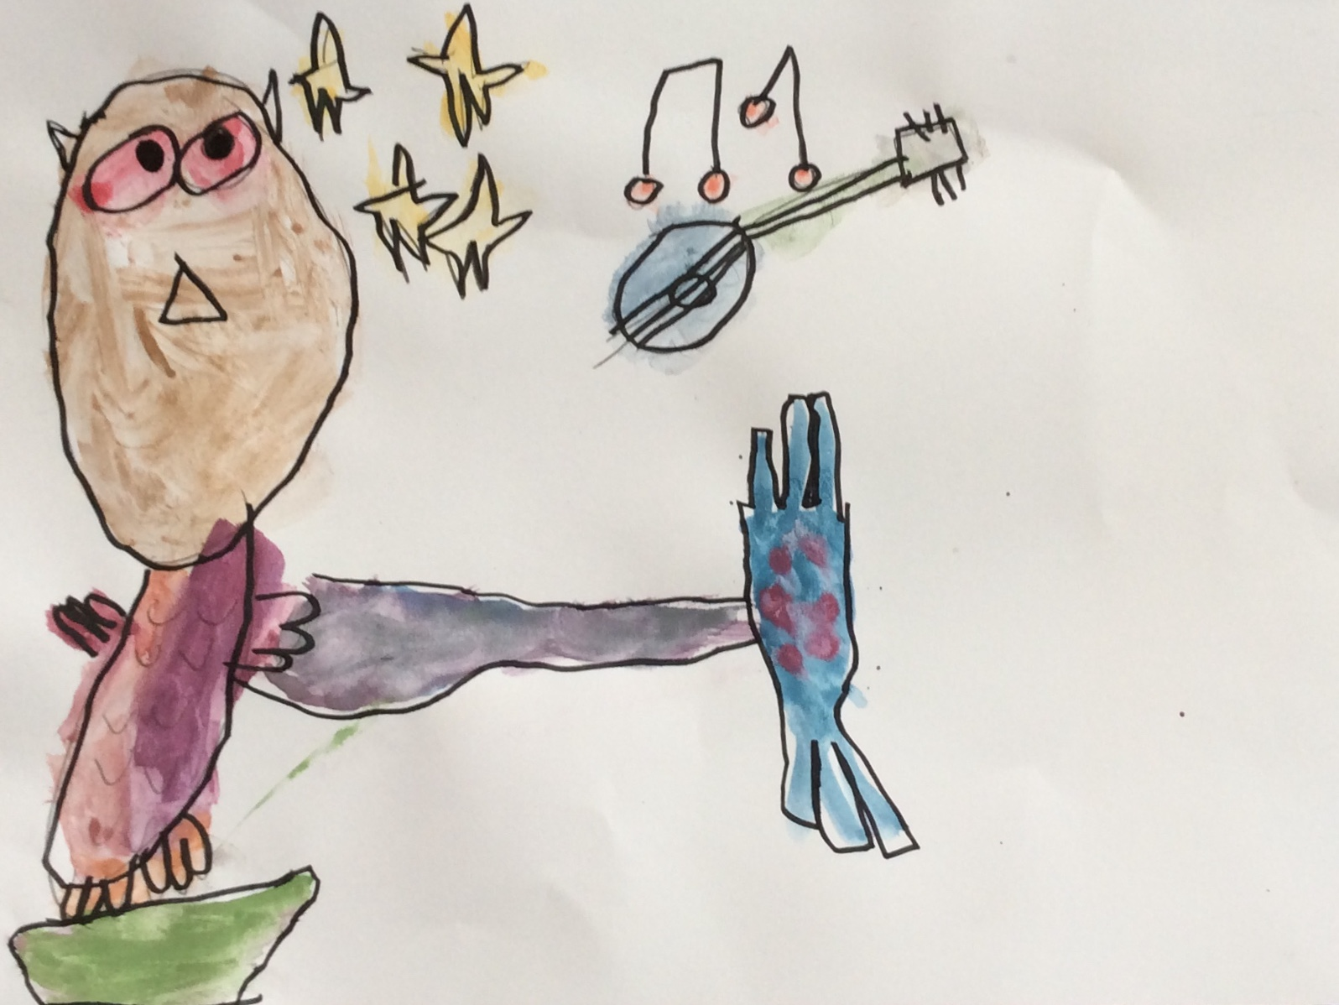
The owl looked up to the stars above

Slide 5
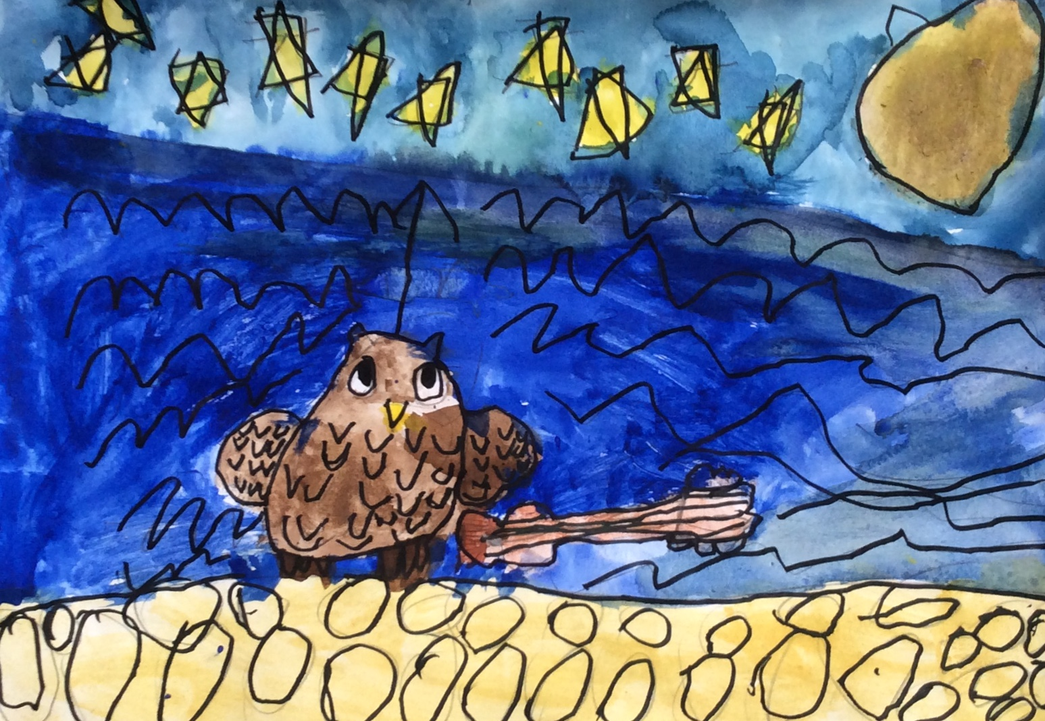
And sang to a small guitar

Slide 6
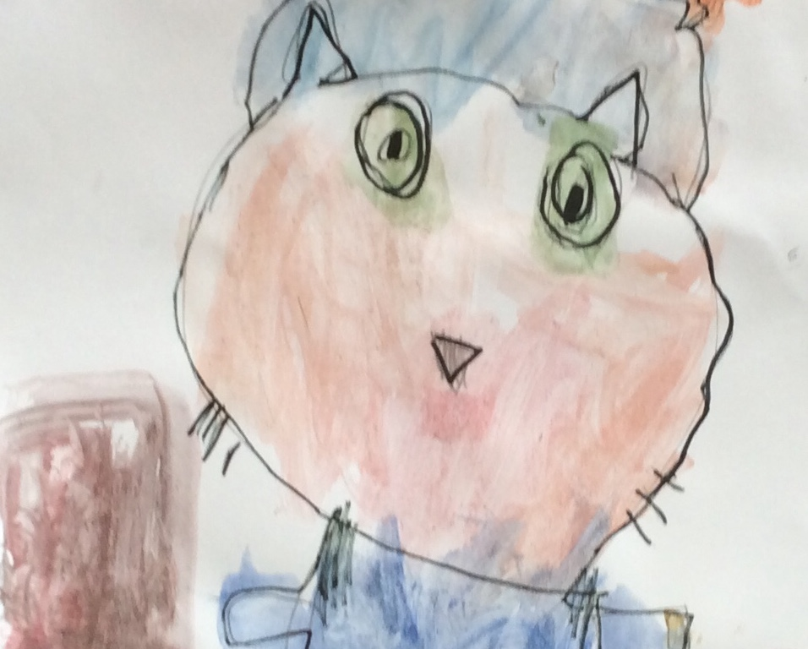
“Oh lovely Pussy,
Oh Pussy my love,
What a beautiful Pussy
You are,
You are,
You are,
What a beautiful Pussy
You are!

Slide 7
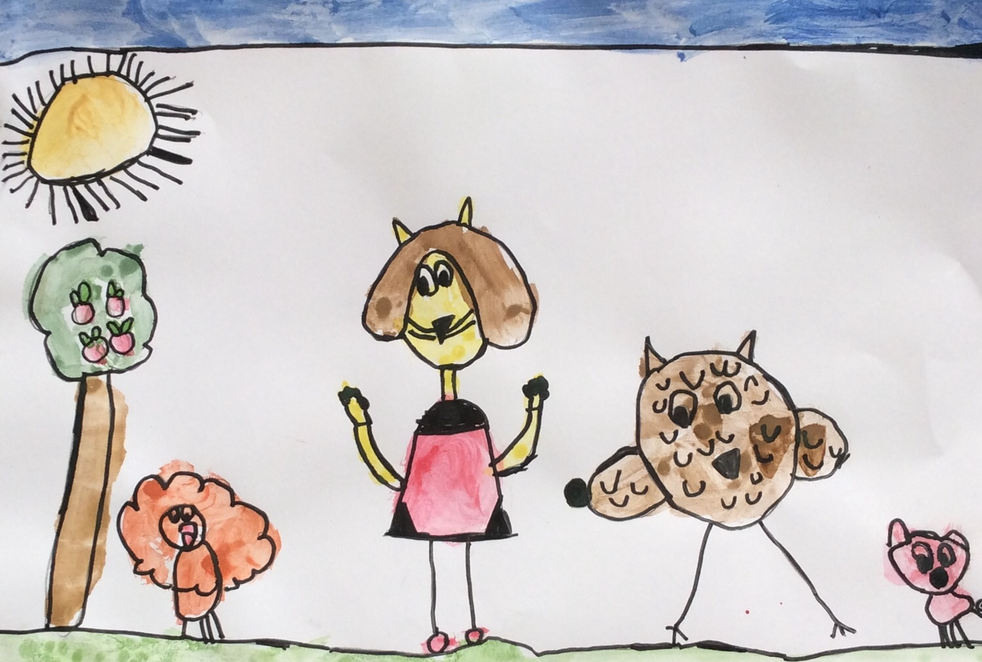
Pussy said to the Owl
“You elegant fowl
How charmingly sweet you sing.
O let us be married
Too long we have tarried
But what shall we do for a ring?”

Slide 8
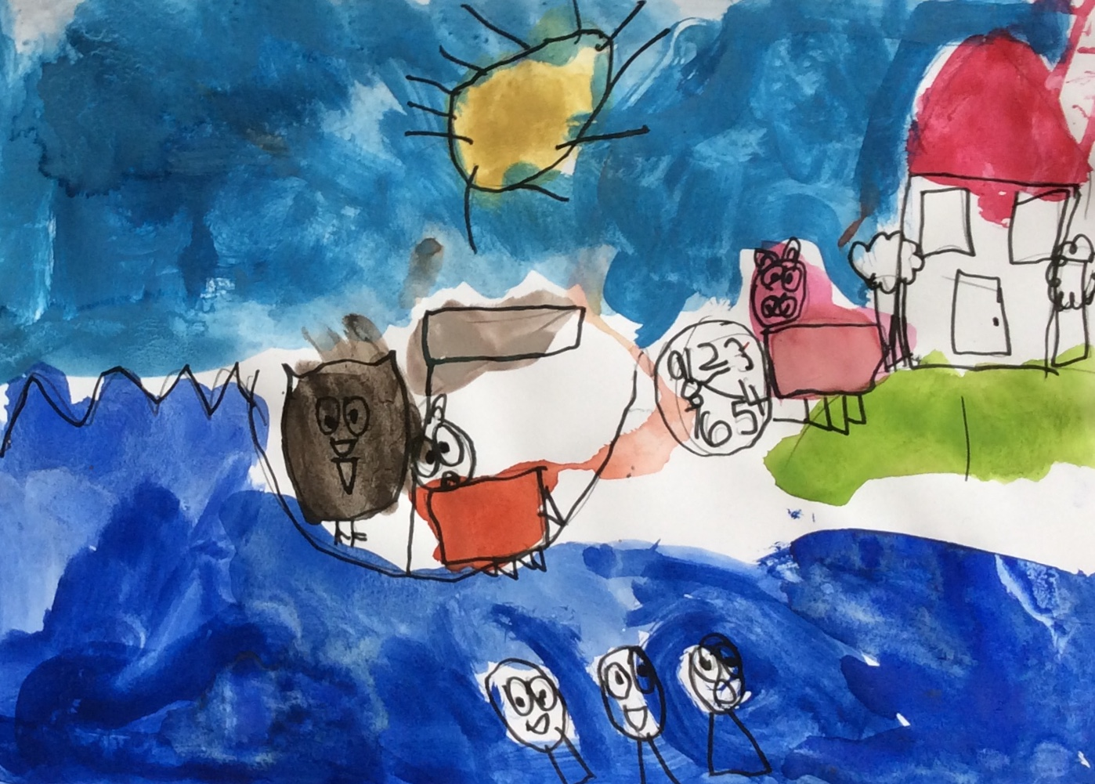
So they sailded away for a year and a day

Slide 9
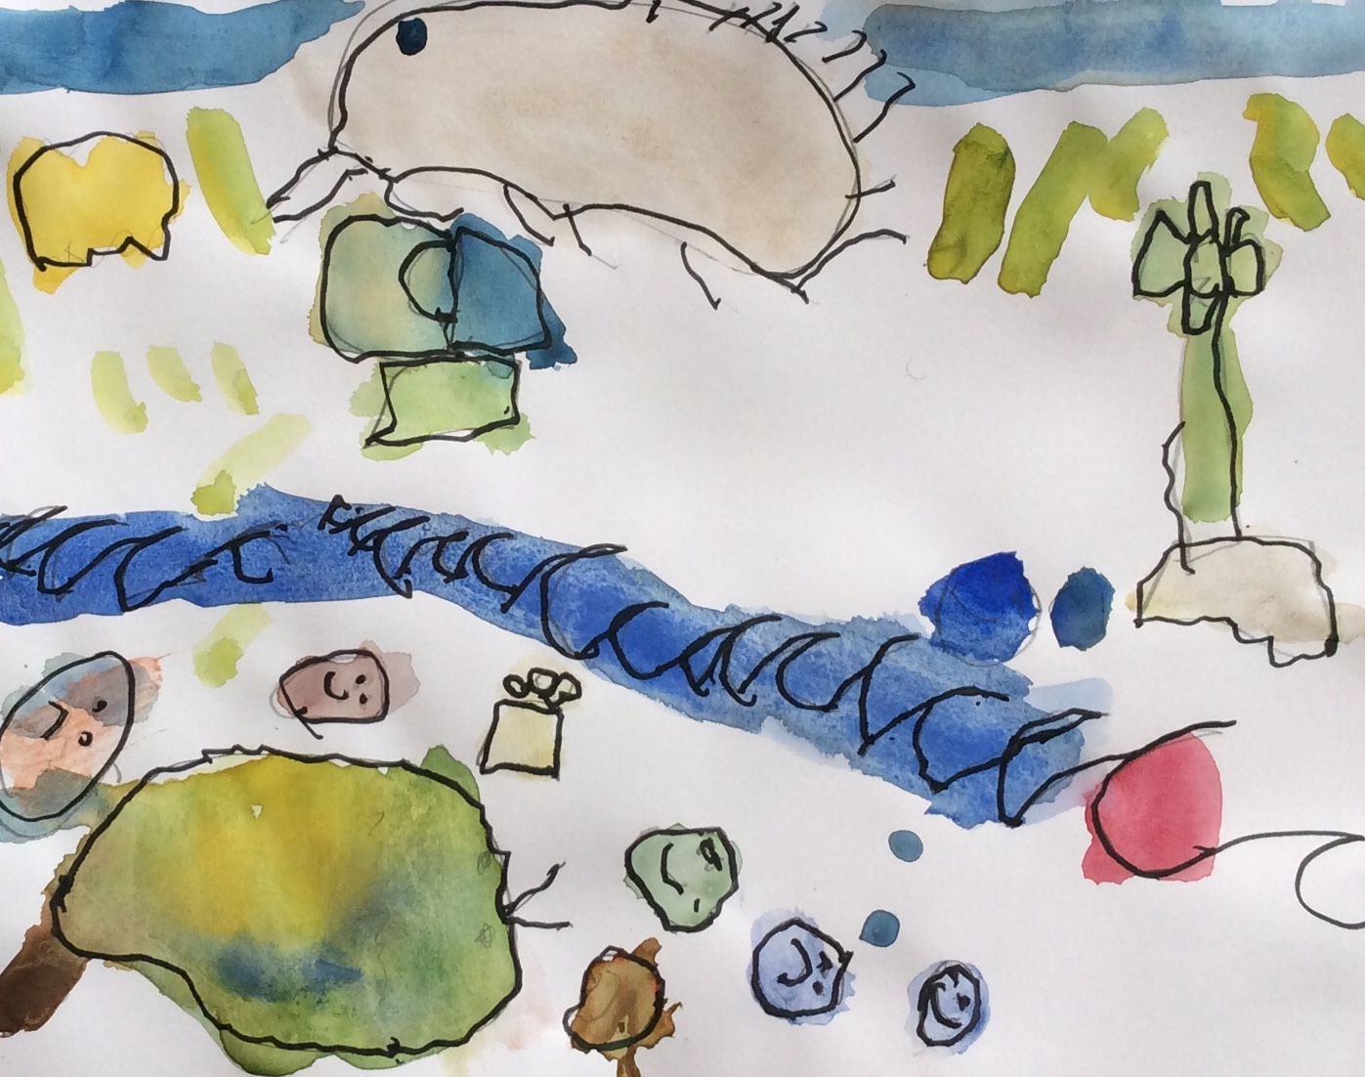
To the land where the Bong-tree grows

Slide 10
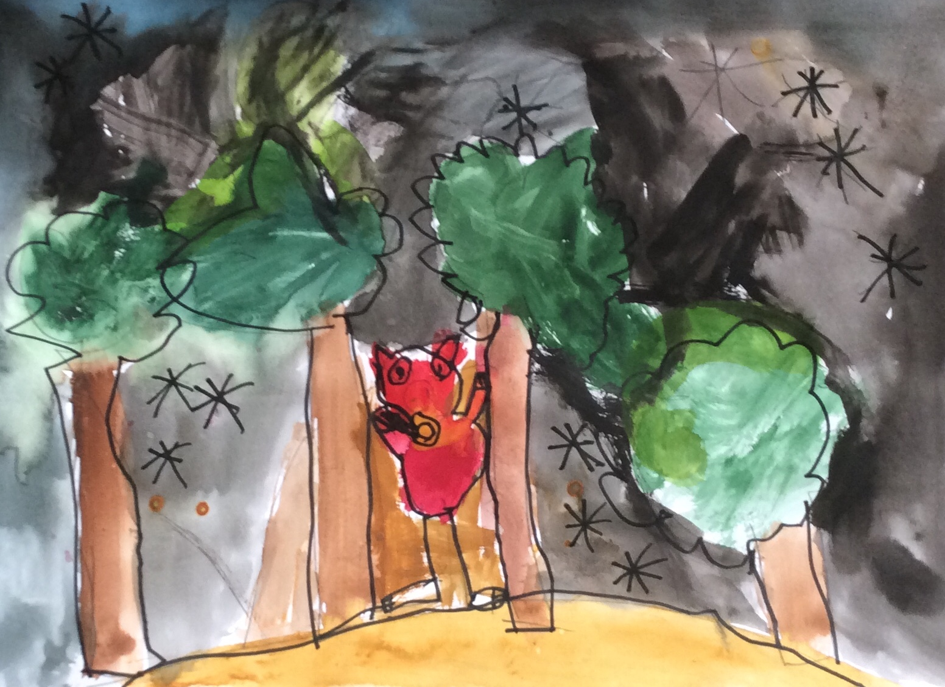
And there in a wood a Piggy-wig stood

Slide 11
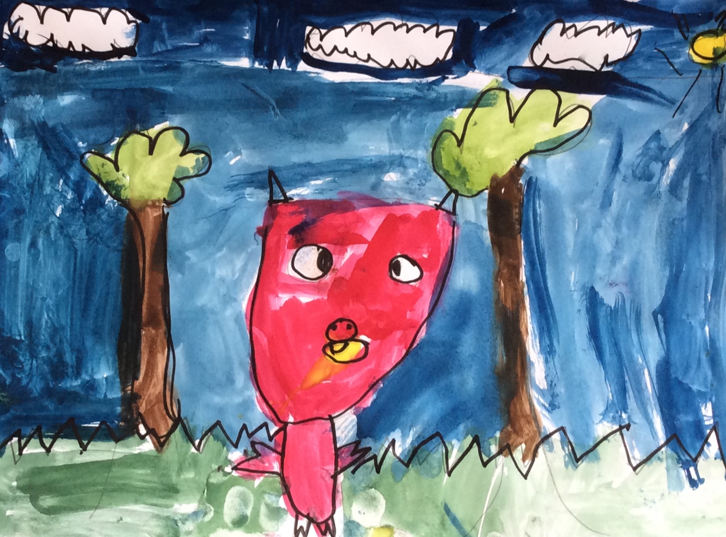
With a ring at the end of
his nose,
his nose,
his nose,
With a ring at the end of
his nose.

Slide 12
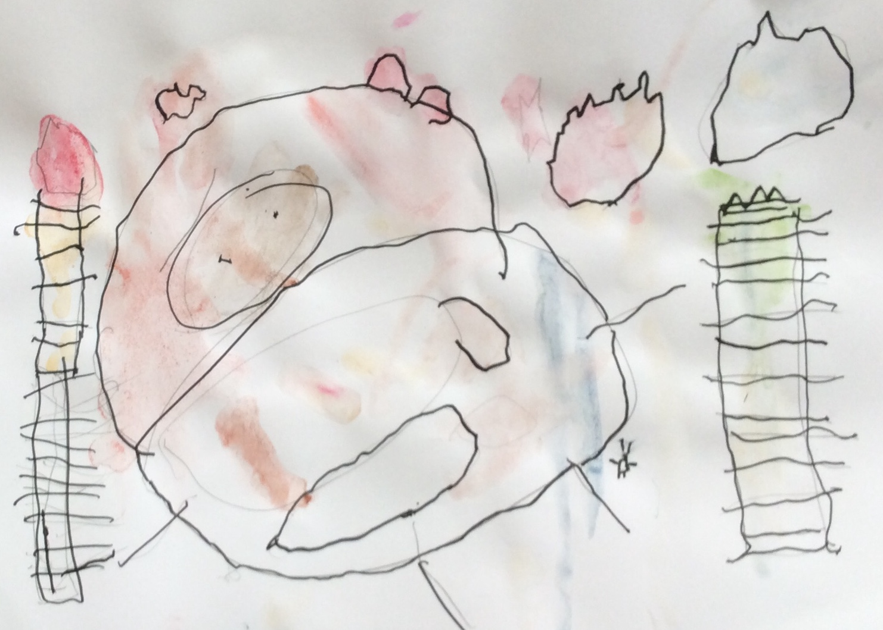
“Dear Pig are you willing
to sell for one shilling, your ring?”
Said the Piggy “I will.”

Slide 13
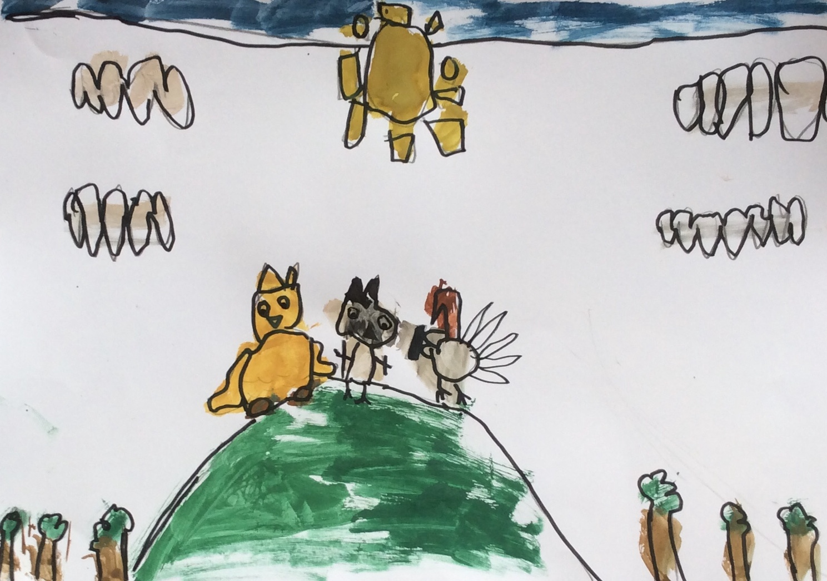
So they took it away and were married next day

Slide 14
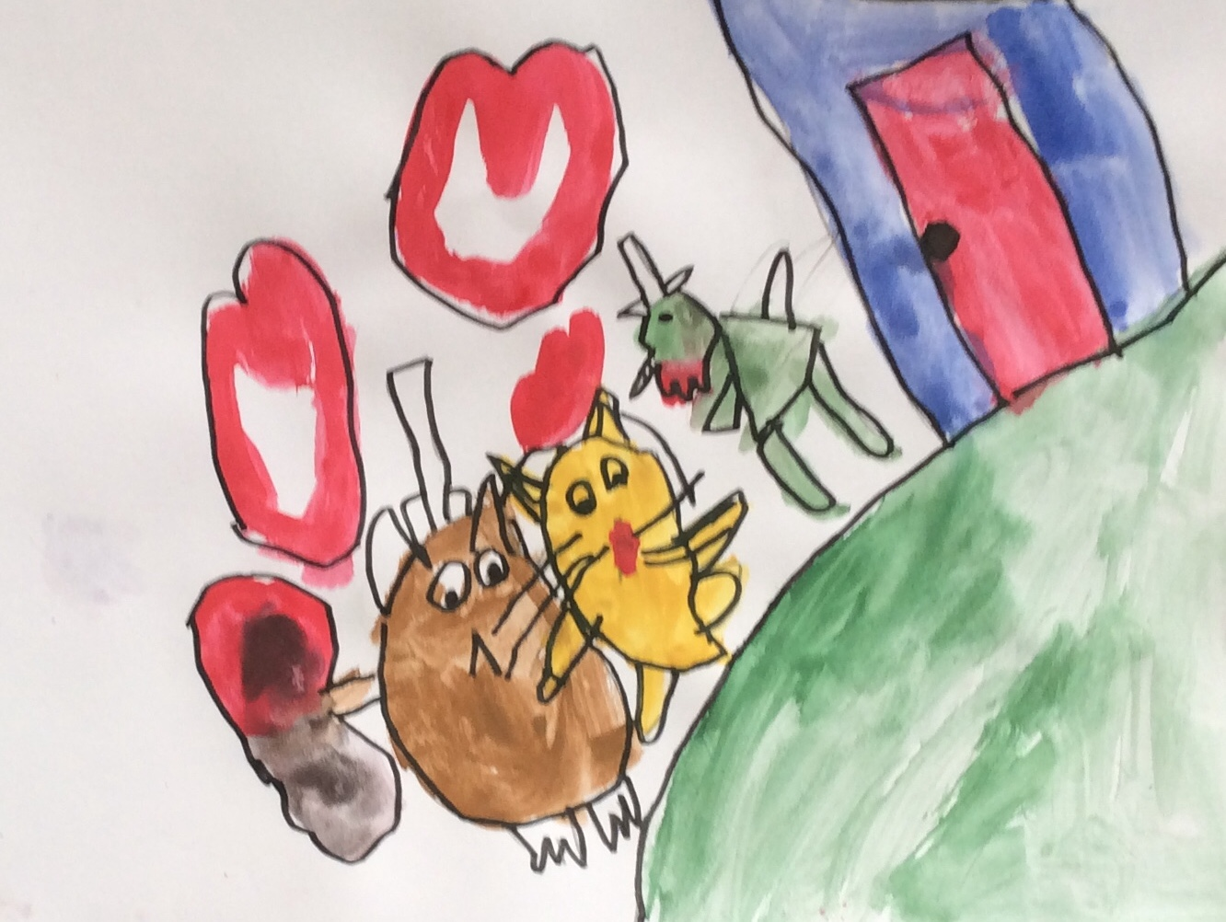
By the
Turkey who lives on the hill

Slide 15
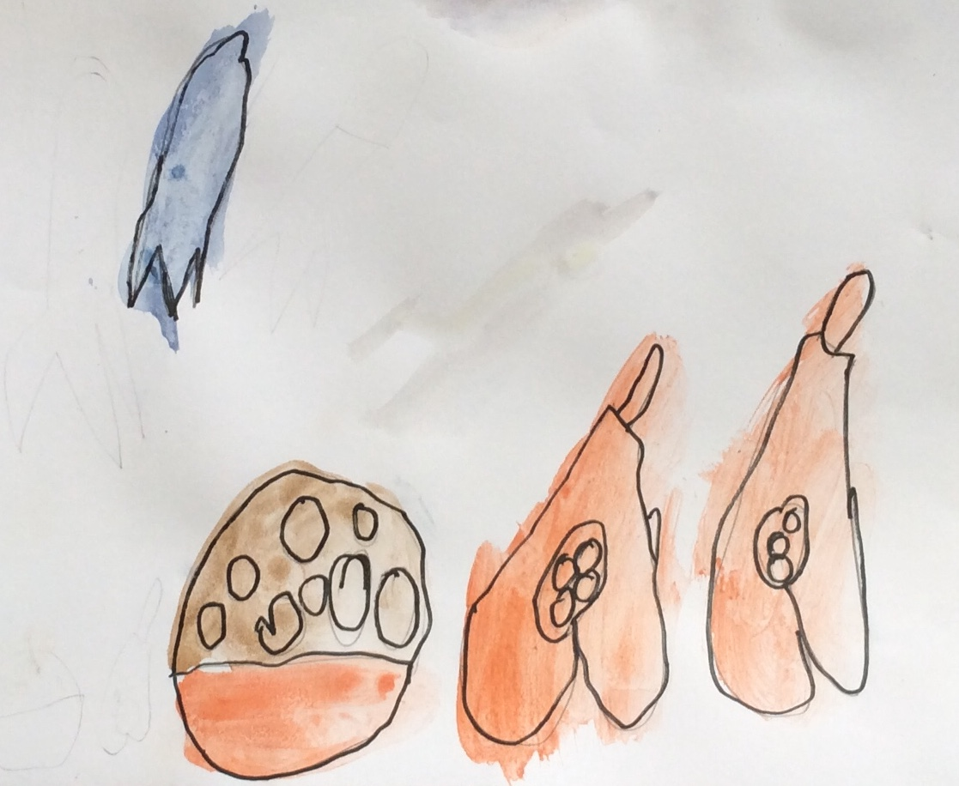
They dined on mince
and slices of quince
Which they ate with
a runcible spoon

Slide 16
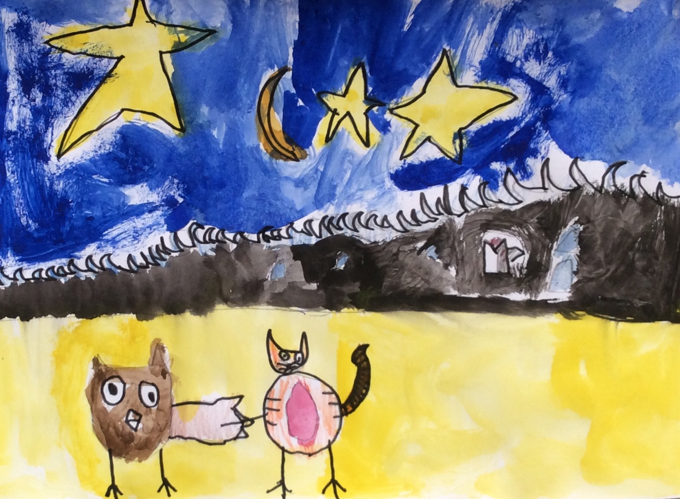
And hand in hand

Slide 17
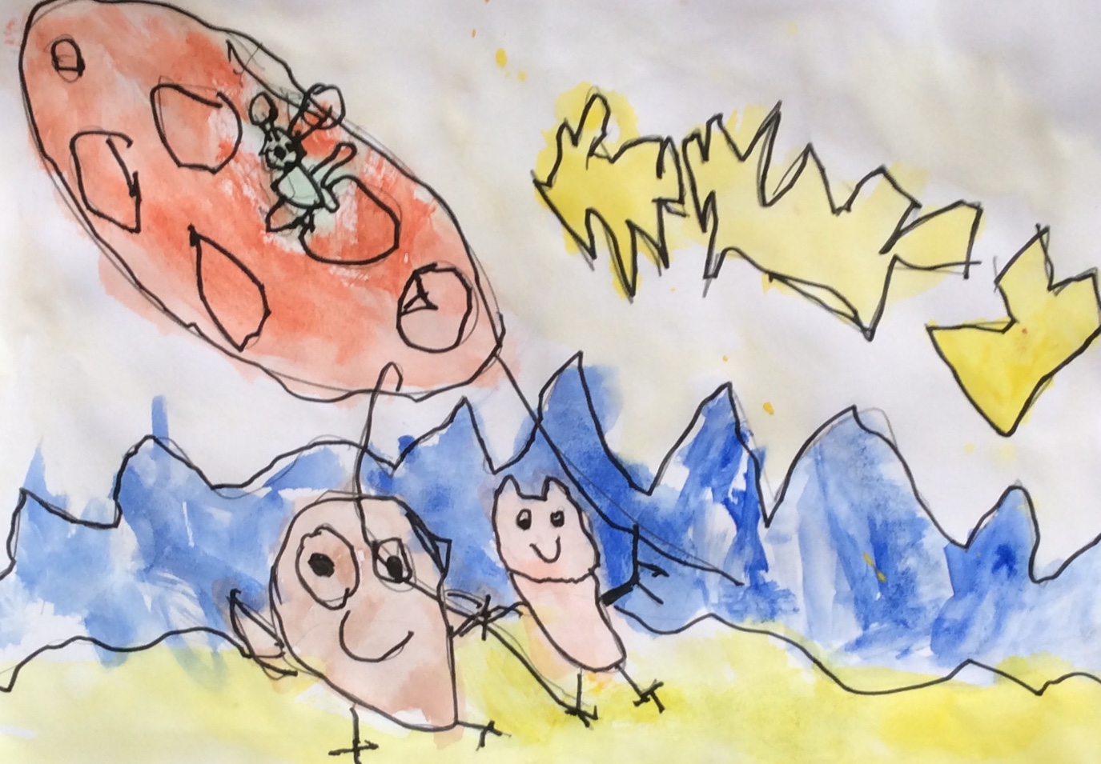
On the edge of the sand

Slide 18
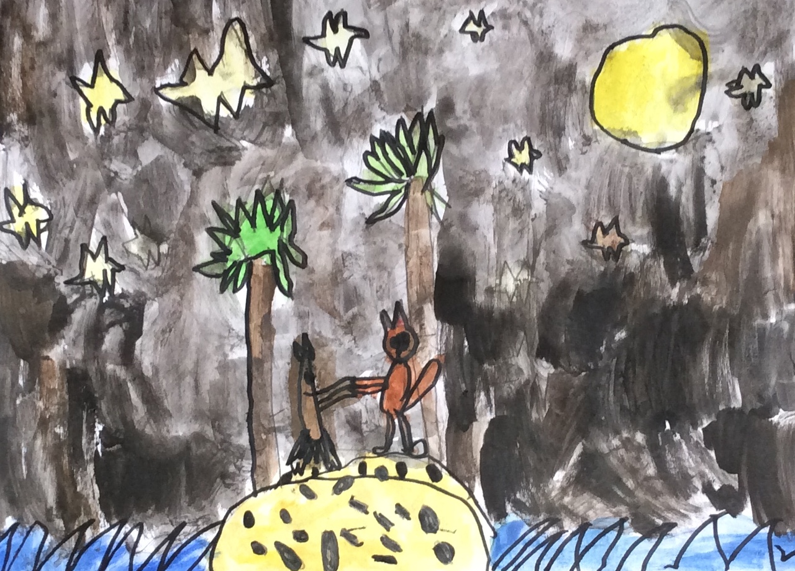
They danced by the light of themoon,
the moon,
the moon,
They daned by the light of the moon.

