Slide 1



A big warm welcome to Ramsey Class.
Here you will find a transition slide show filled with photos of the classroom, toilets and other areas of the school.
Look at it through the summer holidays to help your child become familiar with where they will be coming in September.

Slide 2
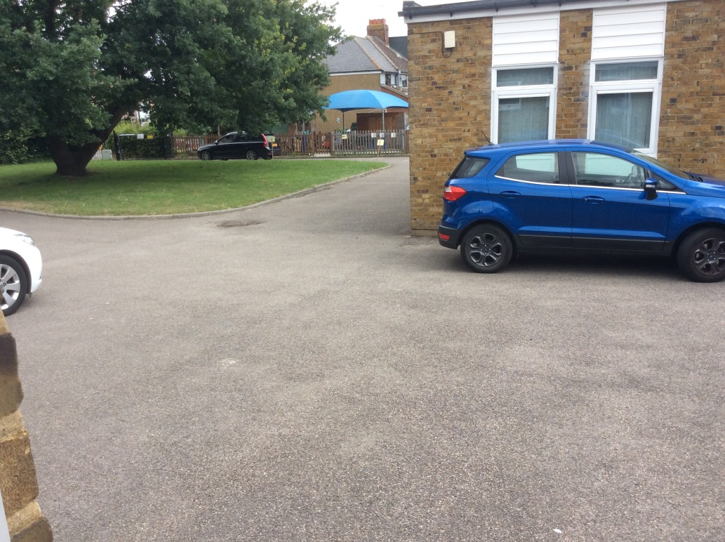


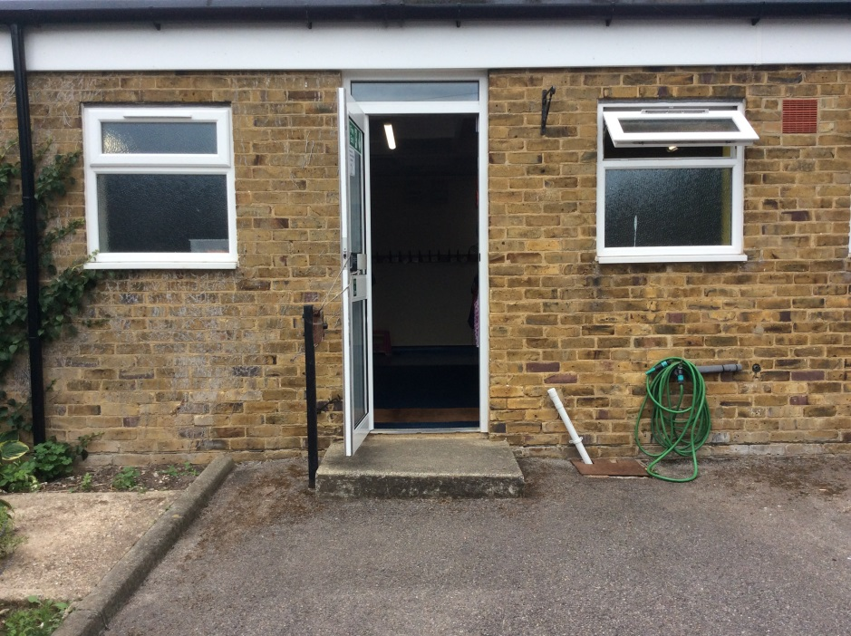
This is the door where you will come into school in the mornings.
In the mornings, this is where you will wait to come into school.

Slide 3
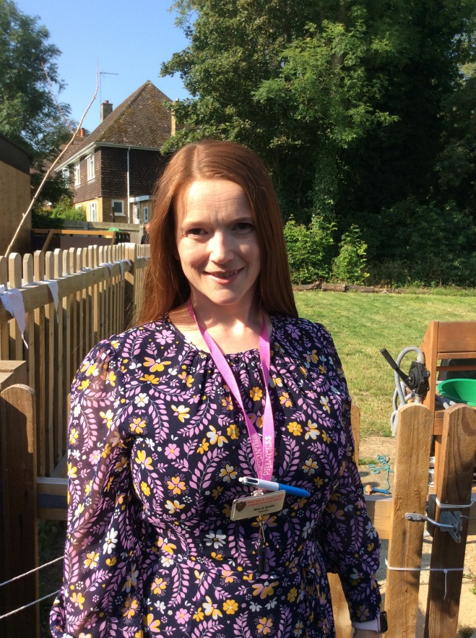
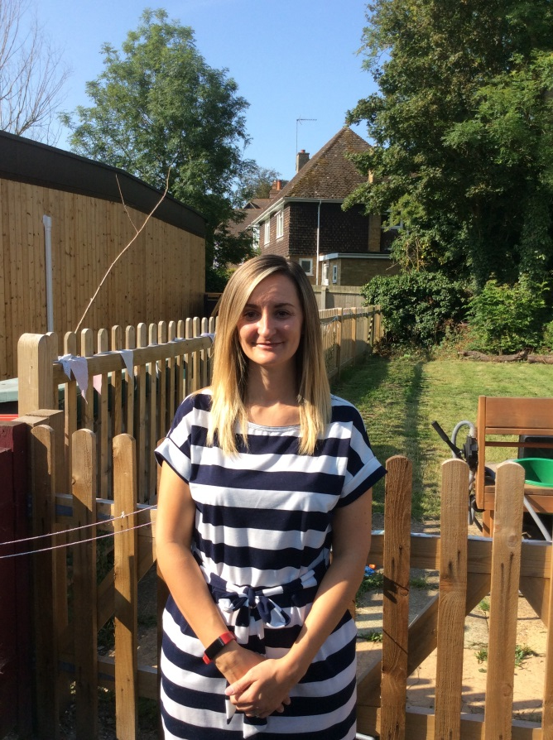
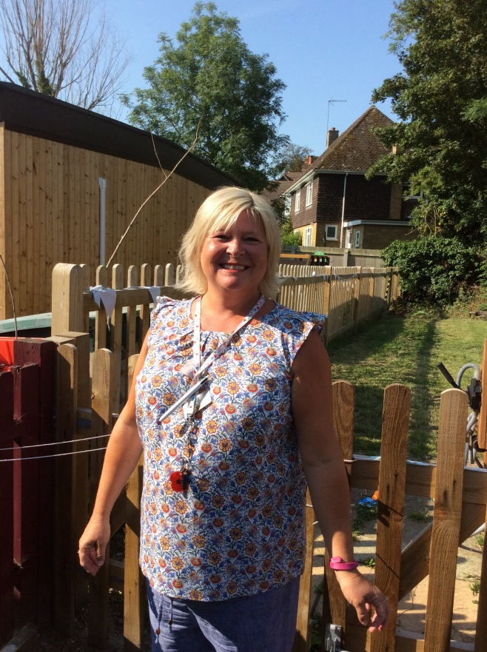
Your teachers will be ready to welcome you.
Mrs Daly will be in the classroom with you every day.
Mrs Smith will be in the classroom Mondays and Tuesdays.
Mrs Green will be in the classroom Wednesdays, Thursdays and Fridays.

Slide 4
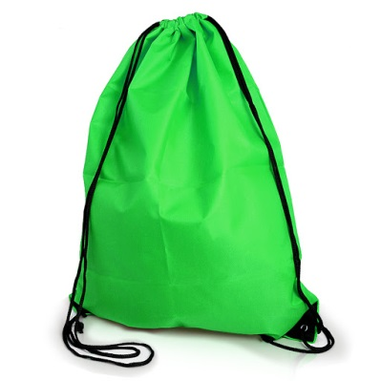
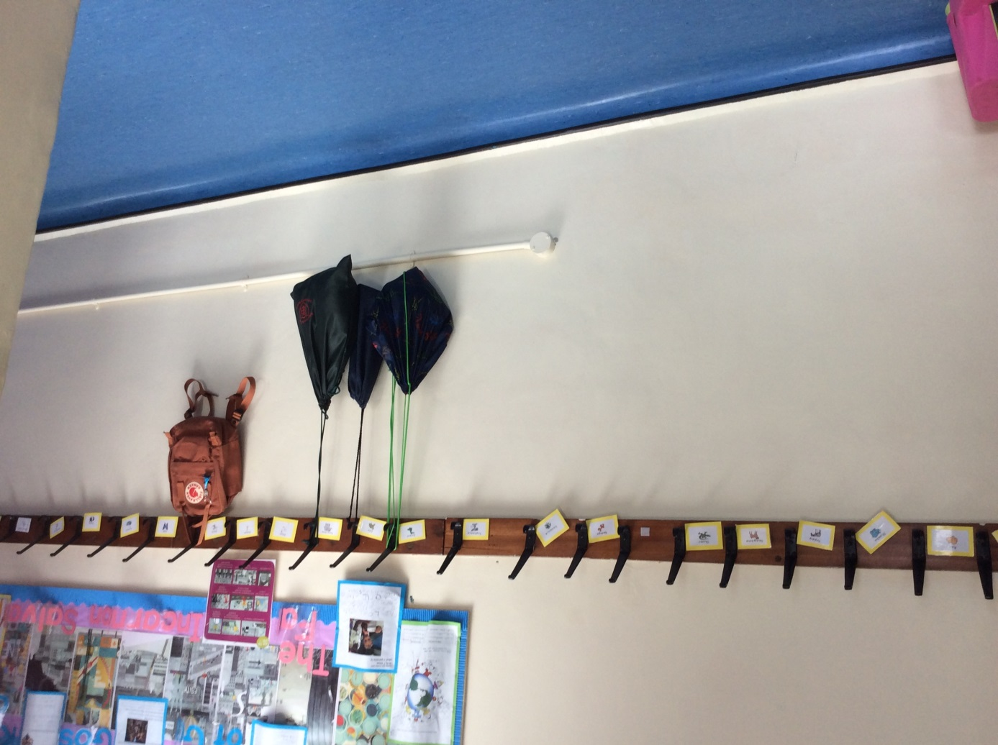


Once you come in, you can hang up your PE bags, coats and hats on your very own peg.

Slide 5
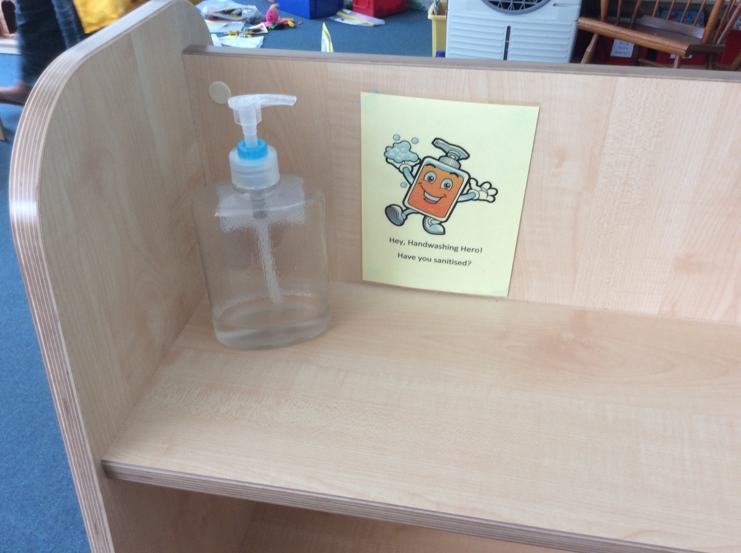

We will need to keep our hands clean whenever we come into the classroom.

Slide 6
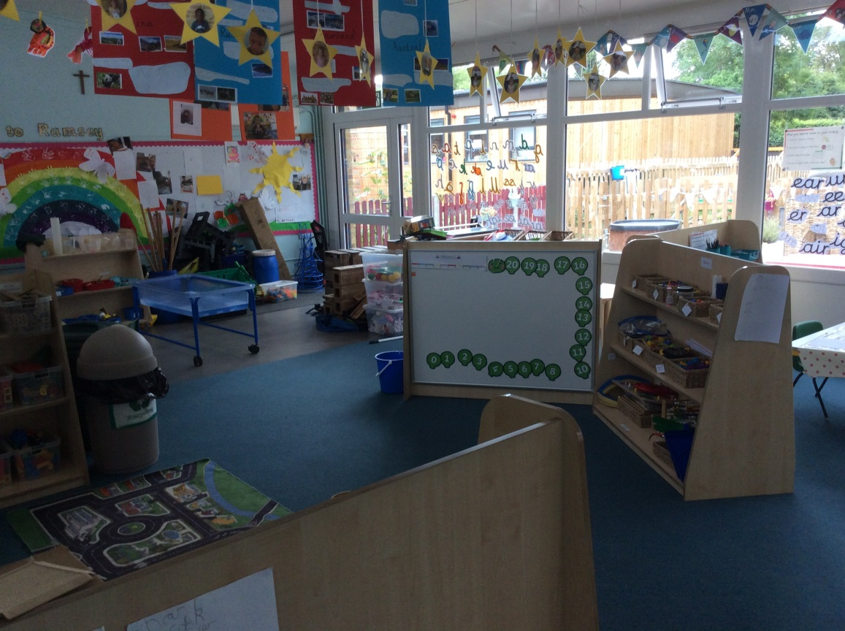

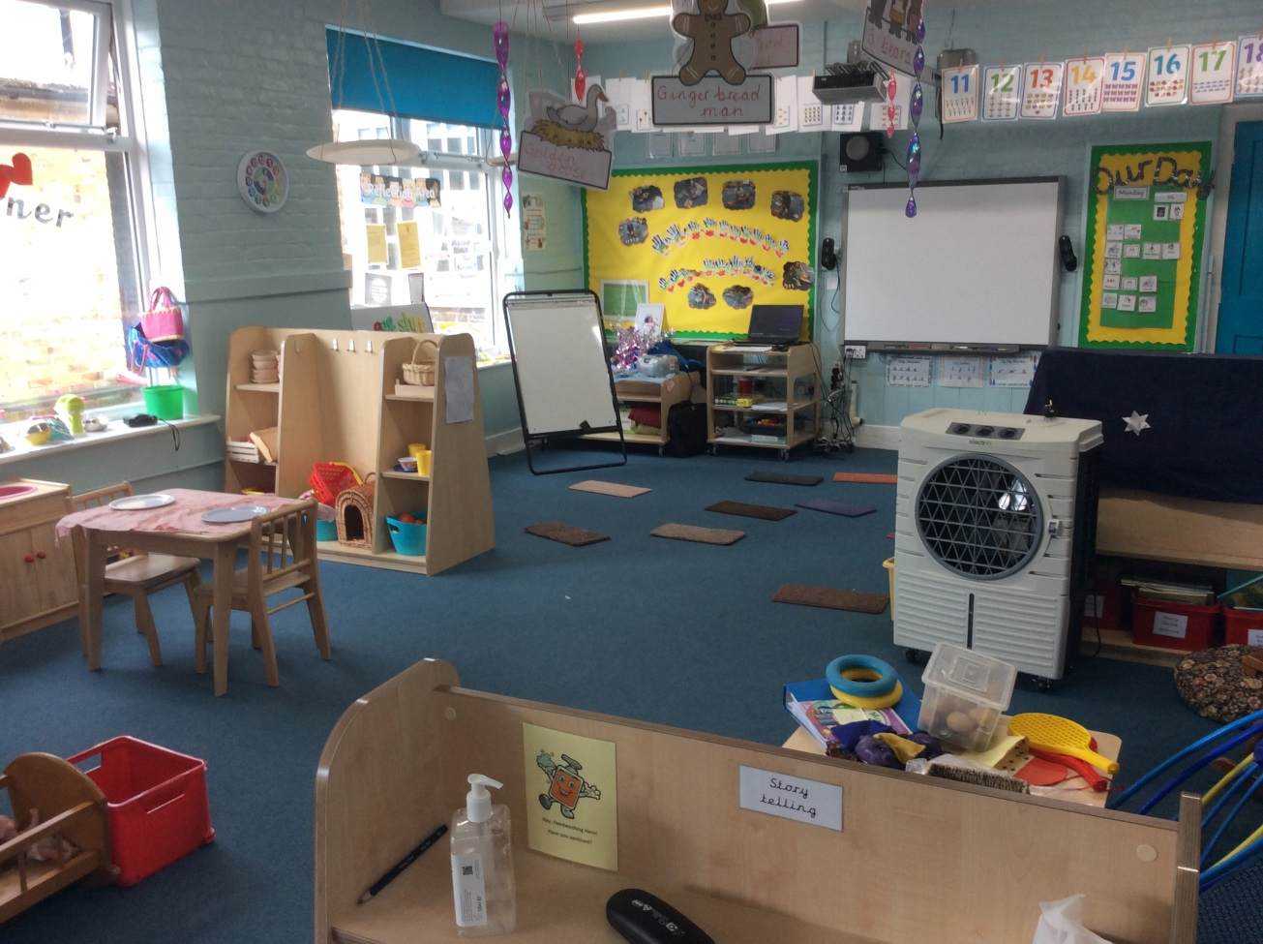
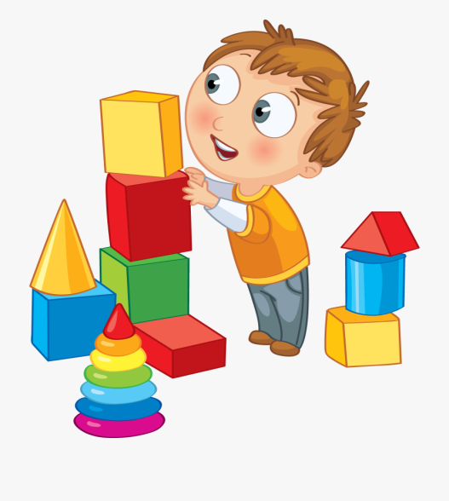
Once you’ve hung your coats and hats on your pegs, go through to the classroom.

Slide 7
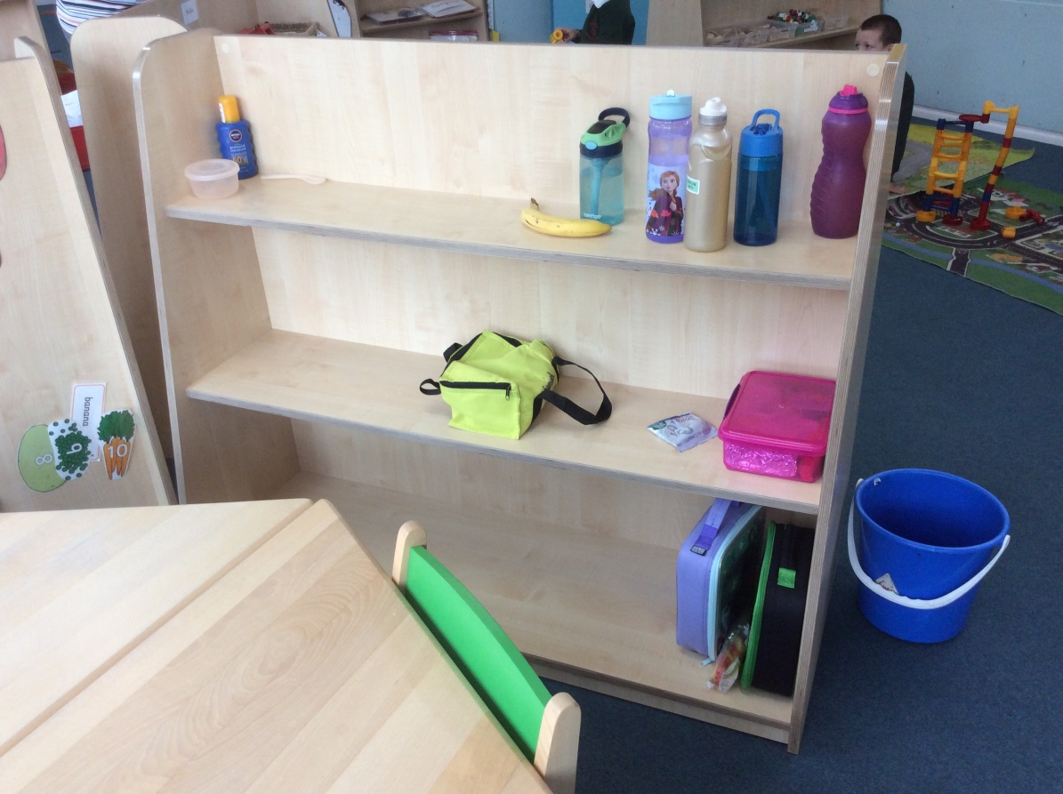

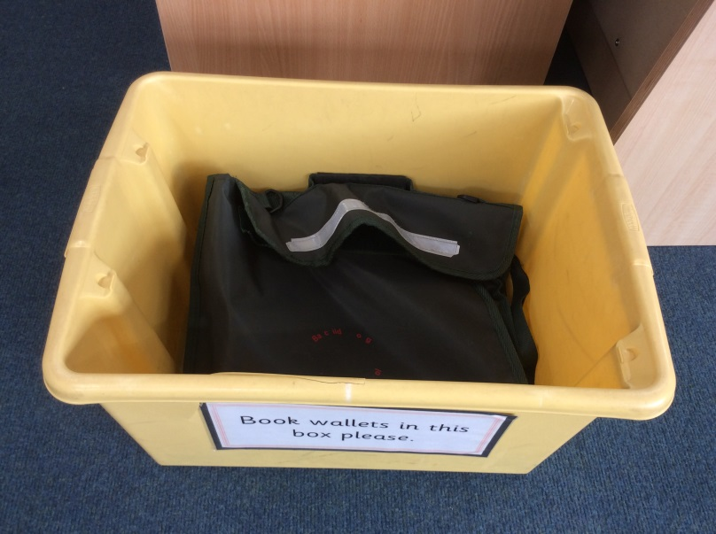

You can put your lunchboxes and water bottles on the shelf and your book bag in the box.

Slide 8
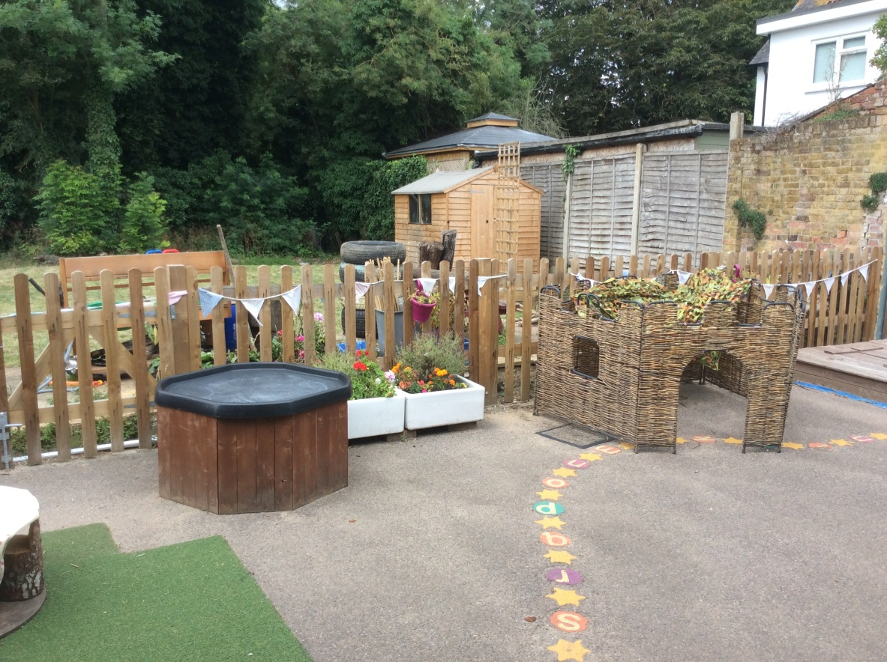

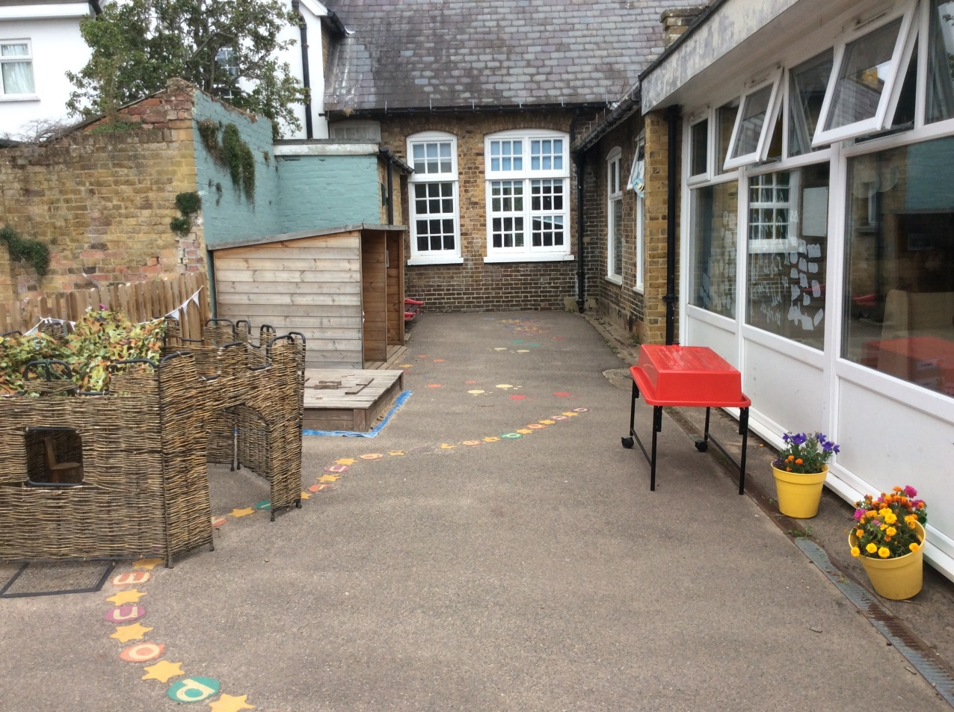
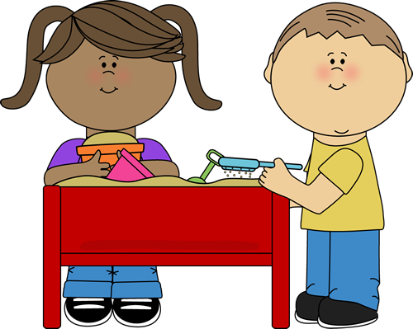
You will be able to play outside in the garden.

Slide 9
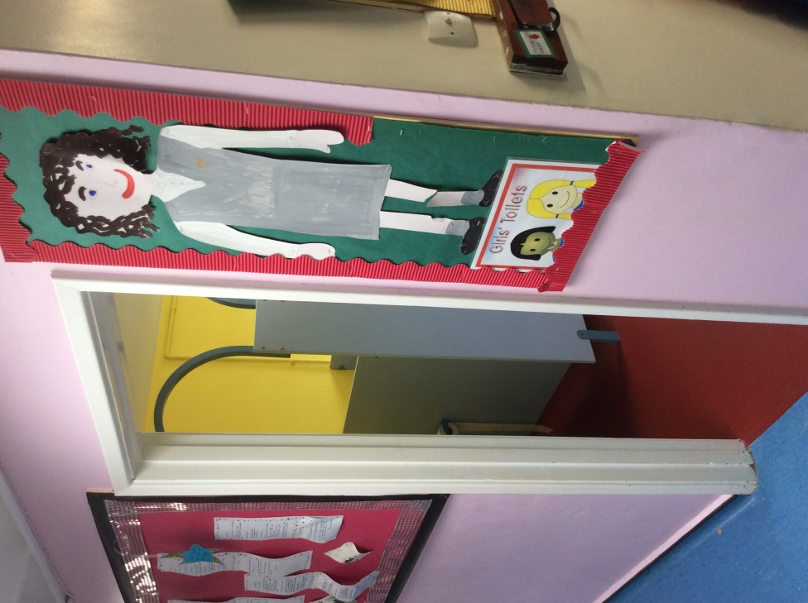
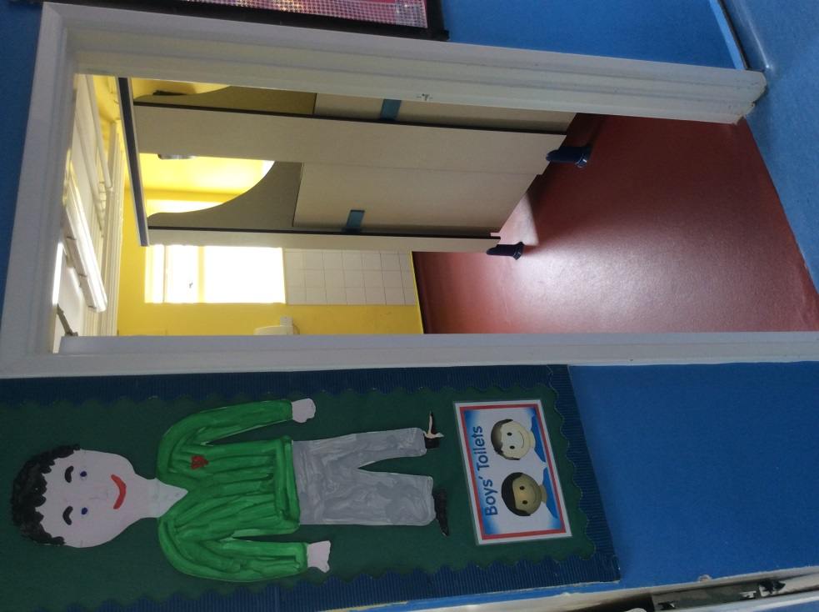

If you need to go to the toilet, or wash your hands for lunchtime, head over to the girls’ or boy’s toilets.

Slide 10
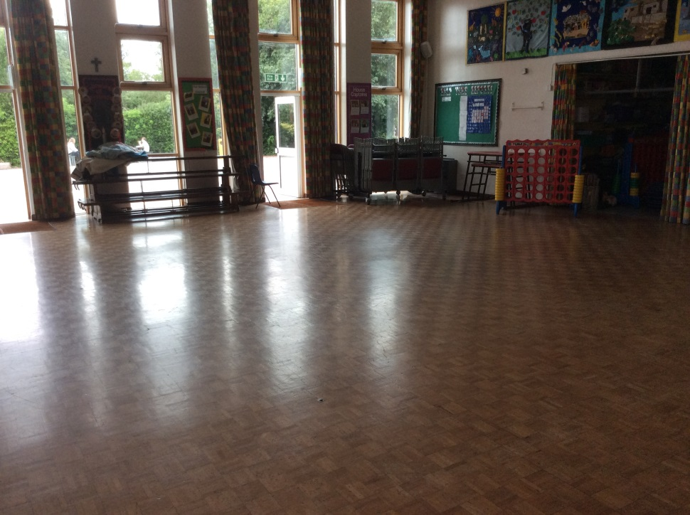
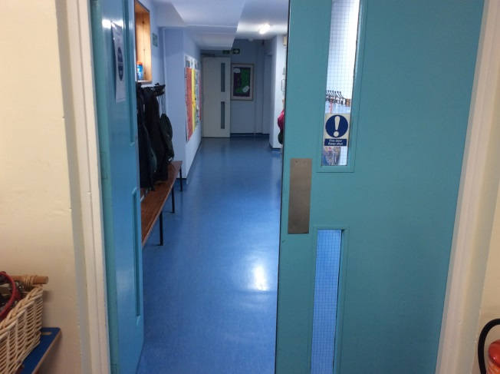
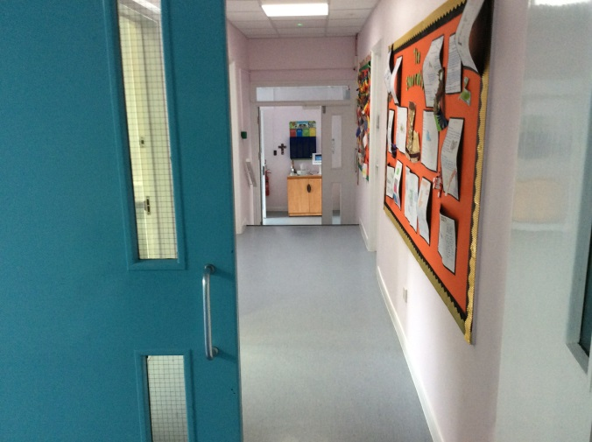
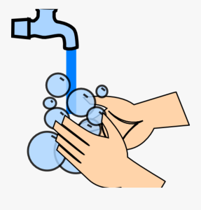
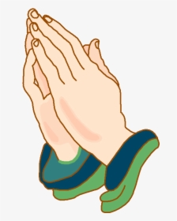
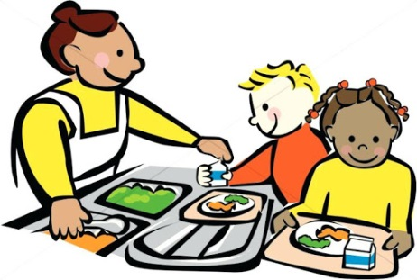
We will wash our hands and say the lunchtime prayer before we go down the corridors to the hall.
We will also go to the hall for worship and do PE.

Slide 11
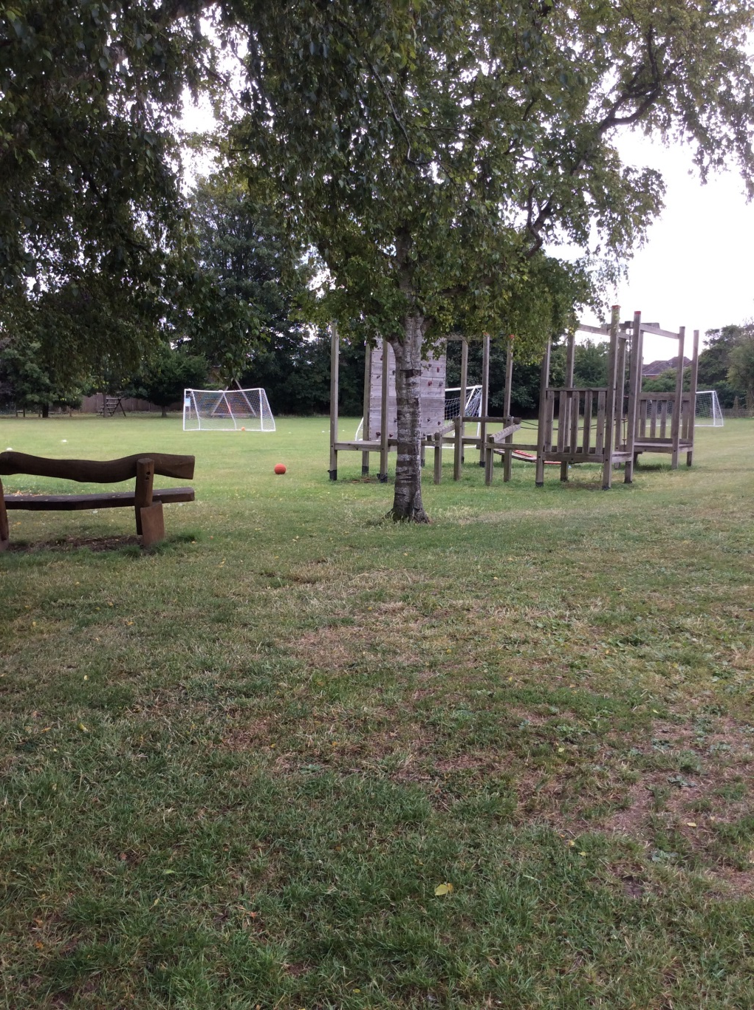

In the summer you get to play on ‘the big field’. You will do some PE lessons on here too.

Slide 12


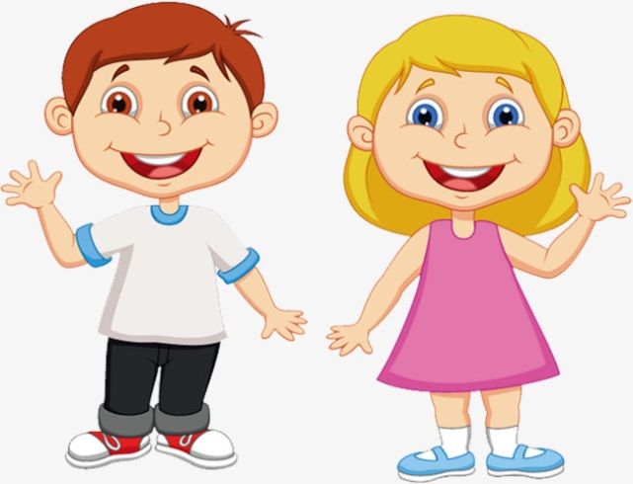
At home time, you will collect all your things and line up ready to go home.
We will go out to meet the grown ups who will be picking you up.

