Slide 1

Home Learning
Year 6 Term 6 Week 7

Slide 2
Message from the class teachers
This is the last week of term and the last week of home learning. We are very proud of how well you have been managing your time, during this unusual situation.
We are sorry that we have not been able to see all of you, but hope we can meet again in September to celebrate your achievements and wish you well in your new schools.
Thank you for your continued support.

Slide 3

Reading
Hopefully you have access to books at home, but we have sent home extra books with your child.
Accelerated Reading
Home quizzing is not always recommended but in this case we have adjusted the settings to allow quizzing to happen at home.
If your child wants to read a book from home, please check that there is a quiz available for the book and that the book level (BL) is within or near to your child’s reading range. Also take note of the quiz number for future reference.
To check books please visit: https://www.arbookfind.co.uk/
Go to the next page for how to quiz.

Slide 4



AR quizzing at home.
To log into AR to take a quiz please visit: https://ukhosted27.renlearn.co.uk/2240835/
Your child should know what to do from here and should know their login details. If they are not aware, most details are written in their reading record.
Click on Accelerated reader.
Type in the name the book or the quiz number.
We advise students complete quizzes unaided. If parents/carers wish to support their child, they can do so in the following ways:
Discuss the book with your child as the book is being read
Ask your child to read the question out loud
Re-word questions for your child, if necessary
Ask your child which answers are not correct

Slide 5

Visit http://readon.myon.co.uk

Slide 6

Choose an area that interests you or use the search option.

Slide 7


Using My Maths
Children should know their way round My Maths but here are some reminders on how access the lessons. Visit: www.mymaths.co.uk
bapchild
divide162

Slide 8

Using My Maths
Access any lesson based on what your child is learning in class or search the topic in the search bar.
Use the login portal to access specific homework and lessons that your teacher has set.

Slide 9

Maths – White Rose Home Learning
In school we follow the White Rose scheme of learning. Their website has put together free lessons and resources that link to the learning taking place in school. Please visit: https://whiterosemaths.com/homelearning/

Slide 10



TT Rockstars
To access TT Rockstars please visit: https://play.ttrockstars.com/auth/school
Start typing in the school name or the post code (ME99NL)
Pupils type in their username and password, usually written in their reading record.
Pupils can practice all tables but Year 2 should be practicing 2, 5, and 10’s
Year 3: 2,5,10,3,4,8’s
Year 4,5,6: all tables

Slide 11

Accessing Twinkl
Many educational content providers are offering free access to their resources. Twinkl is a website that we use from time to time to resource our lessons to aid in teacher input and pupil activities.
We will be able to direct you towards activities and learning via this website based on lessons that may be missed due to absence. To access Twinkl please visit: www.twinkl.co.uk/offer
You will have to sign up and put in the offer code: UKTWINKLHELPS

Slide 12
English Learning
Reflection
Poetry is often written and read to provide space for reflection and deeper thinking. It can help us share our emotions or remember something important in our lives.
On the next few slides you’ll find a selection of poems chosen and enjoyed by young people. Read the poetry, perhaps choose a favourite and then try writing a poem of your own about a theme mentioned in one of these poems…

Slide 13
The End
When I was One,
I had just begun.
When I was Two
I was nearly new.
When I was Three
I was hardly Me.
When I was Four
I was not much more.
When I was Five
I was just alive.
But now I am Six, I’m as clever as clever.
So I think I’ll be six now for ever and ever.
A.A. Milne

Slide 14
The ABC by Spike Milligan
T’was midnight in the schoolroom
And every desk was shut,
When suddenly from the alphabet
Was head a loud ‘Tut-tut!’
Said A to B, ‘I don’t like C;
His manners are a lack.
For all I ever see of C
Is a semi-circular back!
‘I disagree,’ said D to B,
‘I’ve never found C so.
From where I stand, he seems to be
An uncompleted O.’
C was vexed, ‘I’m much perplexed,
You criticise my shape.
I’m made like that, to help spell Cat
And Cow and Cool and Cape.’
‘He’s right,’ said E; said F, ‘Whoopee!’
Said G, ‘’Ip, ‘ip, ‘ooray!’
‘You’re dropping me,’ roared H to G.
‘Don’t do it please I pray!’
‘Out of my way,’ L L said to K.
‘I’ll make poor I look I L L.’
To stop this stunt, J stood in front,
And presto! I L L was J I L L.
‘U know,’ said V, ‘that W
Is twice the age of me,
For as a Roman V is five
I’m half as young as he.’
X and Y yawned sleepily,
‘Look at the time!’ they said.
‘Let’s all get off to beddy byes.’
They did, then, ‘Z-z-z.’

Slide 15
Leisure by W.H. Davies
What is this life if, full of care,
We have no time to stand and stare.
No time to stand beneath the boughs
And stare as long as sheep or cows.
No time to see, when woods we pass,
Where squirrels hide their nuts in grass.
No time to see, in broad daylight,
Streams full of stars like skies at night.
No time to turn at Beauty’s glance,
And watch her feet, how they can dance.
No time to wait till her mouth can
Enrich that smile her eyes began.
A poor life this if, full of care,
We have no time to stand and stare.

Slide 16
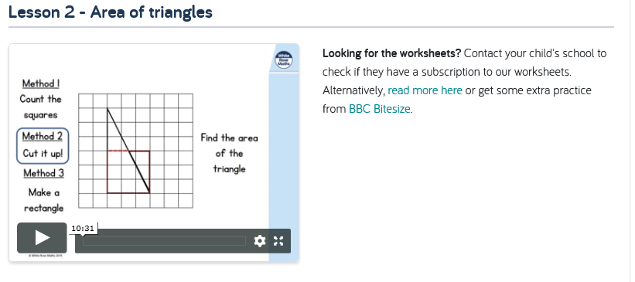
Maths Work

Slide 17
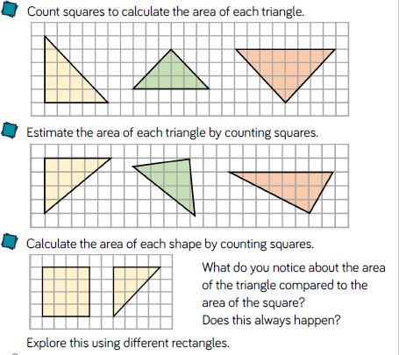
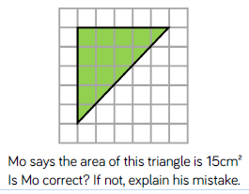
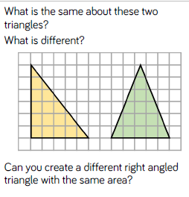
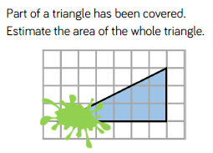
Task 1: Area of Triangles

Slide 18
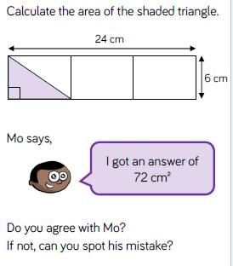
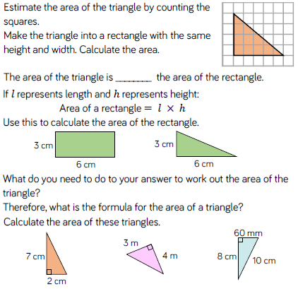
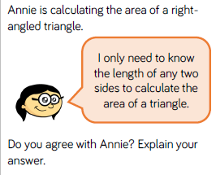

Slide 19
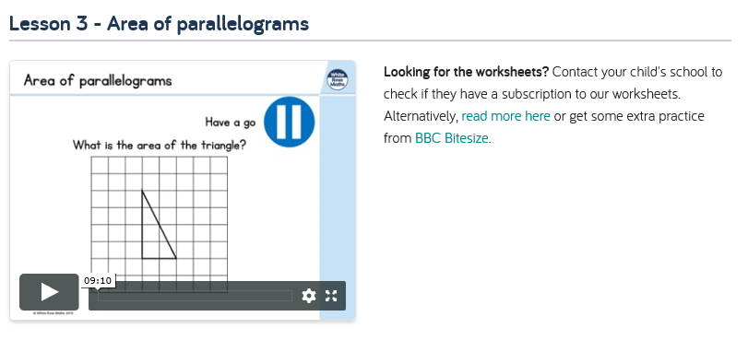
Area of Parallelograms

Slide 20
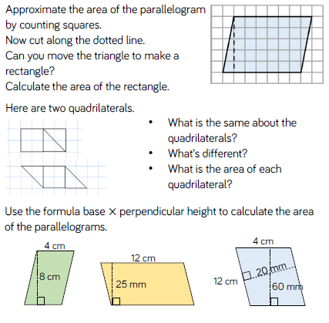
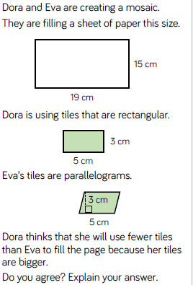
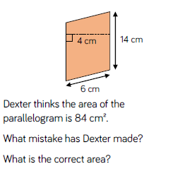
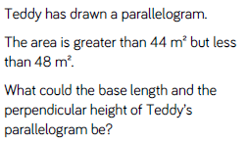
Task 2: Area of a Parallelogram

Slide 21
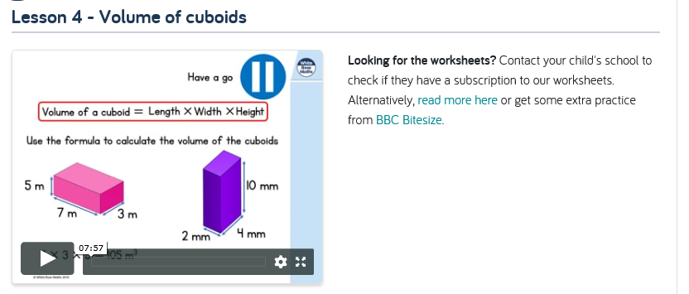
Volume of Cuboids

Slide 22
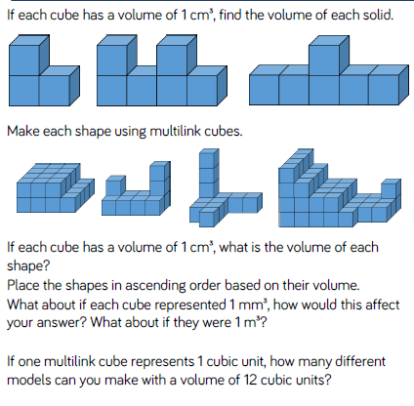
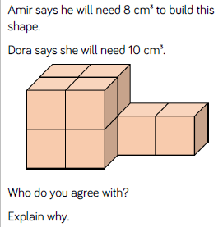
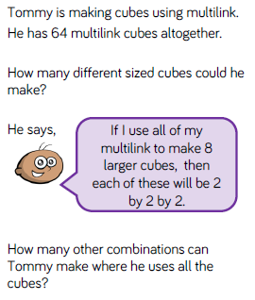
Task 3: Volume of Cuboids

Slide 23
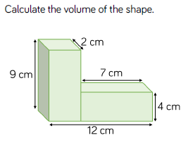
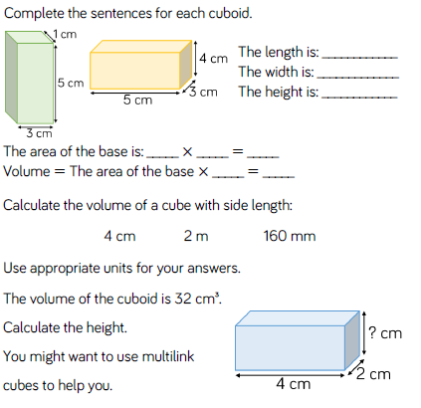
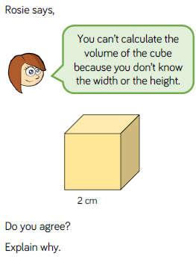


Slide 24

Tree of Life: Paint your own interpretation of this tree

Slide 25

P.E.
It is important to keep your children active. If it is safe to do so, ensure they have some time outside throughout the day. Please visit Joe Wicks YouTube channel (https://www.youtube.com/channel/UCAxW1XT0iEJo0TYlRfn6rYQ), which has lots of exercise videos for children. He will also be hosting a live P.E. lessons Monday to Friday at 9:00am.

Slide 26

Classroom Secrets
The site classroom secrets https://classroomsecrets.co.uk/free-home-learning-packs/ has free class packs which provide some great additional ideas and resources you can use.

