Slide 1

Home Learning
Year 6 Term 6 Week 6

Slide 2
Message from the class teachers
Well done with your continued independent work.
We are very proud of how well you have been managing your time, which will prepare you well for September.
Just a reminder that your secondary school may have transition information and resources on their school websites, so it is well worth having a look on there to learn more about your next school.
Thank you for your continued support.

Slide 3

Reading
Hopefully you have access to books at home, but we have sent home extra books with your child.
Accelerated Reading
Home quizzing is not always recommended but in this case we have adjusted the settings to allow quizzing to happen at home.
If your child wants to read a book from home, please check that there is a quiz available for the book and that the book level (BL) is within or near to your child’s reading range. Also take note of the quiz number for future reference.
To check books please visit: https://www.arbookfind.co.uk/
Go to the next page for how to quiz.

Slide 4



AR quizzing at home.
To log into AR to take a quiz please visit: https://ukhosted27.renlearn.co.uk/2240835/
Your child should know what to do from here and should know their login details. If they are not aware, most details are written in their reading record.
Click on Accelerated reader.
Type in the name the book or the quiz number.
We advise students complete quizzes unaided. If parents/carers wish to support their child, they can do so in the following ways:
Discuss the book with your child as the book is being read
Ask your child to read the question out loud
Re-word questions for your child, if necessary
Ask your child which answers are not correct

Slide 5

Visit http://readon.myon.co.uk

Slide 6

Choose an area that interests you or use the search option.

Slide 7


Using My Maths
Children should know their way round My Maths but here are some reminders on how access the lessons. Visit: www.mymaths.co.uk
bapchild
divide162

Slide 8

Using My Maths
Access any lesson based on what your child is learning in class or search the topic in the search bar.
Use the login portal to access specific homework and lessons that your teacher has set.

Slide 9

Maths – White Rose Home Learning
In school we follow the White Rose scheme of learning. Their website has put together free lessons and resources that link to the learning taking place in school. Please visit: https://whiterosemaths.com/homelearning/

Slide 10



TT Rockstars
To access TT Rockstars please visit: https://play.ttrockstars.com/auth/school
Start typing in the school name or the post code (ME99NL)
Pupils type in their username and password, usually written in their reading record.
Pupils can practice all tables but Year 2 should be practicing 2, 5, and 10’s
Year 3: 2,5,10,3,4,8’s
Year 4,5,6: all tables

Slide 11

Accessing Twinkl
Many educational content providers are offering free access to their resources. Twinkl is a website that we use from time to time to resource our lessons to aid in teacher input and pupil activities.
We will be able to direct you towards activities and learning via this website based on lessons that may be missed due to absence. To access Twinkl please visit: www.twinkl.co.uk/offer
You will have to sign up and put in the offer code: UKTWINKLHELPS

Slide 12
English Learning
Script Writing
This week we would like you to write a script for either a TV show or a stage play.
Watch the clip on the following link as a starting point:
https://www.bbc.co.uk/teach/class-clips-video/english-ks2-write-a-script/z4tmd6f
Your script can be an original idea (a story you have made up yourself) or it can be an adaptation of a story you have read. If you are using a story you have read a shorter story is more manageable – such as a fairy-tale or fable.
Further guidance is available for planning and success criteria on next few slides…

Slide 13
An example template of how you could plan or lay out your planning…
The setting of the scene is…
The characters in this scene are…
Character name | What is said?

Slide 14
Script Writing Success Criteria
Did I… | ✓
Use Act or Scene numbers?
Include a cast list of characters?
Give a short description of each scene’s setting?
Use a narrator to briefly set the scene for the audience?
Write the speaker’s name on the left followed by a colon?
Write dialogue without inverted commas?
Put stage directions in brackets?
Use the present tense?
Start a new line for each speaker?
Use standard and non-standard English to show the difference between formal and informal language?

Slide 15
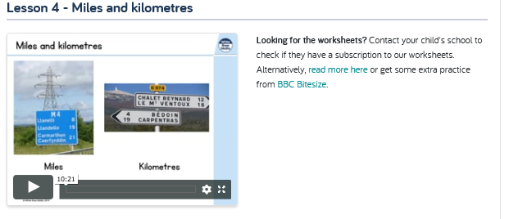
Maths Learning
Converting Miles to Kilometres and Vice Versa

Slide 16
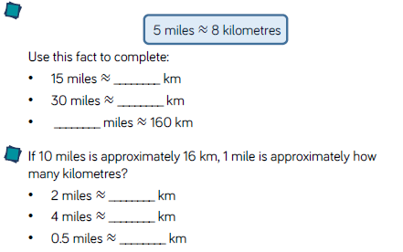
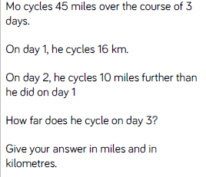
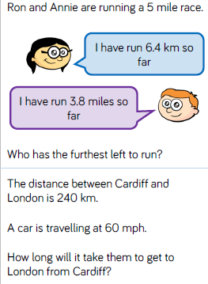
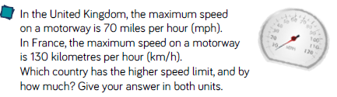
Task 1: Miles to Kilometres

Slide 17
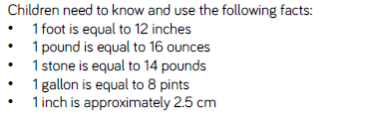
Imperial Measures:
Use equipment that you have around the house to compare imperial and metric measures. You may have: kitchen scales, bathroom scales, jugs, measuring spoons etc…
Measure different items and write down the metric and imperial mass, capacity or length of the items.

Slide 18
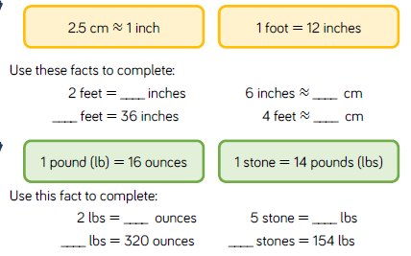
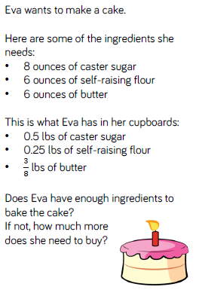
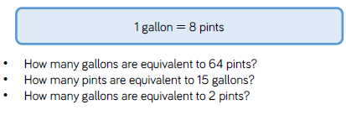
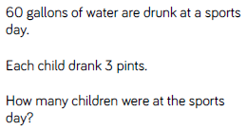

Task 2: Imperial Measures

Slide 19
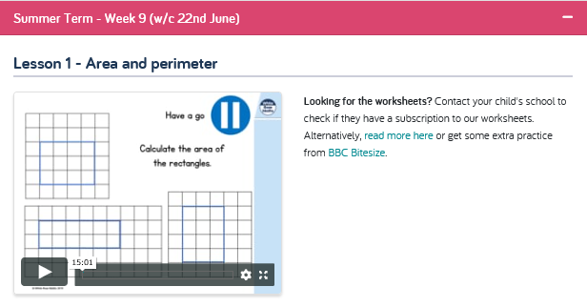
Area and Perimeter
Continuing our measures topic by looking at perimeter and area

Slide 20
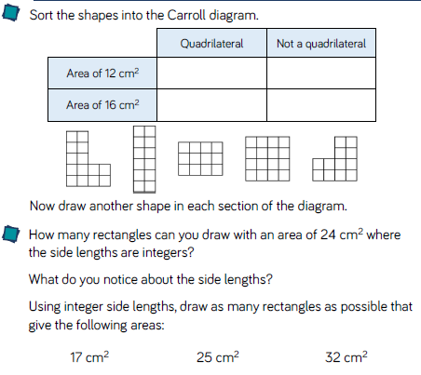
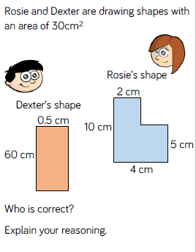
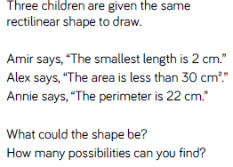
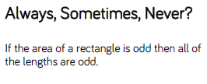
Task 3: Area and Perimeter

Slide 21
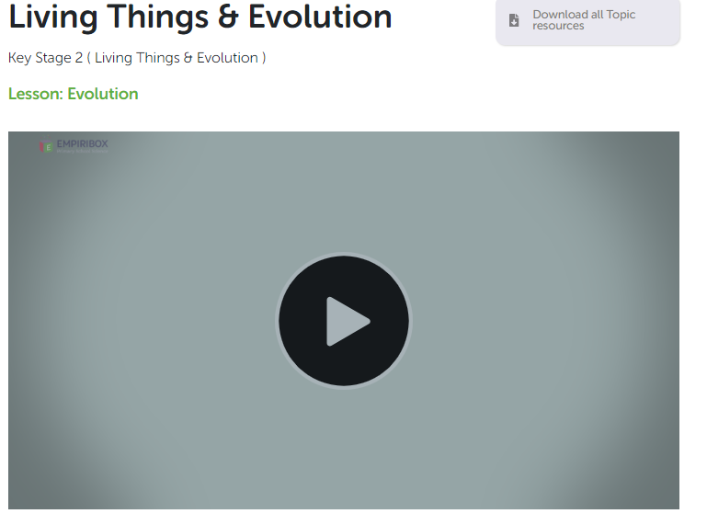
Science Learning
Empiribox Lesson 5
Evolution: Darwin
Print off and work through the associated work sheets.

Slide 22

P.E.
It is important to keep your children active. If it is safe to do so, ensure they have some time outside throughout the day. Please visit Joe Wicks YouTube channel (https://www.youtube.com/channel/UCAxW1XT0iEJo0TYlRfn6rYQ), which has lots of exercise videos for children. He will also be hosting a live P.E. lessons Monday to Friday at 9:00am.

Slide 23

Classroom Secrets
The site classroom secrets https://classroomsecrets.co.uk/free-home-learning-packs/ has free class packs which provide some great additional ideas and resources you can use.

