Slide 1

Home Learning
Year 6 Term 6 Week 5

Slide 2
Message from the class teachers
Well done with your continued independent work.
It has been good to hear from you and speak to you and your parents on the phone.
Just a reminder that your secondary school may have transition information and resources on their school websites, so it is well worth having a look on there to learn more about your next school.
Thank you for your continued support.

Slide 3

Reading
Hopefully you have access to books at home, but we have sent home extra books with your child.
Accelerated Reading
Home quizzing is not always recommended but in this case we have adjusted the settings to allow quizzing to happen at home.
If your child wants to read a book from home, please check that there is a quiz available for the book and that the book level (BL) is within or near to your child’s reading range. Also take note of the quiz number for future reference.
To check books please visit: https://www.arbookfind.co.uk/
Go to the next page for how to quiz.

Slide 4



AR quizzing at home.
To log into AR to take a quiz please visit: https://ukhosted27.renlearn.co.uk/2240835/
Your child should know what to do from here and should know their login details. If they are not aware, most details are written in their reading record.
Click on Accelerated reader.
Type in the name the book or the quiz number.
We advise students complete quizzes unaided. If parents/carers wish to support their child, they can do so in the following ways:
Discuss the book with your child as the book is being read
Ask your child to read the question out loud
Re-word questions for your child, if necessary
Ask your child which answers are not correct

Slide 5

Visit http://readon.myon.co.uk

Slide 6

Choose an area that interests you or use the search option.

Slide 7


Using My Maths
Children should know their way round My Maths but here are some reminders on how access the lessons. Visit: www.mymaths.co.uk
bapchild
divide162

Slide 8

Using My Maths
Access any lesson based on what your child is learning in class or search the topic in the search bar.
Use the login portal to access specific homework and lessons that your teacher has set.

Slide 9

Maths – White Rose Home Learning
In school we follow the White Rose scheme of learning. Their website has put together free lessons and resources that link to the learning taking place in school. Please visit: https://whiterosemaths.com/homelearning/

Slide 10



TT Rockstars
To access TT Rockstars please visit: https://play.ttrockstars.com/auth/school
Start typing in the school name or the post code (ME99NL)
Pupils type in their username and password, usually written in their reading record.
Pupils can practice all tables but Year 2 should be practicing 2, 5, and 10’s
Year 3: 2,5,10,3,4,8’s
Year 4,5,6: all tables

Slide 11

Accessing Twinkl
Many educational content providers are offering free access to their resources. Twinkl is a website that we use from time to time to resource our lessons to aid in teacher input and pupil activities.
We will be able to direct you towards activities and learning via this website based on lessons that may be missed due to absence. To access Twinkl please visit: www.twinkl.co.uk/offer
You will have to sign up and put in the offer code: UKTWINKLHELPS

Slide 12
English Learning
Creative Writing
Using one of the story starters on the next slide write a story that you think others would like to read.
Remember to include character, descriptive setting and an interesting plot. You might like to include dialogue, using inverted commas accurately.
You might like to write a story for each starter and create a book of short stories.

Slide 13

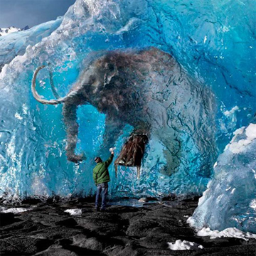


Slowly, a foot moved, then the trunk, then a loud growl shook the cavern...
"Follow me!" she whispered.
Again it appeared. Every morning at six it appeared at the end of my bed. This time it stayed.
I was on the 12th step when I awoke in my pyjamas...

Slide 14
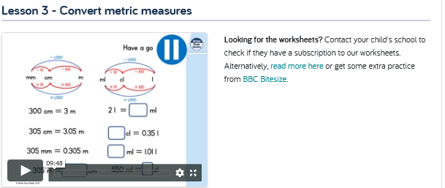

Maths Learning
This week we will be looking at Measures as our topic. Remember to use MyMaths and Bitesize materials to aid your learning.

Slide 15
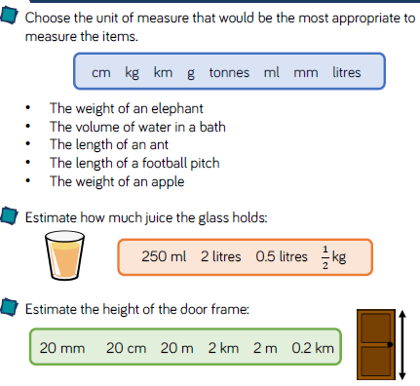
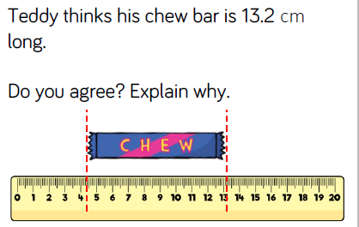
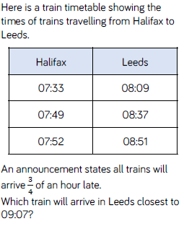
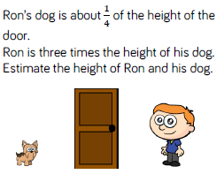
Task 1:Convert Metric Measures

Slide 16
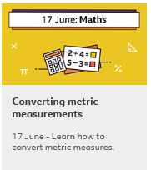
Converting Measures
Continued practise – use yesterday’s link and re-watch and or use Bitesize to aid your understanding.

Slide 17
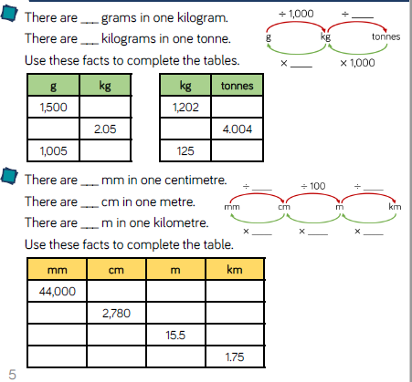
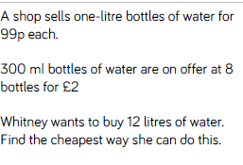
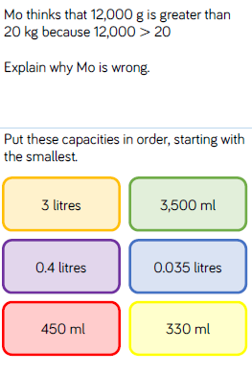
Task 2: Converting Metric Units

Slide 18
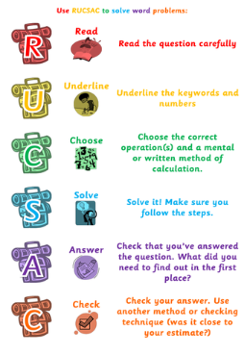
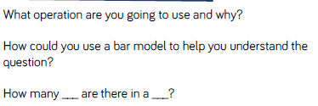
Calculate with Metric Measures

Slide 19
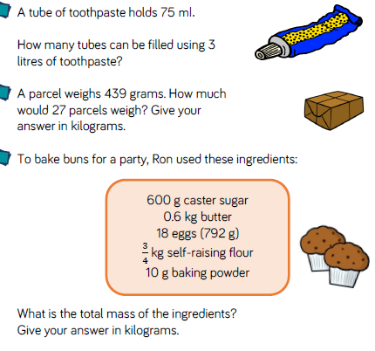
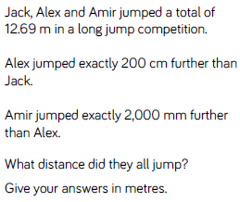
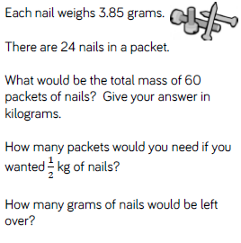
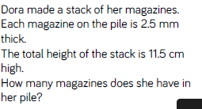
Task 3: Problem Solving

Slide 20
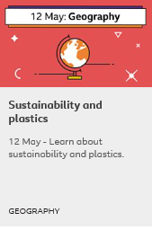
Topic/Science
Go to Bitesize Home Learning Y6 find this slide:
Consider how plastics impact our environment especially our coastal habitats. As a human race, what changes can we make in order to reduce the amount of plastic that we use? Can we learn from materials used in the past? What materials might their be more use for in the future?
Create a leaflet using subheadings, pictures and captions explaining your information.

Slide 21






RE
Christian Service
An important part of being a Christian is following Jesus’ example and serving others.
Research a Christian charity and create an information leaflet or poster about the charity you have chosen. Below are a few examples of charities you could find out about…

Slide 22

P.E.
It is important to keep your children active. If it is safe to do so, ensure they have some time outside throughout the day. Please visit Joe Wicks YouTube channel (https://www.youtube.com/channel/UCAxW1XT0iEJo0TYlRfn6rYQ), which has lots of exercise videos for children. He will also be hosting a live P.E. lessons Monday to Friday at 9:00am.

Slide 23

Classroom Secrets
The site classroom secrets https://classroomsecrets.co.uk/free-home-learning-packs/ has free class packs which provide some great additional ideas and resources you can use.

