Slide 1

Home Learning
Year 6 Term 6 Week 4

Slide 2
Message from the class teachers
Well done with your continued independent work.
It has been good to hear from you and speak to you and your parents on the phone.
Just a reminder that your secondary school may have transition information and resources on their school websites, so it is well worth having a look on there to learn more about your next school.
Thank you for your continued support.

Slide 3

Reading
Hopefully you have access to books at home, but we have sent home extra books with your child.
Accelerated Reading
Home quizzing is not always recommended but in this case we have adjusted the settings to allow quizzing to happen at home.
If your child wants to read a book from home, please check that there is a quiz available for the book and that the book level (BL) is within or near to your child’s reading range. Also take note of the quiz number for future reference.
To check books please visit: https://www.arbookfind.co.uk/
Go to the next page for how to quiz.

Slide 4



AR quizzing at home.
To log into AR to take a quiz please visit: https://ukhosted27.renlearn.co.uk/2240835/
Your child should know what to do from here and should know their login details. If they are not aware, most details are written in their reading record.
Click on Accelerated reader.
Type in the name the book or the quiz number.
We advise students complete quizzes unaided. If parents/carers wish to support their child, they can do so in the following ways:
Discuss the book with your child as the book is being read
Ask your child to read the question out loud
Re-word questions for your child, if necessary
Ask your child which answers are not correct

Slide 5

Visit http://readon.myon.co.uk

Slide 6

Choose an area that interests you or use the search option.

Slide 7


Using My Maths
Children should know their way round My Maths but here are some reminders on how access the lessons. Visit: www.mymaths.co.uk
bapchild
divide162

Slide 8

Using My Maths
Access any lesson based on what your child is learning in class or search the topic in the search bar.
Use the login portal to access specific homework and lessons that your teacher has set.

Slide 9

Maths – White Rose Home Learning
In school we follow the White Rose scheme of learning. Their website has put together free lessons and resources that link to the learning taking place in school. Please visit: https://whiterosemaths.com/homelearning/

Slide 10



TT Rockstars
To access TT Rockstars please visit: https://play.ttrockstars.com/auth/school
Start typing in the school name or the post code (ME99NL)
Pupils type in their username and password, usually written in their reading record.
Pupils can practice all tables but Year 2 should be practicing 2, 5, and 10’s
Year 3: 2,5,10,3,4,8’s
Year 4,5,6: all tables

Slide 11

Accessing Twinkl
Many educational content providers are offering free access to their resources. Twinkl is a website that we use from time to time to resource our lessons to aid in teacher input and pupil activities.
We will be able to direct you towards activities and learning via this website based on lessons that may be missed due to absence. To access Twinkl please visit: www.twinkl.co.uk/offer
You will have to sign up and put in the offer code: UKTWINKLHELPS

Slide 12

English Learning
Treasure Hunt!
Imagine you are a pirate and you have some treasure to bury. You want to leave clues for your shipmates – but don’t want anyone else to discover the bounty.
Create a treasure map of an island setting and a set of clues for your shipmates to find the treasure.
You could also set some traps, in case of intruders!

Slide 13
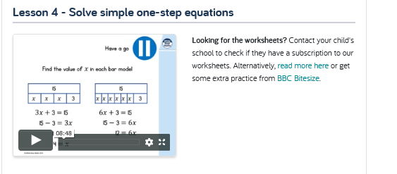
Maths Learning
This week we will continue onward with our algebra journey!
Look out for Lesson 4 on White Rose Hub Home learning – the week you need is shown below.

Slide 14
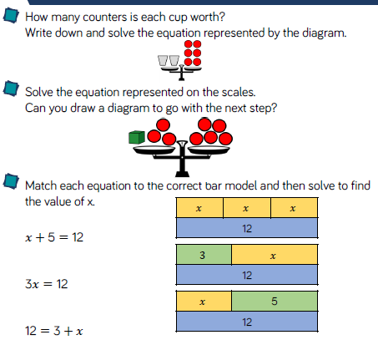
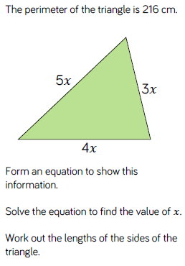
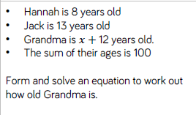
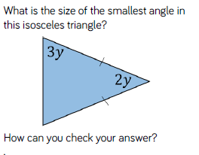
Task 1: Solve Simple One Step Equations

Slide 15
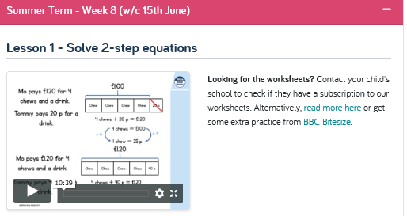
For the next video explaining the work, go to Week 8 – White Rose Hub Home Learning.
Remember to retain balance in your equation (and in The Force!)….

Slide 16
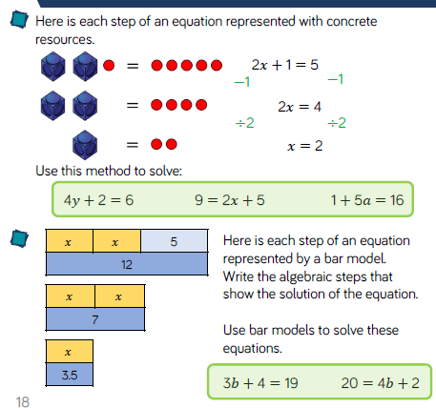
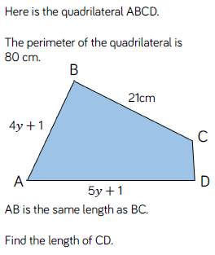
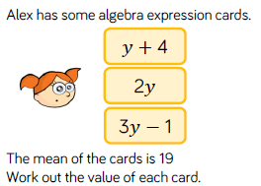
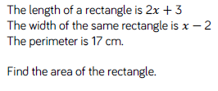
Task 2: Solve Two-Step Equations

Slide 17
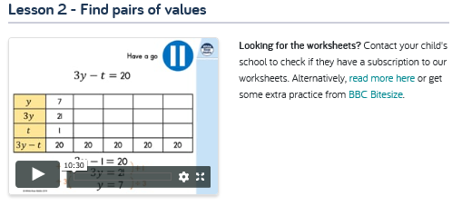
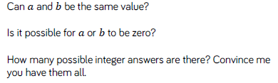
Finding All Possibilities
Things to consider…

Slide 18
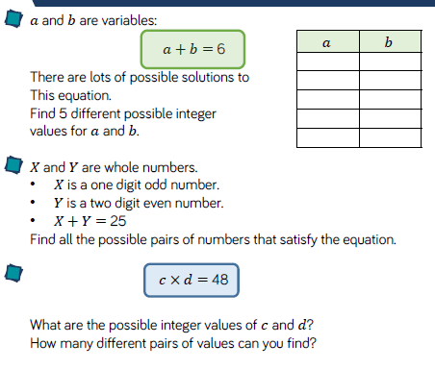
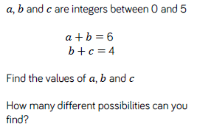
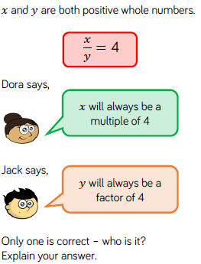
Task 3: Find Pairs of Values

Slide 19
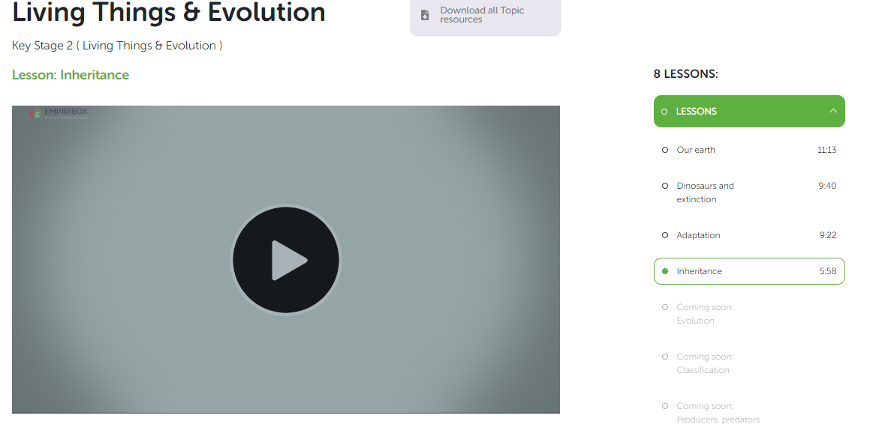
Topic/Science
Go to your Empiribox Home Learning Slides (if you haven't as yet set up an account, remember it is easy and free!)
There are experiments and activities to do associated with this slide…
Enjoy!

Slide 20


Art
Origami is the Japanese art of paper folding.
Follow the link below and see what you can make at home.
https://www.easypeasyandfun.com/easy-origami-for-kids/
Remember, practice makes perfect!

Slide 21

P.E.
It is important to keep your children active. If it is safe to do so, ensure they have some time outside throughout the day. Please visit Joe Wicks YouTube channel (https://www.youtube.com/channel/UCAxW1XT0iEJo0TYlRfn6rYQ), which has lots of exercise videos for children. He will also be hosting a live P.E. lessons Monday to Friday at 9:00am.

Slide 22

Classroom Secrets
The site classroom secrets https://classroomsecrets.co.uk/free-home-learning-packs/ has free class packs which provide some great additional ideas and resources you can use.

