Slide 1

Home Learning
Year 6 Term 6 Week 3

Slide 2
Message from the class teachers
There are lots of activities and learning planned for this week in a range of subjects, which we know will help you to plan your daily routine.
Do make use of the internet resources as well as keeping busy by doing physical activities and spending time with family.
Thank you for your continued support.

Slide 3

Reading
Hopefully you have access to books at home, but we have sent home extra books with your child.
Accelerated Reading
Home quizzing is not always recommended but in this case we have adjusted the settings to allow quizzing to happen at home.
If your child wants to read a book from home, please check that there is a quiz available for the book and that the book level (BL) is within or near to your child’s reading range. Also take note of the quiz number for future reference.
To check books please visit: https://www.arbookfind.co.uk/
Go to the next page for how to quiz.

Slide 4



AR quizzing at home.
To log into AR to take a quiz please visit: https://ukhosted27.renlearn.co.uk/2240835/
Your child should know what to do from here and should know their login details. If they are not aware, most details are written in their reading record.
Click on Accelerated reader.
Type in the name the book or the quiz number.
We advise students complete quizzes unaided. If parents/carers wish to support their child, they can do so in the following ways:
Discuss the book with your child as the book is being read
Ask your child to read the question out loud
Re-word questions for your child, if necessary
Ask your child which answers are not correct

Slide 5

Visit http://readon.myon.co.uk

Slide 6

Choose an area that interests you or use the search option.

Slide 7


Using My Maths
Children should know their way round My Maths but here are some reminders on how access the lessons. Visit: www.mymaths.co.uk
bapchild
divide162

Slide 8

Using My Maths
Access any lesson based on what your child is learning in class or search the topic in the search bar.
Use the login portal to access specific homework and lessons that your teacher has set.

Slide 9

Maths – White Rose Home Learning
In school we follow the White Rose scheme of learning. Their website has put together free lessons and resources that link to the learning taking place in school. Please visit: https://whiterosemaths.com/homelearning/

Slide 10



TT Rockstars
To access TT Rockstars please visit: https://play.ttrockstars.com/auth/school
Start typing in the school name or the post code (ME99NL)
Pupils type in their username and password, usually written in their reading record.
Pupils can practice all tables but Year 2 should be practicing 2, 5, and 10’s
Year 3: 2,5,10,3,4,8’s
Year 4,5,6: all tables

Slide 11

Accessing Twinkl
Many educational content providers are offering free access to their resources. Twinkl is a website that we use from time to time to resource our lessons to aid in teacher input and pupil activities.
We will be able to direct you towards activities and learning via this website based on lessons that may be missed due to absence. To access Twinkl please visit: www.twinkl.co.uk/offer
You will have to sign up and put in the offer code: UKTWINKLHELPS

Slide 12
English Learning
Diary
Your task is to write a diary that covers 5 days
Below are the main features of a diary.
Past tense
Use of ‘I, we, us, my etc.’
Describes writer’s point of view, thoughts and feelings
Includes opinion as well as facts
Written in an informal style, as if speaking to somebody
Uses time conjunctions to link events
Organises events into paragraphs
Uses inverted commas to show direct speech
You can write the diary as yourself writing about real events that have happened to you (this week or a while ago) or you can write as a character that you have created.

Slide 13

Maths Learning
This week we will be focusing on algebra – take a deep breath, it is not as bad as you think it is! In fact it is exciting as you are finding all possibilities and you know how my mantra is nothing is impossible. Keep your head and give it a go…
Continue to use these as a mental and oral starter: you don’t have to stick strictly to the day, but they give varied and fun options to warm your brains up.

Slide 14
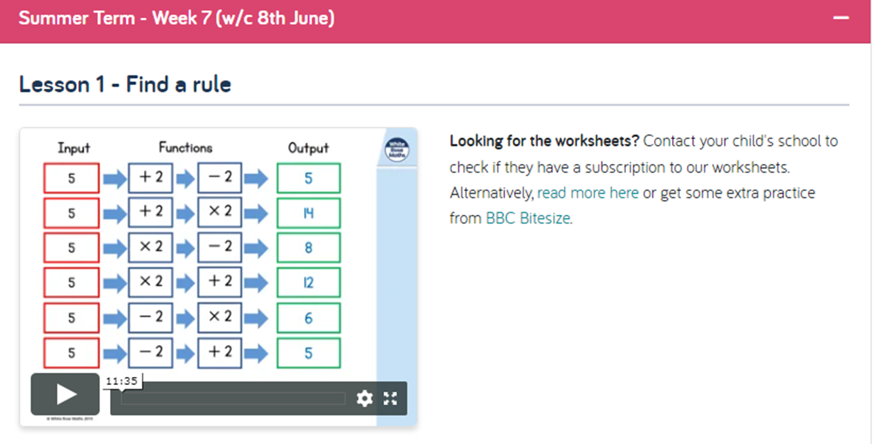
Using White Rose Hub Home Learning Year 6

Slide 15
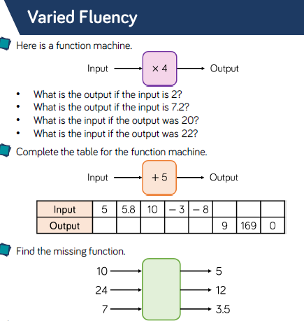
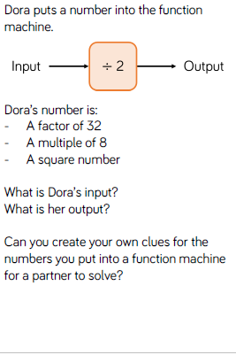
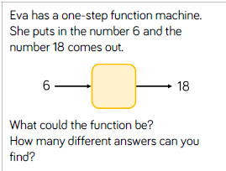
Task 1:Find a Rule

Slide 16
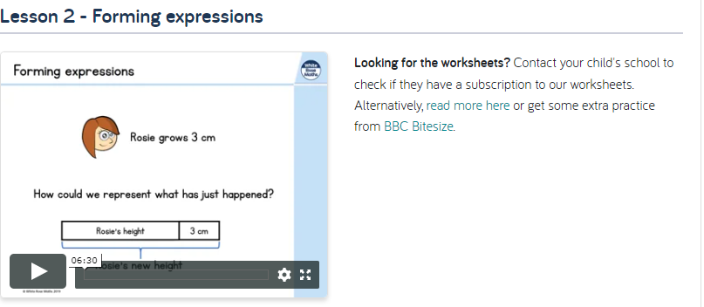
Forming Expressions:

Slide 17
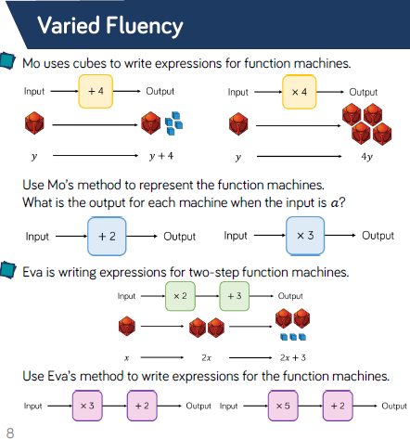
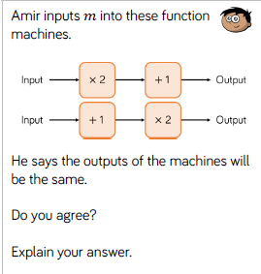
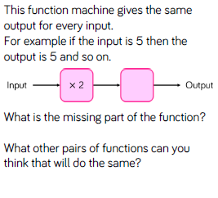
Task 2: Forming Expressions

Slide 18
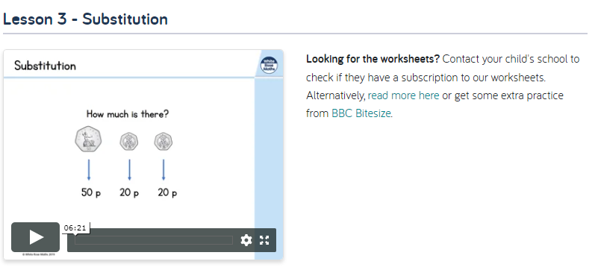
Substitution:

Slide 19
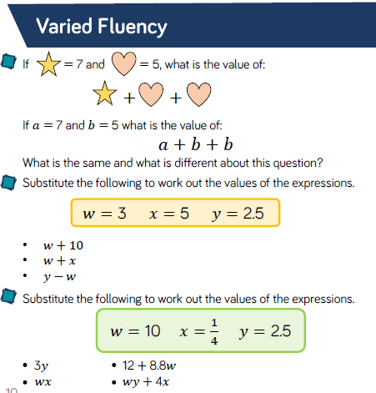
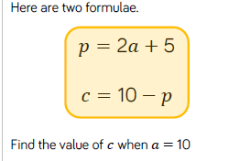
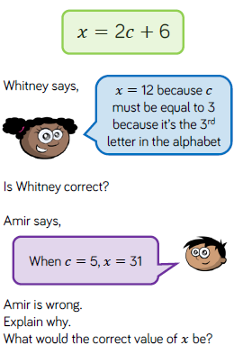
Task 3: Substitution

Slide 20
RE: Private Prayer
Churches have been closed for worship since the start of lockdown. From Monday 15th June they will be able to reopen for private prayer.
Follow the link to learn more about private prayer: https://www.bbc.co.uk/bitesize/guides/zsgbtv4/revision/7
Answer the questions below with your views:
What is the difference between private and communal prayer?
Where are Christians allowed to pray?
Why is prayer important to Christians?
Is it better to pray in a church building, or does it not matter where a Christian prays? Explain your view.
Why might a Christian be please that the church buildings are open?

Slide 21

Topic
Coasts:
This week we will be focusing on wildlife at our coasts and I am including a reading comprehension for you to have a go at. There are three levels of difficulty – 3 stars being the most stretching. You do not need to answer all three levels. Pick one and answer the questions.
WARNING: answers are included but please don’t cheat yourself and look at them before you answer the questions – I’m sure you will not.
After reading and assimilating please produce a poster about our coasts using the information that you have learnt to inform you. Also, any trips that you take to the beach and exciting discoveries that you find – we would be glad to see in photos, emails to us or any other way you’d like to communicate with us.

Slide 22

P.E.
It is important to keep your children active. If it is safe to do so, ensure they have some time outside throughout the day. Please visit Joe Wicks YouTube channel (https://www.youtube.com/channel/UCAxW1XT0iEJo0TYlRfn6rYQ), which has lots of exercise videos for children. He will also be hosting a live P.E. lessons Monday to Friday at 9:00am.

Slide 23

Classroom Secrets
The site classroom secrets https://classroomsecrets.co.uk/free-home-learning-packs/ has free class packs which provide some great additional ideas and resources you can use.

