Slide 1

Home Learning
Year 6 Term 6 Week 2

Slide 2
Message from the class teachers
There are lots of activities and learning planned for this week in a range of subjects, which we know will help you to plan your daily routine.
Do make use of the internet resources as well as keeping busy by doing physical activities and spending time with family.
Thank you for your continued support.

Slide 3

Reading
Hopefully you have access to books at home, but we have sent home extra books with your child.
Accelerated Reading
Home quizzing is not always recommended but in this case we have adjusted the settings to allow quizzing to happen at home.
If your child wants to read a book from home, please check that there is a quiz available for the book and that the book level (BL) is within or near to your child’s reading range. Also take note of the quiz number for future reference.
To check books please visit: https://www.arbookfind.co.uk/
Go to the next page for how to quiz.

Slide 4



AR quizzing at home.
To log into AR to take a quiz please visit: https://ukhosted27.renlearn.co.uk/2240835/
Your child should know what to do from here and should know their login details. If they are not aware, most details are written in their reading record.
Click on Accelerated reader.
Type in the name the book or the quiz number.
We advise students complete quizzes unaided. If parents/carers wish to support their child, they can do so in the following ways:
Discuss the book with your child as the book is being read
Ask your child to read the question out loud
Re-word questions for your child, if necessary
Ask your child which answers are not correct

Slide 5

Visit http://readon.myon.co.uk

Slide 6

Choose an area that interests you or use the search option.

Slide 7


Using My Maths
Children should know their way round My Maths but here are some reminders on how access the lessons. Visit: www.mymaths.co.uk
bapchild
divide162

Slide 8

Using My Maths
Access any lesson based on what your child is learning in class or search the topic in the search bar.
Use the login portal to access specific homework and lessons that your teacher has set.

Slide 9

Maths – White Rose Home Learning
In school we follow the White Rose scheme of learning. Their website has put together free lessons and resources that link to the learning taking place in school. Please visit: https://whiterosemaths.com/homelearning/

Slide 10



TT Rockstars
To access TT Rockstars please visit: https://play.ttrockstars.com/auth/school
Start typing in the school name or the post code (ME99NL)
Pupils type in their username and password, usually written in their reading record.
Pupils can practice all tables but Year 2 should be practicing 2, 5, and 10’s
Year 3: 2,5,10,3,4,8’s
Year 4,5,6: all tables

Slide 11

Accessing Twinkl
Many educational content providers are offering free access to their resources. Twinkl is a website that we use from time to time to resource our lessons to aid in teacher input and pupil activities.
We will be able to direct you towards activities and learning via this website based on lessons that may be missed due to absence. To access Twinkl please visit: www.twinkl.co.uk/offer
You will have to sign up and put in the offer code: UKTWINKLHELPS

Slide 12
English Learning
Non-Chronological Report
Your task is to write a non-chronological report about a subject of interest to you
Below are the main features of a non-chronological report.
• Ordered by topic or subject, not time.
• Main title
• Factual
• Introductory paragraph
• Subheadings
• Paragraphs
• Present tense
• Third person
• Diagrams
• Bullet points
• Glossary
On the next slide are some examples of non-chronological reports.

Slide 13
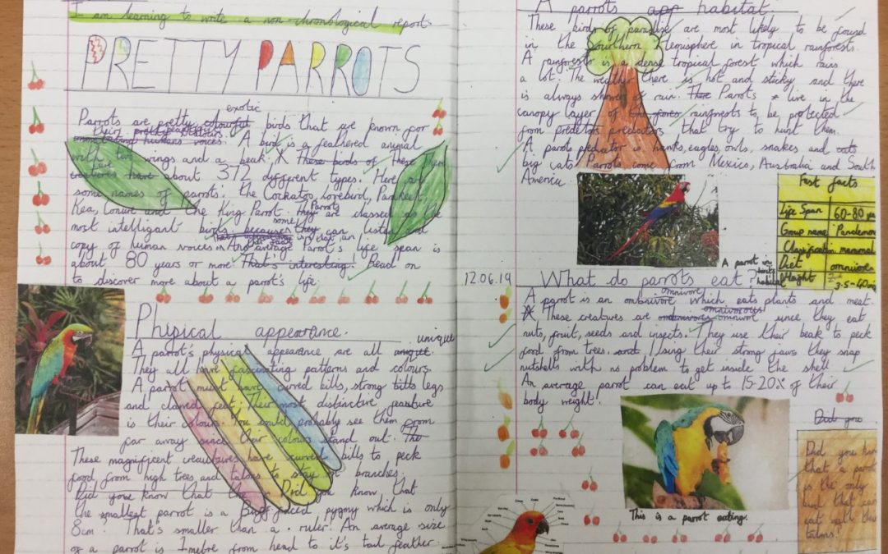

Slide 14
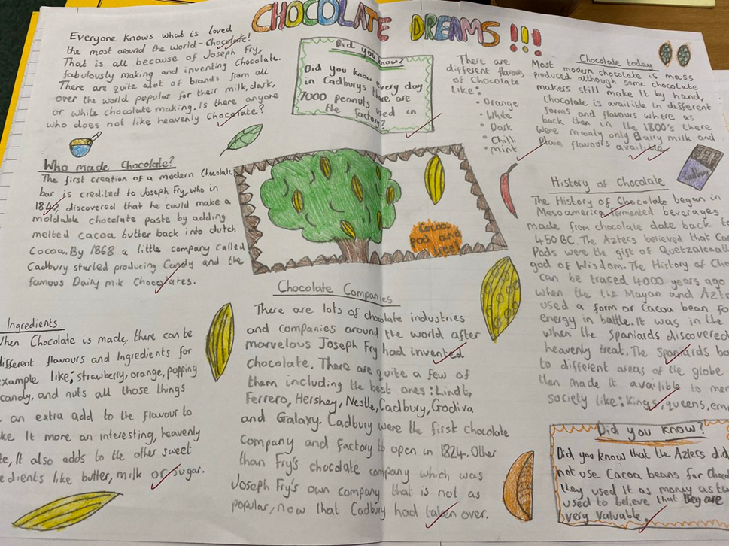

Slide 15
RE
Follow the link below which provides a lot of information about Christianity.
https://www.bbc.co.uk/bitesize/topics/ztkxpv4/articles/zvfnkmn
Take the quiz at the bottom of the webpage to see what you know.

Slide 16
Maths Learning
Continue to use White Rose Hub Home Learning Year 6 slides. We are reviewing fractions, decimals and percentages this week, which follows on from our previous learning.
I have included mental and oral starters this week as well, just to get your brains warmed up!

Slide 17
08.06.2020
Mental and Oral starter:
Display the Boggle board on the whiteboard or provide pairs of children
with a Boggle board to use at their tables.
Tell the chn that the aim of the game is to
make a total of 24 using +, -, ÷ and x and numbers from the board.
:
5 | 11 | 2 | 10
6 | 4 | 5 | 3
10 | 3 | 9 | 4
6 | 12 | 8 | 12

Slide 18
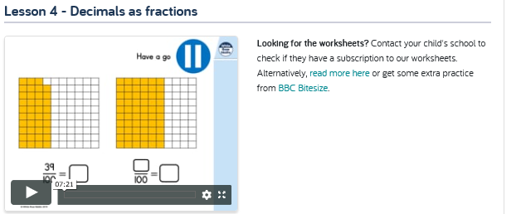
08.06.2020
WALT: write decimals as fractions
Use Bitesize and CPG revision books for additional/complementary work

Slide 19
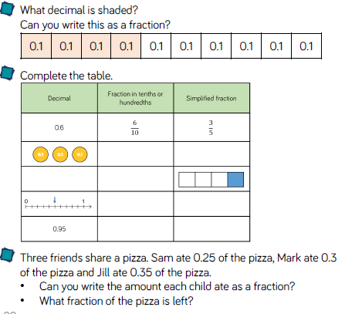
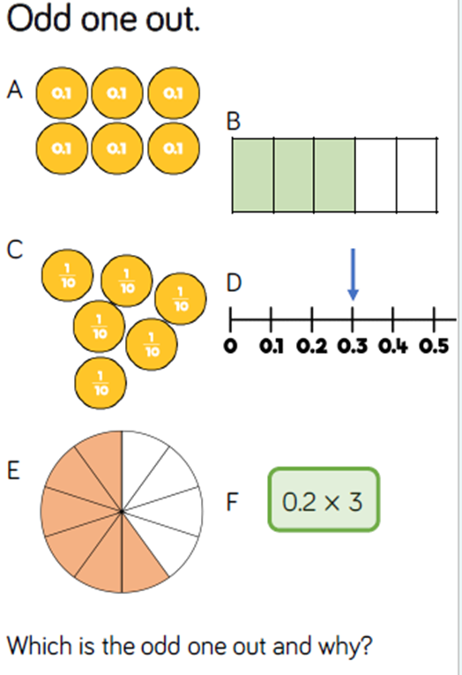
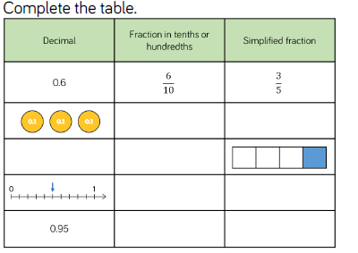
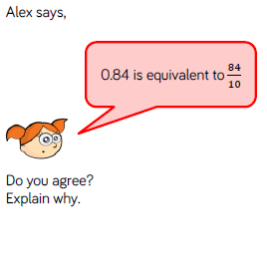
Task 1: Decimals as Fractions

Slide 20

09.06.2020
Mental and Oral starter:
https://www.transum.org/Software/SW/Starter_of_the_day/

Slide 21
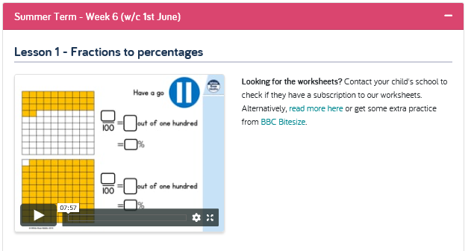
09.06.2020
WALT: convert fractions to percentages
https://whiterosemaths.com/homelearning/year-6/
Bitesize for additional work on equivalents…

Slide 22
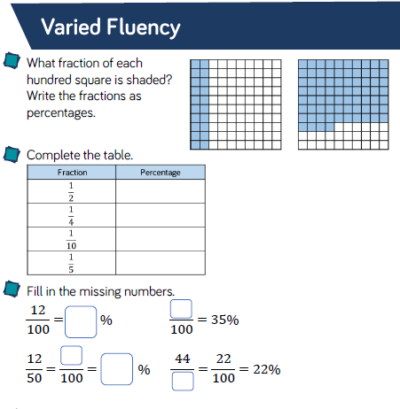
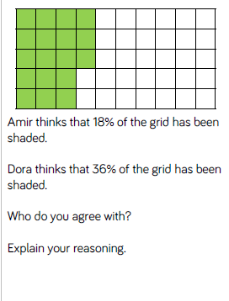
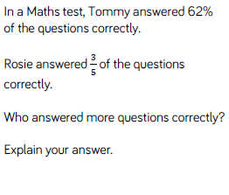
Task 2: Fractions to Percentages

Slide 23
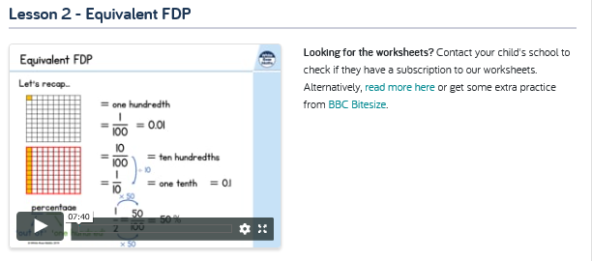
10.06.2020
WALT: recognise equivalent fractions, decimals and percentages.

Slide 24
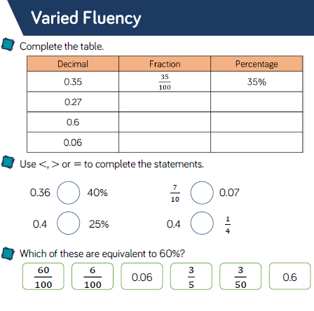
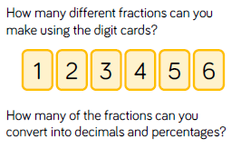

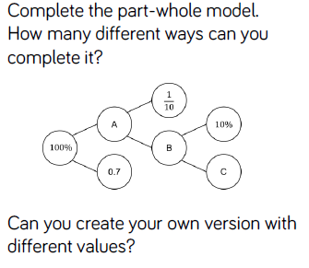
Task 3: Equivalent FDPs

Slide 25
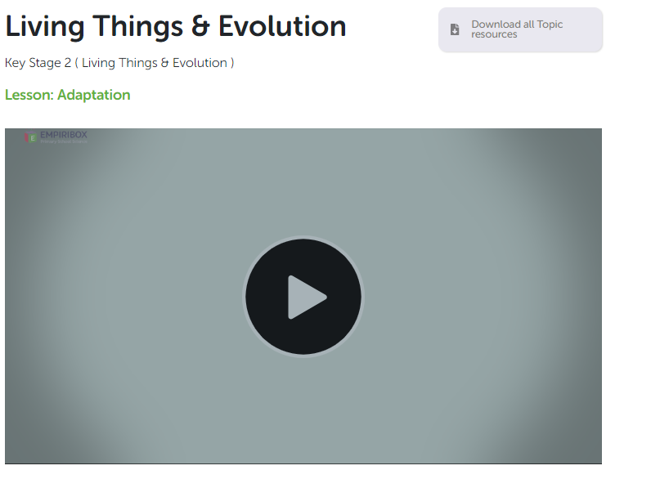
Topic/Science
Login to Empiribox Home Learning (using chrome browser). Watch the video on:
Adaptation and complete the following work…

Slide 26

Science work is found with Home Learning slides in PDF format.
If you wish to learn more around this subject look at:
Charles Darwin
David Attenborough

Slide 27

P.E.
It is important to keep your children active. If it is safe to do so, ensure they have some time outside throughout the day. Please visit Joe Wicks YouTube channel (https://www.youtube.com/channel/UCAxW1XT0iEJo0TYlRfn6rYQ), which has lots of exercise videos for children. He will also be hosting a live P.E. lessons Monday to Friday at 9:00am.

Slide 28

Classroom Secrets
The site classroom secrets https://classroomsecrets.co.uk/free-home-learning-packs/ has free class packs which provide some great additional ideas and resources you can use.

