Slide 1

Home Learning
Year 6 Term 6 Week 1

Slide 2
Message from the class teachers
We hope you have had a relaxing and refreshing half term break.
There are lots of activities and learning planned for this week in a range of subjects, which we know will help you to plan your daily routine.
Do make use of the internet resources as well as keeping busy by doing physical activities and spending time with family.
Thank you for your continued support.

Slide 3

Reading
Hopefully you have access to books at home, but we have sent home extra books with your child.
Accelerated Reading
Home quizzing is not always recommended but in this case we have adjusted the settings to allow quizzing to happen at home.
If your child wants to read a book from home, please check that there is a quiz available for the book and that the book level (BL) is within or near to your child’s reading range. Also take note of the quiz number for future reference.
To check books please visit: https://www.arbookfind.co.uk/
Go to the next page for how to quiz.

Slide 4



AR quizzing at home.
To log into AR to take a quiz please visit: https://ukhosted27.renlearn.co.uk/2240835/
Your child should know what to do from here and should know their login details. If they are not aware, most details are written in their reading record.
Click on Accelerated reader.
Type in the name the book or the quiz number.
We advise students complete quizzes unaided. If parents/carers wish to support their child, they can do so in the following ways:
Discuss the book with your child as the book is being read
Ask your child to read the question out loud
Re-word questions for your child, if necessary
Ask your child which answers are not correct

Slide 5

Visit http://readon.myon.co.uk

Slide 6

Choose an area that interests you or use the search option.

Slide 7


Using My Maths
Children should know their way round My Maths but here are some reminders on how access the lessons. Visit: www.mymaths.co.uk
bapchild
divide162

Slide 8

Using My Maths
Access any lesson based on what your child is learning in class or search the topic in the search bar.
Use the login portal to access specific homework and lessons that your teacher has set.

Slide 9

Maths – White Rose Home Learning
In school we follow the White Rose scheme of learning. Their website has put together free lessons and resources that link to the learning taking place in school. Please visit: https://whiterosemaths.com/homelearning/

Slide 10



TT Rockstars
To access TT Rockstars please visit: https://play.ttrockstars.com/auth/school
Start typing in the school name or the post code (ME99NL)
Pupils type in their username and password, usually written in their reading record.
Pupils can practice all tables but Year 2 should be practicing 2, 5, and 10’s
Year 3: 2,5,10,3,4,8’s
Year 4,5,6: all tables

Slide 11

Accessing Twinkl
Many educational content providers are offering free access to their resources. Twinkl is a website that we use from time to time to resource our lessons to aid in teacher input and pupil activities.
We will be able to direct you towards activities and learning via this website based on lessons that may be missed due to absence. To access Twinkl please visit: www.twinkl.co.uk/offer
You will have to sign up and put in the offer code: UKTWINKLHELPS

Slide 12
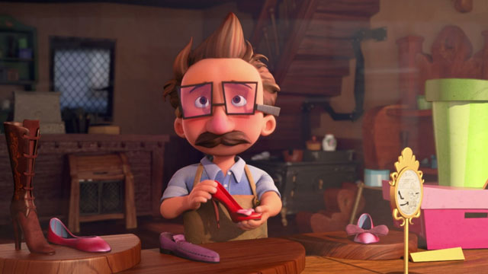
English Learning
The Shoemaker
Watch the short video of the shoemaker at https://www.literacyshed.com/littleshoemaker.html
Task: Imagine you are the shoemaker. You have created a new shoe and wish to advertise it. Create a poster using persuasive language and pictures to encourage shoppers to buy your product.
Remember features of persuasive writing include:
Emotive language
Power of three
Rhetorical questions
Opinion made to look like fact
Imperative verbs
Personal pronouns – ‘I, you, we’
Alliteration

Slide 13
Maths Learning
Hey folks! Welcome to Term 6 and your final term of primary. I am hoping that you’ve all kept up with Timestable revision and using MyMaths and other resources to tailor your learning to meet your individual needs.
We are missing you all so much. Keep up the good work and hope to see you soon.
The following slides are for this week but use your revision books and online resources to aid your understanding, fluency and problem solving skills.

Slide 14
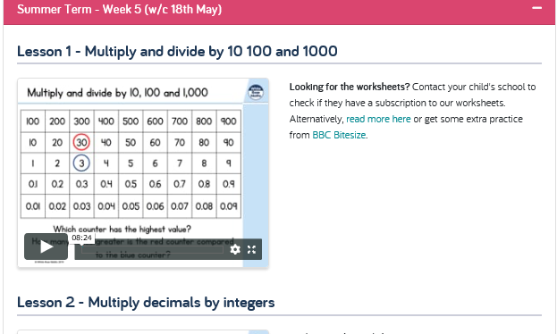
Term 6 Week 1

Slide 15
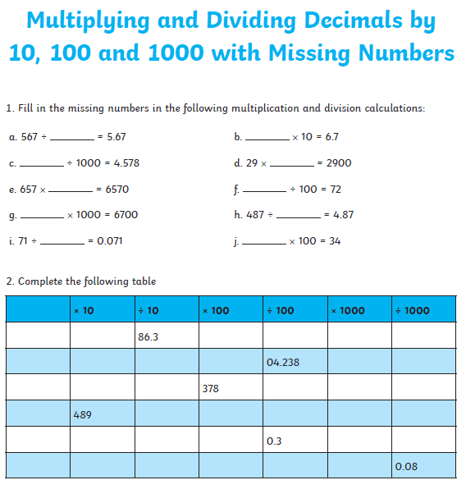
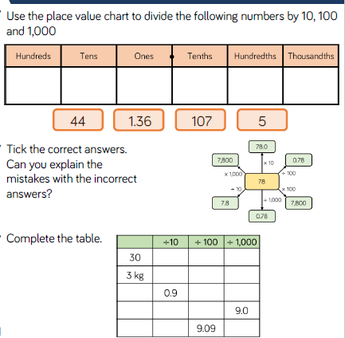
Task 1: Multiplying and dividing by 10, 100 and 1000.

Slide 16
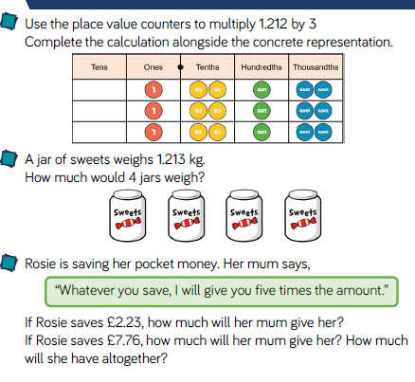
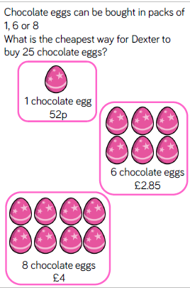
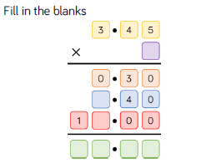
Task 2:Multiply decimals by integers

Slide 17
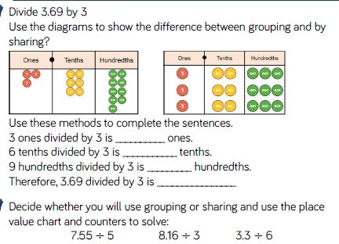
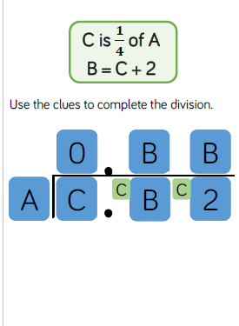
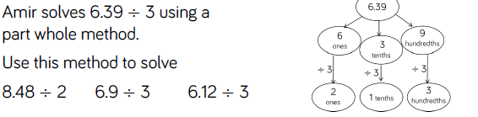
Task 3: Divide decimals by integers

Slide 18

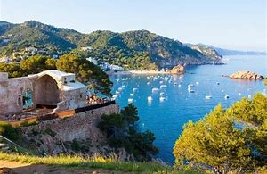
Topic/Science
Create and design a fabulous coastal resort for families to stay in. Make a holiday resort brochure describing all of the amenities, attractions, trips and coastal features that families would enjoy.
You can use paper and pens, laptops or go 3D and make a model with accompanying details and info as sign posts and mini leaflets. Let your imagination run wild but remember it has to be safe and suitable for families with children of all ages.
Enjoy!

Slide 19



Art
These pictures are by famous Japanese artist Katsushika Hokusai. He created artwork based on the nature he saw around him.
He would use woodblock printing to create images.
You can find out more about him at https://kids.kiddle.co/Katsushika_Hokusai
Look around at the nature you can see – can you create a piece of artwork in the style of Hokusai?

Slide 20

P.E.
It is important to keep your children active. If it is safe to do so, ensure they have some time outside throughout the day. Please visit Joe Wicks YouTube channel (https://www.youtube.com/channel/UCAxW1XT0iEJo0TYlRfn6rYQ), which has lots of exercise videos for children. He will also be hosting a live P.E. lessons Monday to Friday at 9:00am.

Slide 21

Classroom Secrets
The site classroom secrets https://classroomsecrets.co.uk/free-home-learning-packs/ has free class packs which provide some great additional ideas and resources you can use.

