Slide 1

Home Learning
Year 6 Term 5 Week 6

Slide 2
Message from the class teachers
We hope you have had a good week and have enjoyed the range of learning activities. Don’t forget you can explore other areas of learning alongside what we set – learning is about exploring!
There are lots of activities and learning planned for this week, which we know will help you to plan your daily routine.
Do make use of the internet resources as well as keeping busy by doing physical activities and spending time with family.
Thank you for your continued support.

Slide 3

Reading
Hopefully you have access to books at home, but we have sent home extra books with your child.
Accelerated Reading
Home quizzing is not always recommended but in this case we have adjusted the settings to allow quizzing to happen at home.
If your child wants to read a book from home, please check that there is a quiz available for the book and that the book level (BL) is within or near to your child’s reading range. Also take note of the quiz number for future reference.
To check books please visit: https://www.arbookfind.co.uk/
Go to the next page for how to quiz.

Slide 4



AR quizzing at home.
To log into AR to take a quiz please visit: https://ukhosted27.renlearn.co.uk/2240835/
Your child should know what to do from here and should know their login details. If they are not aware, most details are written in their reading record.
Click on Accelerated reader.
Type in the name the book or the quiz number.
We advise students complete quizzes unaided. If parents/carers wish to support their child, they can do so in the following ways:
Discuss the book with your child as the book is being read
Ask your child to read the question out loud
Re-word questions for your child, if necessary
Ask your child which answers are not correct

Slide 5

Visit http://readon.myon.co.uk

Slide 6

Choose an area that interests you or use the search option.

Slide 7


Using My Maths
Children should know their way round My Maths but here are some reminders on how access the lessons. Visit: www.mymaths.co.uk
bapchild
divide162

Slide 8

Using My Maths
Access any lesson based on what your child is learning in class or search the topic in the search bar.
Use the login portal to access specific homework and lessons that your teacher has set.

Slide 9

Maths – White Rose Home Learning
In school we follow the White Rose scheme of learning. Their website has put together free lessons and resources that link to the learning taking place in school. Please visit: https://whiterosemaths.com/homelearning/

Slide 10



TT Rockstars
To access TT Rockstars please visit: https://play.ttrockstars.com/auth/school
Start typing in the school name or the post code (ME99NL)
Pupils type in their username and password, usually written in their reading record.
Pupils can practice all tables but Year 2 should be practicing 2, 5, and 10’s
Year 3: 2,5,10,3,4,8’s
Year 4,5,6: all tables

Slide 11

Accessing Twinkl
Many educational content providers are offering free access to their resources. Twinkl is a website that we use from time to time to resource our lessons to aid in teacher input and pupil activities.
We will be able to direct you towards activities and learning via this website based on lessons that may be missed due to absence. To access Twinkl please visit: www.twinkl.co.uk/offer
You will have to sign up and put in the offer code: UKTWINKLHELPS

Slide 12
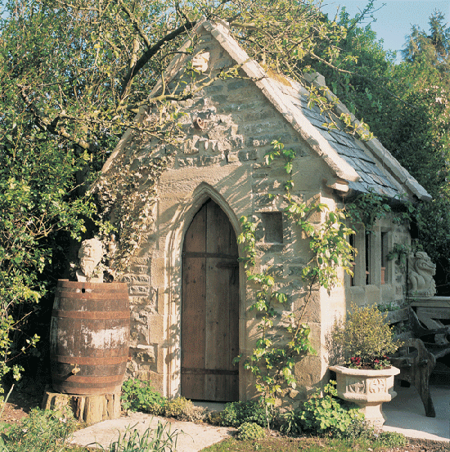
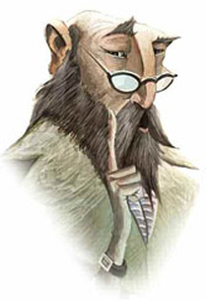
English Learning
There’s a Wizard in my Potting Shed
Imagine you discover this 'shed' at the bottom of your garden, What is inside? Imagine it's magical inside, much bigger than it seems on the outside. Perhaps lit by candles, strange instruments on the tables, cobwebbed and dusty.
Behind you the door closes gently and you spy this man sat in emerald green robes, peering at you over his glasses, the candles flicker and die out. It's pitch black and he whispers....
Your task is to complete the story.

Slide 13
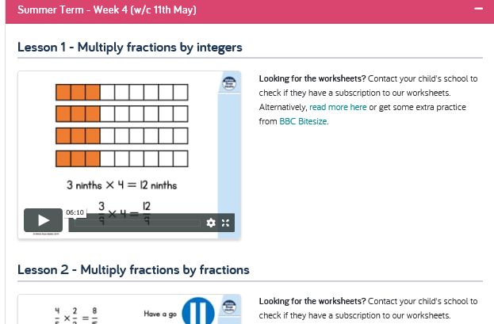
Maths Learning
Please use the White Rose Hub film clips to help with your understanding and then complete the work given…
Remember to use other resources to help. Your CPG revision books and MyMaths can help and provide additional activities.

Slide 14
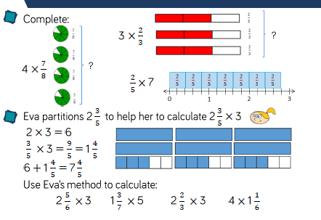
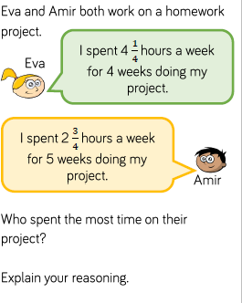
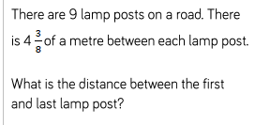
Day 1: Multiply Fractions by Integers

Slide 15
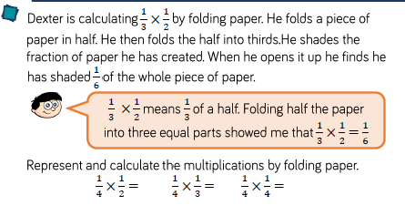
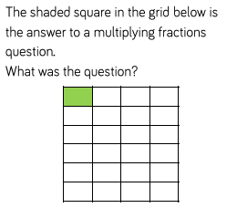
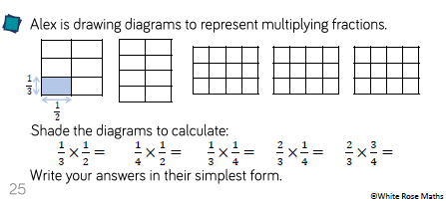
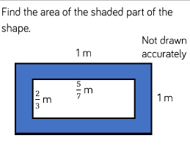
Day Two: Multiply Fractions by Fractions

Slide 16
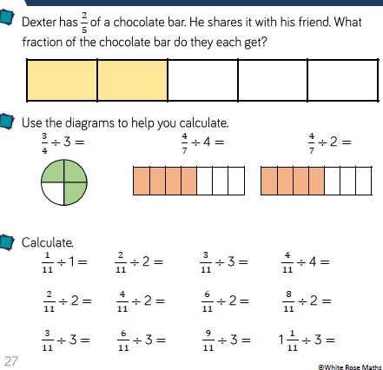
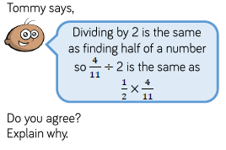
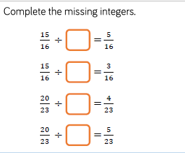
Day Three: Divide Fractions by Integers

Slide 17
Religious Education
Pentecost
We are coming up to the half-term break, which is traditionally known as the Whitsun Holiday. This is a time when Christians celebrate Pentecost. On the next page is the story of Pentecost, which can be found in the book of Acts 2:1-4.
Read through the story and answer the comprehension questions.
Do you have any questions about Pentecost after reading the story?

Slide 18
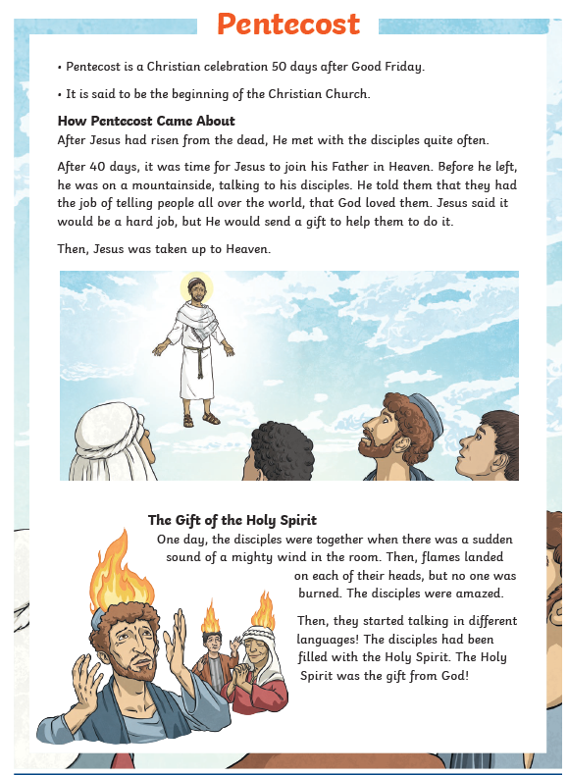
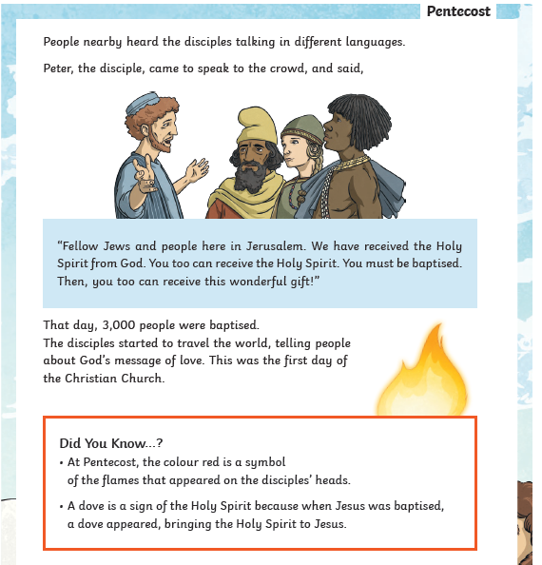
Questions on next slide…

Slide 19
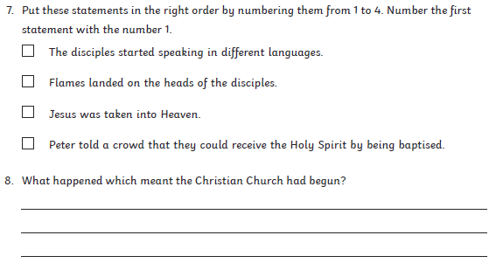
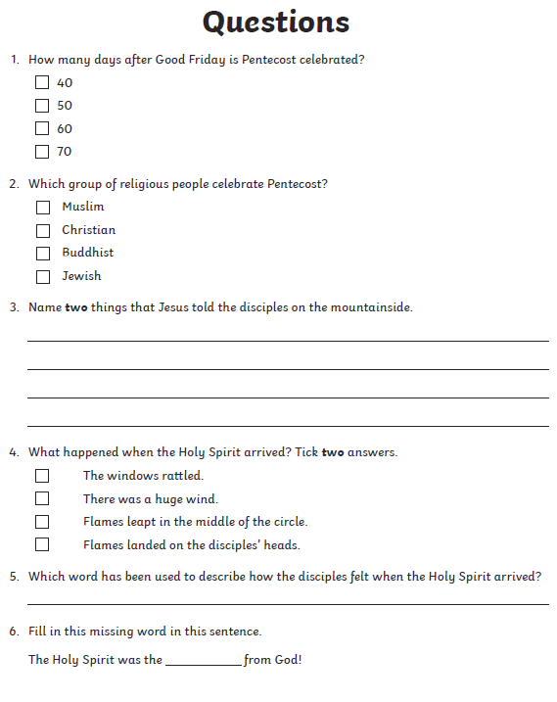
What questions do you have about Pentecost?

Slide 20
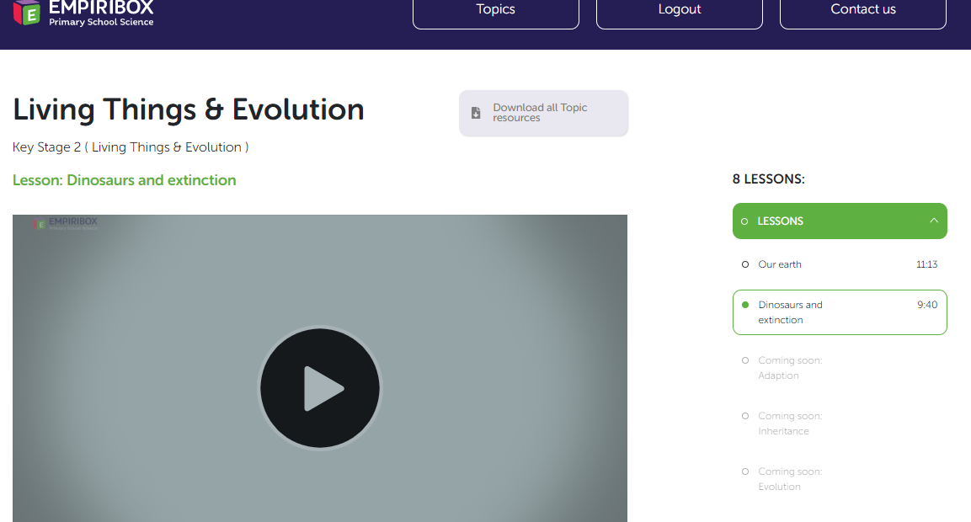
Science: Dinosaurs and Extinction
Please log on to your free Empiribox.org Home Learning Slides and find lesson 2 on Living Things and Evolution. There is a clip and science activities that you can do at home. Enjoy!
(Use Google Chrome browser as opposed to internet explorer)

Slide 21

P.E.
It is important to keep your children active. If it is safe to do so, ensure they have some time outside throughout the day. Please visit Joe Wicks YouTube channel (https://www.youtube.com/channel/UCAxW1XT0iEJo0TYlRfn6rYQ), which has lots of exercise videos for children. He will also be hosting a live P.E. lessons Monday to Friday at 9:00am.

Slide 22

Classroom Secrets
The site classroom secrets https://classroomsecrets.co.uk/free-home-learning-packs/ has free class packs which provide some great additional ideas and resources you can use.

