Slide 1

Home Learning
Year 6 Term 5 Week 5

Slide 2
Message from the class teachers
We hope you have had a good bank holiday weekend seeing and taking part in the VE Day anniversary.
There are lots of activities and learning planned for this week, which we know will help you to plan your daily routine.
Do make use of the internet resources as well as keeping busy by doing physical activities and spending time with family.
Thank you for your continued support.

Slide 3

Reading
Hopefully you have access to books at home, but we have sent home extra books with your child.
Accelerated Reading
Home quizzing is not always recommended but in this case we have adjusted the settings to allow quizzing to happen at home.
If your child wants to read a book from home, please check that there is a quiz available for the book and that the book level (BL) is within or near to your child’s reading range. Also take note of the quiz number for future reference.
To check books please visit: https://www.arbookfind.co.uk/
Go to the next page for how to quiz.

Slide 4



AR quizzing at home.
To log into AR to take a quiz please visit: https://ukhosted27.renlearn.co.uk/2240835/
Your child should know what to do from here and should know their login details. If they are not aware, most details are written in their reading record.
Click on Accelerated reader.
Type in the name the book or the quiz number.
We advise students complete quizzes unaided. If parents/carers wish to support their child, they can do so in the following ways:
Discuss the book with your child as the book is being read
Ask your child to read the question out loud
Re-word questions for your child, if necessary
Ask your child which answers are not correct

Slide 5

Visit http://readon.myon.co.uk

Slide 6

Choose an area that interests you or use the search option.

Slide 7


Using My Maths
Children should know their way round My Maths but here are some reminders on how access the lessons. Visit: www.mymaths.co.uk
bapchild
divide162

Slide 8

Using My Maths
Access any lesson based on what your child is learning in class or search the topic in the search bar.
Use the login portal to access specific homework and lessons that your teacher has set.

Slide 9

Maths – White Rose Home Learning
In school we follow the White Rose scheme of learning. Their website has put together free lessons and resources that link to the learning taking place in school. Please visit: https://whiterosemaths.com/homelearning/

Slide 10



TT Rockstars
To access TT Rockstars please visit: https://play.ttrockstars.com/auth/school
Start typing in the school name or the post code (ME99NL)
Pupils type in their username and password, usually written in their reading record.
Pupils can practice all tables but Year 2 should be practicing 2, 5, and 10’s
Year 3: 2,5,10,3,4,8’s
Year 4,5,6: all tables

Slide 11

Accessing Twinkl
Many educational content providers are offering free access to their resources. Twinkl is a website that we use from time to time to resource our lessons to aid in teacher input and pupil activities.
We will be able to direct you towards activities and learning via this website based on lessons that may be missed due to absence. To access Twinkl please visit: www.twinkl.co.uk/offer
You will have to sign up and put in the offer code: UKTWINKLHELPS

Slide 12
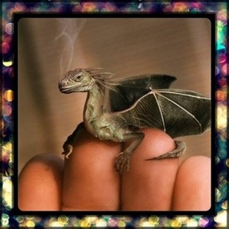
English Learning
The Tiny Dragon
Think about the following questions. You could write your answers down, or discuss:
•Where is it from?
•Why is it so small?
•Are there more like him?
•Where does he live?
•How will you look after it?
•Will you keep it a secret or tell someone?
•What is it called?
•Is it magic? What magic can it do?
Storywriting:
Imagine that it is a really small dragon which you can keep in your pocket but when you need to it can grow huge so that you can ride it. Tell the story of your pet dragon.

Slide 13
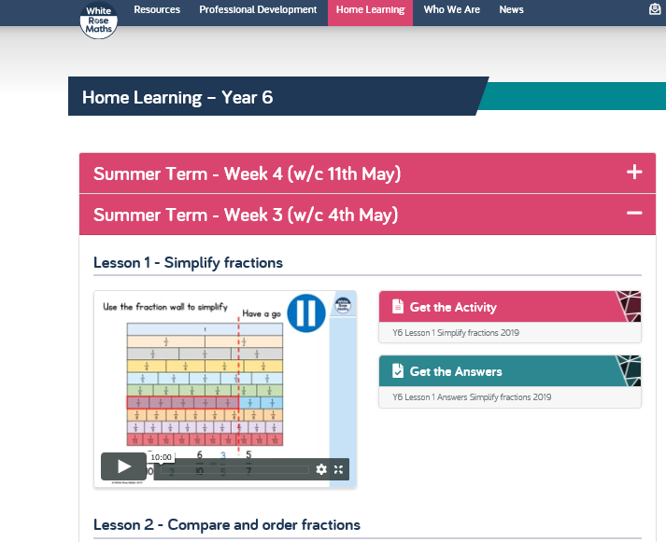
Maths Learning
White Rose Hub Week 3 (scroll to the bottom of the page if you have trouble finding it).

Slide 14
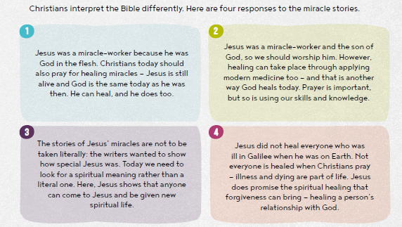
Religious Education
Healing Miracles
There are a number of accounts of the types of miracles Christians believe Jesus performed in the Gospels. The Christian belief in miracles helps to form their ideas of Jesus’ action in the world.
What are the types of miracles outlined in the Bible? (Hint – there are four categories).
Look at the ways in which Christians respond to miracles, outlined below. Which do you find most convincing and why?

Slide 15
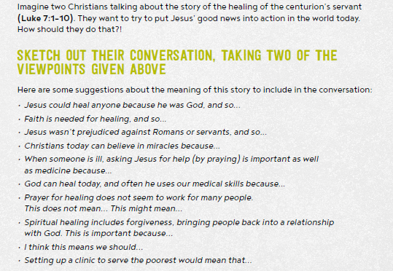
To read the story you can access it via the link below: https://www.biblegateway.com/passage/?search=Luke+7%3A1-10&version=GNT

Slide 16
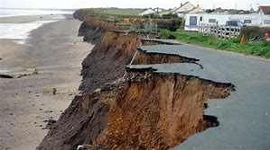
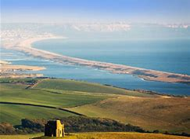
Topic/Science
Geography – Coasts
Research and find out about Erosion and Deposition on the shore line.
Make a small booklet, a storyboard or a flow diagram explaining the process.
What does erosion mean for people living
near the coast?

Slide 17

P.E.
It is important to keep your children active. If it is safe to do so, ensure they have some time outside throughout the day. Please visit Joe Wicks YouTube channel (https://www.youtube.com/channel/UCAxW1XT0iEJo0TYlRfn6rYQ), which has lots of exercise videos for children. He will also be hosting a live P.E. lessons Monday to Friday at 9:00am.

Slide 18

Classroom Secrets
The site classroom secrets https://classroomsecrets.co.uk/free-home-learning-packs/ has free class packs which provide some great additional ideas and resources you can use.

