Slide 1

Home Learning
Year 6 Term 5 Week 4

Slide 2
Message from the class teachers
Thank you for continuing to work so hard independently. You are showing maturing and definitely being excellent role models!
Don’t worry if you find some activities more challenging than others, allow yourself time to think over your learning and maybe come back to it after some reflection time.
Do make use of the internet resources as well as keeping busy by doing physical activities and spending time with family.
Thank you for your continued support.

Slide 3

Reading
Hopefully you have access to books at home, but we have sent home extra books with your child.
Accelerated Reading
Home quizzing is not always recommended but in this case we have adjusted the settings to allow quizzing to happen at home.
If your child wants to read a book from home, please check that there is a quiz available for the book and that the book level (BL) is within or near to your child’s reading range. Also take note of the quiz number for future reference.
To check books please visit: https://www.arbookfind.co.uk/
Go to the next page for how to quiz.

Slide 4



AR quizzing at home.
To log into AR to take a quiz please visit: https://ukhosted27.renlearn.co.uk/2240835/
Your child should know what to do from here and should know their login details. If they are not aware, most details are written in their reading record.
Click on Accelerated reader.
Type in the name the book or the quiz number.
We advise students complete quizzes unaided. If parents/carers wish to support their child, they can do so in the following ways:
Discuss the book with your child as the book is being read
Ask your child to read the question out loud
Re-word questions for your child, if necessary
Ask your child which answers are not correct

Slide 5

Visit http://readon.myon.co.uk

Slide 6

Choose an area that interests you or use the search option.

Slide 7


Using My Maths
Children should know their way round My Maths but here are some reminders on how access the lessons. Visit: www.mymaths.co.uk
bapchild
divide162

Slide 8

Using My Maths
Access any lesson based on what your child is learning in class or search the topic in the search bar.
Use the login portal to access specific homework and lessons that your teacher has set.

Slide 9

Maths – White Rose Home Learning
In school we follow the White Rose scheme of learning. Their website has put together free lessons and resources that link to the learning taking place in school. Please visit: https://whiterosemaths.com/homelearning/

Slide 10



TT Rockstars
To access TT Rockstars please visit: https://play.ttrockstars.com/auth/school
Start typing in the school name or the post code (ME99NL)
Pupils type in their username and password, usually written in their reading record.
Pupils can practice all tables but Year 2 should be practicing 2, 5, and 10’s
Year 3: 2,5,10,3,4,8’s
Year 4,5,6: all tables

Slide 11

Accessing Twinkl
Many educational content providers are offering free access to their resources. Twinkl is a website that we use from time to time to resource our lessons to aid in teacher input and pupil activities.
We will be able to direct you towards activities and learning via this website based on lessons that may be missed due to absence. To access Twinkl please visit: www.twinkl.co.uk/offer
You will have to sign up and put in the offer code: UKTWINKLHELPS

Slide 12
English Learning
Apostrophes for Possession
Use the link below to revise your understanding of apostrophes: https://www.bbc.co.uk/bitesize/topics/zvwwxnb/articles/zx9ydxs
After watching the video, try the exercises on the webpage and quiz.
Apostrophes for Contraction
Now do the same for apostrophes for contraction using this link:
https://www.bbc.co.uk/bitesize/topics/zvwwxnb/articles/zcyv4qt
Independent Work
Try writing a paragraph or two about something that interests you using what you know about apostrophes for possession and contraction.
Spellings
Keep learning 5 a week. Can you write these in context by writing five sentences that include these words?

Slide 13
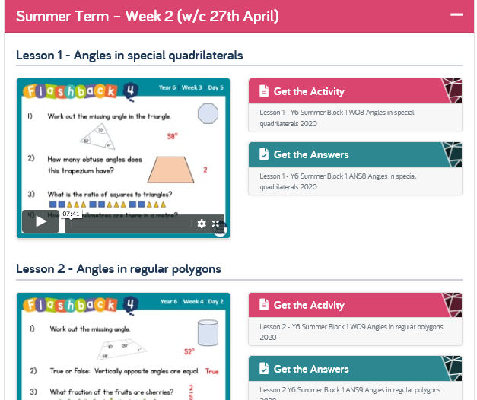
Maths Learning
White Rose Hub Week 2 (scroll to the bottom of the page if you have trouble finding it).
Additionally keep using your CPG Year 6 resources, My Maths and TT Rockstars to rehearse your times tables recall.

Slide 14
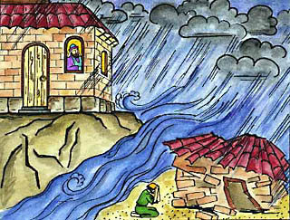
Religious Education
Foundations for Living: The Wise and Foolish Builders, Matthew 7:24–27.
Jesus spoke to the people:
“So then, anyone who hears these words of mine and obeys them is like a wise man who built his house on rock. The rain poured down, the rivers flooded over, and the wind blew hard against that house. But it did not fall, because it was built on rock.
“But anyone who hears these words of mine and does not obey them is like a foolish man who built his house on sand. The rain poured down, the rivers flooded over, the wind blew hard against that house, and it fell. And what a terrible fall that was!”
Reflect on the Parable of the Two
House Builders and consider what makes for strong
foundations in life. Using the next slide consider
what Christians do to build good foundations for living.

Slide 15

Consider what Christians do to
build good foundations for living.
What activities of the local
Christian community help
people to secure the foundations
of their lives?
Where else do people get
foundations for life (for example, in
Islam, from the Five Pillars)?
How do these compare with
Christian foundations?
What foundations do you live by?

Slide 16

Topic/Science
Using Chrome go to Empiribox home learning - home.empiribox.com.
Register for free using your own email and create a password. Using the correct school name (Bapchild) and postcode (ME9 9NL) will get you access to all of the free home learning resources that include experiments that you can do at home.

Slide 17
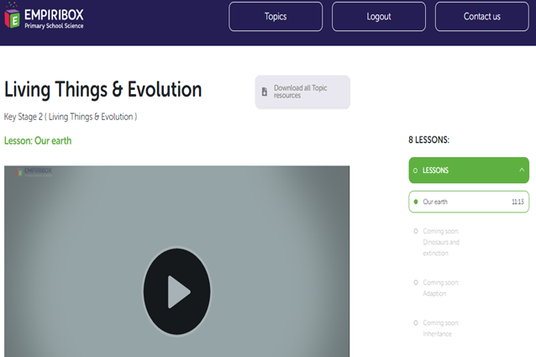
Evolution
This is the first video and activities that you will be doing:

Slide 18

P.E.
It is important to keep your children active. If it is safe to do so, ensure they have some time outside throughout the day. Please visit Joe Wicks YouTube channel (https://www.youtube.com/channel/UCAxW1XT0iEJo0TYlRfn6rYQ), which has lots of exercise videos for children. He will also be hosting a live P.E. lessons Monday to Friday at 9:00am.

Slide 19

Classroom Secrets
The site classroom secrets https://classroomsecrets.co.uk/free-home-learning-packs/ has free class packs which provide some great additional ideas and resources you can use.

