Slide 1

Home Learning
Year 6 Term 5 Week 3

Slide 2
Message from the class teachers
Spring has definitely sprung! Take some time to look at how nature is blooming this week, maybe sketch something you are seeing grow?
We have a selection of learning and activities on this week’s power point. Keeping to a routine of learning during the week is the best way to maintain and develop your skills and knowledge.
Do make use of the internet resources as well as keeping busy by doing physical activities and spending time with family.
Thank you for your continued support.

Slide 3

Reading
Hopefully you have access to books at home, but we have sent home extra books with your child.
Accelerated Reading
Home quizzing is not always recommended but in this case we have adjusted the settings to allow quizzing to happen at home.
If your child wants to read a book from home, please check that there is a quiz available for the book and that the book level (BL) is within or near to your child’s reading range. Also take note of the quiz number for future reference.
To check books please visit: https://www.arbookfind.co.uk/
Go to the next page for how to quiz.

Slide 4



AR quizzing at home.
To log into AR to take a quiz please visit: https://ukhosted27.renlearn.co.uk/2240835/
Your child should know what to do from here and should know their login details. If they are not aware, most details are written in their reading record.
Click on Accelerated reader.
Type in the name the book or the quiz number.
We advise students complete quizzes unaided. If parents/carers wish to support their child, they can do so in the following ways:
Discuss the book with your child as the book is being read
Ask your child to read the question out loud
Re-word questions for your child, if necessary
Ask your child which answers are not correct

Slide 5

Visit http://readon.myon.co.uk

Slide 6

Choose an area that interests you or use the search option.

Slide 7


Using My Maths
Children should know their way round My Maths but here are some reminders on how access the lessons. Visit: www.mymaths.co.uk
bapchild
divide162

Slide 8

Using My Maths
Access any lesson based on what your child is learning in class or search the topic in the search bar.
Use the login portal to access specific homework and lessons that your teacher has set.

Slide 9

Maths – White Rose Home Learning
In school we follow the White Rose scheme of learning. Their website has put together free lessons and resources that link to the learning taking place in school. Please visit: https://whiterosemaths.com/homelearning/

Slide 10



TT Rockstars
To access TT Rockstars please visit: https://play.ttrockstars.com/auth/school
Start typing in the school name or the post code (ME99NL)
Pupils type in their username and password, usually written in their reading record.
Pupils can practice all tables but Year 2 should be practicing 2, 5, and 10’s
Year 3: 2,5,10,3,4,8’s
Year 4,5,6: all tables

Slide 11

Accessing Twinkl
Many educational content providers are offering free access to their resources. Twinkl is a website that we use from time to time to resource our lessons to aid in teacher input and pupil activities.
We will be able to direct you towards activities and learning via this website based on lessons that may be missed due to absence. To access Twinkl please visit: www.twinkl.co.uk/offer
You will have to sign up and put in the offer code: UKTWINKLHELPS

Slide 12
English Learning
Recipes
This week we would like you to get involved with cooking or baking something that you or your family chooses. Maybe take some photos of you cooking and the result – you could ask for feedback from your family.
Then, write up the recipe including ingredients, method and outcome. To make your recipe more interesting add descriptive words (adjectives to describe the ingredients, adverbs to describe the activity).
Spellings
Keep learning 5 a week. Can you write these in context by writing five sentences that include these words?

Slide 13
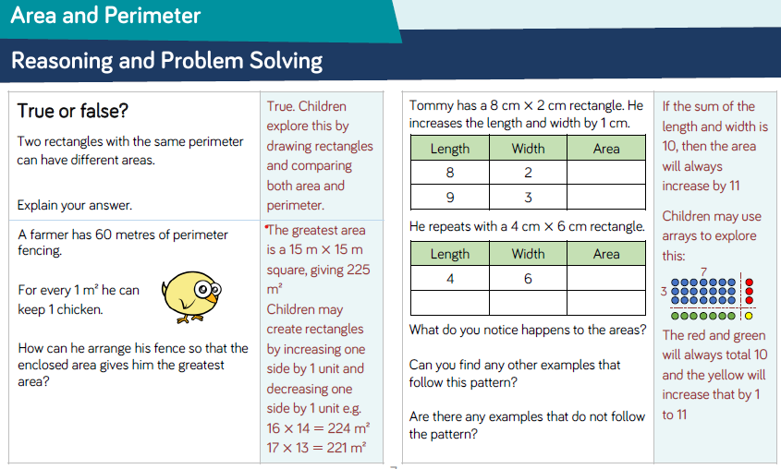
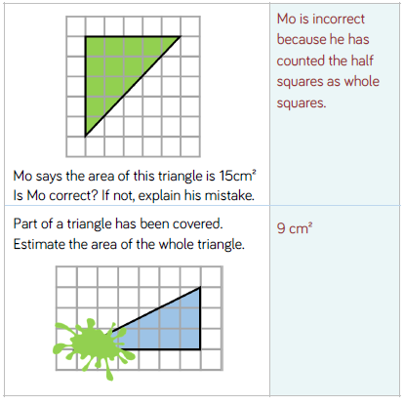
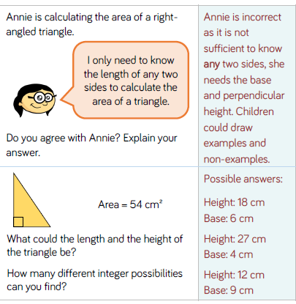
Maths Learning
Answers to previous reasoning:

Slide 14
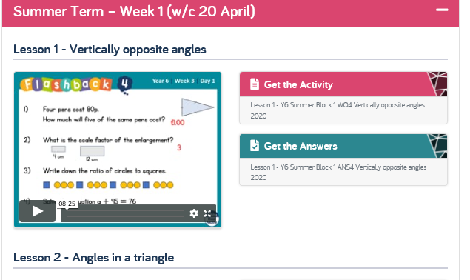
Maths learning
Please visit: https://whiterosemaths.com/homelearning/
Revise work on vertically opposite angles, there are 5 days of learning and answers provided in one area.

Slide 15
Religious Education
Gospel: What Would Jesus Do?
If you have a Bible at home you could read the story: Jesus gets Angry: The Moneylenders in the Temple, Mark 11:15–19. Or, you can watch the film clip of this story at www.youtube.com/watch?v=rUJVTdNSCTA
Questions to think about:
How do you feel about Jesus’ reaction? Is he right to do what he did? Why?
Would it make God angry if people cared about money but not about prayer?
Would it make God angry if people excluded other races from worship? If the market mattered more than worship?
Is this story of Jesus getting angry about the importance of prayer, or the value of holy buildings?
In which situations might it be acceptable to get angry?
Activities:
Create a picture or cartoon of Jesus getting angry in the Temple.
Or, write a story about a situation in which an individual got angry for a good reason – what happened, how was the situation resolved?

Slide 16

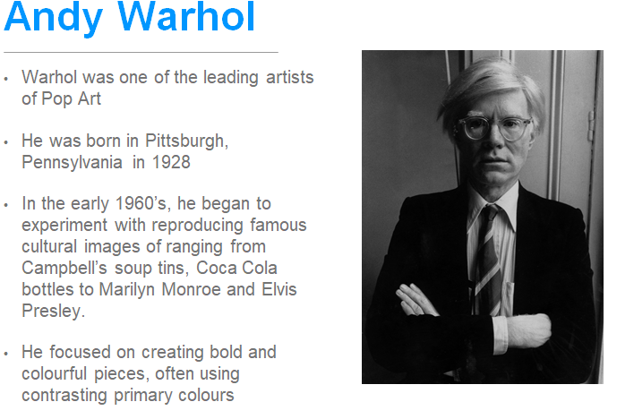
Topic/Science
Art
Find out about Andy Warhol, look at some of his art work (which is your favourite and why?) and try out some of your own!

Slide 17

P.E.
It is important to keep your children active. If it is safe to do so, ensure they have some time outside throughout the day. Please visit Joe Wicks YouTube channel (https://www.youtube.com/channel/UCAxW1XT0iEJo0TYlRfn6rYQ), which has lots of exercise videos for children. He will also be hosting a live P.E. lessons Monday to Friday at 9:00am.

Slide 18

Classroom Secrets
The site classroom secrets https://classroomsecrets.co.uk/free-home-learning-packs/ has free class packs which provide some great additional ideas and resources you can use.

