Slide 1

Home Learning
Year 6 Term 5 Week 2

Slide 2
Message from the class teachers
We hope you have had an good weekend.
This is our first full week and we have designed the learning so that you have a variety of activities that you can access at your own pace.
Do make use of the internet resources as well as keeping busy by doing physical activities.
Thank you for your continued support.

Slide 3

Reading
Hopefully you have access to books at home, but we have sent home extra books with your child.
Accelerated Reading
Home quizzing is not always recommended but in this case we have adjusted the settings to allow quizzing to happen at home.
If your child wants to read a book from home, please check that there is a quiz available for the book and that the book level (BL) is within or near to your child’s reading range. Also take note of the quiz number for future reference.
To check books please visit: https://www.arbookfind.co.uk/
Go to the next page for how to quiz.

Slide 4



AR quizzing at home.
To log into AR to take a quiz please visit: https://ukhosted27.renlearn.co.uk/2240835/
Your child should know what to do from here and should know their login details. If they are not aware, most details are written in their reading record.
Click on Accelerated reader.
Type in the name the book or the quiz number.
We advise students complete quizzes unaided. If parents/carers wish to support their child, they can do so in the following ways:
Discuss the book with your child as the book is being read
Ask your child to read the question out loud
Re-word questions for your child, if necessary
Ask your child which answers are not correct

Slide 5

Visit http://readon.myon.co.uk

Slide 6

Choose an area that interests you or use the search option.

Slide 7


Using My Maths
Children should know their way round My Maths but here are some reminders on how access the lessons. Visit: www.mymaths.co.uk
bapchild
divide162

Slide 8

Using My Maths
Access any lesson based on what your child is learning in class or search the topic in the search bar.
Use the login portal to access specific homework and lessons that your teacher has set.

Slide 9

Maths – White Rose Home Learning
In school we follow the White Rose scheme of learning. Their website has put together free lessons and resources that link to the learning taking place in school. Please visit: https://whiterosemaths.com/homelearning/

Slide 10



TT Rockstars
To access TT Rockstars please visit: https://play.ttrockstars.com/auth/school
Start typing in the school name or the post code (ME99NL)
Pupils type in their username and password, usually written in their reading record.
Pupils can practice all tables but Year 2 should be practicing 2, 5, and 10’s
Year 3: 2,5,10,3,4,8’s
Year 4,5,6: all tables

Slide 11

Accessing Twinkl
Many educational content providers are offering free access to their resources. Twinkl is a website that we use from time to time to resource our lessons to aid in teacher input and pupil activities.
We will be able to direct you towards activities and learning via this website based on lessons that may be missed due to absence. To access Twinkl please visit: www.twinkl.co.uk/offer
You will have to sign up and put in the offer code: UKTWINKLHELPS

Slide 12
English Learning
Diary
This week write a diary of your experiences throughout the week. You could include the activities you are doing, ways in which you have been in contact with others and how you have been feeling. It would also be nice to add some illustrations.
Spellings
Keep learning 5 a week. Can you write these in context in your blurb, or in other sentences of your choosing.

Slide 13
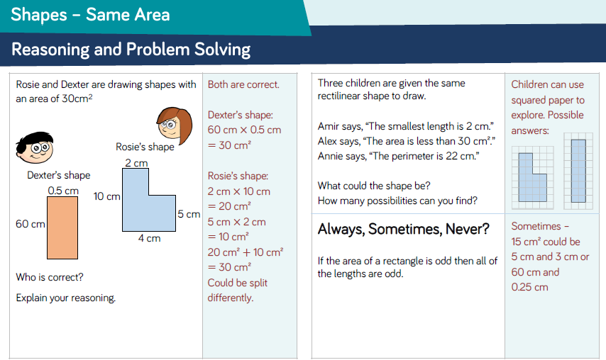
Maths Learning
Continue to use My Maths and your CPG red revision books as resources if needed.
The answers to last week’s reasoning is below and then further work on area and perimeter will follow.

Slide 14
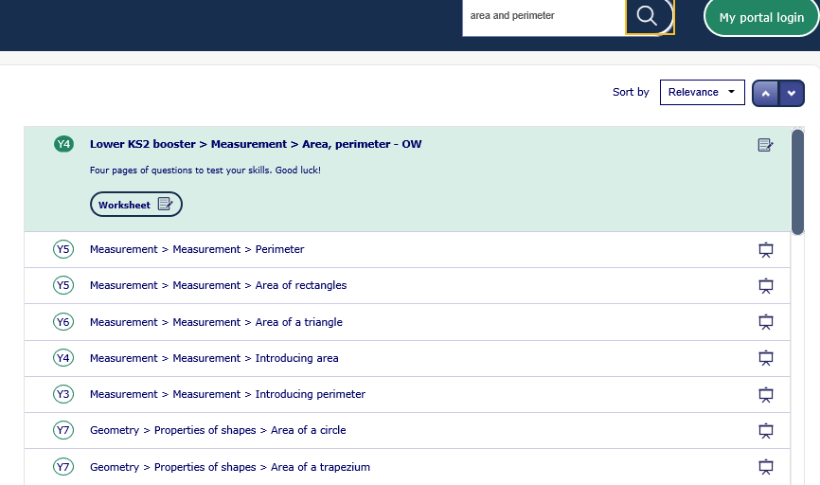
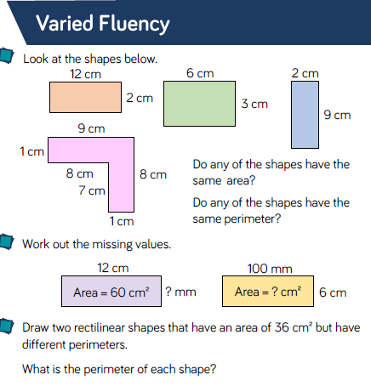
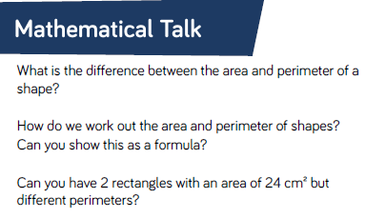
Lesson 1: Area and Perimeter of Rectilinear Shapes
Notes:
Search My Maths – area and perimeter, for lessons reminding you how to find the area and perimeter of rectilinear shapes.

Slide 15
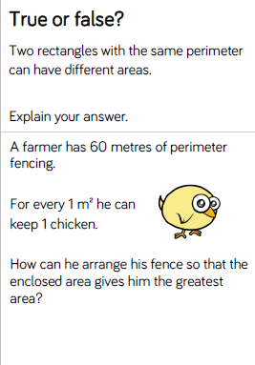
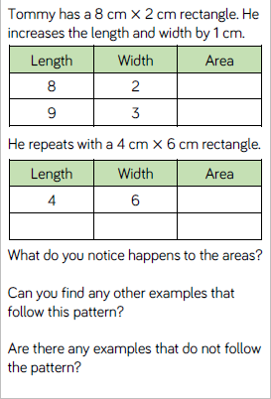
Reasoning and Problem solving:
Notes:
Use My Maths and your white revision book for more activities and practice of these skills.

Slide 16
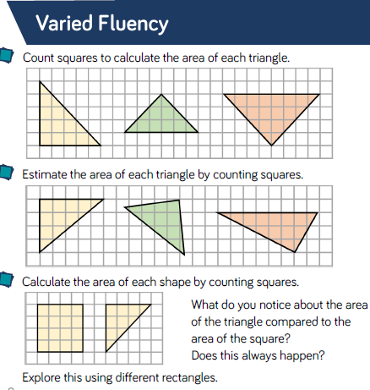
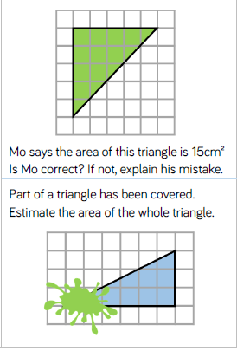
Lesson 2: Area of a Triangle

Slide 17
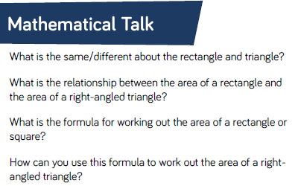
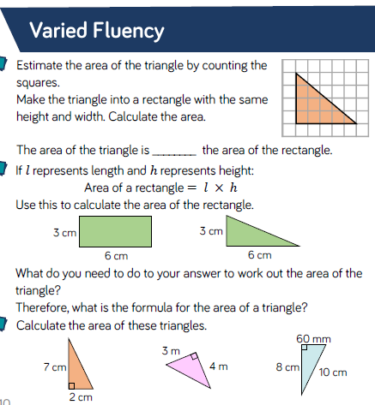
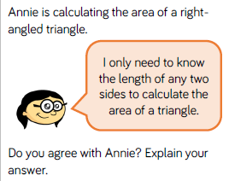
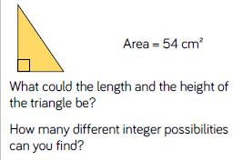
Using the formula: Fluency and Reasoning

Slide 18
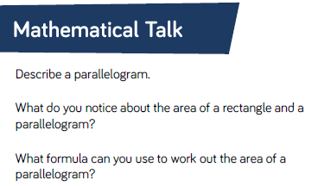
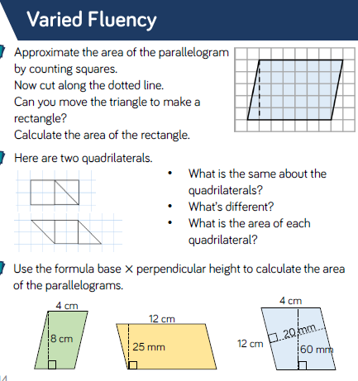
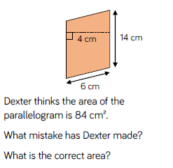
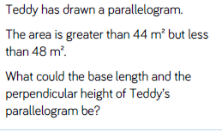
Lesson 3: Area of a Parallelogram

Slide 19
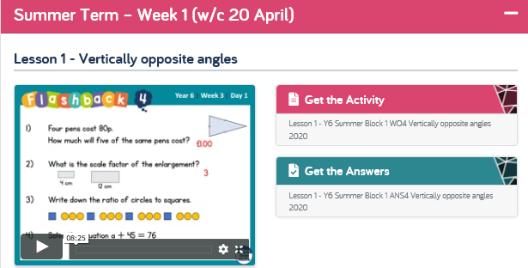
Next week’s maths and moving forward.
Year 6 Pupils,
During these strange and unusual times there are many companies providing different learning resources. From next week our learning will be focused on the White Rose Hub Home Learning scheme of work. This is because it can be hard going to many different websites to find information and tasks that link well. Please feel free to use other resources as they are fantastic but I will endeavour to only direct you to one place so that it is an easier process.
Here is a sneak peak at next week’s work:
Keep up the good work folks!

Slide 20
Religious Education
Gospel: What Would Jesus Do?
If you have a Bible at home you could read the story: Jesus gets Angry: The Moneylenders in the Temple, Mark 11:15–19. Or, you can watch the film clip of this story at www.youtube.com/watch?v=rUJVTdNSCTA
Questions to think about:
How do you feel about Jesus’ reaction? Is he right to do what he did? Why?
Would it make God angry if people cared about money but not about prayer?
Would it make God angry if people excluded other races from worship? If the market mattered more than worship?
Is this story of Jesus getting angry about the importance of prayer, or the value of holy buildings?
In which situations might it be acceptable to get angry?
Activities:
Create a picture or cartoon of Jesus getting angry in the Temple.
Or, write a story about a situation in which an individual got angry for a good reason – what happened, how was the situation resolved?

Slide 21
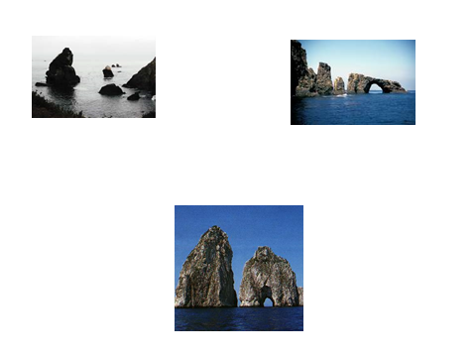
Geography: Coasts
Using the PowerPoint as a learning guide:
Read about some features of coastlines and look at their formation.
Watch, read, discover more using online journals, explanatory videos and diagrams to understand this mediocre PowerPoint.
Add detail to the PowerPoint and improve the explanations, overall presentation and design of it.

Slide 22

P.E.
It is important to keep your children active. If it is safe to do so, ensure they have some time outside throughout the day. Please visit Joe Wicks YouTube channel (https://www.youtube.com/channel/UCAxW1XT0iEJo0TYlRfn6rYQ), which has lots of exercise videos for children. He will also be hosting a live P.E. lessons Monday to Friday at 9:00am.

Slide 23

Classroom Secrets
The site classroom secrets https://classroomsecrets.co.uk/free-home-learning-packs/ has free class packs which provide some great additional ideas and resources you can use.

