Slide 1

Home Learning
Year 6 Term 5 Week 1

Slide 2
Message from the class teachers
We hope you have had an enjoyable Easter with your family and have been able to spend some time outdoors in the beautiful weather.
We have been keeping up our reading, exercise and learning (Mrs Sawyer’s been learning French adjectives and the past tense).
We’ve been connecting with friends and family using the wonder of technology – which is such a good way to keep in touch.
Our first week back is just Thursday and Friday, so you’ll find some activities on the next few slides to help you build a learning routine at the start of the term.
Thank you for your continued support.

Slide 3

Reading
Hopefully you have access to books at home, but we have sent home extra books with your child.
Accelerated Reading
Home quizzing is not always recommended but in this case we have adjusted the settings to allow quizzing to happen at home.
If your child wants to read a book from home, please check that there is a quiz available for the book and that the book level (BL) is within or near to your child’s reading range. Also take note of the quiz number for future reference.
To check books please visit: https://www.arbookfind.co.uk/
Go to the next page for how to quiz.

Slide 4



AR quizzing at home.
To log into AR to take a quiz please visit: https://ukhosted27.renlearn.co.uk/2240835/
Your child should know what to do from here and should know their login details. If they are not aware, most details are written in their reading record.
Click on Accelerated reader.
Type in the name the book or the quiz number.
We advise students complete quizzes unaided. If parents/carers wish to support their child, they can do so in the following ways:
Discuss the book with your child as the book is being read
Ask your child to read the question out loud
Re-word questions for your child, if necessary
Ask your child which answers are not correct

Slide 5

Visit http://readon.myon.co.uk

Slide 6

Choose an area that interests you or use the search option.

Slide 7


Using My Maths
Children should know their way round My Maths but here are some reminders on how access the lessons. Visit: www.mymaths.co.uk
bapchild
divide162

Slide 8

Using My Maths
Access any lesson based on what your child is learning in class or search the topic in the search bar.
Use the login portal to access specific homework and lessons that your teacher has set.

Slide 9

Maths – White Rose Home Learning
In school we follow the White Rose scheme of learning. Their website has put together free lessons and resources that link to the learning taking place in school. Please visit: https://whiterosemaths.com/homelearning/

Slide 10



TT Rockstars
To access TT Rockstars please visit: https://play.ttrockstars.com/auth/school
Start typing in the school name or the post code (ME99NL)
Pupils type in their username and password, usually written in their reading record.
Pupils can practice all tables but Year 2 should be practicing 2, 5, and 10’s
Year 3: 2,5,10,3,4,8’s
Year 4,5,6: all tables

Slide 11

Accessing Twinkl
Many educational content providers are offering free access to their resources. Twinkl is a website that we use from time to time to resource our lessons to aid in teacher input and pupil activities.
We will be able to direct you towards activities and learning via this website based on lessons that may be missed due to absence. To access Twinkl please visit: www.twinkl.co.uk/offer
You will have to sign up and put in the offer code: UKTWINKLHELPS

Slide 12
English Learning
Blurb
Pick a book, a film or a TV series that you have read or watched over Easter.
Write a blurb about the book, film or TV programme which would be used to describe it to someone who might be interested in reading or watching.
Remember, you want to draw them in, without giving too much away…
Spellings
Keep learning 5 a week. Can you write these in context in your blurb, or in other sentences of your choosing.

Slide 13
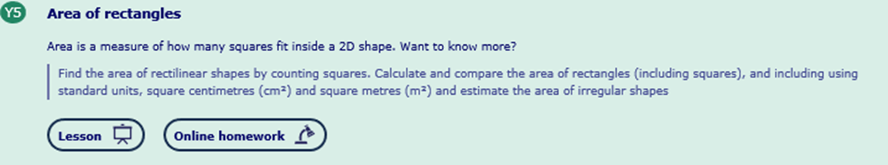
Maths Learning: Measures
Week 1: Area and Perimeter (Review of Previous Learning)
Use MyMaths to help refresh your memory – area of rectangles comes under the Year 5 scheme of work. We will be quickly moving on to finding the area of quadrilaterals, triangles and other polygons so a solid understanding of the basics is essential.
The lesson and accompanying work to be done looks like this on the My Maths website:

Slide 14
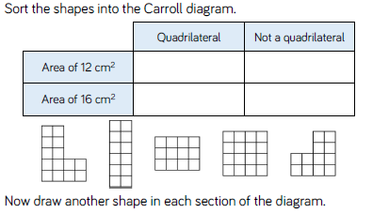
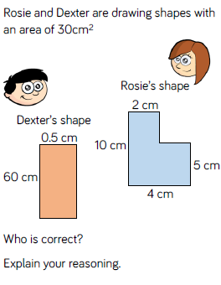
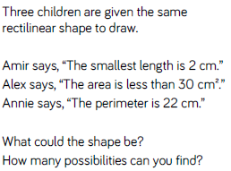
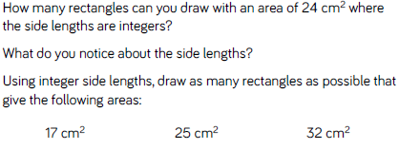
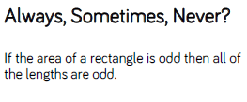
Maths Learning:
Area and Perimeter of rectilinear shapes:taken from the White Rose Hub scheme of work for year 6.
Fluency:
Reasoning:

Slide 15
Topic/Science/RE/PHSE
Science:
Evolution –
Who formulated the Theory of Evolution?
Write a non-chronological report about the man and the discoveries that he found.
Consider…
How was he in direct conflict with the church?
Other topics we will be looking at this term include:
Art: Pop Art
Geography: Coasts
PHSE: Empathy

Slide 16

P.E.
It is important to keep your children active. If it is safe to do so, ensure they have some time outside throughout the day. Please visit Joe Wicks YouTube channel (https://www.youtube.com/channel/UCAxW1XT0iEJo0TYlRfn6rYQ), which has lots of exercise videos for children. He will also be hosting a live P.E. lessons Monday to Friday at 9:00am.

Slide 17

Classroom Secrets
The site classroom secrets https://classroomsecrets.co.uk/free-home-learning-packs/ has free class packs which provide some great additional ideas and resources you can use.

