Slide 2



Christmas Number Ones
In the United Kingdom, a Christmas number one is the song that is top of the UK Singles Chart in the week leading up to Christmas.
A song reaches number one on the chart if it has the most sales, downloads and streams in a week. The number one is announced every Friday.
Talk About
It
Do you know any songs that have been number one at Christmas?

Slide 3

Christmas Number Ones
Here are some well-known Christmas songs that were also Christmas number ones. How many do you know?
‘Mary’s Boy Child’ – Harry Belafonte (1957)
‘Merry Xmas Everybody’ – Slade (1973)
‘Lonely This Christmas’ - Mud (1974)
‘Do They Know it’s Christmas?’ – Band Aid (1984)
‘Merry Christmas Everyone’ – Shakin’ Stevens (1985)

Slide 4

Christmas Number Ones
Not all Christmas number ones are songs about Christmas. In 2016, Clean Bandit had a Christmas number one with 'Rockabye’ and Ladbaby sang about building a city on sausage rolls in the 2018 Christmas number one! Here are some other surprising Christmas number one facts:
‘Last Christmas’ by Wham has never been a Christmas number one.
‘Happy Christmas (War Is Over)’ by John Lennon was beaten to the Christmas number one position by a song about a Grandma.
‘Walking in the Air’ from ‘The Snowman’ wasn’t Christmas number one.
Mariah Carey’s ‘All I Want for Christmas Is You’ has never been Christmas number one.

Slide 5
What Makes a Good
Christmas Number One?
In a group or a pair, you are going to try writing a hit Christmas song. What do you think makes a good Christmas song?
Here are some ideas:
Most Christmas hits are happy and lively. Others might be a bit sad or try to make the listener feel emotional.
Some Christmas hits tell a story – this might be about the nativity story or about a Christmas memory or event.
Instruments can turn a song into a Christmas hit. When East 17 recorded 1994’s Christmas number one ‘Stay’, jingle bells and church bells were added, giving it a Christmas feel.
The word ‘Christmas’ is often in the title and chorus.

Slide 6


How to Write a Christmas Number One
People who write pop songs work in different ways. Some people start with the lyrics (the words), others start with a melody (the tune).
Sometimes, one person will write both the melody and the lyrics, for other songs one person will do each job. Elton John, who had a hit called ‘Step into Christmas’, writes the melody and his songwriting partner, Bernie Taupin, writes the lyrics. The two are often not in the same country as each other when they write a song. Bernie will email Elton the lyrics to a song and then Elton will write a melody for them.
Decide whether you will start with the lyrics or melody.

Slide 7
How to Write a Christmas Number One
When you write the lyrics, it’s often easier to start with the chorus.
The chorus of a song is the bit which is repeated after each verse. Here are some lyric ideas:
Father Christmas
deck the halls
snow
everybody
hoping
tree
stocking
love
everyone
happy
December
fun
Christmas
white
wonderful
holly
winter
bells
fireplace
star
wrapping
merry
Christmas tree
presents
gifts
Santa Claus
decorations
silent night
bright
jingle bells
peace on earth
snowman

Slide 8

How to Write a Christmas Number One
Songs often have rhyming words. Use a rhyming dictionary to help you find rhyming words for your lyrics. Here are some ideas:
bells – yells
Claus – paws
merry – berry
holly – jolly
tree – see
bright – night
star – far
Earth – birth
fun – begun
snow – glow
love – glove

Slide 9
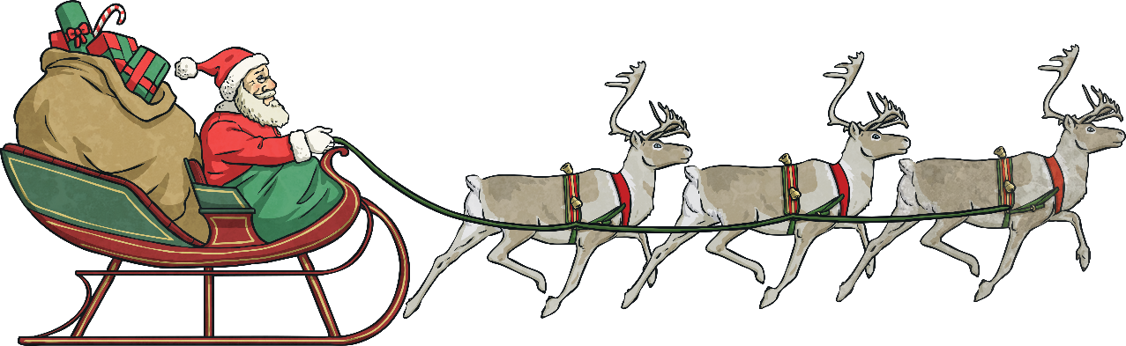
How to Write a Christmas Number One
Instruments can make a song feel Christmassy:
Jingle bells will make your audience think of sleigh bells.
You could use claves to recreate the sound of reindeer hooves.
Triangles and cymbals can help to create a wintry sound.
If you have access to keyboards, you could experiment with finding different voices.

