Slide 1


Slide 2

Garage Band
By the end of this topic you will:
Know how to create a piece of music using Garage Band on the iPad
Understand how to use all of the functions on Garage Band
Understand what a sampler is and how to use one
Have created your own piece of music

Slide 3
How to use
Garage Band

Slide 4
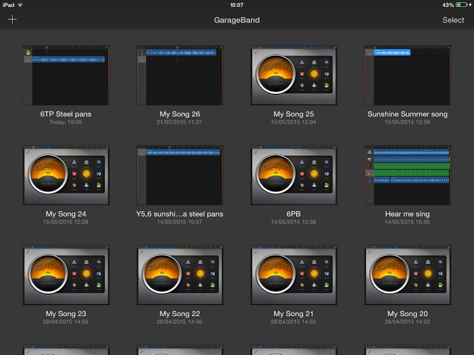
New song
Notes:
1. Create a new song by tapping on the + sign in the top left corner.

Slide 5
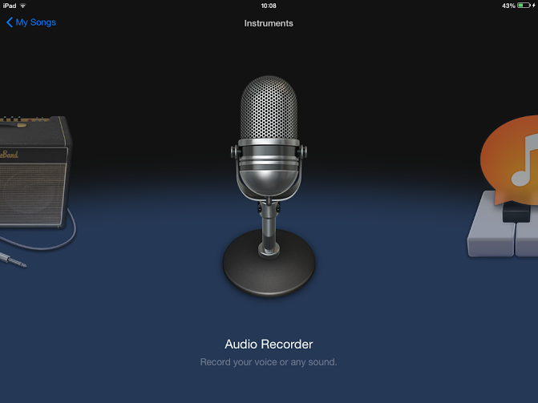
Notes:
2. Garage Band will now give you the option to choose what instrument you’d like to use. Find Smart Guitar.

Slide 6
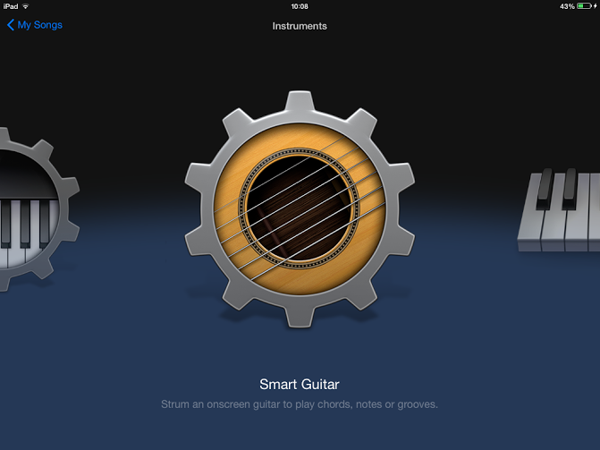
Notes:
3. Tap on Smart Guitar.

Slide 7
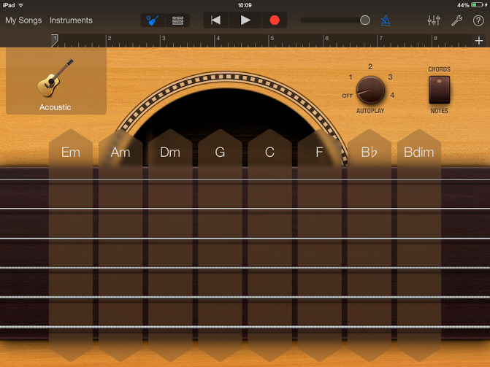
Track view
Notes:
4. Smart guitar will now open (This is the instrument view). However, we don’t want to use this just yet! We want to open the Tracks view.

Slide 8
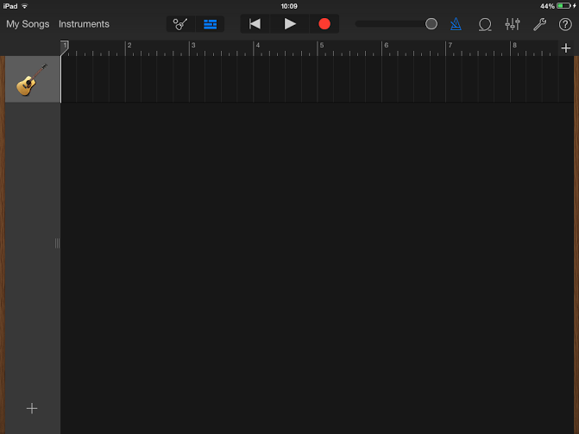
This is the Track view
Drum track/loop
Notes:
5. This is the Tracks view. We are now going to add a drum track/loop. Tap the loop button near the top right.

Slide 9
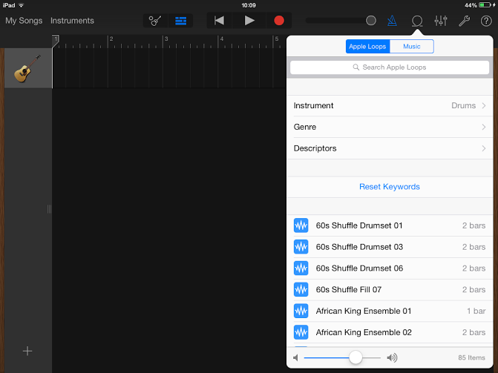
Find Solid 70s Drumset 01 near the bottom
Drag it underneath the guitar
Notes:
6. You can now choose a drum beat from the drop down selection. Let’s go for Solid 70s Drumset 01 near the bottom.

Slide 10
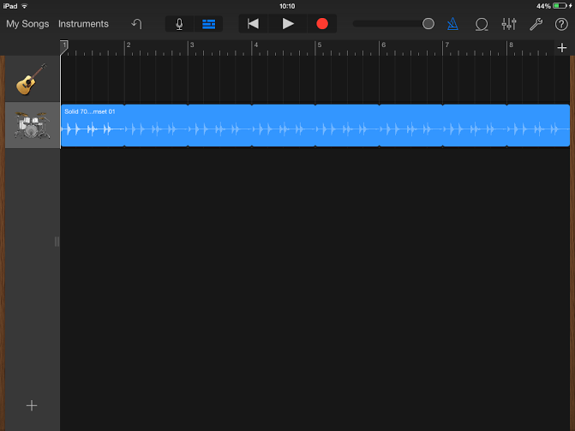
Tap + to make the track longer
Notes:
7. Once you have located Solid 70s Drumset 01, drag it on to the Track view (DON’T drag it on to the guitar part!!).

Slide 11
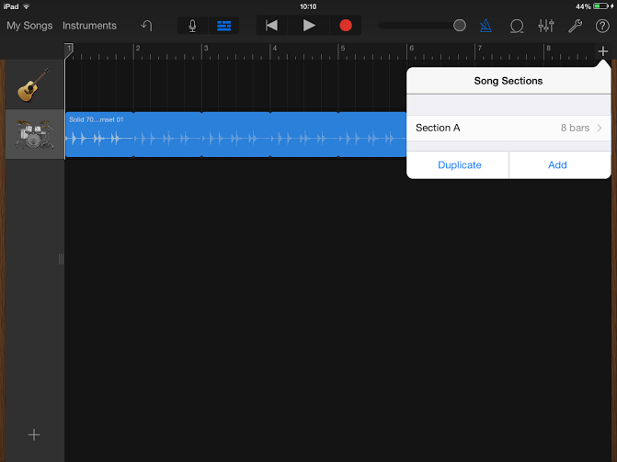
Tap here to increase the number of bars
Notes:
8. At the moment our track is only 8 bars long. We need to make it longer. Tap on the + sign in the top right corner.

Slide 12
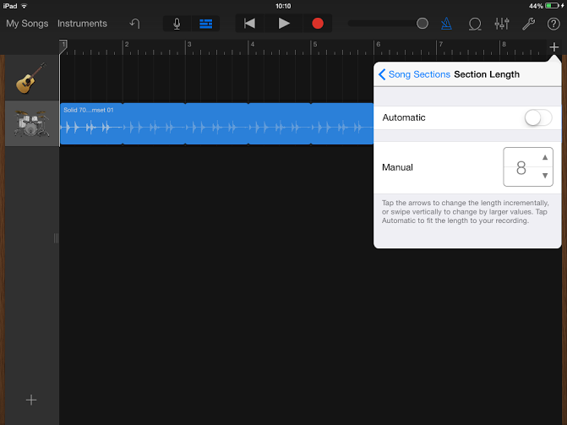
Tap on the up arrow until it gets to 30
Notes:
9. Once you’ve tapped on the + sign this box will open. We want to add more bars. Change the number 8 to 30 by tapping on the up arrow.

Slide 13

Select Instrument view
Tap on the guitar
Notes:
10. The number now says 30. Let’s start recording some guitar music. Highlight the guitar picture then click on the instrument sign for instrument view.

Slide 14

Tap on the image to change the guitar
Notes:
11. This is the guitar (instrument) view. This shows you a selection of chords we can choose the guitar to play. We are going to write a Rock piece of music.

Slide 15
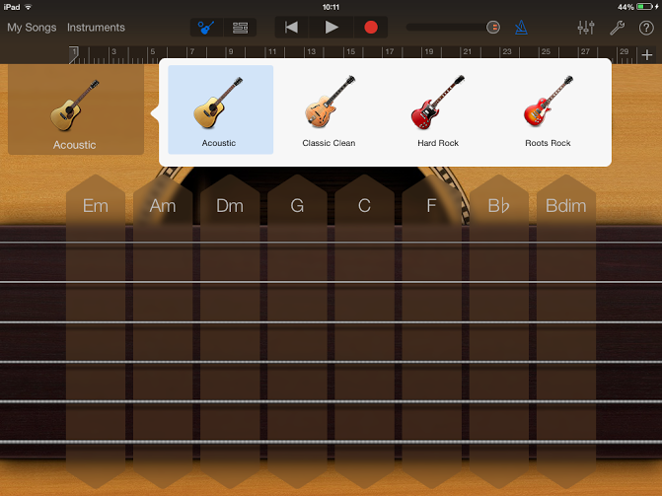
Select Hard Rock guitar
Notes:
12. Let’s change the type of guitar. Tap on the acoustic guitar and find Hard Rock guitar. Tap on Hard Rock guitar.

Slide 16
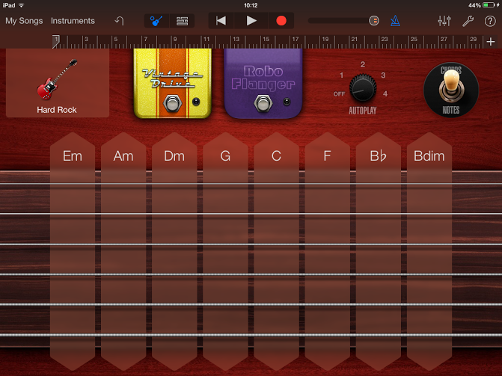
Select different strumming/picking patterns by turning this dial
Notes:
13. You’ve now opened Rock guitar. You can manually strum these chords or choose some preset strumming/picking patterns. Do this by turning the dial.

Slide 17
Press play to hear the patterns
Select pattern 4
For this song we are going to tap on G and count to 8. Followed by Em for 4 beats and then C for 4 beats. Repeat this 4 times
Notes:
14. Turn the dial to number 4. You can hear the guitar patterns by tapping on one of the chords. For this song we want to play G for 8 beats, followed by Em for 4 beats and then C for 4 beats. Repeat this 4 times.

Slide 18
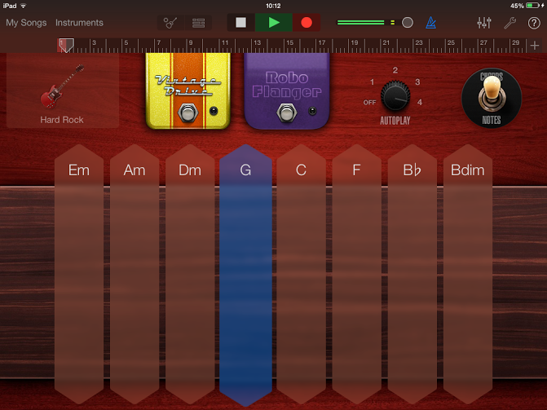
Tap Track view to see your recorded part
Tap the red circle to record. It will give you a 4 beat intro
Don’t forget – G for 8 beats, Em for 4 beats and then C for 4 beats. Do this 4 times
Notes:
15. Let’s record some guitar! To record, you have to tap on the red button at the top. Garage Band will give you 4 beats before you start playing/recording. Press G and count to 8, Em for 4, then C for 4. Do this 4 times. Press the square to stop.

Slide 19
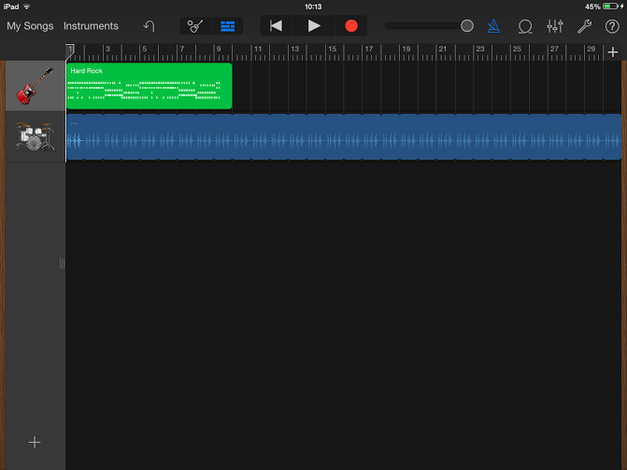
Tap on Instruments and select Bass guitar
Notes:
16. You’ve now recorded some guitar. Tap on the Track view sign to see the recorded part. Let’s add a bass guitar part now. To do this tap on Instruments.

Slide 20
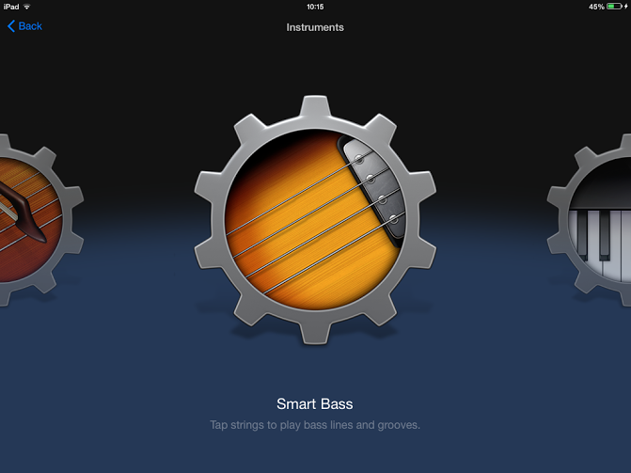
Notes:
17. Tap on Smart Bass.

Slide 21
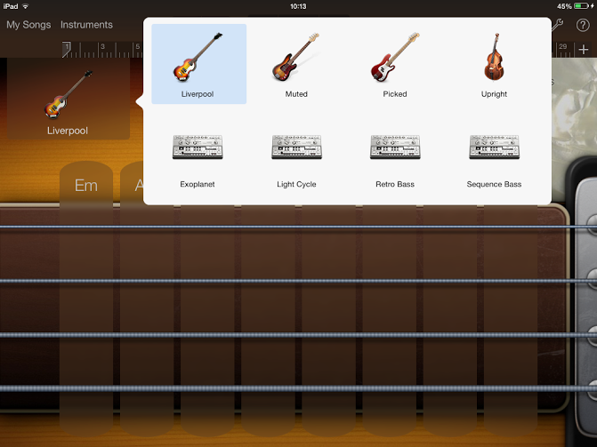
Picked bass guitar
Tap on the bass guitar picture and select Picked bass guitar
Notes:
18. You’ve now opened the Smart Bass. Change the type of bass guitar by tapping on the bass guitar picture (Liverpool). Select Picked for a more ‘rocky’ sound.

Slide 22
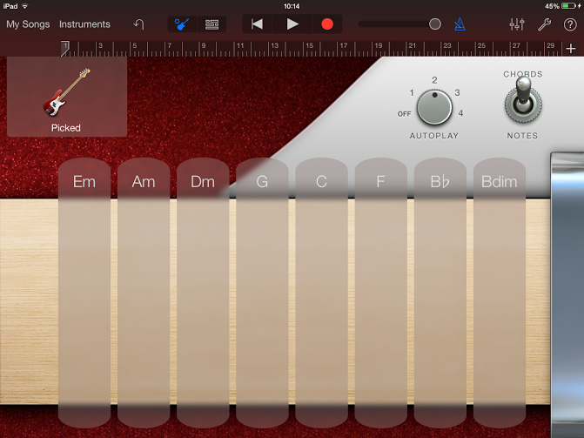
Change it from Notes to Chords
Notes:
19. It’s currently on notes (so you can manually play the strings). Change it to Chords using the switch. We can now use the pre-set patterns.

Slide 23
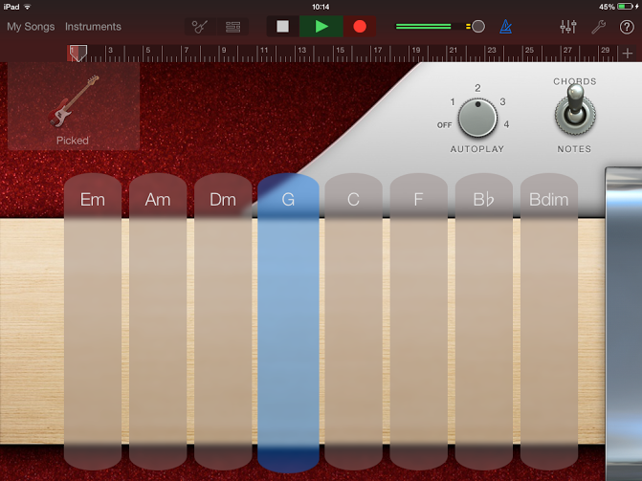
Select pattern 2
Tap Track view to see your recorded part
Tap the red button to start recording. Don’t forget the 4 beat intro
Don’t forget – G for 8 beats, Em for 4 beats and then C for 4 beats. Do this 4 times.
Notes:
20. Turn the dial to number 2. Let’s record the bass! Press record. After the 4 beat intro, just like the guitar part, press G and count to 8, Em for 4 followed by C for 4. Do this four times.

Slide 24
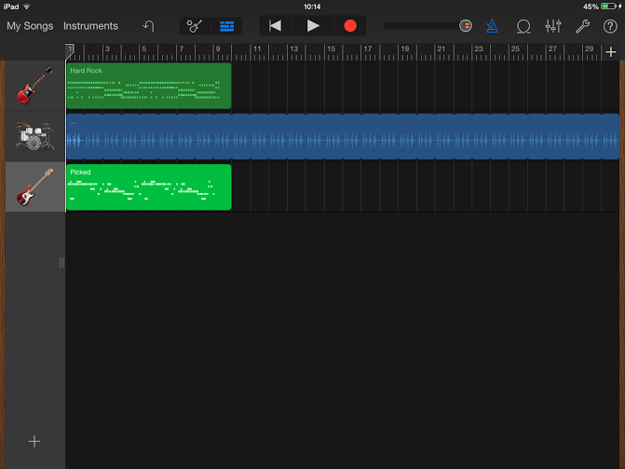
Let’s now add a keyboard part. Tap on instruments
Notes:
21. To see what you have recorded tap on the Track view button. Next, we’re going to add a keyboard part. Tap on Instruments again.

Slide 25
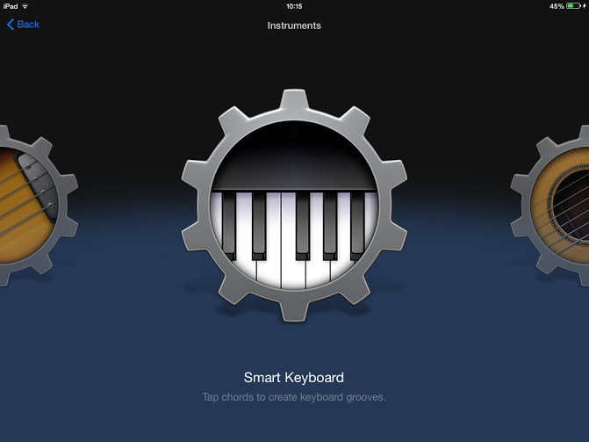
Notes:
22. Locate Smart Keyboard and tap on it.

Slide 26
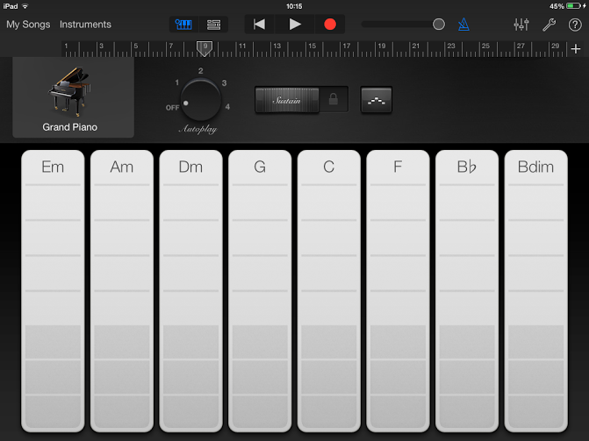
Tap on the picture and select Classic Rock Organ
Notes:
23. This is the Smart Keyboard/Piano view. Just like the guitar, we can choose to play different chords.

Slide 27
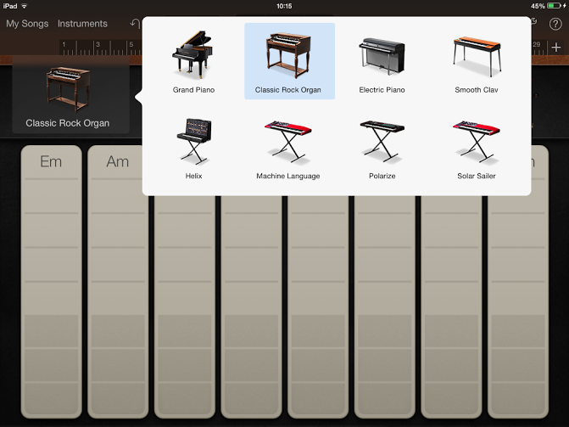
Notes:
24. Because we are going to record a Rock song we need to choose a different sounding keyboard. Select Classic Rock Organ.

Slide 28
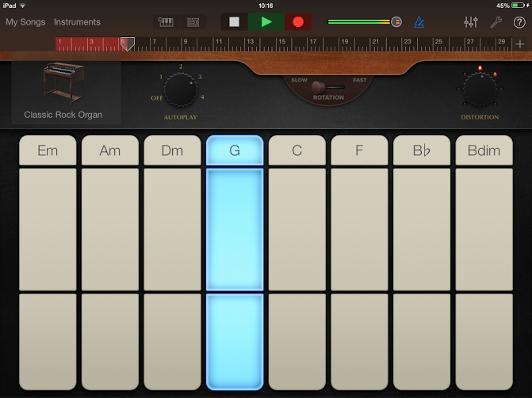
Tap on Track view to see what you’ve recorded
Select a pattern of your choice (I’ve gone for 3). Press record and follow the same chord patter. G x 8, Em x 4, C x 4. Do this 4 times.
Notes:
25. Let’s record the keyboard part! I’ve selected pattern 3. Just like the guitar parts, press record, then G and count to 8, Em for 4 followed by C for 4 beats.

Slide 29
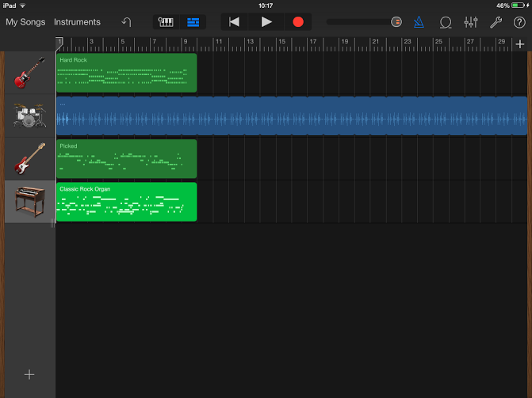
Add another guitar part. Tap on Instruments
Have a listen by tapping the play (triangle) button
Notes:
26. Press the Track view button again to see what you have recorded. If you want to listen to it press the Triangle/Play symbol. We’re now going to record a lead guitar part to finish the piece of music. Tap on Instruments once again.

Slide 30
Notes:
27. Select Smart Guitar again.

Slide 31

This time we’re going to play the guitar ourselves! Slide from Chords to Notes
Notes:
28. The guitar always opens with this view (chords). This time we are going to manually play our own guitar part. Slide the control button from Chords to Notes.

Slide 32
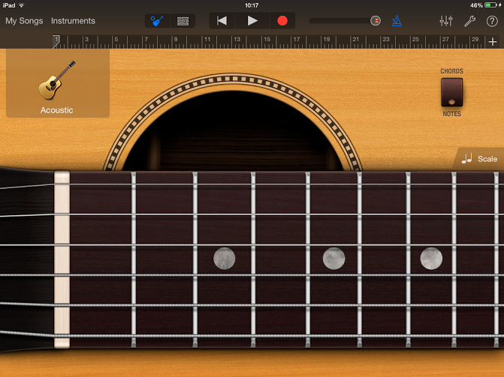
Change the guitar to Hard Rock Guitar
Notes:
29. The view has now changed to a guitar fret board. We can manually play the guitar by tapping/strumming on the strings. Before we do that let’s change it from Acoustic to Hard Rock Guitar. Tap on the guitar picture to do this.

Slide 33
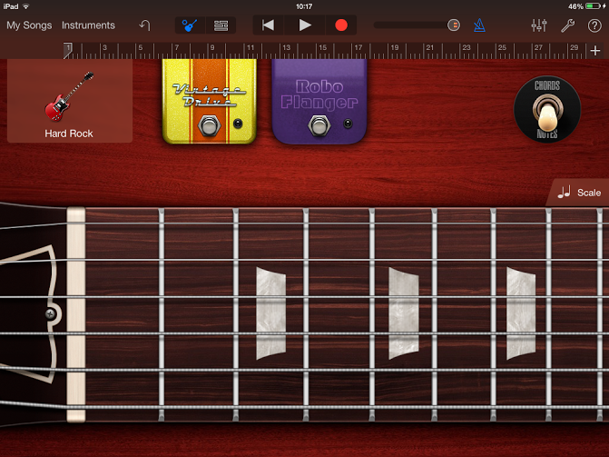
To listen to your piece tap on Track view
Press record and then create your own lead guitar part. Use the frets marked by a red dot for the best sound
Notes:
30. The last thing you are going to do is play a lead guitar part over everything you have recorded. Use the selected notes (dots) for the best sound, or make it up yourself! Press record and play. To listen back tap on the Track view button.

Slide 34
Now record your own tune!

Slide 35
How to use
Smart Strings

Slide 36
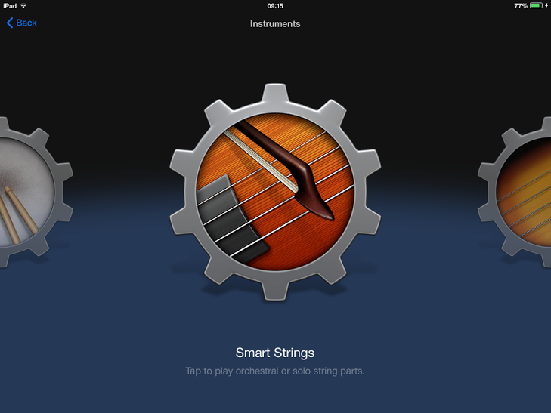

Slide 37
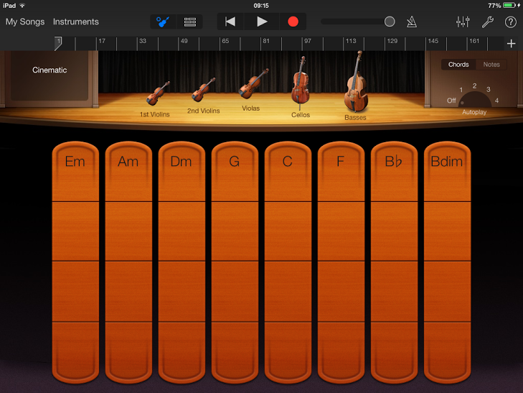
It’s currently on Chords
Select which string instruments you want
Tap on what chord you’d like to use
Select an autoplay pattern

Slide 38
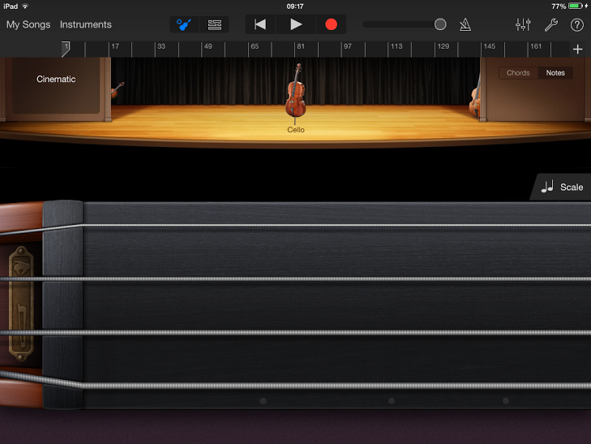
Select which string instrument to play
Select Notes to manually play the instrument yourself
Manually play the instrument by tapping on the strings

Slide 39
How to use
Smart Drums

Slide 40
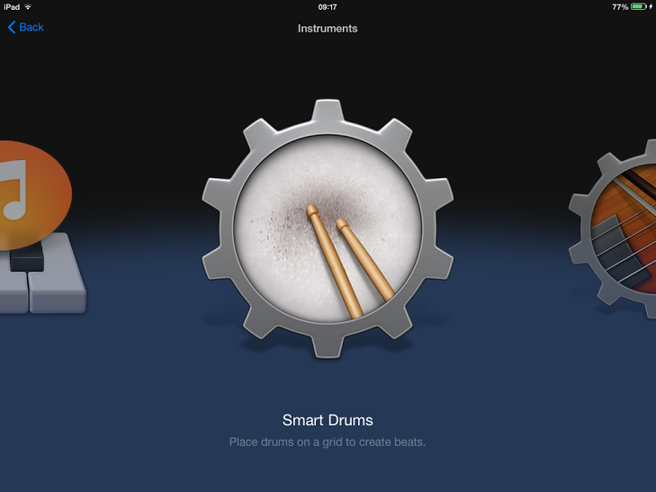

Slide 41
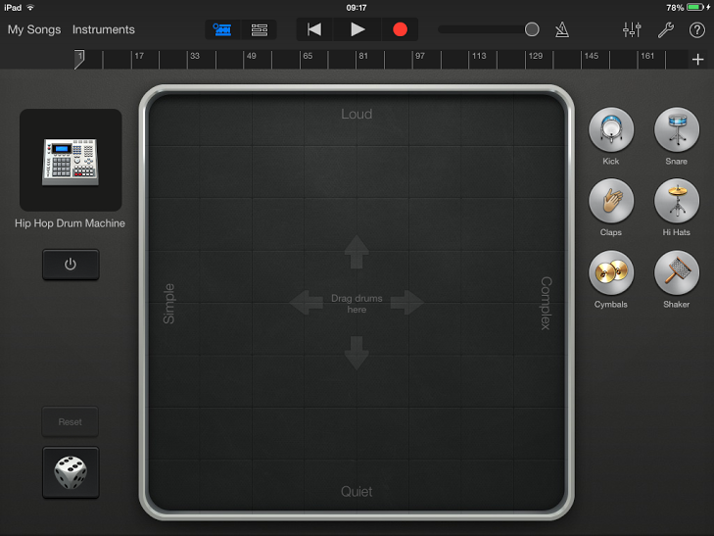
Choose a different drum kit

Slide 42
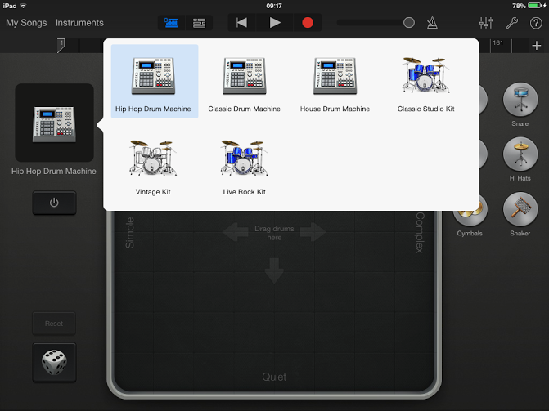

Slide 43
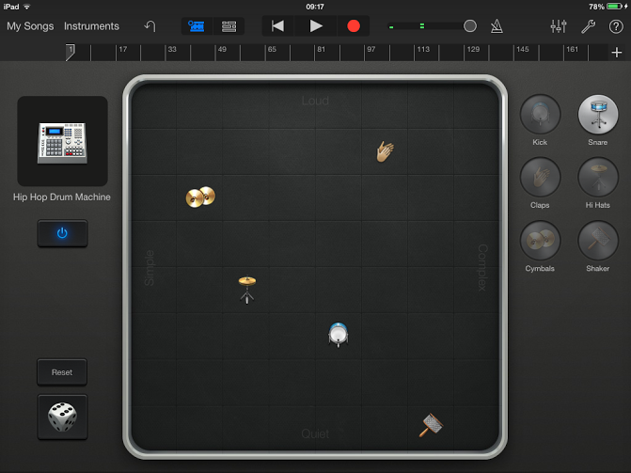
Drag an instrument onto the grid to create your on rhythm

Slide 44
How to use the
Drums

Slide 45
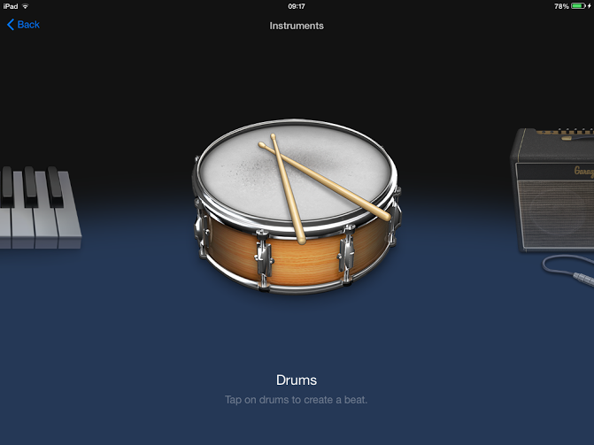

Slide 46
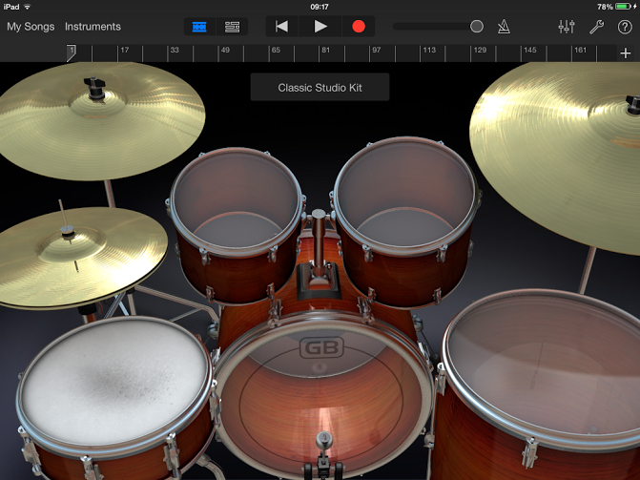
Tap on any of the drums/cymbals to make a sound

Slide 47
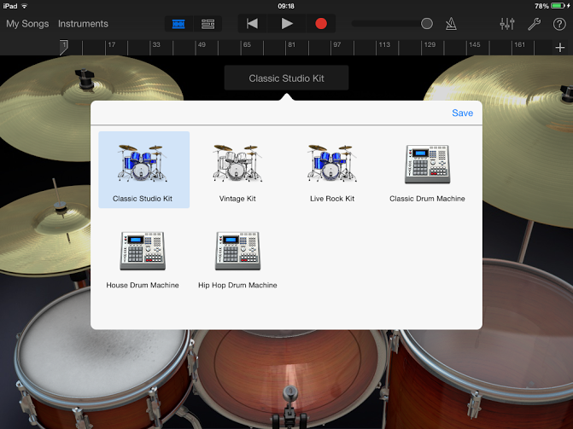

Slide 48
How to use
Audio recorder

Slide 49


Slide 50
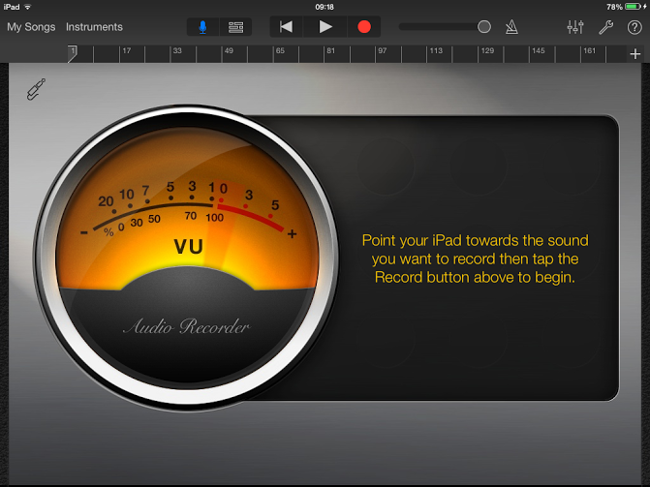

Slide 51
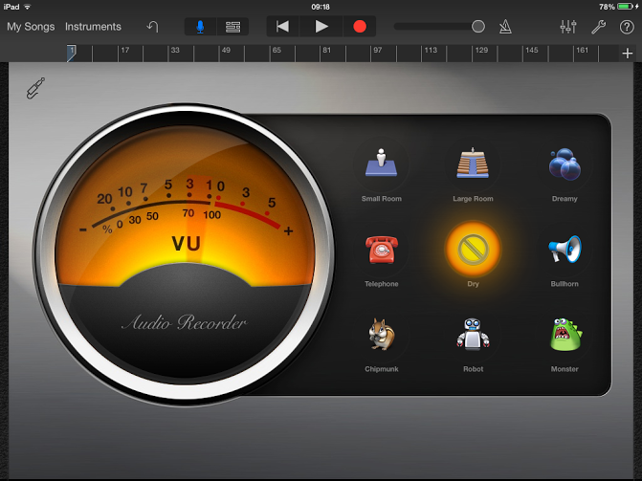
These will change the sound of your voice after you’ve recorded

Slide 52
How to copy & paste (Loop)

Slide 53
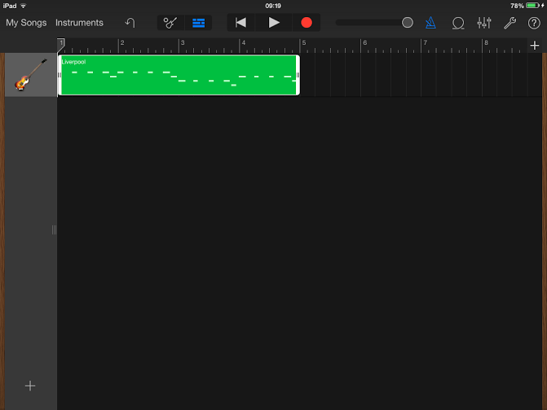
Record something! Anything!!

Slide 54

Tap on the recorded section (in green). A list of options will appear. Tap on Copy

Slide 55
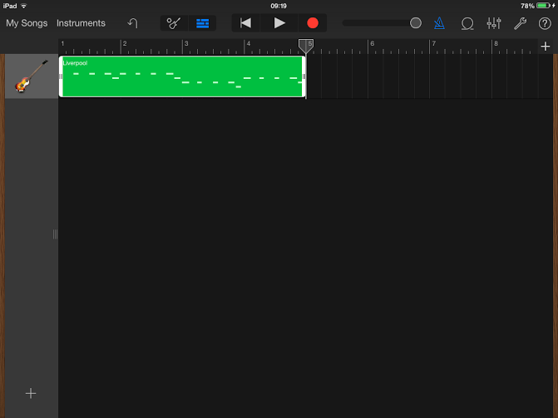
Now tap on where on the timeline you would like to paste the same recorded section.

Slide 56
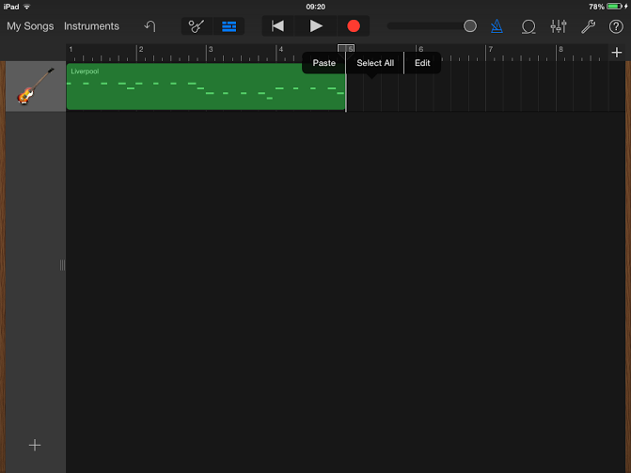
Press Paste and the recorded section will be pasted. This means you only need to record a section once and then copy it.

Slide 57
If you tap on Loop it will paste the section over and over again to the end of the timeline (looping the section). This is useful if you have the same backing music repeated throughout your composition.

Slide 58
How to use the
Sampler

Slide 59
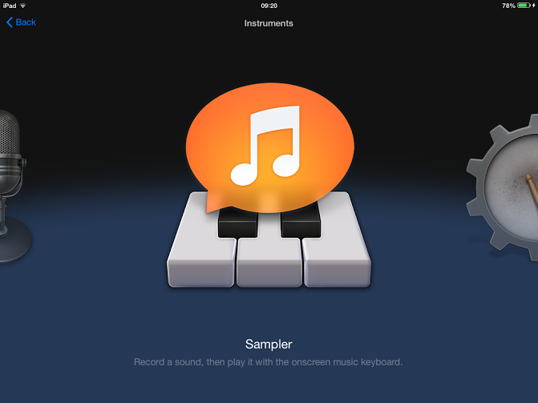

Slide 60
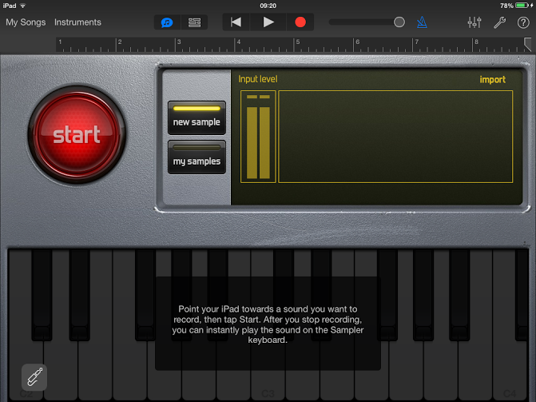
Press start to begin the recording. Make it very short! One word

Slide 61
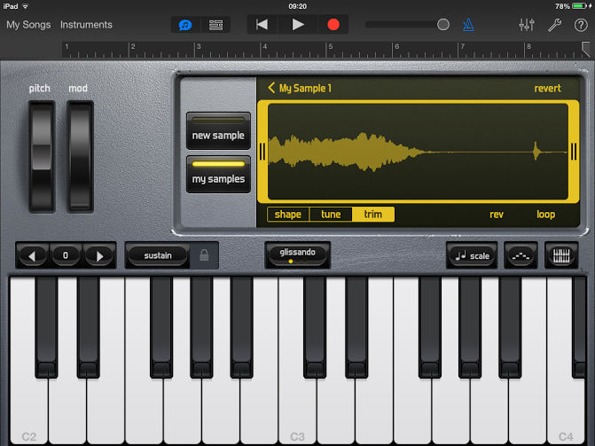
Drag this bar to the end of the sound
This is your recording

Slide 62
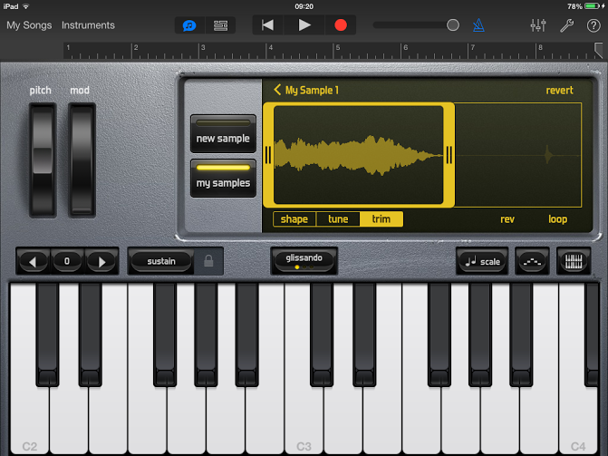
Like this!!
You can now play the keyboard using the ‘sample’ you’ve just made

Slide 63
Create your own composition

Slide 64
How to use the
Keyboard

Slide 65
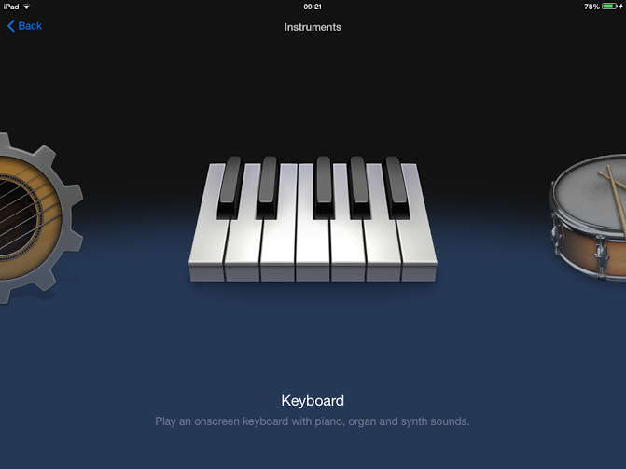

Slide 66
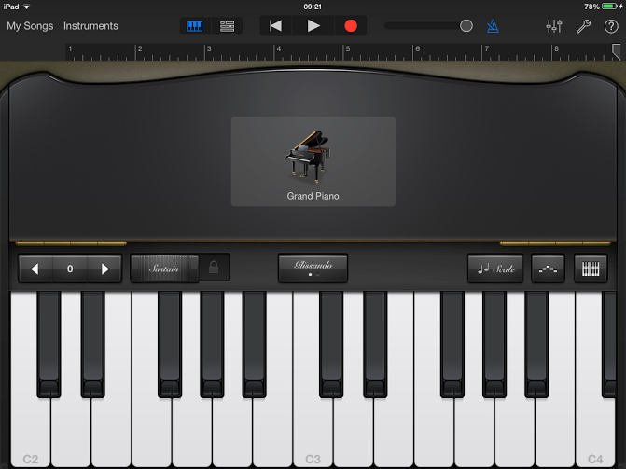
Tap here to change the type of keyboard/piano
Play this keyboard just like you would on a real keyboard/piano!

Slide 67


