Slide 1

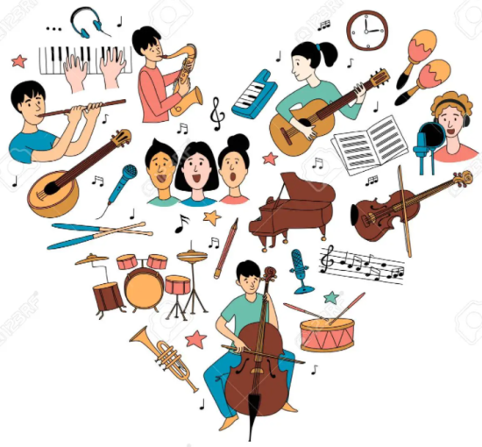


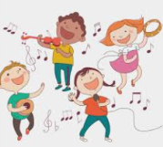

Bapchild Vision for Music
Music at Bapchild
Music is an essential part of life; integral in the development of the whole person. We believe that the opportunity to engage in musical experiences is crucial for the development of the whole child. Learning music develops all aspects of a child’s learning, from the physical action of using an instrument to the mathematical skills needed to keep a pulse. These abilities are directly transferable to other areas of the curriculum, allowing them to flourish, and will be invaluable in their future life.
At Bapchild, children actively engage in singing, playing, composing, improvising, listening and through our Music Plus programme, every child has opportunity to learn a musical instrument (other than voice.) for a year. There are also many opportunities for children to perform both in school and in the local community. Peripatetic lessons on the guitar, violin, flute and clarinet are also offered.
Our visions…
♩As music utilises both sides of the brain, it will foster connections which will improve memory and coordination.
♩Through music, children will develop confidence, communication, thinking and creative skills and improve their emotional well-being.
♫The skills involved in playing and listening to music will also help learners develop the self-esteem, self-discipline, cooperation, creativity, and self-motivation necessary for success.
♫ Children will find that music is enjoyable and relaxing which will help reduce stress. All children will be able to experience a sense of achievement and pride.
Above all, it is our vision that every child adopts an understanding and love of music which they can carry with them for the rest of their lives.

