Slide 1

Home Learning
Year R
Term 6 Week 7

Slide 2

Message from Mrs Coffey
Hi Everyone,
I hope you enjoyed last week’s learning about Mrs Armitage’s special bike.
This week we are continuing thinking about journeys but the journey of a Naughty Bus. In Maths we are recapping on 2D and 3D shapes and in Phonics including words with four sounds in our sentences words.
I always enjoy reading your comments and seeing your lovely photos and videos so keep them coming. They make me smile and brighten the day! As usual if you have any questions then I am contactable via Tapestry or the school office.
Have fun.
Mrs. Coffey

Slide 3
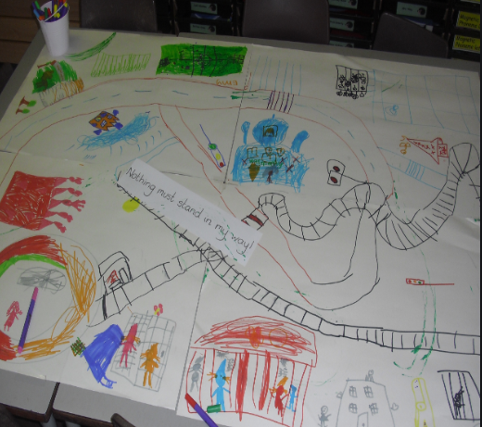
English Learning
Task 1
We are going to be continuing thinking about journeys this week in particular that of the naughty bus.
Watch the story of The Naughty Bus on the link below:
https://www.youtube.com/watch?v=sqQ1BAEj1oE
Which is your favourite thing that the bus does? Can you explain why?
Can you draw out your own picture plan of the story then use a toy bus to retell the story?

Slide 4

English Learning
Task 2
Listen to the song of the journey of the Naughty Bus on the link below:
https://www.youtube.com/watch?v=jwYU3aQ3tHc
Can you join in and add some actions?

Slide 5


English Learning
Task 3
Pick three words from the list below and write me an interesting sentence with each of your chosen words in. Don’t forget capital letters and full stops.

Slide 6
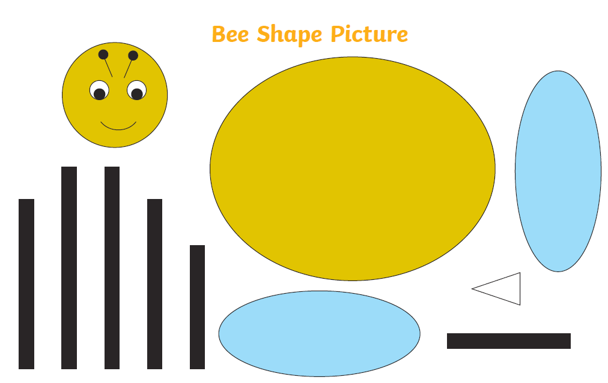
Maths Learning
This week we are recapping 2D and 3D shapes.
Task 1 – Name the 2D shapes then cut and make your own bee.

Slide 7
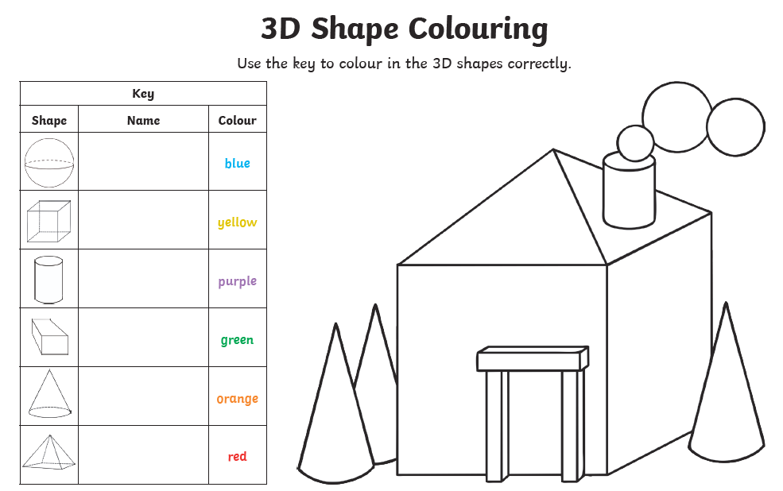
Maths Learning
Task 2

Slide 8
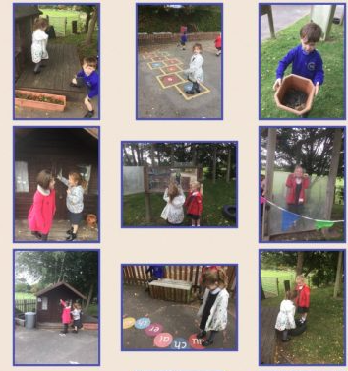
Maths Learning
Task 3
Go on your own shape hunt outside. Can you name the shapes you find?

Slide 9
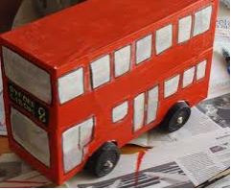
Topic
Task 1
Make your own naughty bus however you would like.

Slide 10
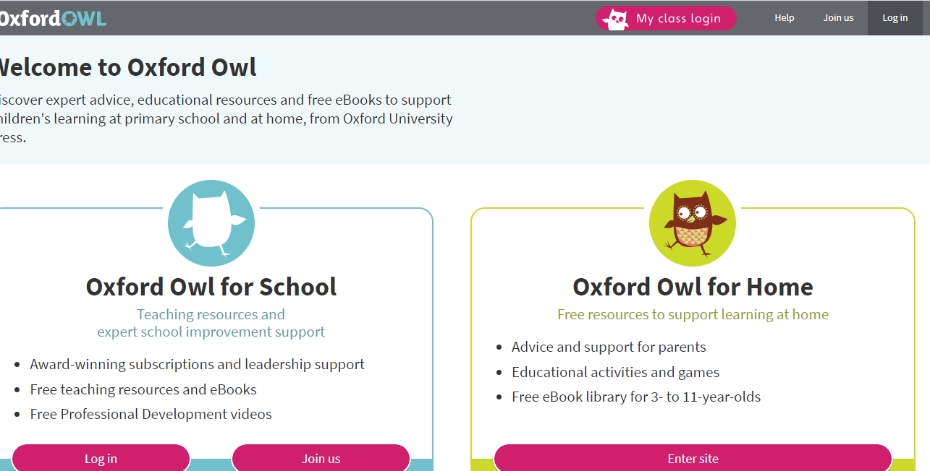
Reading
A good site to use for reading is Oxford Owl, which is free. Please visit - https://www.oxfordowl.co.uk/

Slide 11

Reading
Another useful site for reading is Renaissance myON. This is a good source for books you can read to the children or provide information books that follow their interests. Please visit - http://readon.myon.co.uk

Slide 12

Reading
Choose an area that interests you or use the search option
Please continue sharing books together. Talking about the content and the characters in the books and making predictions about what might happen as you read.

Slide 13

Phonics
Continue using your Orange sound book and Blue tricky word book to practice the sounds and words.
Phonics play https://new.phonicsplay.co.uk/ is a great site for reinforcing our phonics learning. It is free use at the moment.
We have covered all of phase 2 and most of phase 3 and there are lots of fun interactive games to play.

Slide 14

Maths – White Rose Home Leaning
In school we follow the White Rose scheme of learning. Their website has put together free lessons and resources that link to the learning taking place in school. Please visit: https://whiterosemaths.com/homelearning/early-years/
Look out for EYFS pack.

Slide 15

Accessing Twinkl
Many educational content providers are offering free access to their resources. Twinkl is a website that we use from time to time to resource our lessons to aid in teacher input and pupil activities.
We will be able to direct you towards activities and learning via this website based on lessons that may be missed due to absence. To access Twinkl please visit: www.twinkl.co.uk/offer
You will have to sign up and put in the offer code: UKTWINKLHELPS
Search EYFS

Slide 16

P.E.
It is important to keep your children active. If it is safe to do so, ensure they have some time outside throughout the day. Please visit Joe Wicks YouTube channel (https://www.youtube.com/channel/UCAxW1XT0iEJo0TYlRfn6rYQ), which has lots of exercise videos for children. He will also be hosting a live P.E. lessons Monday to Friday at 9:00am.

Slide 17

Classroom Secrets
The site classroom secrets https://classroomsecrets.co.uk/free-home-learning-packs/ has free Reception (EYFS) packs which provide some great additional ideas and resources you can use.

