Slide 1

Home Learning
Year R
Term 6 Week 6

Slide 2
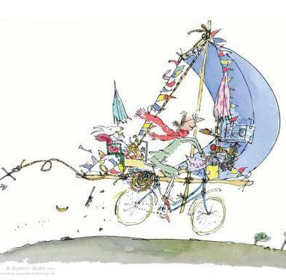
Message from Mrs Coffey
Hi Everyone,
I hope you enjoyed last week’s learning about animals taking different types of transport and the problems they might come across.
This week we are continuing thinking about journeys but in particular a bike with a difference. In Maths we are looking at capacity and in Phonics continuing reading and writing words with four sounds as well as recapping those Phase 3 digraphs.
I always enjoy reading your comments and seeing your lovely photos and videos so keep them coming. They make me smile and brighten the day! As usual if you have any questions then I am contactable via Tapestry or the school office.
Have fun.
Mrs. Coffey

Slide 3
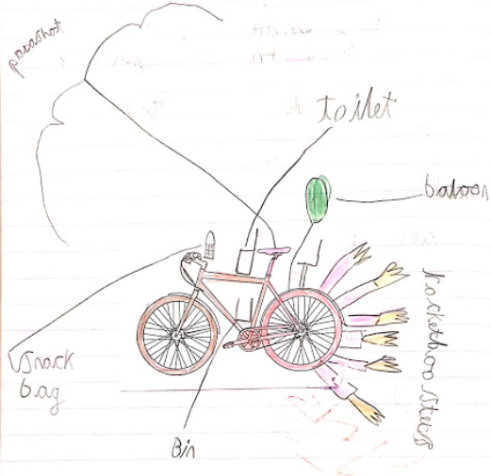
English Learning
Task 1
We are going to be continuing thinking about journeys this week but in particular a bike with some special additions.
Watch the story of Mrs Armitage on Wheels on the link below:
https://www.youtube.com/watch?v=BL_JIl9V16s
Which is your favourite change to her bike? Can you explain why?
I would like you to draw and label you own bike with a difference like Mrs Armitage. Remember is can have anything you like added to it. Be creative.

Slide 4
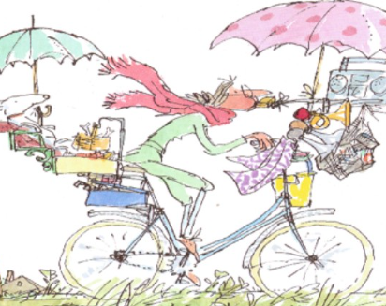
English Learning
Task 2
Can draw me a picture of where you would go on your newly created bike and tell me why you would take it there and what you would do there?

Slide 5
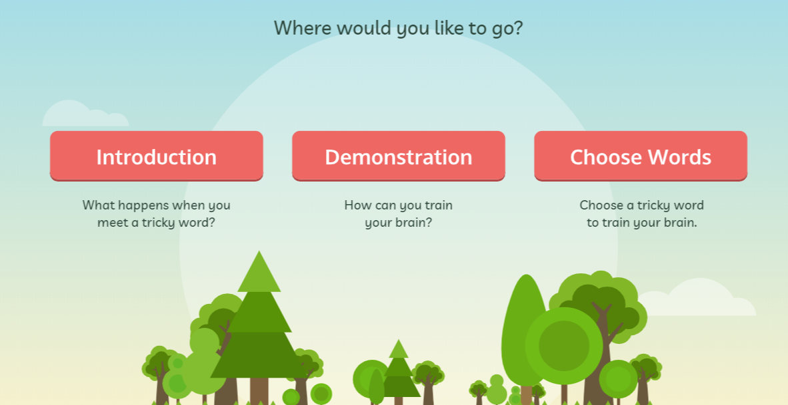
English Learning
Task 3
This week we are going to be continuing our learning of tricky words by learning four more:
were
there
little
one
I would like you to practise reading and writing them. Can you put them in a sentence? I have also included a game on tricky word bingo for you to play.
The link below provides a helpful way of teaching these to your child.
https://www.phonicsplay.co.uk/resources/phase/4/train-your-brain-ph4
Then go into ‘Choose Words’ and choose this week’s tricky words.

Slide 6
Tricky word bingo
little | you | one | all | have
they | come | there | some | were
are | said | her | like | so

Slide 7
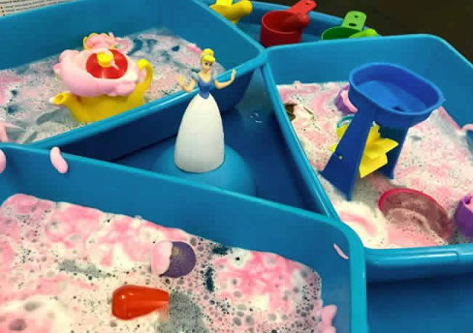
Maths Learning
This week we are learning capacity.
Task 1
Choose four containers and explore filling them full, half full, nearly empty and empty with water.

Slide 8
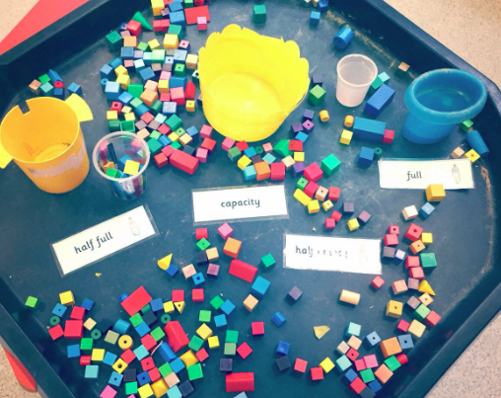
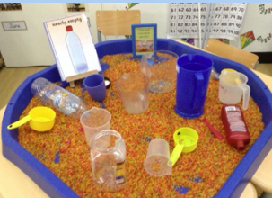
Maths Learning
Task 2
Choose four containers and explore filling them full, half full, nearly empty and empty with something other than water.

Slide 9
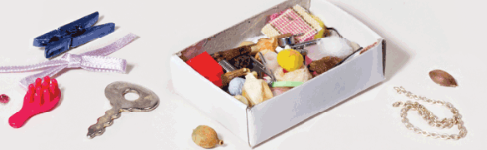
Maths Learning
Task 3
Find a small container like a matchbox and investigate how many items you can fit inside.

Slide 10
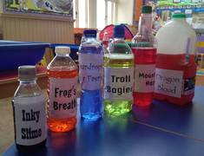
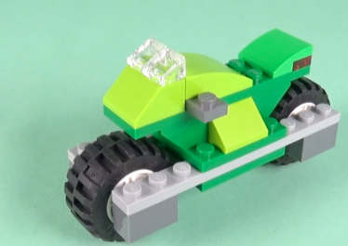
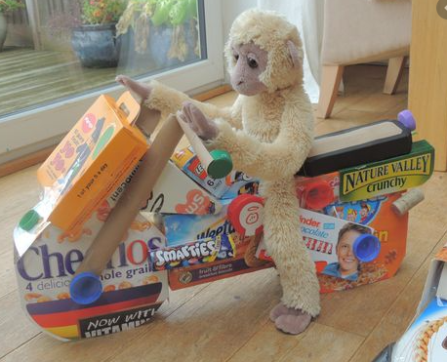
Topic
Task 1
Design and make you own bike out of any material you would like.
Task 2
Create your own potions lab.

Slide 11

Reading
A good site to use for reading is Oxford Owl, which is free. Please visit - https://www.oxfordowl.co.uk/

Slide 12

Reading
Another useful site for reading is Renaissance myON. This is a good source for books you can read to the children or provide information books that follow their interests. Please visit - http://readon.myon.co.uk

Slide 13

Reading
Choose an area that interests you or use the search option
Please continue sharing books together. Talking about the content and the characters in the books and making predictions about what might happen as you read.

Slide 14

Phonics
Continue using your Orange sound book and Blue tricky word book to practice the sounds and words.
Phonics play https://new.phonicsplay.co.uk/ is a great site for reinforcing our phonics learning. It is free use at the moment.
We have covered all of phase 2 and most of phase 3 and there are lots of fun interactive games to play.

Slide 15

Maths – White Rose Home Leaning
In school we follow the White Rose scheme of learning. Their website has put together free lessons and resources that link to the learning taking place in school. Please visit: https://whiterosemaths.com/homelearning/early-years/
Look out for EYFS pack.

Slide 16

Accessing Twinkl
Many educational content providers are offering free access to their resources. Twinkl is a website that we use from time to time to resource our lessons to aid in teacher input and pupil activities.
We will be able to direct you towards activities and learning via this website based on lessons that may be missed due to absence. To access Twinkl please visit: www.twinkl.co.uk/offer
You will have to sign up and put in the offer code: UKTWINKLHELPS
Search EYFS

Slide 17

P.E.
It is important to keep your children active. If it is safe to do so, ensure they have some time outside throughout the day. Please visit Joe Wicks YouTube channel (https://www.youtube.com/channel/UCAxW1XT0iEJo0TYlRfn6rYQ), which has lots of exercise videos for children. He will also be hosting a live P.E. lessons Monday to Friday at 9:00am.

Slide 18

Classroom Secrets
The site classroom secrets https://classroomsecrets.co.uk/free-home-learning-packs/ has free Reception (EYFS) packs which provide some great additional ideas and resources you can use.

