Slide 1

Home Learning
Year R
Term 6 Week 5

Slide 2
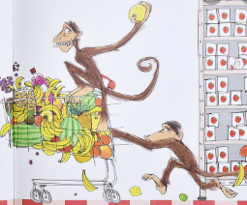
Message from Mrs Coffey
Hi Everyone,
I hope you enjoyed learning about another country and found out some interesting facts last week.
This week we are continuing thinking about journeys but a little differently with animals travelling on different types of vehicles and how this would not work. In Maths we are looking at weight and in Phonics continuing reading and writing words with four sounds as well as two more tricky words.
I always enjoy reading your comments and seeing your lovely photos and videos so keep them coming. They make me smile and brighten the day! As usual if you have any questions then I am contactable via Tapestry or the school office.
Have fun.
Mrs. Coffey

Slide 3
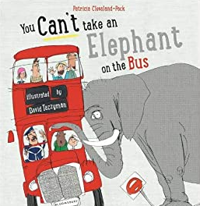
English Learning
Task 1
We are going to be continuing thinking about journeys this week but with a bit of a difference and a little bit silly.
Watch the story of You Can’t Take an Elephant on a Bus on the link below:
https://www.youtube.com/watch?v=fYsNRjObvu4
Which is your favourite animal on which transport? Can you explain why?
I would like you to choose an animal and think of a silly way for it to travel. Don’t forget the because and to add a reason for why they can’t do it?

Slide 4
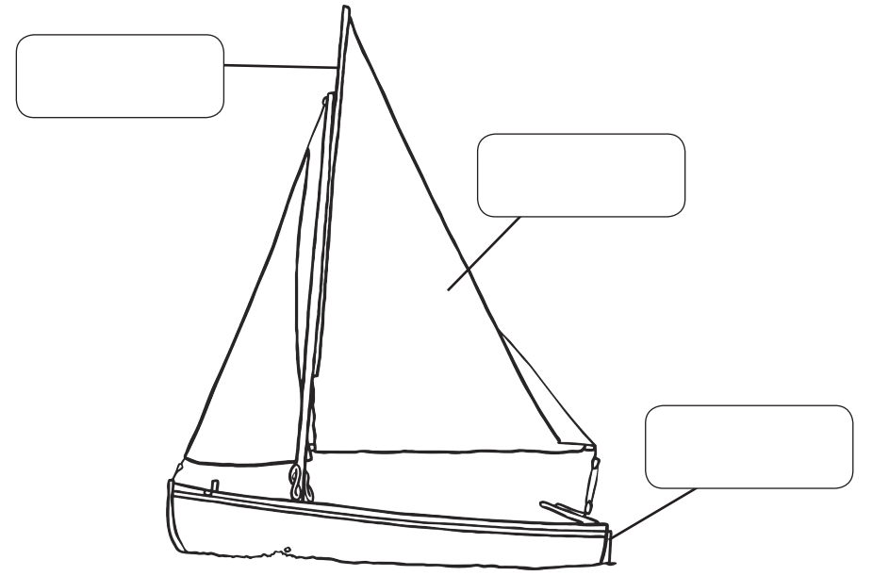
English Learning
Task 2
Can draw or paint me a picture of your favourite type of vehicle? Can you label it’s features and tell me why you like it?

Slide 5
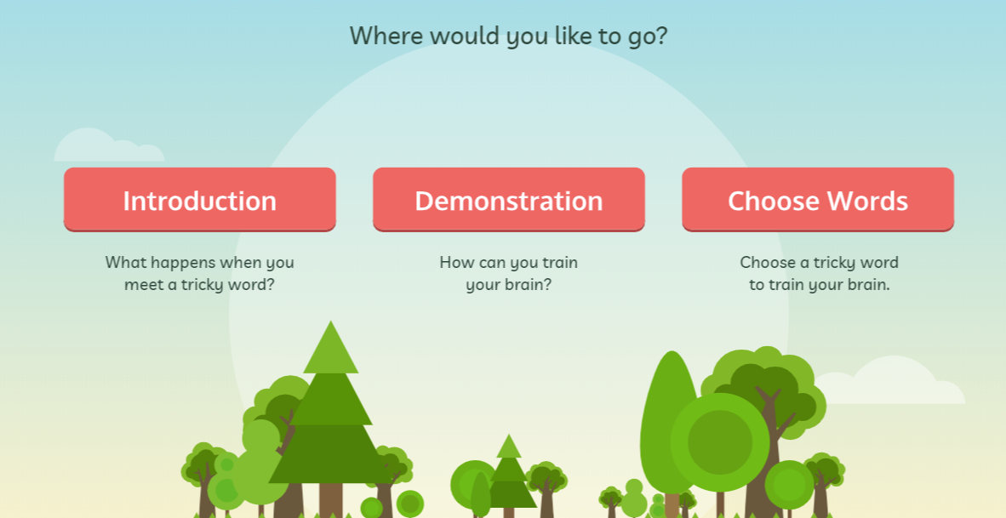
English Learning
Task 3
This week we are going to be continuing our learning of tricky words by learning two more:
some
come
I would like you to practise reading and writing them. Can you put them in a sentence? I have also included a game on tricky word bingo for you to play.
The link below provides a helpful way of teaching these to your child.
https://www.phonicsplay.co.uk/resources/phase/4/train-your-brain-ph4
Then go into ‘Choose Words’ and choose this week’s tricky words.

Slide 6
Tricky word bingo
she | you | was | all | have
they | come | my | some | put
are | said | her | like | so

Slide 7
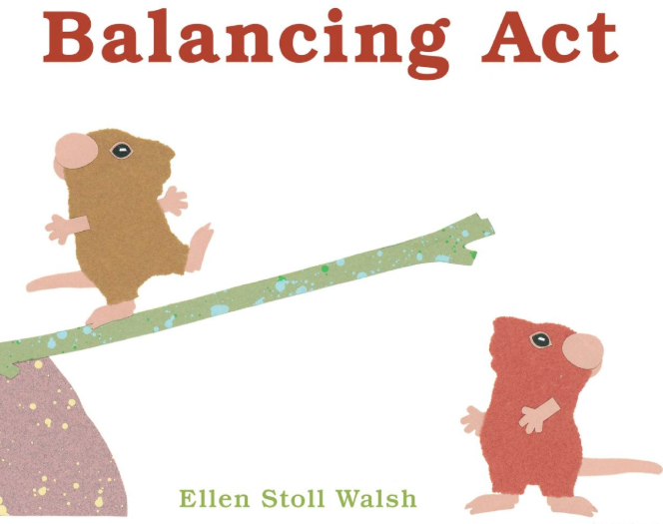
Maths Learning
This week we are learning weight.
Task 1
Please use the link to the book ‘Balancing Act’ to recap some of the familiar vocabulary related to this topic.
https://www.youtube.com/watch?v=Lm8Pg5iwJL4
Can you make your own balancing scales like in the clip and test it out with your toys?

Slide 8
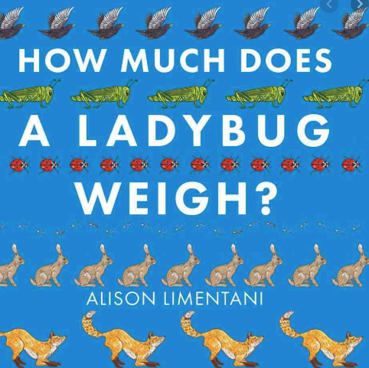
Maths Learning
Task 2
Please use the link to the book ‘How Much Does a Ladybird Weigh’.
https://www.youtube.com/watch?v=bhEtwYh1Hw8
Explore the mathematical vocabulary of heavier and lighter using weighing scales or balancing scales from Task 1.

Slide 9

Maths Learning
Task 3
Please use the link to the book ‘Who sank the Boat’.
https://www.youtube.com/watch?v=ZpFWuHSDFtQ
Explore how you can overfill a container/boat so that it sinks. Why does this happen?

Slide 10
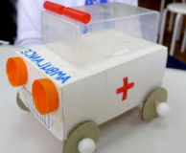
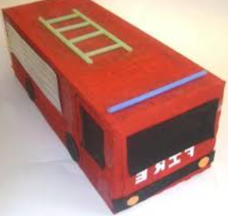
Topic
This week we have thinking about weight as well as animals travelling on different types of transport and the silly reasons why this would not work. You might like to try out one of these tasks connected to this week’s learning.
Role play a Post Office. Can you make you own parcels and compare to see which are heavier and lighter?
Can you build me a vehicle that an animal from the story could travel on?
On plates put brightly colour paint and a range of wheeled transport toys. Children dip the wheels into the paint and run them across sheets of paper.
Collect together transport toys, e.g. car, train, boat, bicycle, taxis, motorbike. Identify them. Discuss specialised forms of transport, e.g. ambulance, lifeboat, mobility scooter. Generate different criteria to group the collection of vehicles. Consider reasons for travelling in each.

Slide 11
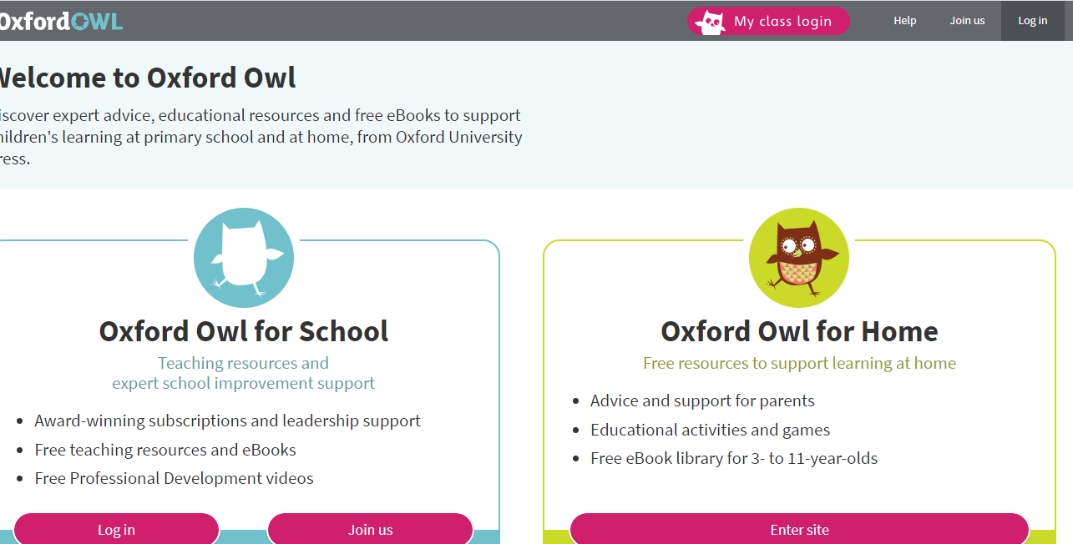
Reading
A good site to use for reading is Oxford Owl, which is free. Please visit - https://www.oxfordowl.co.uk/

Slide 12

Reading
Another useful site for reading is Renaissance myON. This is a good source for books you can read to the children or provide information books that follow their interests. Please visit - http://readon.myon.co.uk

Slide 13

Reading
Choose an area that interests you or use the search option
Please continue sharing books together. Talking about the content and the characters in the books and making predictions about what might happen as you read.

Slide 14

Phonics
Continue using your Orange sound book and Blue tricky word book to practice the sounds and words.
Phonics play https://new.phonicsplay.co.uk/ is a great site for reinforcing our phonics learning. It is free use at the moment.
We have covered all of phase 2 and most of phase 3 and there are lots of fun interactive games to play.

Slide 15

Maths – White Rose Home Leaning
In school we follow the White Rose scheme of learning. Their website has put together free lessons and resources that link to the learning taking place in school. Please visit: https://whiterosemaths.com/homelearning/early-years/
Look out for EYFS pack.

Slide 16

Accessing Twinkl
Many educational content providers are offering free access to their resources. Twinkl is a website that we use from time to time to resource our lessons to aid in teacher input and pupil activities.
We will be able to direct you towards activities and learning via this website based on lessons that may be missed due to absence. To access Twinkl please visit: www.twinkl.co.uk/offer
You will have to sign up and put in the offer code: UKTWINKLHELPS
Search EYFS

Slide 17

P.E.
It is important to keep your children active. If it is safe to do so, ensure they have some time outside throughout the day. Please visit Joe Wicks YouTube channel (https://www.youtube.com/channel/UCAxW1XT0iEJo0TYlRfn6rYQ), which has lots of exercise videos for children. He will also be hosting a live P.E. lessons Monday to Friday at 9:00am.

Slide 18

Classroom Secrets
The site classroom secrets https://classroomsecrets.co.uk/free-home-learning-packs/ has free Reception (EYFS) packs which provide some great additional ideas and resources you can use.

