Slide 1

Home Learning
Year R
Term 6 Week 4

Slide 2
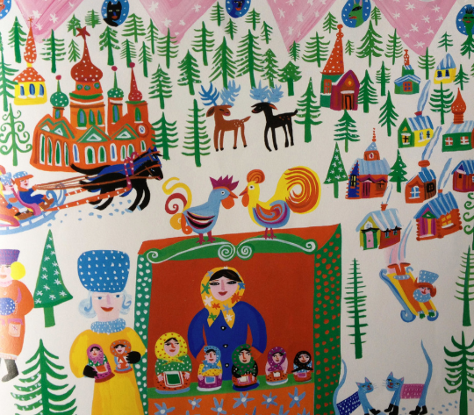
Message from Mrs Coffey
Hi Everyone,
I hope you enjoyed learning about Granny’s magic carpet ride last week.
This week we are continuing with looking at Granny’s journey but focusing on the places she went and the things she bought. In Maths we are looking at length, height and distance and in Phonics continuing reading and writing words with four sounds.
I always enjoy reading your comments and seeing your lovely photos and videos so keep them coming. They make me smile and brighten the day! As usual if you have any questions then I am contactable via Tapestry or the school office.
Have fun.
Mrs. Coffey

Slide 3
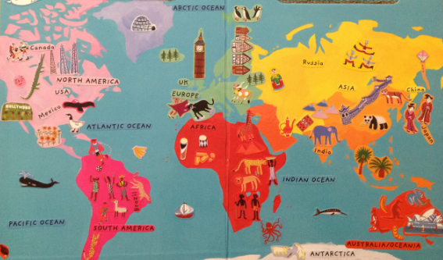
English Learning
Task 1
This week we are going to be continuing thinking about journeys but we are going to think about the places Granny visited in our story last week.
Can you remember any of the places she visited and what she bought?
The story retelling link is here if you need a reminder –
https://www.youtube.com/watch?v=8tEh_yG_k44
Which country is your favourite?
Can you explain why?
I would like you to choose one of the countries from the story to research with the help of a grown up.
What is the weather like?
What types of food is the country famous for?
Are there any animals found there that we won’t find in the U.K.?
Can you tell me an interesting fact about the country?

Slide 4
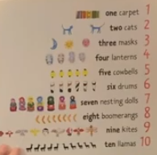
English Learning
Task 2
Can you write me a list and draw me some pictures of the objects Granny buys in each country. Which is your favourite object and why?

Slide 5
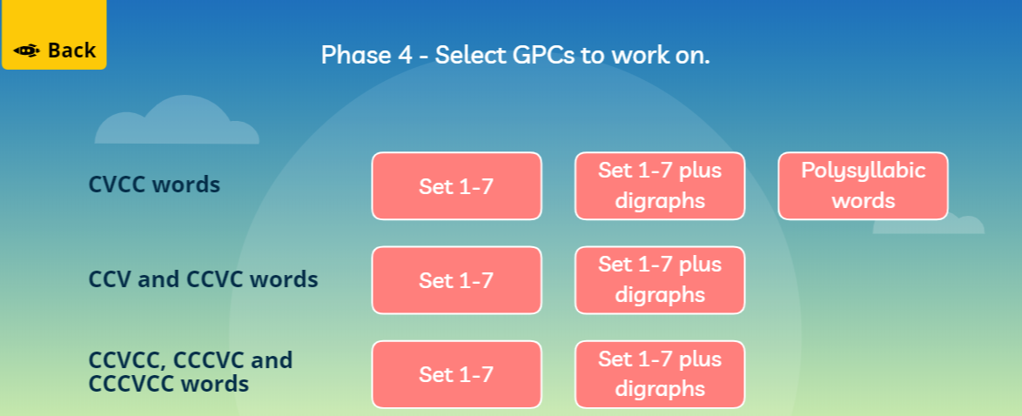
English Learning
Task 3
This week we are going to continue with our learning to read words with four sounds by playing the game Buried Treasure on Phonics Play. Please use this link https://new.phonicsplay.co.uk/resources/phase/2/buried-treasure then press the start button and it will take you to the different phases. Click on Phase 4 and you will then see the page below. Please pick the CVCC words option, Set 1-7 plus digraphs.
Please continue practising your child’s sounds as well as their tricky words.
These links below provide some fun songs to do this.
Phase 3 Digraphs
https://www.youtube.com/watch?v=aNcBWSBxSp0
Tricky words
https://www.youtube.com/watch?v=TvMyssfAUx0
https://www.youtube.com/watch?v=R087lYrRpgY

Slide 6

Maths Learning
This week we are learning about length, height and distance.
Task 1
Please use the link to the book Titch to recap some of the familiar vocabulary related to this topic.
https://www.youtube.com/watch?v=Lm8Pg5iwJL4
Can you compare your toys, yourselves or plants in the garden by length and height?

Slide 7
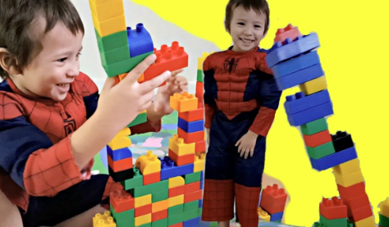
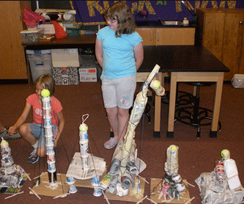
Maths Learning
Task 2
Can you build towers the same height as yourselves?
How tall is the tallest tower you can build?
Can you build a short tower?

Slide 8
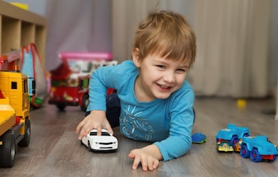
Maths Learning
Task 3
Test out how far you can push a toy car? How could you measure the distance? Does the type of car you use change your results?

Slide 9


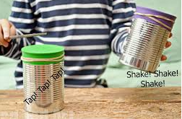
Topic
This week we have been thinking about the places Granny visits and the things she buys. Here are some ideas you might like to explore.
Can you decorate your own boomerang?
Can you make your own drum to play?
Can you write a shopping list and roleplay buying the objects in a shop?
Can you make a traditional recipe from one of the countries Granny visited?
Can you make your own kite to fly like Granny?

Slide 10

Reading
A good site to use for reading is Oxford Owl, which is free. Please visit - https://www.oxfordowl.co.uk/

Slide 11

Reading
Another useful site for reading is Renaissance myON. This is a good source for books you can read to the children or provide information books that follow their interests. Please visit - http://readon.myon.co.uk

Slide 12

Reading
Choose an area that interests you or use the search option
Please continue sharing books together. Talking about the content and the characters in the books and making predictions about what might happen as you read.

Slide 13

Phonics
Continue using your Orange sound book and Blue tricky word book to practice the sounds and words.
Phonics play https://new.phonicsplay.co.uk/ is a great site for reinforcing our phonics learning. It is free use at the moment.
We have covered all of phase 2 and most of phase 3 and there are lots of fun interactive games to play.

Slide 14

Maths – White Rose Home Leaning
In school we follow the White Rose scheme of learning. Their website has put together free lessons and resources that link to the learning taking place in school. Please visit: https://whiterosemaths.com/homelearning/early-years/
Look out for EYFS pack.

Slide 15

Accessing Twinkl
Many educational content providers are offering free access to their resources. Twinkl is a website that we use from time to time to resource our lessons to aid in teacher input and pupil activities.
We will be able to direct you towards activities and learning via this website based on lessons that may be missed due to absence. To access Twinkl please visit: www.twinkl.co.uk/offer
You will have to sign up and put in the offer code: UKTWINKLHELPS
Search EYFS

Slide 16

P.E.
It is important to keep your children active. If it is safe to do so, ensure they have some time outside throughout the day. Please visit Joe Wicks YouTube channel (https://www.youtube.com/channel/UCAxW1XT0iEJo0TYlRfn6rYQ), which has lots of exercise videos for children. He will also be hosting a live P.E. lessons Monday to Friday at 9:00am.

Slide 17

Classroom Secrets
The site classroom secrets https://classroomsecrets.co.uk/free-home-learning-packs/ has free Reception (EYFS) packs which provide some great additional ideas and resources you can use.

