Slide 1

Home Learning
Year R
Term 6 Week 3

Slide 2

Message from Mrs Coffey
Hi Everyone,
I hope you enjoyed learning about the adventures of a superhero vegetable.
This week we are starting our new theme of journeys. In Maths we are looking at odd and even numbers and in Phonics learning a couple more tricky words alongside reading words with four sounds.
I always enjoy reading your comments and seeing your lovely photos and videos so keep them coming. They make me smile and brighten the day! As usual if you have any questions then I am contactable via Tapestry or the school office.
Have fun.
Mrs. Coffey

Slide 3

English Learning
Task 1
This week we are going to be learning about a journey with a difference, travelling on a magic carpet.
Can you think of ways we can travel? Which way of travelling do you use the most? Which is your favourite?
Watch this retelling of the story –
https://www.youtube.com/watch?v=8tEh_yG_k44
What is your favourite country she visits?
What is your favourite thing she buys on her travels?
Where would you fly on a magic carpet?
I would like you to design your own magic carpet and then write me a sentence or two about where you would go on your magic carpet journey. Don’t forget school writing, capital letters and full stops. Think about using describing words to describe where you go and a joining word to add ideas or explain your choice of place.

Slide 4
English Learning
Task 2
This week we are going to continue with our learning to read words with four sounds. Remember we do this in the same way as we read a three sound word and that is to break the word into it’s sounds, it just has 1 more. Some of your children may have no trouble with this others may need a little bit more practice.
On the next slide I had included a match the word to the correct picture task. If your child is finding this too easy I have included on the slide after some sentences for you to have a go at reading and matching to the correct picture.

Slide 5
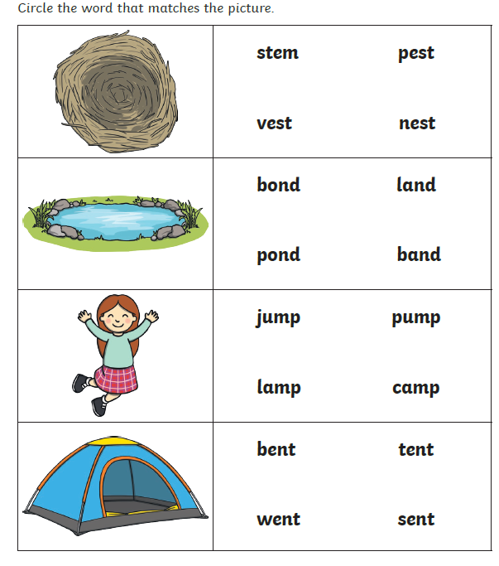
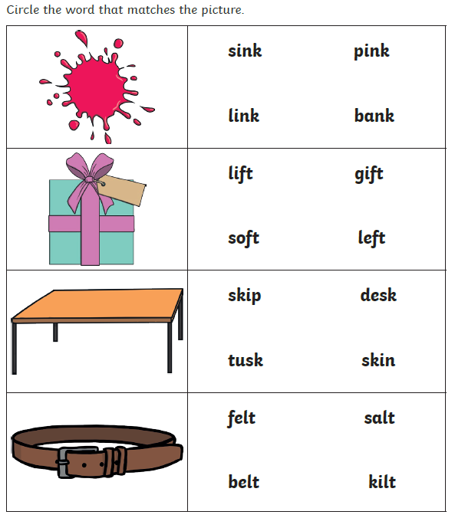

Slide 6
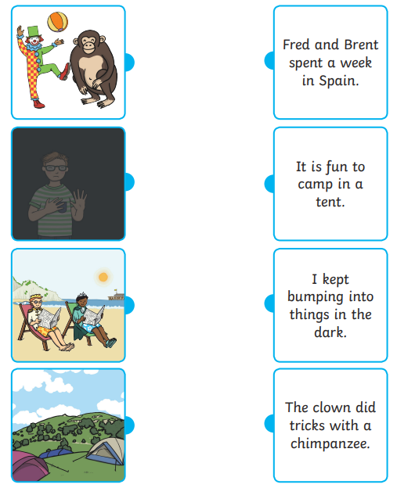

Slide 7
English Learning
Task 3
This week we are going to be continuing our learning of tricky words by learning two more:
have
like
I would like you to practise reading and writing them. Can you put them in a sentence? I have also included a game on tricky word bingo for you to play.

Slide 8
Tricky word bingo
she | you | was | all | have
they | he | my | we | put
are | said | her | like | so

Slide 9
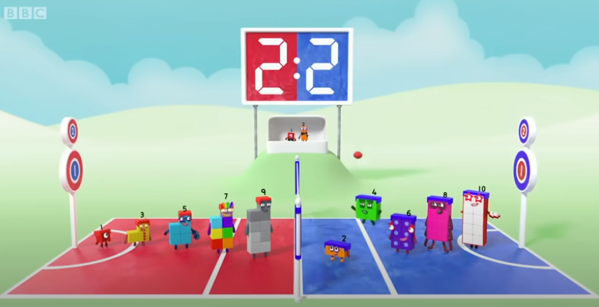
Maths Learning
This week we are learning about odd and even numbers.
Task 1
Please use the link to introduce odd and even numbers to your child.
https://www.youtube.com/watch?v=0wzyD3qrWUc
Can you remember which were even
numbers and which were odd?
A little tip if you get stuck is that odd numbers will always have one left out when halved in two and that even numbers can be shared fairly.

Slide 10
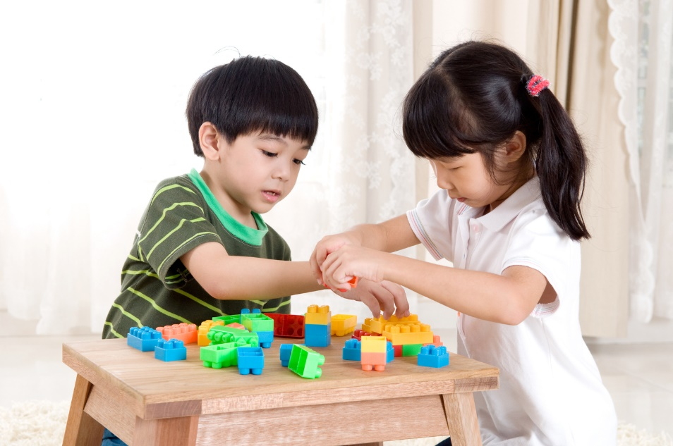
Maths Learning
Task 2
Can you sort numbers to twenty into odd and evens? Useful to have objects to hand for working out and checking. Reinforce that objects which can be shared into 2 equal groups with no items left over are even and those which have one left over when shared into two equal groups are odd.

Slide 11
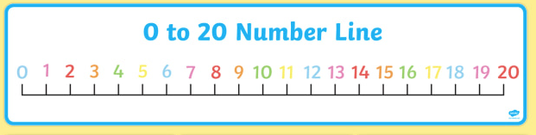
Maths Learning
Task 3
Watch odd and even song, stop at 1 minute 50 secs.
https://www.youtube.com/watch?v=-kHtGbnYKGc
Using a number line count only the odd numbers then just the even numbers until confident.

Slide 12
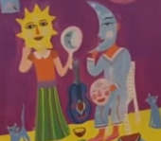
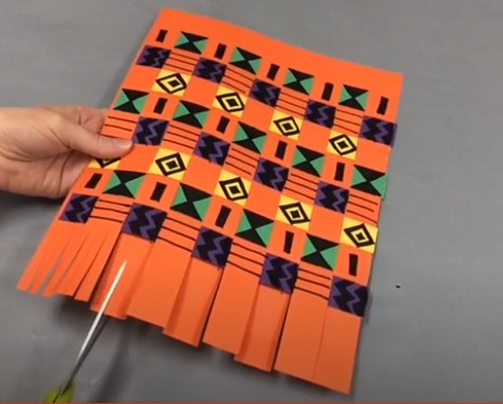
Topic
This week we have been thinking about a magic carpet journey ride. Here are some ideas you might like to explore.
Can you imagine going on a magic journey and role play where you might go, who might go with you, who might you meet?
Can you make your own mask like Granny bought in Mexico?
Can you make your own magic carpet. Here is a link of an example you could use with paper weaving.
https://www.youtube.com/watch?v=jX_CQQ-i7cA

Slide 13

Reading
A good site to use for reading is Oxford Owl, which is free. Please visit - https://www.oxfordowl.co.uk/

Slide 14

Reading
Another useful site for reading is Renaissance myON. This is a good source for books you can read to the children or provide information books that follow their interests. Please visit - http://readon.myon.co.uk

Slide 15

Reading
Choose an area that interests you or use the search option
Please continue sharing books together. Talking about the content and the characters in the books and making predictions about what might happen as you read.

Slide 16

Phonics
Continue using your Orange sound book and Blue tricky word book to practice the sounds and words.
Phonics play https://new.phonicsplay.co.uk/ is a great site for reinforcing our phonics learning. It is free use at the moment.
We have covered all of phase 2 and most of phase 3 and there are lots of fun interactive games to play.

Slide 17

Maths – White Rose Home Leaning
In school we follow the White Rose scheme of learning. Their website has put together free lessons and resources that link to the learning taking place in school. Please visit: https://whiterosemaths.com/homelearning/early-years/
Look out for EYFS pack.

Slide 18

Accessing Twinkl
Many educational content providers are offering free access to their resources. Twinkl is a website that we use from time to time to resource our lessons to aid in teacher input and pupil activities.
We will be able to direct you towards activities and learning via this website based on lessons that may be missed due to absence. To access Twinkl please visit: www.twinkl.co.uk/offer
You will have to sign up and put in the offer code: UKTWINKLHELPS
Search EYFS

Slide 19

P.E.
It is important to keep your children active. If it is safe to do so, ensure they have some time outside throughout the day. Please visit Joe Wicks YouTube channel (https://www.youtube.com/channel/UCAxW1XT0iEJo0TYlRfn6rYQ), which has lots of exercise videos for children. He will also be hosting a live P.E. lessons Monday to Friday at 9:00am.

Slide 20

Classroom Secrets
The site classroom secrets https://classroomsecrets.co.uk/free-home-learning-packs/ has free Reception (EYFS) packs which provide some great additional ideas and resources you can use.

