Slide 1

Home Learning
Year R
Term 6 Week 2

Slide 2
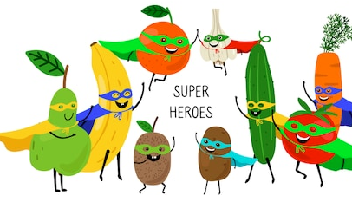
Message from Mrs Coffey
Hi Everyone,
I hope you enjoyed thinking about superheroes last week and enjoyed our work on doubling.
This week we are continuing with our theme of superheroes and thinking about a superhero vegetable. In Maths we are looking at how to half objects and in Phonics learning a couple more tricky words alongside reading words with four sounds.
I always enjoy reading your comments and seeing your lovely photos and videos so keep them coming. They make me smile and brighten the day! As usual if you have any questions then I am contactable via Tapestry or the school office.
Have fun.
Mrs. Coffey

Slide 3

English Learning
Task 1
This week we are going to be thinking about a Superhero Vegetable.
Can you think of a vegetable you think would make a good superhero? What might they wear? What is their superhero power? What problems do they solve?
Watch this clip of Supertato –
https://www.youtube.com/watch?v=rze89HB9u8g
How can we tell that Supertato is a superhero?
What does he do?
How does he help?
I would like you to design your own superhero vegetable. Draw me a picture of them and tell me about them? Do they have a Superhero name? Are they protecting the world from a baddie vegetable?

Slide 4
English Learning
Task 2
This week we are going to move into Phase 4 with our Phonics and begin to work on learning to read words with four sounds. We do this in the same way as we read a three sound word and that is to break the word into it’s sounds, it just has 1 more. Some of your children may have no trouble with this others may need a little bit more practice.
On the next slide I had included some examples, which you use in a game of I spy.

Slide 5
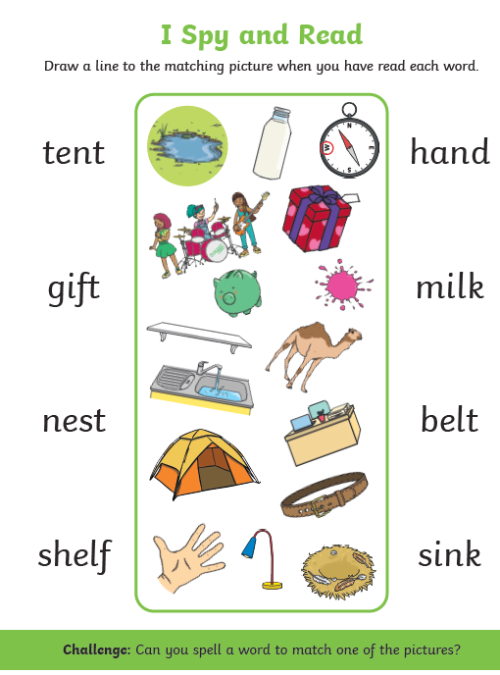

Slide 6
English Learning
Task 3
This week we are going to be continuing our learning of tricky words by learning two more:
said
so
I would like you to practise reading and writing them. Can you put them in a sentence? I have also included a game on tricky word bingo for you to play.

Slide 7
Tricky word bingo
she | you | was | all | be
they | he | my | we | put
are | said | her | me | so

Slide 8
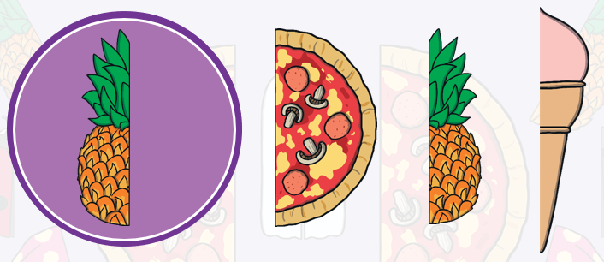
Maths Learning
This week we are learning how to halve and share.
Task 1
Please use the link to introduce what is halving to your child.
https://www.twinkl.co.uk/resource/what-is-half-a-halving-shapes-powerpoint-t-n-7554
Can you think of any other examples?

Slide 9
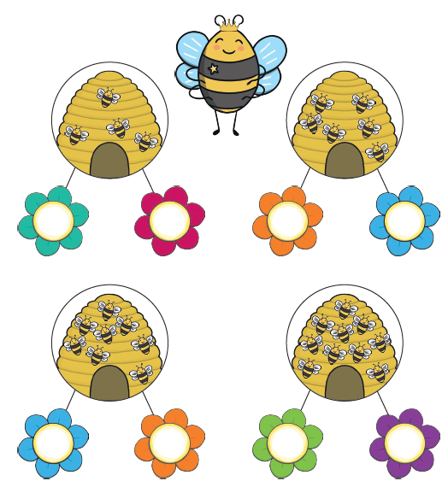
Maths Learning
Task 2
The queen bee needs to share the bees out fairly so that each flower has half the number of bees from the hive. Can you help her?

Slide 10
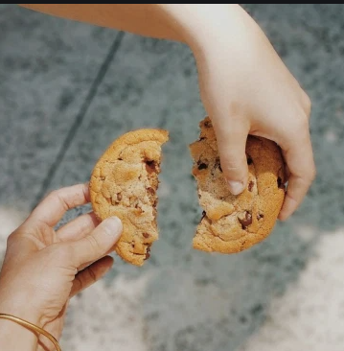
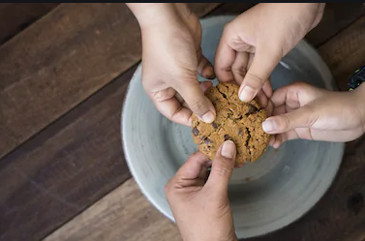
Maths Learning
Task 3
Remember that halving is sharing something equally. Look at what you can do when sharing an unequal number and there is 1 left over e.g. 3 biscuits. What could you do?

Slide 11
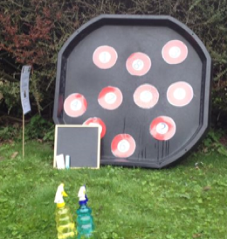
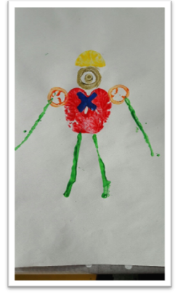
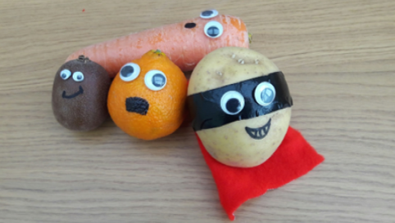
Topic
This week we have been thinking about a superhero vegetable.
As part of this you might like to have ago at one of these ideas.
Can you make your own superhero vegetable?
Can you create your own superhero adventure story with your model?
Can you make your own superhero gadget?
Can you find the heaviest and lightest vegetable/fruit in your house?
Can you make you own superhero target?
Can print your own superhero vegetables using vegetables?
Can you rescue trapped vegetables in jelly or ice?

Slide 12
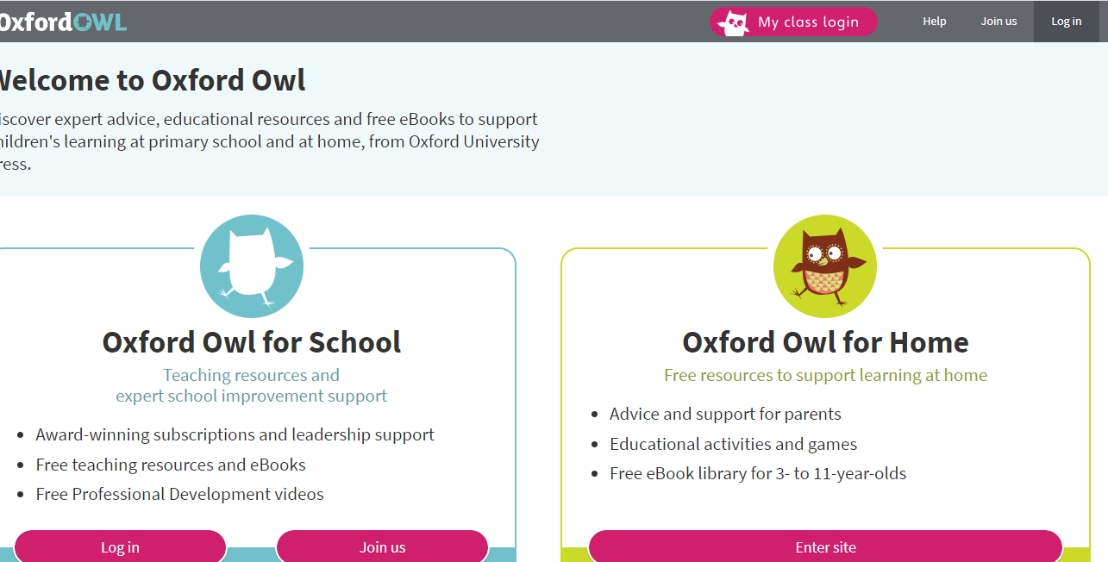
Reading
A good site to use for reading is Oxford Owl, which is free. Please visit - https://www.oxfordowl.co.uk/

Slide 13

Reading
Another useful site for reading is Renaissance myON. This is a good source for books you can read to the children or provide information books that follow their interests. Please visit - http://readon.myon.co.uk

Slide 14

Reading
Choose an area that interests you or use the search option
Please continue sharing books together. Talking about the content and the characters in the books and making predictions about what might happen as you read.

Slide 15

Phonics
Continue using your Orange sound book and Blue tricky word book to practice the sounds and words.
Phonics play https://new.phonicsplay.co.uk/ is a great site for reinforcing our phonics learning. It is free use at the moment.
We have covered all of phase 2 and most of phase 3 and there are lots of fun interactive games to play.

Slide 16

Maths – White Rose Home Leaning
In school we follow the White Rose scheme of learning. Their website has put together free lessons and resources that link to the learning taking place in school. Please visit: https://whiterosemaths.com/homelearning/early-years/
Look out for EYFS pack.

Slide 17

Accessing Twinkl
Many educational content providers are offering free access to their resources. Twinkl is a website that we use from time to time to resource our lessons to aid in teacher input and pupil activities.
We will be able to direct you towards activities and learning via this website based on lessons that may be missed due to absence. To access Twinkl please visit: www.twinkl.co.uk/offer
You will have to sign up and put in the offer code: UKTWINKLHELPS
Search EYFS

Slide 18

P.E.
It is important to keep your children active. If it is safe to do so, ensure they have some time outside throughout the day. Please visit Joe Wicks YouTube channel (https://www.youtube.com/channel/UCAxW1XT0iEJo0TYlRfn6rYQ), which has lots of exercise videos for children. He will also be hosting a live P.E. lessons Monday to Friday at 9:00am.

Slide 19

Classroom Secrets
The site classroom secrets https://classroomsecrets.co.uk/free-home-learning-packs/ has free Reception (EYFS) packs which provide some great additional ideas and resources you can use.

